Slide 1
Project name: Environmental Monitoring
Phase 1: Problem Definition and Design Thinking
In this part you will need to understand the problem statement and create a document on what have you understood and how will you proceed ahead with solving the problem. Please think on a design and present in form of a document.
Project Definition:
The project involves setting up IoT devices to monitor environmental conditions in public parks, including temperature and humidity. The primary objective is to provide real-time environmental data to park visitors through a public platform, enabling them to plan their outdoor activities accordingly. This project includes defining objectives, designing the IoT sensor system, developing the environmental monitoring platform, and integrating them using IoT technology and Python.
ENVIRONMENTEL MONITERING:
Environmental monitoring refers to the tools and techniques designed to observe an environment, characterize its quality, and establish environmental parameters, for the purpose of accurately quantifying the impact an activity has on an environment.

Slide 2
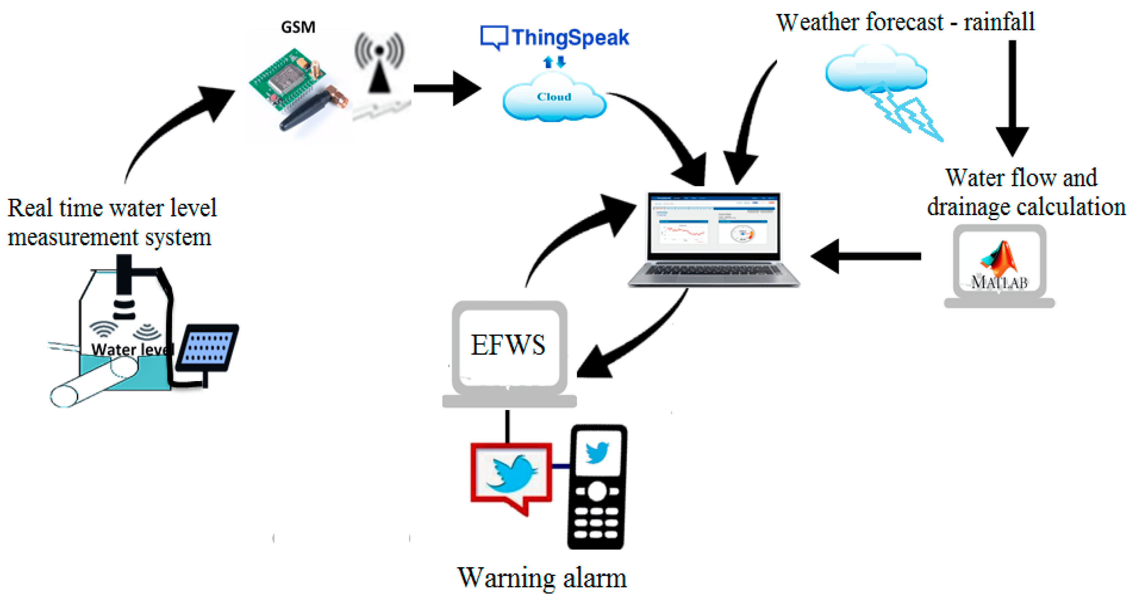
OBJECTIVES
1.Real-Time Environmental Monitoring:
Objective: Implement a system for real-time environmental monitoring within the park.
Key Results:
Install weather stations, air quality sensors, and water quality sensors at strategic locations.
Develop a centralized monitoring dashboard accessible to park management for real-time data analysis.
Alert park authorities and visitors about extreme weather conditions or environmental hazards.

Slide 3
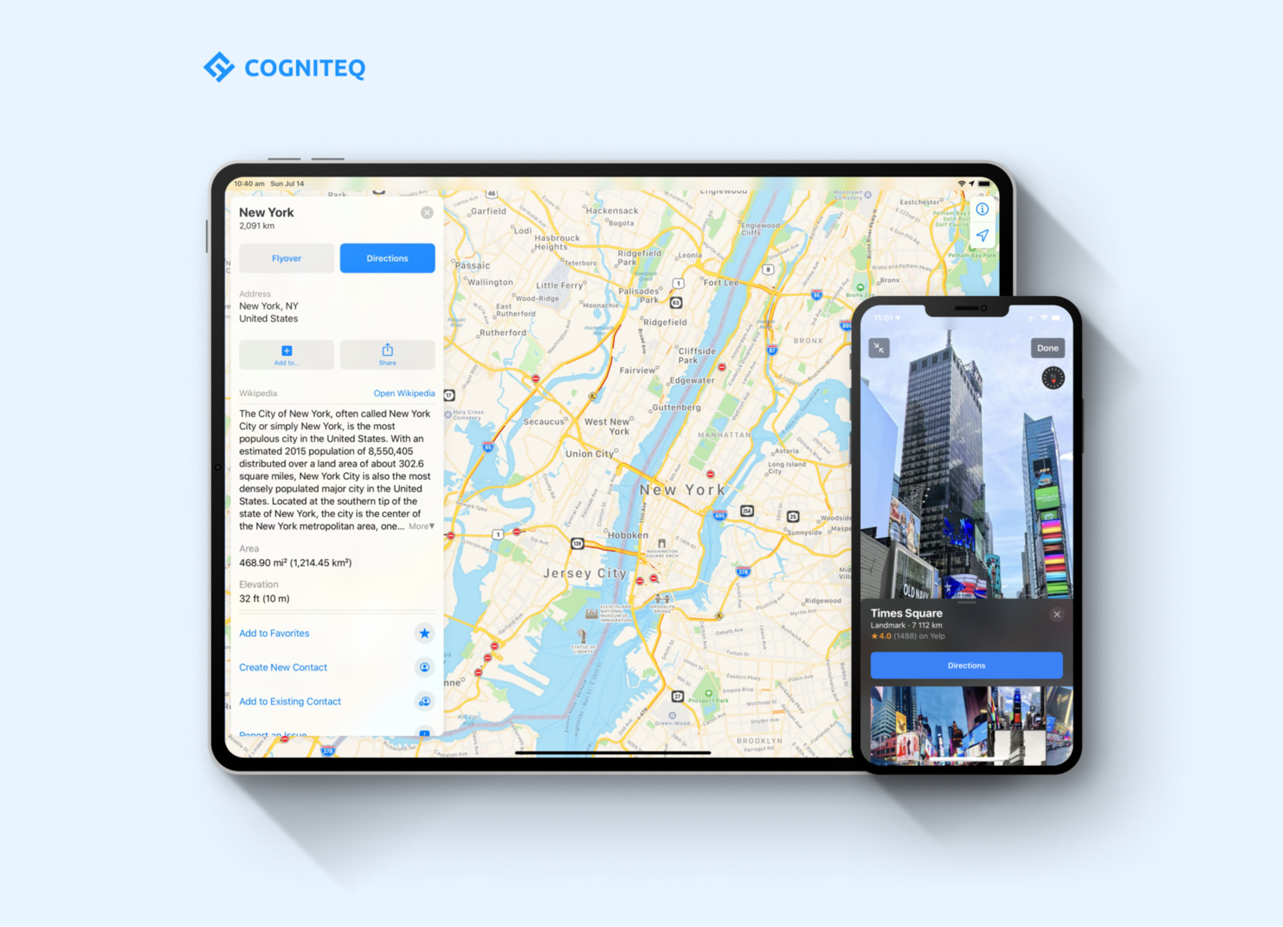
2.Aiding Park Visitors in Activity Planning:
Objective: Provide park visitors with tools and information to plan their activities effectively.
Key Results:
Develop a user-friendly mobile app with a park map, activity recommendations, and real-time updates.
Integrate the app with GPS technology to help visitors navigate the park and locate amenities.
Create an interactive website with detailed activity guides and schedules.

Slide 4

3.Promoting Outdoor Experiences:
Objective: Encourage park visitors to engage in outdoor activities and connect with nature.
Key Results:
Organize outdoor events such as guided hikes, bird-watching excursions, and stargazing nights.
Establish designated outdoor education areas for workshops and nature-related programs.
Install signage and information boards highlighting the park's natural features and history.

Slide 5
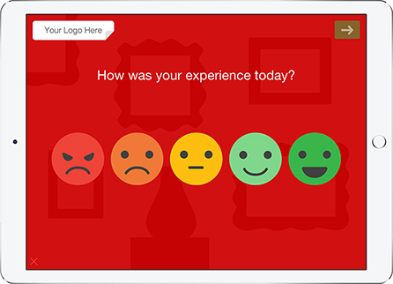

4.Enhancing Visitor Satisfaction:
Objective: Improve overall visitor satisfaction and park experience.
Key Results:
Collect visitor feedback through surveys, comment boxes, and online reviews.
Use feedback to make improvements, such as adding more amenities, enhancing safety measures, and addressing concerns.
Implement a responsive customer service system to address visitor inquiries and issues promptly

Slide 6

5.Data-Driven Decision-Making:
Objective: Utilize data collected from various sources to make informed decisions.
Key Results:
Analyse visitor data to identify peak times and popular activities, allowing for better resource allocation.
Evaluate environmental data to develop strategies for conservation and sustainability.
Collaborate with local businesses and organizations based on visitor trends and preferences.

Slide 7
6.Community Engagement and Education:
Objective: Foster a sense of community and environmental stewardship among park visitors.
Key Results:
Establish partnerships with schools and community groups for educational programs and volunteer opportunities.
Create interpretive signage and displays that educate visitors about the park's ecosystems and history.
Host regular community meetings to gather input and involve residents in park planning.

Slide 8
Plan the deployment of IoT sensors in public parks
3. Sensor Placement:
Identify strategic locations within the park for sensor placement. Consider areas where environmental conditions are most critical or where visitor comfort is a priority.
1. Define Objectives:
Identify the specific environmental parameters you want to monitor in the park, such as temperature, humidity, air quality, soil moisture, or noise levels.
2. Sensor Selection:
Choose appropriate IoT sensors for temperature and humidity monitoring. Consider factors like sensor accuracy, range, power source, and connectivity options (e.g., Wi-Fi, LoRa, cellular).
4.Connectivity Infrastructure:
Establish a robust and reliable connectivity infrastructure to transmit data from sensors to a central data hub or cloud server. This may involve setting up Wi-Fi access.

Slide 9
5. Power Supply:
Determine the power source for the IoT sensors. Options include battery-powered sensors, solar panels, or wired connections.
Consider the maintenance requirements associated with each power source option
6.Data Collection and Storage:
Choose a data collection and storage solution that can handle the volume of sensor data. Cloud-based platforms are often suitable for scalability and data accessibility.
7. Data Visualization and Analysis:
Develop a user-friendly interface or dashboard for visualizing real-time sensor data . Implement data analysis tools to identify trends and anomalies in the collected data.
8.Alerts and Notifications:
Set up alerting mechanisms to notify park management or visitors in the event of extreme environmental conditions. Alerts can be sent via email, SMS, or mobile app

Slide 10
9.Maintenance and Calibration:
Establish a regular maintenance schedule to ensure sensors remain functional. This includes battery replacement (if applicable) and sensor calibration.
10.Public Engagement: - Promote awareness of the IoT monitoring system among park visitors. Display information about the system on signage or through the park's website.
11.Data Sharing: Consider sharing anonymized environmental data with research institutions, local authorities, or educational programs to contribute to broader environmental monitoring efforts.
12.Continuous Improvement: Regularly review the monitoring system's performance and assess whether it meets its objectives. Make adjustments and improvements as needed.

Slide 11
Design a web-based platform to display real time environmental data to the public
1. Define Objectives:
Identify the specific environmental data to be displayed, such as temperature, humidity, air quality, and more.
Determine the scope and objectives of the platform, including its target audience (e.g., park visitors, local residents, researchers).
2. Data Sources:
Identify the sources of real-time environmental data, including sensors deployed in the park or data from external sources (e.g., weather services, air quality monitoring agencies).
Ensure data quality, accuracy, and reliability from these sources.
3. User Interface (UI) Design:
Develop a user-friendly and visually appealing interface that is accessible on various devices (desktops, tablets, smartphones).
Create a clean and intuitive design with easy navigation and clear data presentation.
Use responsive design principles to adapt to different screen sizes.
4. Data Visualization:
Choose appropriate data visualization techniques to represent environmental data effectively. Examples include charts, graphs, maps, and gauges.
Implement real-time updates to ensure users see the most current data.
Provide historical data access for trend analysis and comparisons.
5. Map Integration:
If relevant, integrate interactive maps to display geographical data, such as temperature variations across the park.
Include markers or overlays to show sensor locations or specific environmental conditions in different park areas.
6. User Interactivity:
Allow users to customize their experience by selecting which environmental parameters they want to view.
Implement features like zooming, panning, and tooltips for an interactive experience.
Provide options for users to set alerts or notifications based on predefined thresholds (e.g., high temperature warnings).

Slide 12
7. Accessibility and Inclusivity:
Ensure the platform complies with web accessibility standards (e.g., WCAG) to accommodate users with disabilities.
Design for inclusivity by making data and features accessible to a diverse audience.
8. Data Privacy and Security:
Implement robust data security measures to protect sensitive information and user privacy.
Clearly communicate data usage and privacy policies to users.
9. Real-Time Updates:
Establish a data acquisition and processing pipeline to handle real-time data from sensors or external sources.
Implement mechanisms for automatic data refresh at defined intervals (e.g., every few minutes).
10. User Engagement:
Encourage user engagement by providing educational content related to the displayed environmental data. This can include explanations of data trends or tips on outdoor activities. - Offer a feedback mechanism for users to report issues or provide suggestions for platform improvement.
11. Mobile Responsiveness:
Ensure the platform is mobile-responsive to accommodate users accessing it from smartphones and tablets while in the park.
12. Performance Optimization:
Optimize the platform's performance to handle concurrent user access, especially during peak times.
13. Testing and Feedback: -
Conduct thorough testing, including usability testing, to identify and address any issues or usability concerns. - Gather feedback from potential users and stakeholders to make necessary improvements.
14. Launch and Promotion: -
Launch the platform and promote it through various channels, such as the park's website, social media, and local media outlets. - Consider an official launch event or outreach campaign to raise awareness.

Slide 13
IOT devices send data to the environmental monitoring platform:
1.Sensor Data Collection:
IoT devices equipped with environmental sensors (e.g., temperature, humidity, air quality) collect data from the park's surroundings.
2.Data Processing on IoT Devices:
Process and preprocess data on IoT devices as needed, including calibration, filtering, or aggregation to reduce the volume of data transmitted.
3.Data Transmission Protocols:
Choose appropriate data transmission protocols based on factors like data volume, device power constraints, and network availability. Common options include MQTT, HTTP, CoAP, or Lora WAN.
4.Connectivity Options:
Select the most suitable connectivity options for IoT devices:
Wi-Fi: If park areas have Wi-Fi coverage.
Cellular: For areas without Wi-Fi coverage, providing broader connectivity.
LoRa or other LPWAN technologies: Ideal for low-power, long-range communication in outdoor settings.
Bluetooth or Zigbee: Suitable for short-range communications, such as within a local sensor network.
5.Security Measures:
Implement robust security measures to protect data during transmission, including encryption and authentication.
Utilize secure communication channels, such as VPNs or encrypted tunnels, to enhance data security.
6.Data Aggregation and Packaging:
Aggregate data from multiple IoT devices into packets for efficient transmission.
Include essential metadata, such as device ID, timestamps, and data type, in each packet.
7.Data Routing and Integration Layer:
Set up a data routing and integration layer to receive incoming data from IoT devices.
Implement routing rules to direct data to the appropriate destinations within the environmental monitoring platform.
8.Cloud or Server Integration:
Integrate the data routing and integration layer with cloud services or a dedicated server hosting the environmental monitoring platform.
Establish data storage solutions (e.g., databases, data lakes) to store and manage incoming data efficiently.

