Slide 1
AlphaSKI CASESTUDY

Slide 2
INITIATIVE #1
INFRASTRUCTURE AS A SERVICE
• REQUIREMENTS (PHASE 1)
• FIND APPLICATIONS AND OS DEPENDENCIES USE LIFT AND SHIFT MODEL IF REQUIRED
• DEPLOY A WINDOWS SERVER 2016 VIRTUAL MACHINE WITH RDP ACCESS
• DEPLOY AN UBUNTU SERVER VIRTUAL MACHINE WITH SSH ACCESS
• ADD ADDITIONAL STORAGE DISKS TO THE VIRTUAL MACHINES

Slide 3
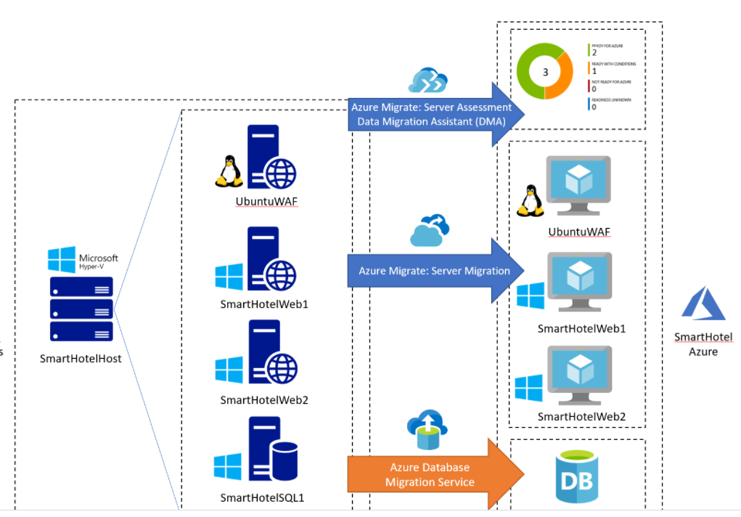

Slide 4
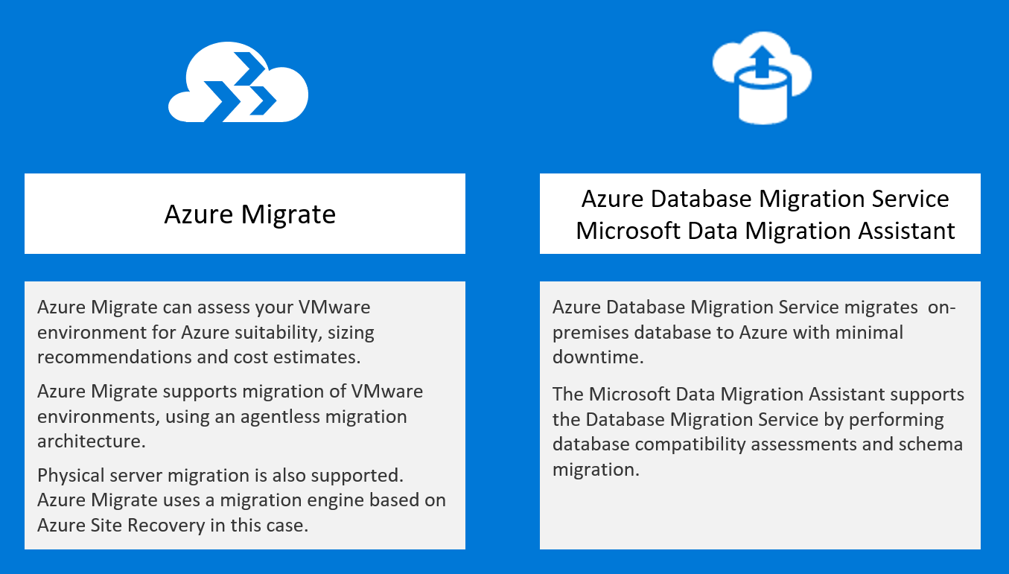

Slide 5
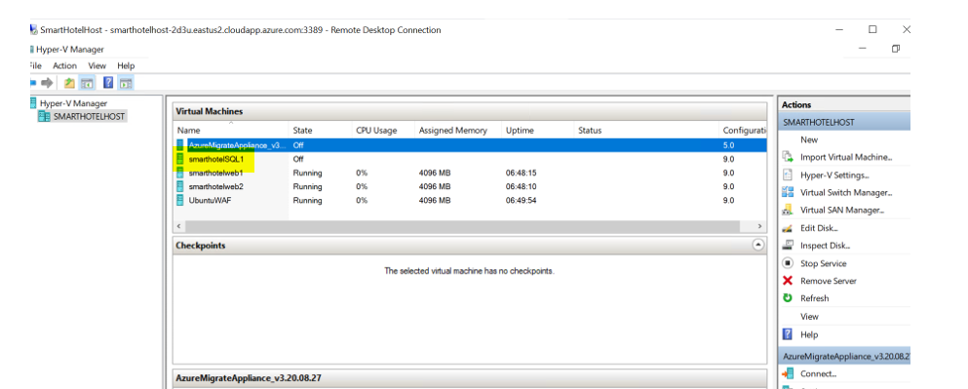
VM
Plan of Action
Deployed Windows Server 2016 Virtual Machine in Smart Hotel Lab named as smarthotelSQL1 VM

Slide 6
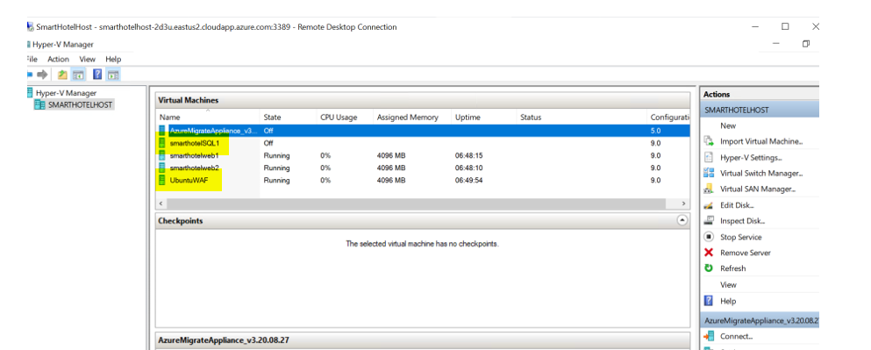
Deployed Ubuntu Virtual Machine

Slide 7
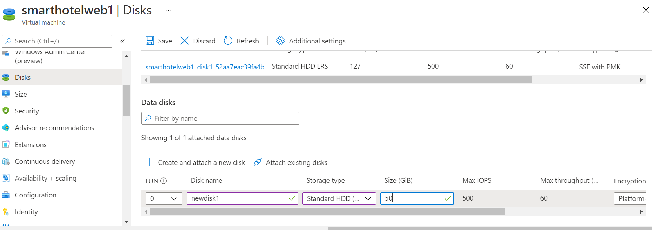
Attaching New Disk
We can lift and shift existing web servers ,ubuntu server and sql db server

Slide 8
INITIATIVE #2
NEW CORPORATE WEBSITE SITUATION
• CURRENTLY THERE IS ONLY ONE WEB SERVER IN THE DENVAR DATACENTER
• THE WEB SERVER IS A SINGLE POINT OF FAILURE
• THE WEB SERVER WILL NOT SUPPORT THE NEW MOBILE GAME TRAFFIC
• CONNECTIONS FROM EUROPE ARE VERY POOR AND VERY SLOW
REQUIREMENTS
• DEPLOY A NEW WEBSITES IF POSSIBLE PER REGION IN CLOUD
• ENSURE AT LEAST TWO COPIES OF THE WEBSITE ARE RUNNING AT ALL TIMES
• DIRECT CUSTOMERS TO THE NEAREST AZURE REGION
• SHOULD NOT USE IAAS TO REDUCE MANAGING AND MAINTAINING THE WEBSITE IN LONG
RUN.

Slide 9
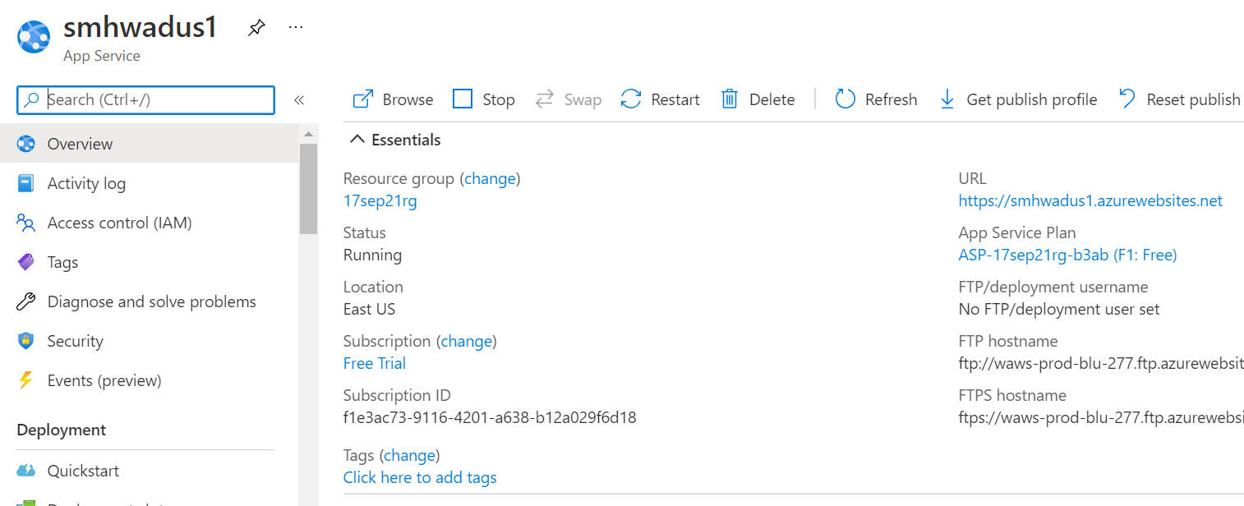
Creating webapp in us region

Slide 10
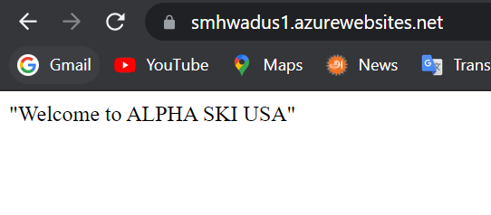

Slide 11
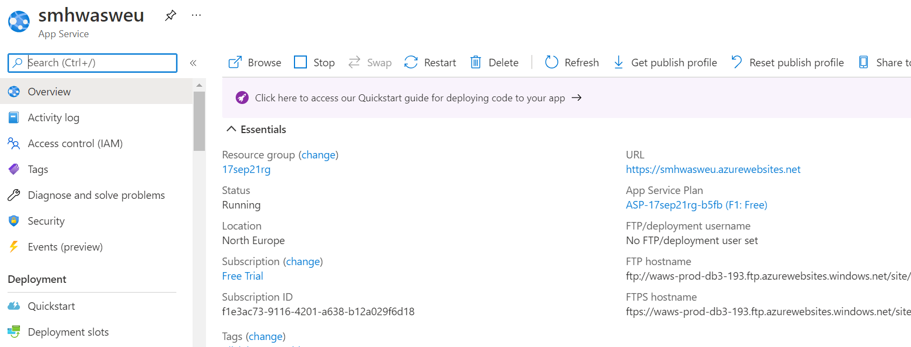
Creating webapp2

Slide 12
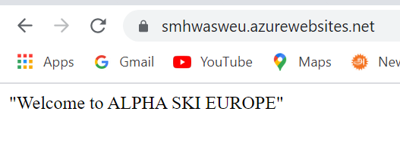

Slide 13
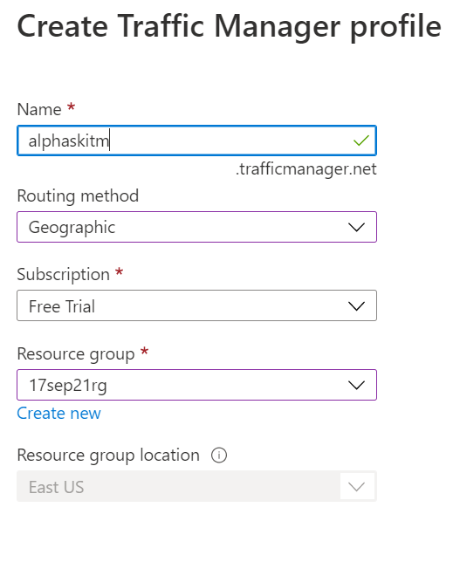
Creating Traffic Manager PROFILE

Slide 14
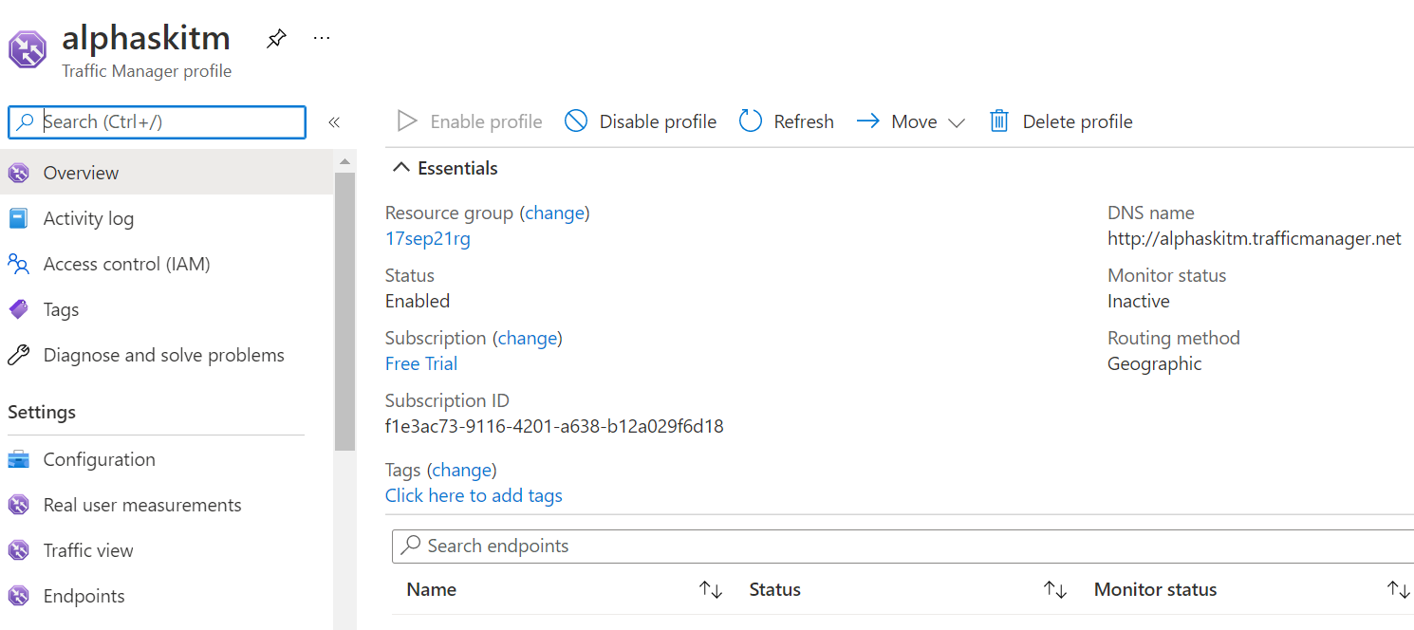

Slide 15
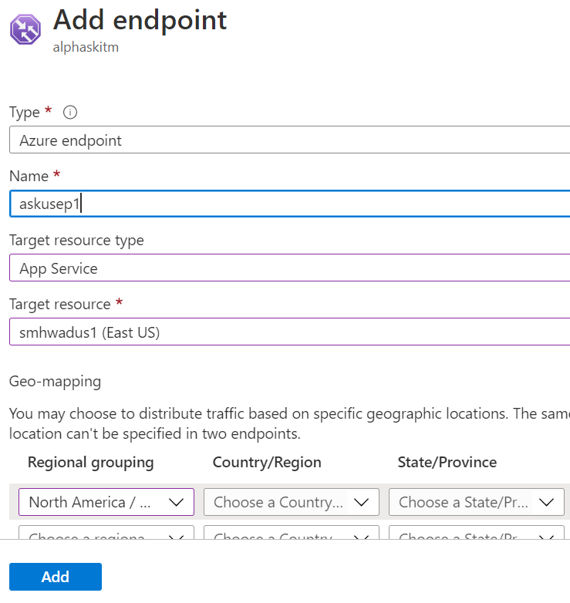
Adding endpoints

Slide 16
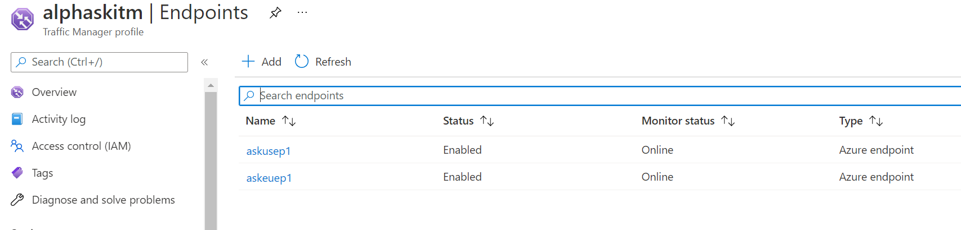

Slide 17
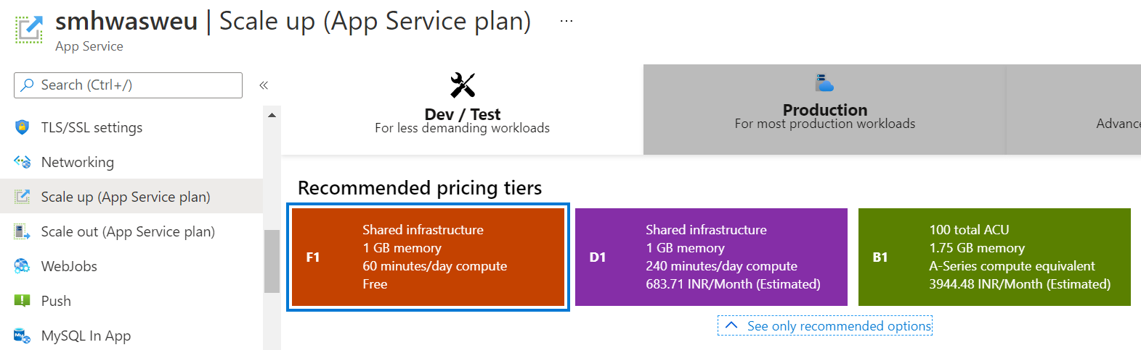

Slide 18
INITIATIVE #3
Situation - New Mobile Game
• New social media team focused on apps
• Game - Alpha Ski House “Downhill Racer” is in development
• The new game uses actual images from the different mountain resorts
• The application MUST have scalability as youngsters are targeted for AR based
game
Requirements
• ALL THE GAME'S PROJECT AND GRAPHIC FILES MUST BE STORED IN CLOUD
• ALL THE GAME FILES MUST BE ACCESSIBLE PROGRAMMATICALLY
• THE STORAGE SOLUTION MUST BE OPTIMIZED FOR UNSTRUCTURED DATA

Slide 19
Plan of Action
Need to create storage account in azure
Need to Create Azure File Shares and Nuget to access the game files programmatically
Need to create Azure blob storage Container for storing unstructured data.

Slide 20
INITIATIVE #4
• MOVE DATA TO THE CLOUD
• CURRENTLY USING MICROSOFT SQL SERVER ON-PREMISES
• ALL BUSINESS AND CUSTOMER DATA IS STORED IN THE DATABASE
• DATA SECURITY IS VERY IMPORTANT
• WANTS TO EVALUATE AZURE DATABASE SOLUTIONS
• REQUIREMENTS (PHASE 1)
• MOVE DATA TO THE CLOUD WHICH ARE IN ON-PREM PHYSICAL STORAGE UNITS AND AS SQL DB’S
• DEPLOY A SAMPLE AZURE SQL DATABASE FOR TESTING
• IMPLEMENT SECURITY FEATURES, SUCH AS FIREWALL RULES AND ADMINISTRATOR ACCOUNTS
• REQUIREMENTS (PHASE 2)
• READ-ONLY COPIES OF THE DATABASES

Slide 21
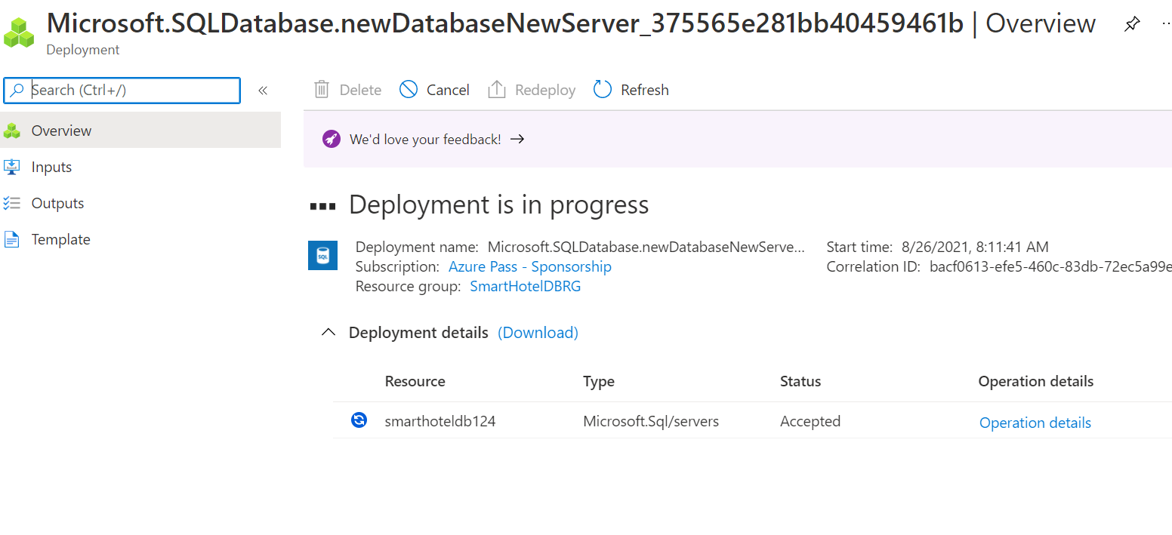
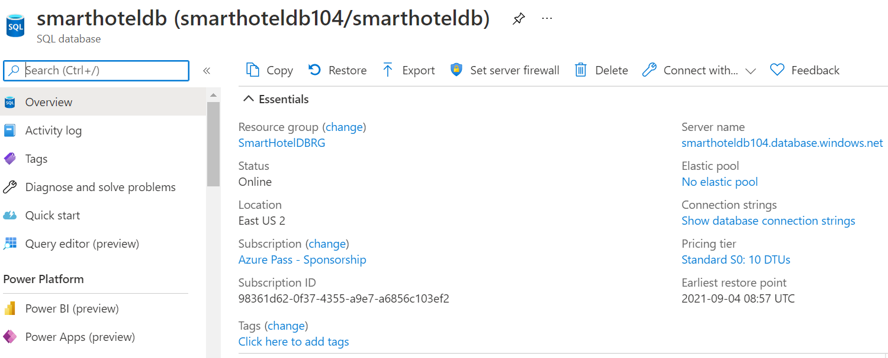

Slide 22
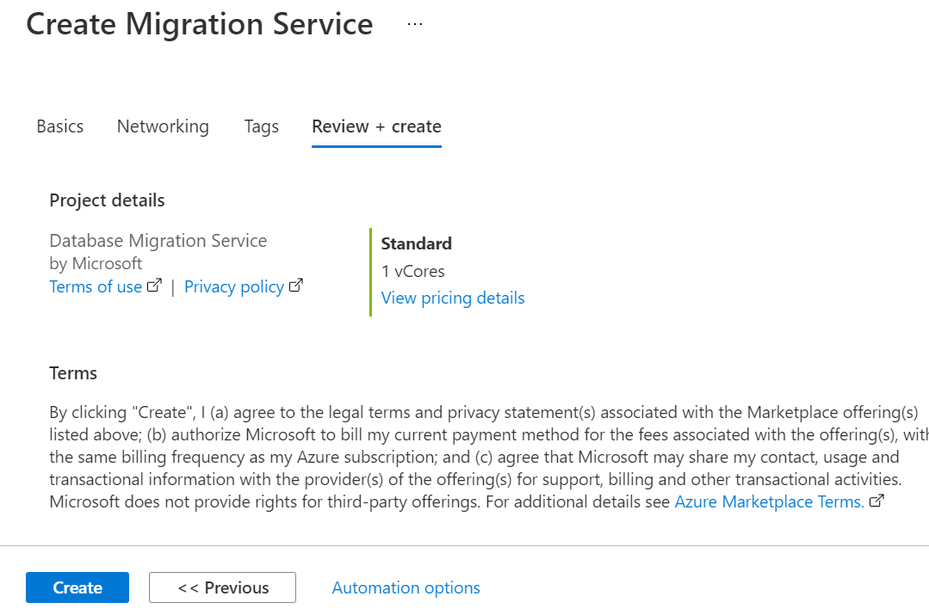

Slide 23
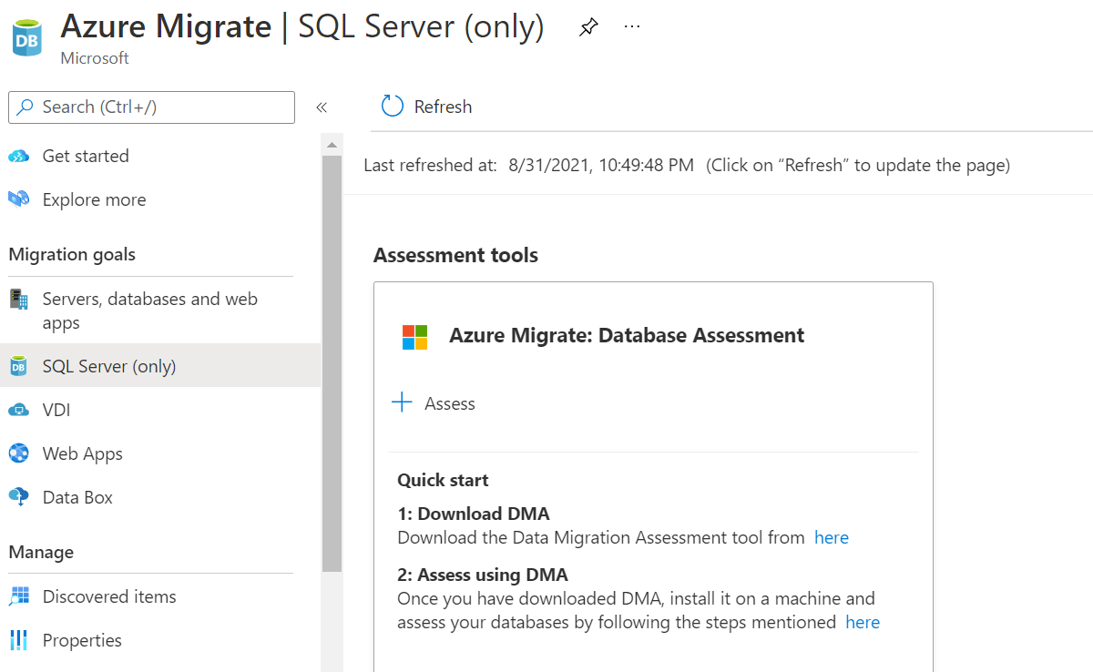

Slide 24
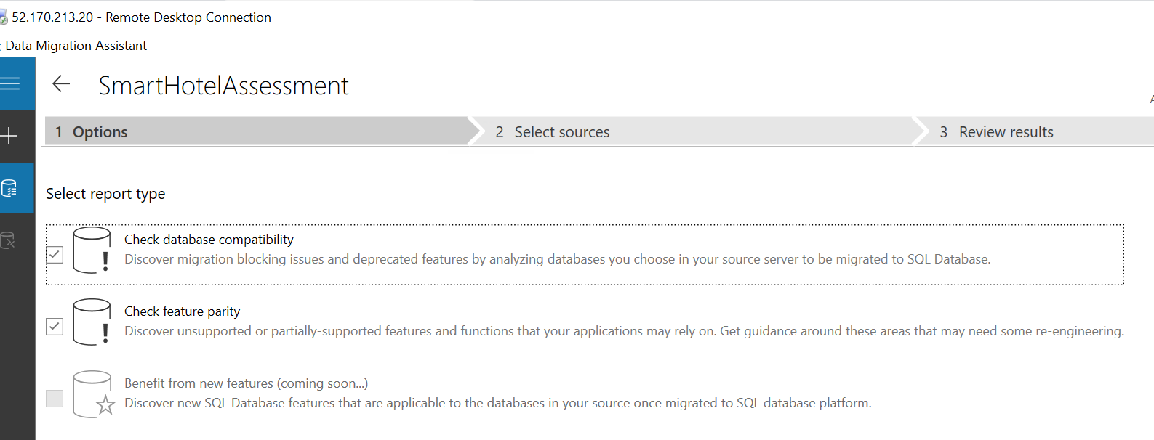

Slide 25
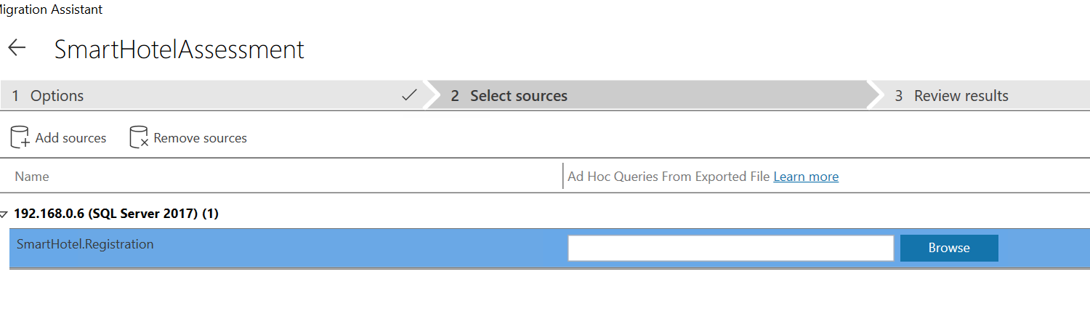

Slide 26
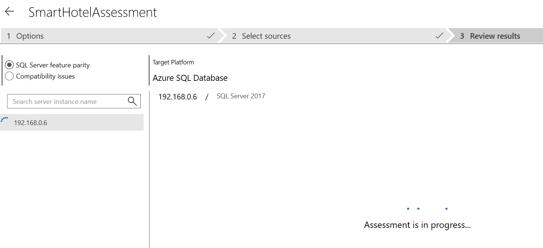

Slide 27
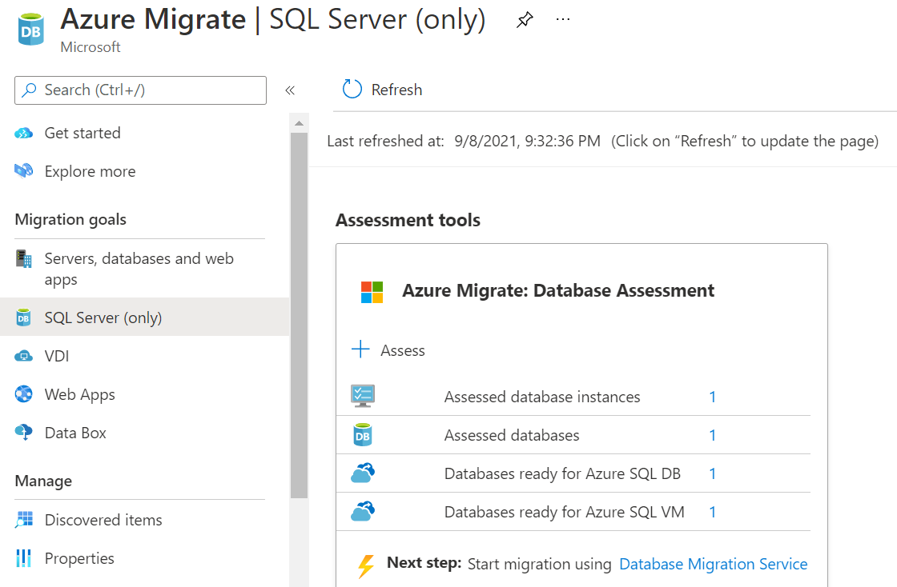

Slide 28
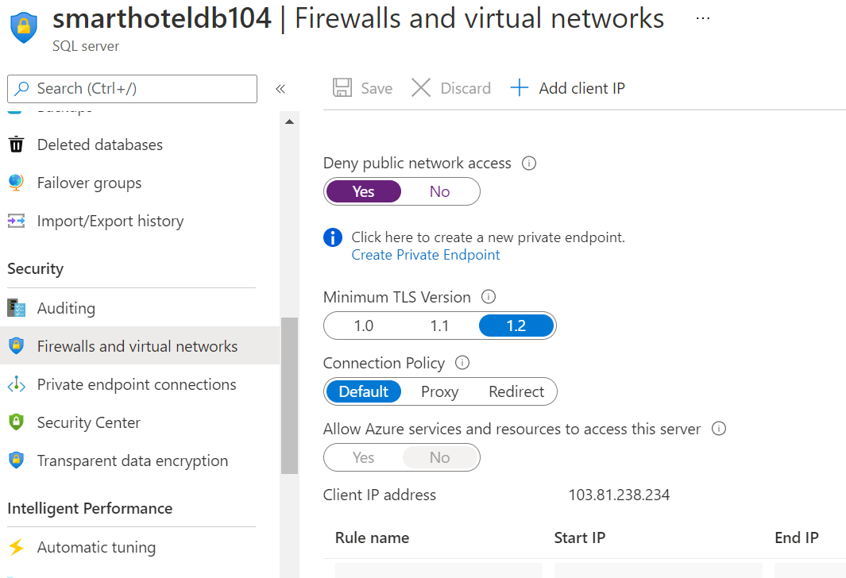

Slide 29
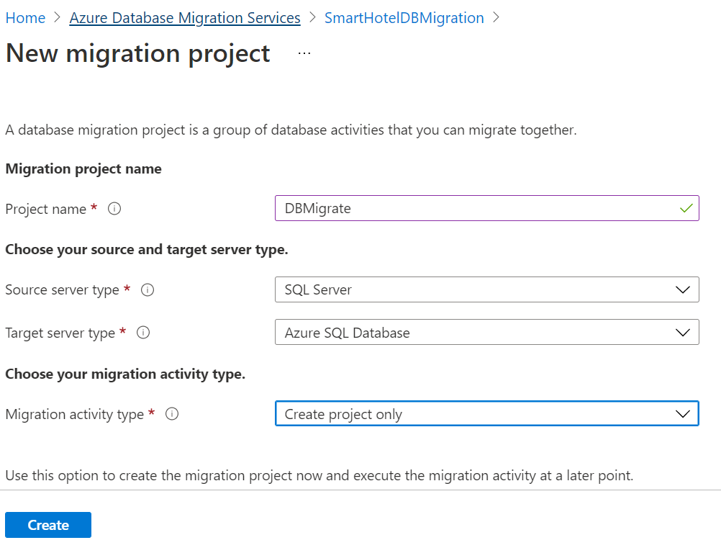

Slide 30
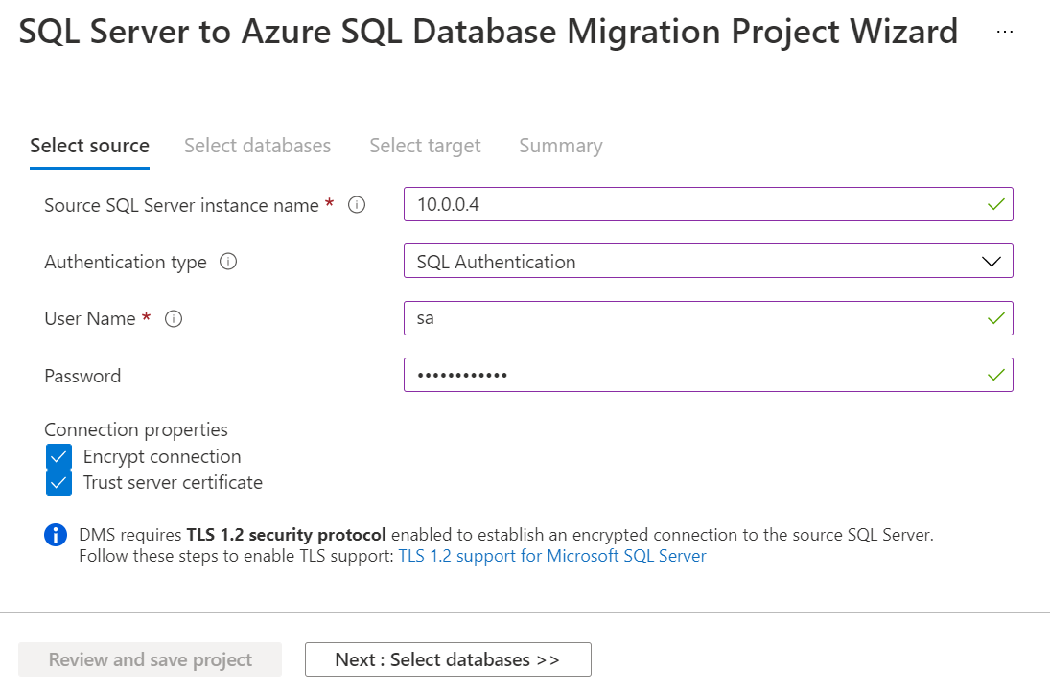

Slide 31
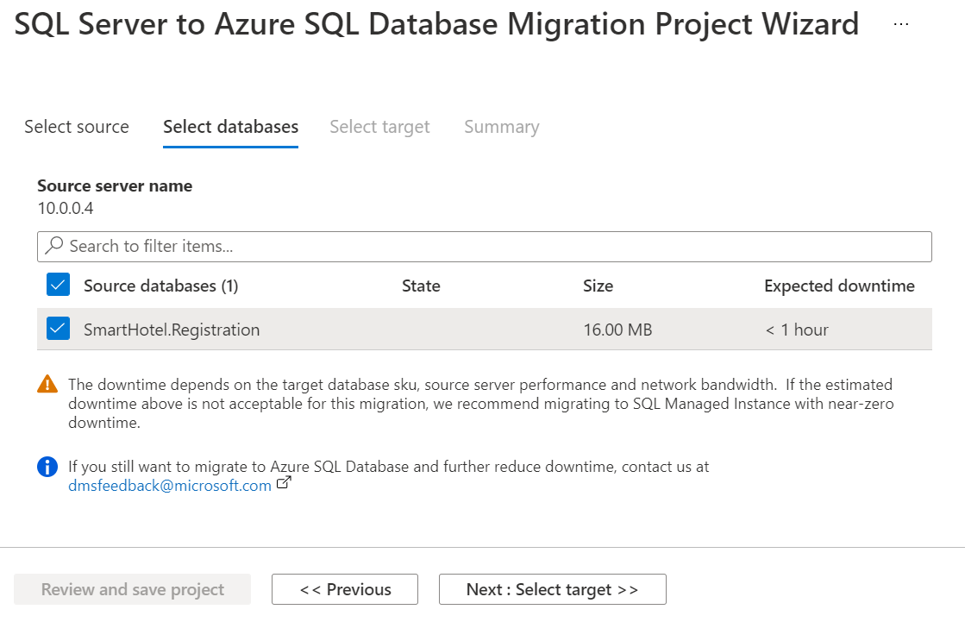

Slide 32
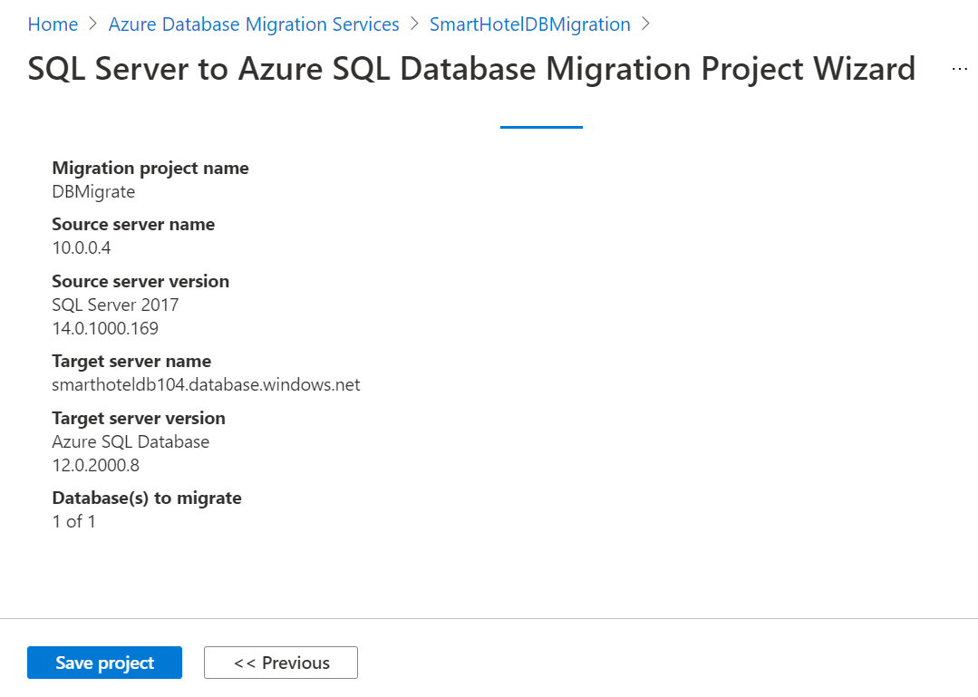

Slide 33
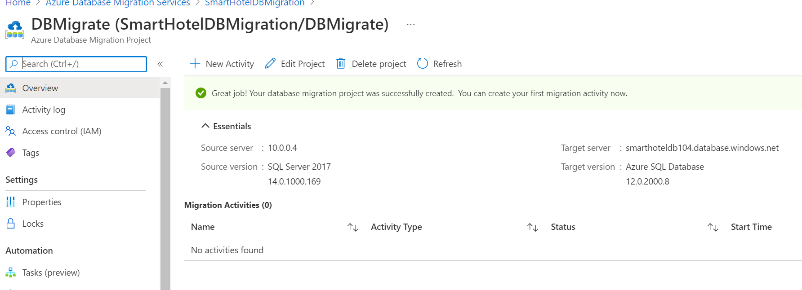

Slide 34
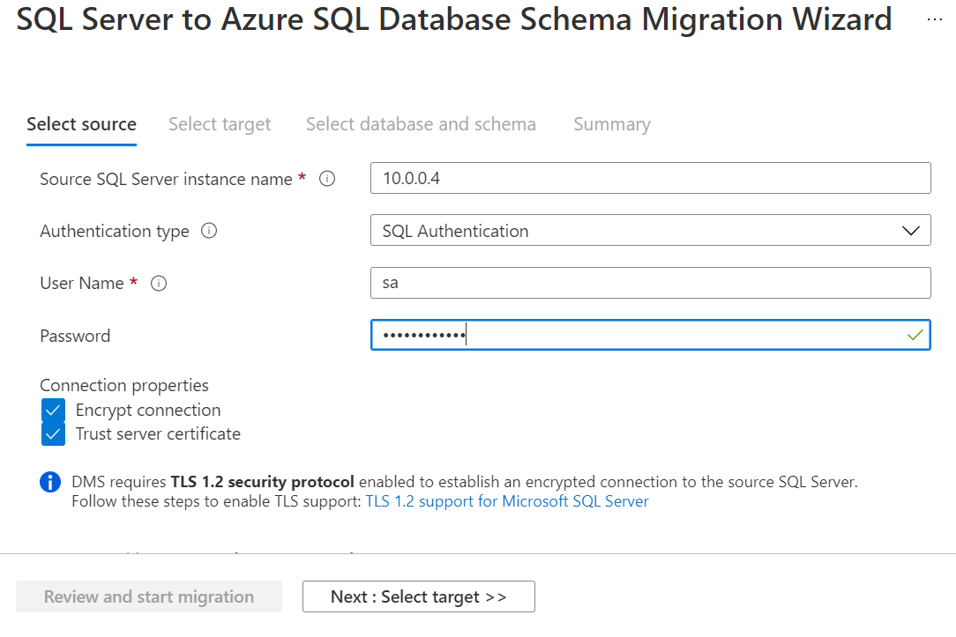

Slide 35
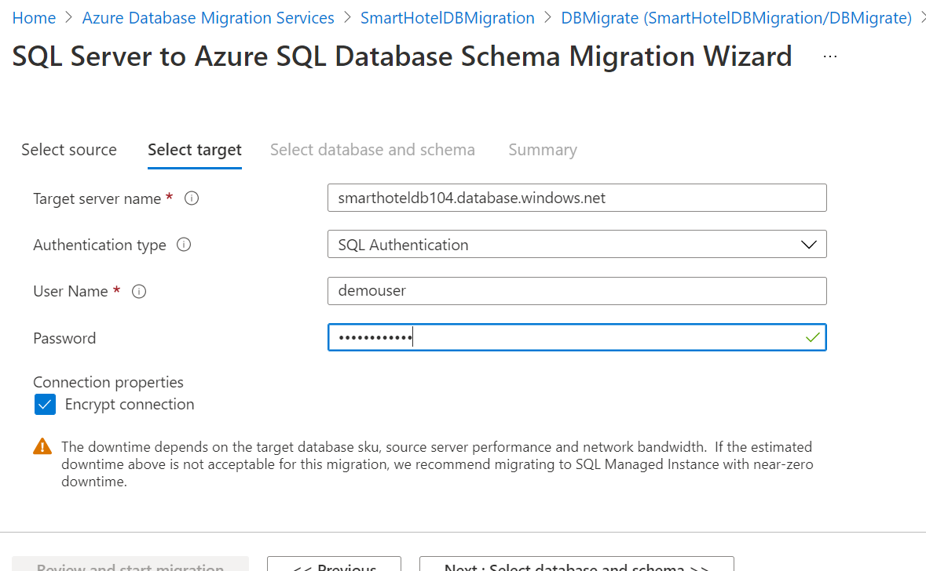

Slide 36
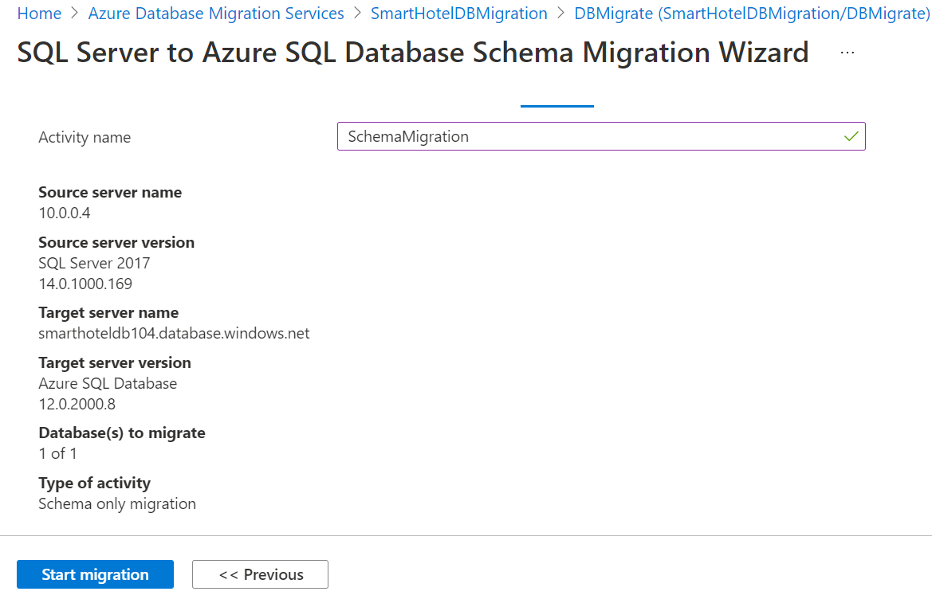

Slide 37
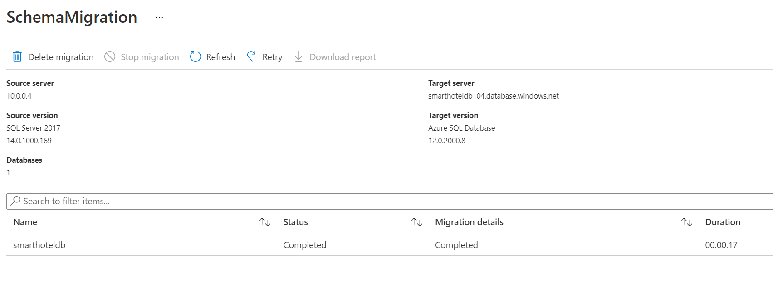

Slide 38
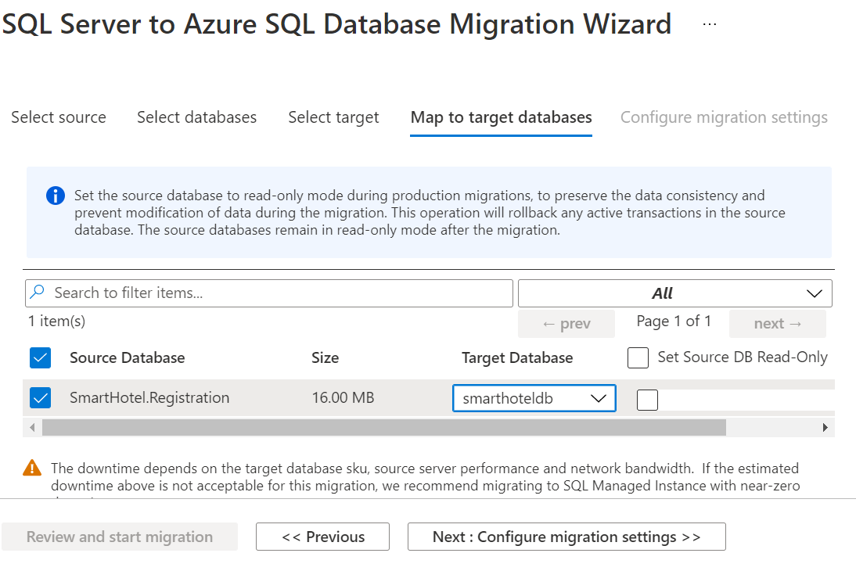

Slide 39
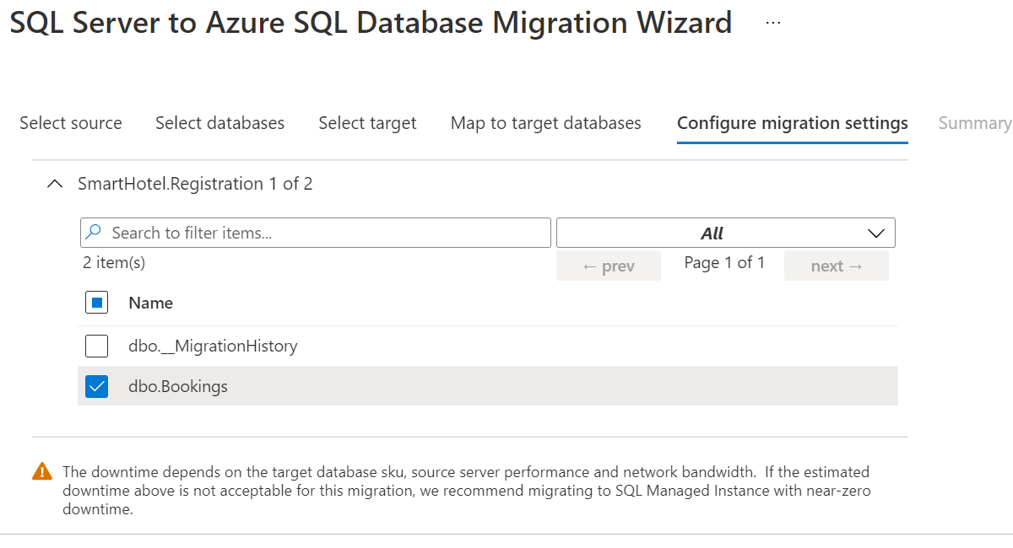

Slide 40
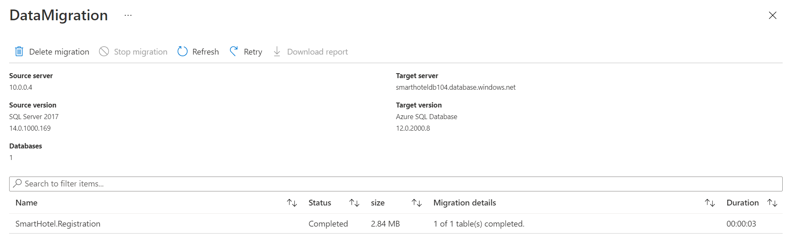

Slide 41
INITIATIVE #5
IDENTITY AND AUTHENTICATION SITUATION
• THE LONG-TERM PLAN IS FOR ALL INFRASTRUCTURE AND SERVICES TO BE IN AZURE
• A HYBRID ENVIRONMENT IS NEEDED IN THE IMMEDIATE FUTURE.
• REQUIREMENTS
• USERS MUST BE ABLE TO USE THEIR ON-PREMISES ACTIVE DIRECTORY CREDENTIALS IN AZURE
• ALL AZURE ADMINISTRATORS MUST USE THE MICROSOFT AUTHENTICATOR APP
• AVOID PROVIDING PERMANENT "STANDING" ACCESS FOR ANY CRITICAL IMPACT ACCOUNTS
• ALL ADMINISTRATIVE ACTIVITY MUST HAVE APPROVAL MECHANISM

Slide 42
Plan of action
1.In order to Build Hydrid AD environment,need to integrate Onprimise AD with Azure AD
2.Create Global administrator User account in Azure Ad
3.Install Azure AD connect to connect the Onpremise AD with Azure AD and Syncronize the Users .
4.To use Microsoft Authenticater app for authentication, need to enable Multifactor auth connector in azure
To enable the authentication method for passwordless phone sign-in, complete the following steps:
Sign in to the Azure portal with an authentication policy administrator account.
Search for and select Azure Active Directory, then browse to Security > Authentication methods > Policies.
Under Microsoft Authenticator, choose the following options:
Enable - Yes or No
Target - All users or Select users
Each added group or user is enabled by default to use Microsoft Authenticator in both passwordless and push notification modes ("Any" mode). To change this, for each row:
Browse to ... > Configure.
For Authentication mode - choose Any, or Passwordless. Choosing Push prevents the use of the passwordless phone sign-in credential.
To apply the new policy, select Save.

Slide 43
5.Sign in to Azure portal with a user that is a member of the Privileged role administrator role.Open Azure AD Previlege identity Management(PIM),add assignment with role for time bound
6.Use PIM Approve Requests

