Slide 1

COVID-19 VACCINE
ANALYSIS
PUGALEESHWARAN

Slide 2
PROBLEM DEFINITION
COVID-19 analysis data refers to the collection, organization, and interpretation of information related to the COVID-19 pandemic. This data is critical for understanding the spread and impact of the virus, making informed decisions, and formulating public health strategies.
COVID-19 analysis data is continually updated and analyzed by epidemiologists, public health officials, researchers, and policymakers to inform strategies for mitigating the spread of the virus, managing healthcare resources, and guiding vaccination efforts during the pandemic. It plays a central role in our collective response to this global health crisis.

Slide 3
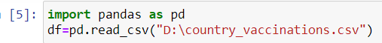
DATACOLLECTION:
Data collection in Python refers to the process of gathering, retrieving, or obtaining data from various sources or input methods for further processing, analysis, or storage. Python provides a wide range of tools, libraries, and techniques for collecting data from various sources
EXAMPLE:

Slide 4
EXPLANATION:
First the data is collected by importing the data set . Next the data is made into dataframes to look deep into the data
In Python, importing datasets typically involves loading data from external files or sources into your Python environment so that you can analyze, manipulate, or work with the data. There are several common methods for importing datasets in Python:
Reading from Text Files
Using APIs
Reading from Databases
Web Scraping

Slide 5
DATA PREPROCESSING:
Data Cleaning:
Handling Missing Data: Identify and deal with missing values, either by removing rows or columns, imputing values, or using advanced techniques like predictive modeling.
Removing Duplicates: Detect and remove duplicate records from the dataset.
Data Transformation:
Data Scaling: Standardize or normalize numeric features to ensure that they have similar scales. This is important for algorithms like k-means clustering and support vector machines.

Slide 6
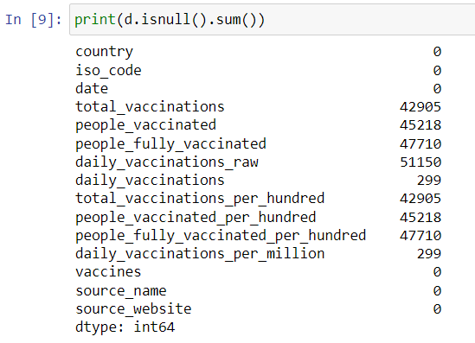
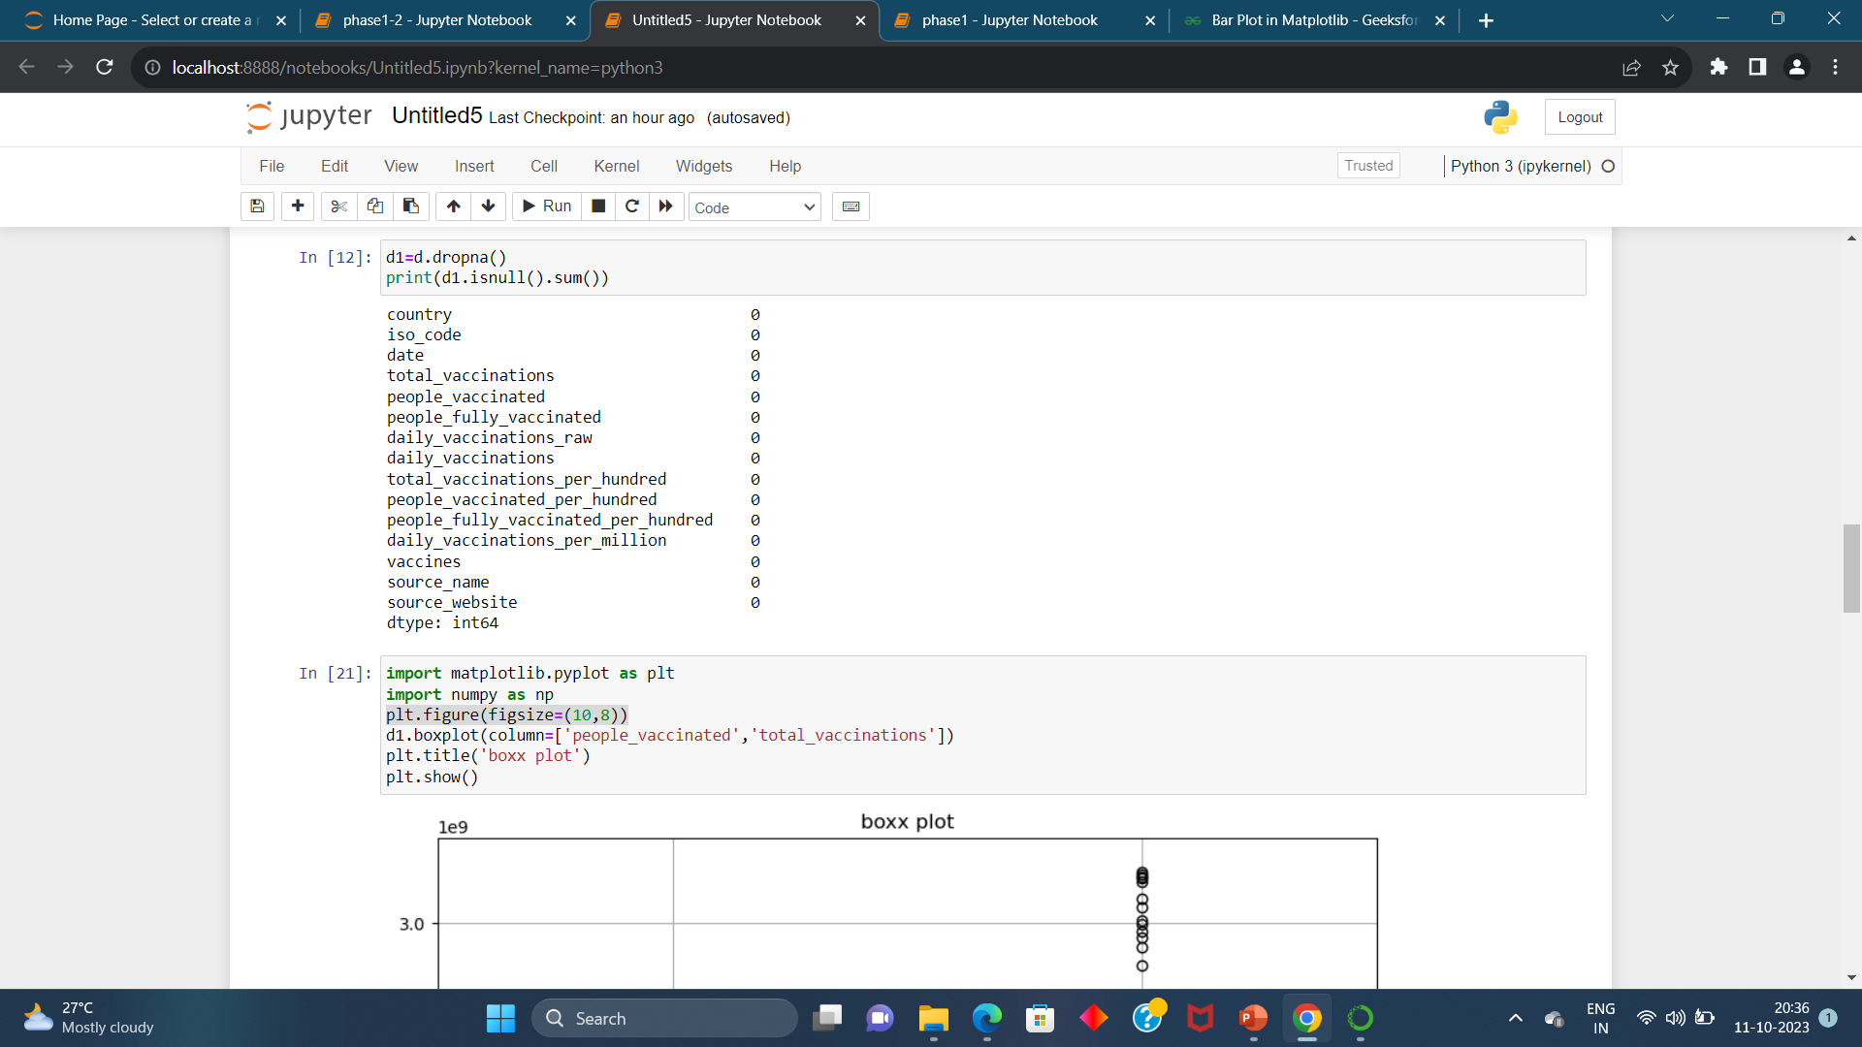
EXAMPLE:

Slide 7
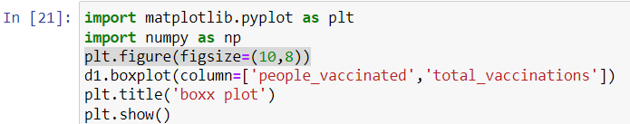
EXPLORATORY DATA ANALYSIS:
Exploratory Data Analysis (EDA) in Python is a critical process that involves visually and statistically summarizing and exploring a dataset to gain insights, discover patterns, identify anomalies, and formulate hypotheses. EDA is typically one of the first steps in any data analysis or data science project. Python provides various libraries, such as pandas, matplotlib, seaborn, and numpy, which are commonly used for conducting EDA.

Slide 8
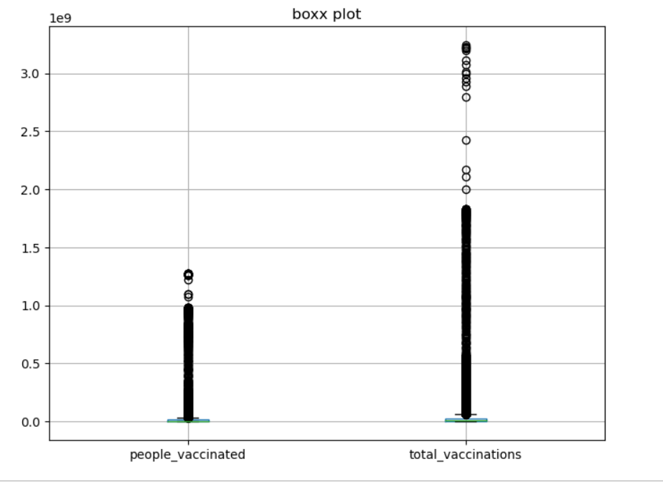

Slide 9
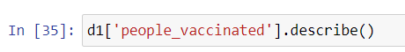
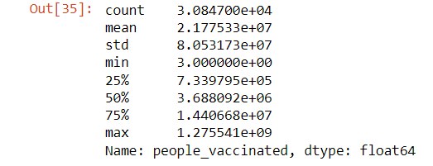

Slide 10
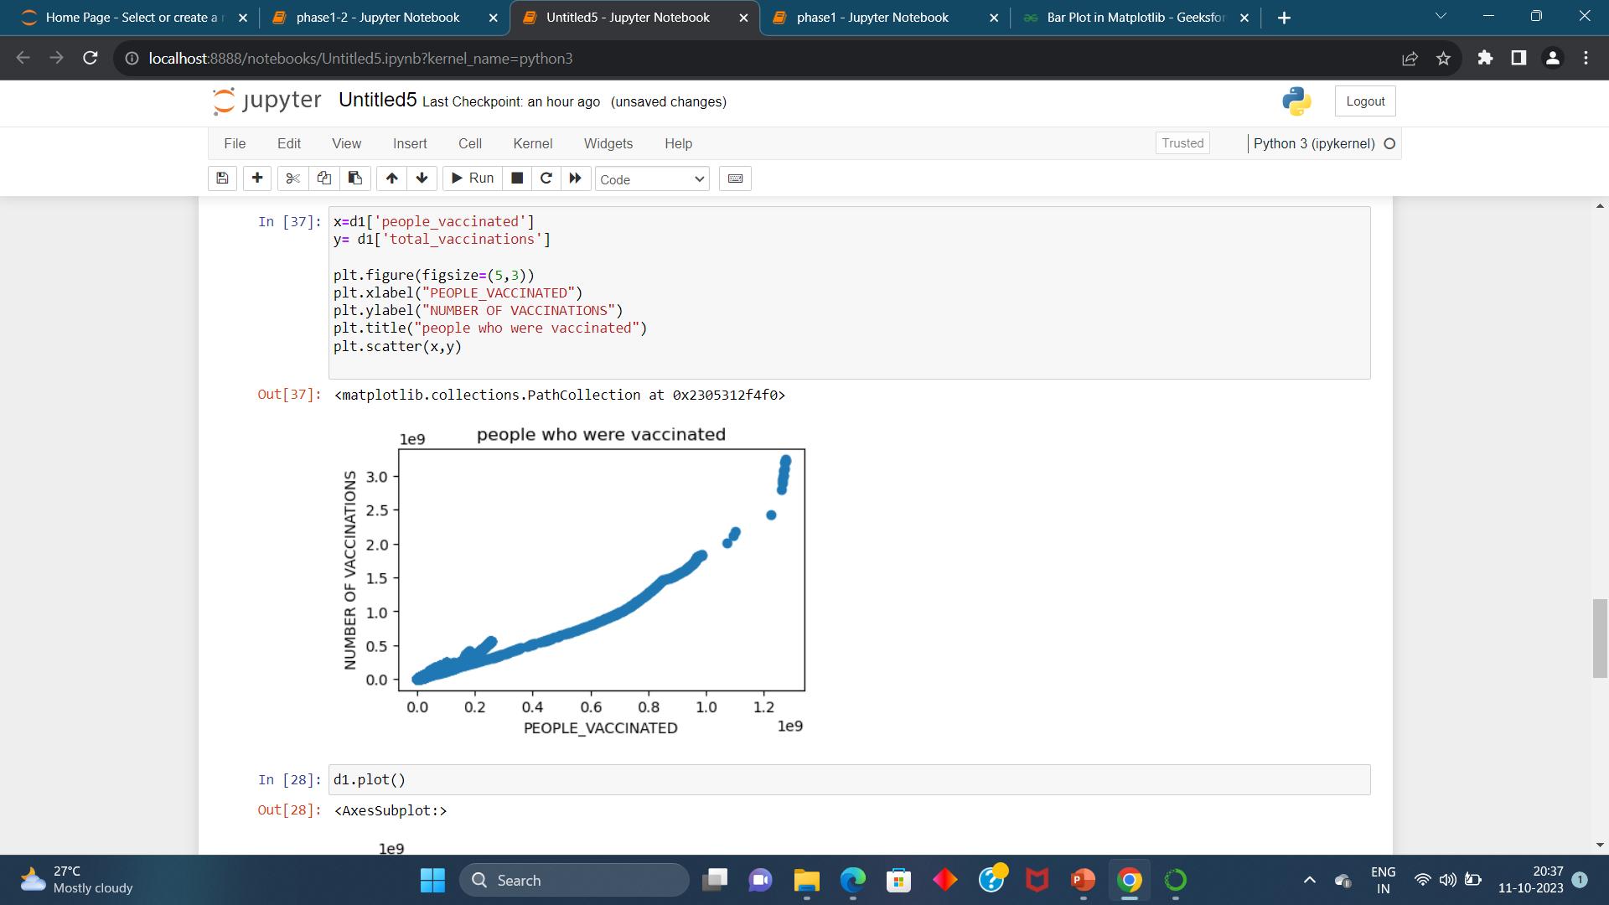

Slide 11
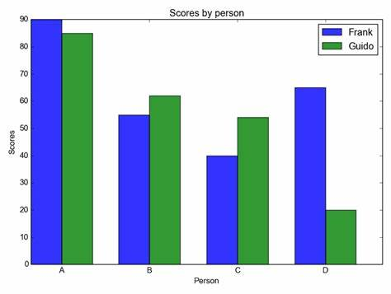
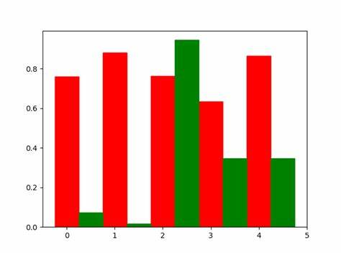
VISUALIZATION
Visualization in Python refers to the creation of graphical representations of data to help understand and communicate information effectively. Data visualization is a crucial aspect of data analysis, storytelling, and reporting, and Python offers several powerful libraries for creating various types of visualizations. The most commonly used libraries for data visualization in Python include matplotlib, seaborn, plotly, and bokeh.

Slide 12
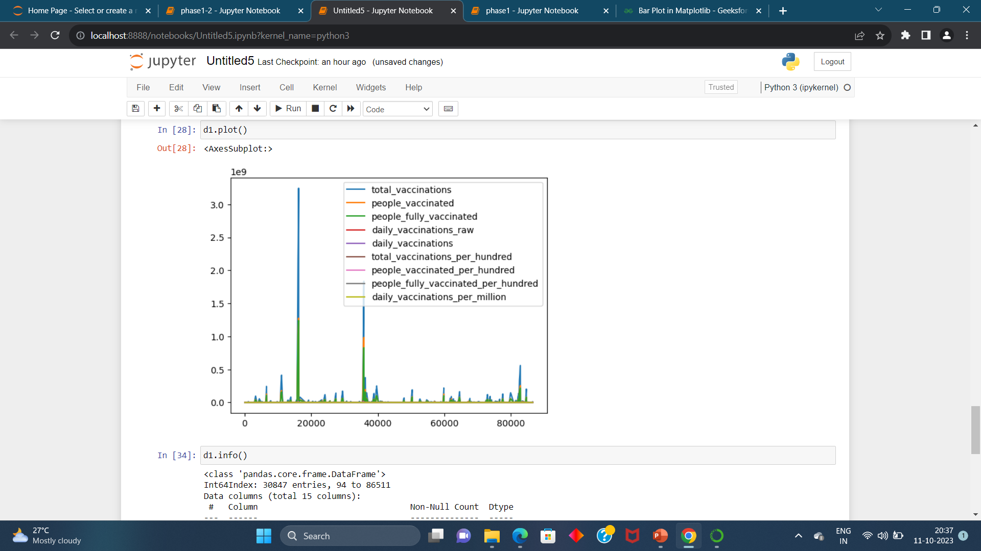

Slide 13
THANKYOU

