Slide 1
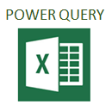
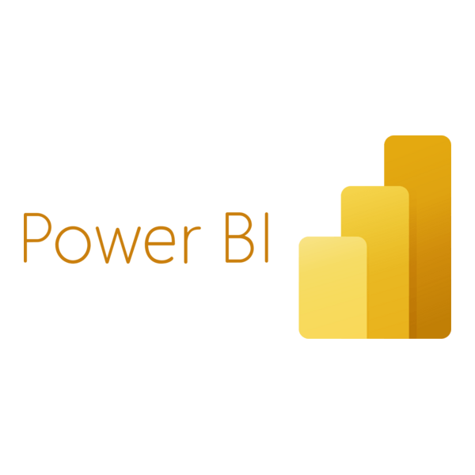
Understanding Power BI and Power Query
Transforming Data into Actionable Insights

Slide 2
What is Power Bi ?
Power BI is a business intelligence (BI) and data visualization tool developed by Microsoft.
It allows users to connect to various data sources, transform data, and create interactive reports and dashboards.
Power BI helps organizations make data-driven decisions by providing insights and trends from the data.

Slide 3
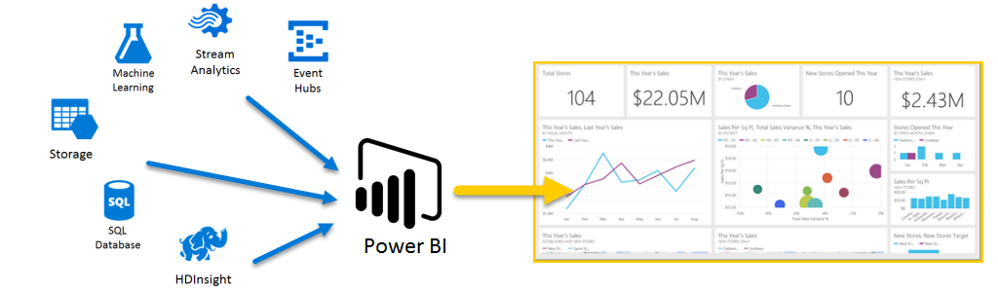
Power BI is a business intelligence (BI) tool developed by Microsoft.

Slide 4
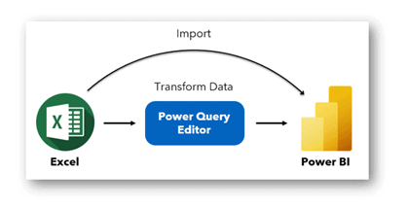
Power Query is a data connection and transformation tool in Power BI.
It allows you to: Connect to different data sources (Excel, CSV, SQL, etc.).
Clean and transform data using a user-friendly interface.
Automate data refresh and transformation.
Why Use Power Query?
Easy Data Preparation: No need for complex coding.
Reusable Workflows: Create repeatable data transformation steps.
Handles Large Datasets: Can process millions of rows efficiently.
Improved Accuracy: Removes errors and inconsistencies in data.
Power Query Process
Connect: Import data from various sources.
Transform: Clean, reshape, and merge data.
Combine: Join multiple data sets.
Load: Load the transformed data into Power BI

Slide 5
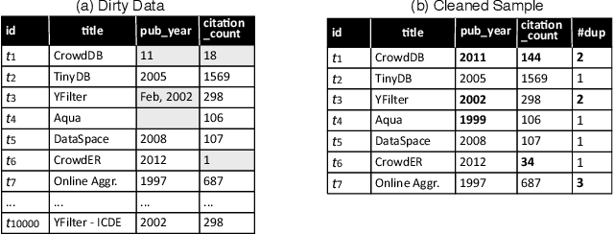
Uncleaned Data From the Database to Cleaned Sample

Slide 6
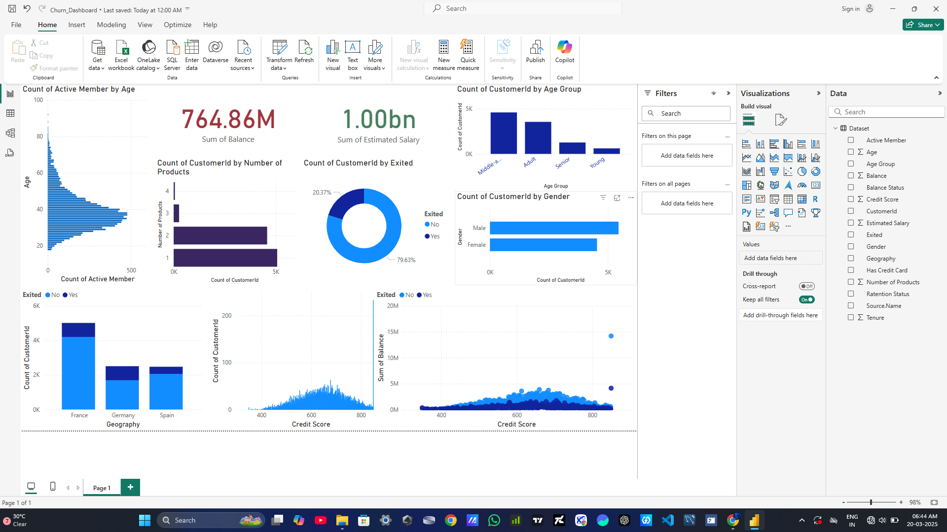

Structuring the Raw Data to Wonderful Dashboard
Churn.csv
Power Bi Dashboard

Slide 7

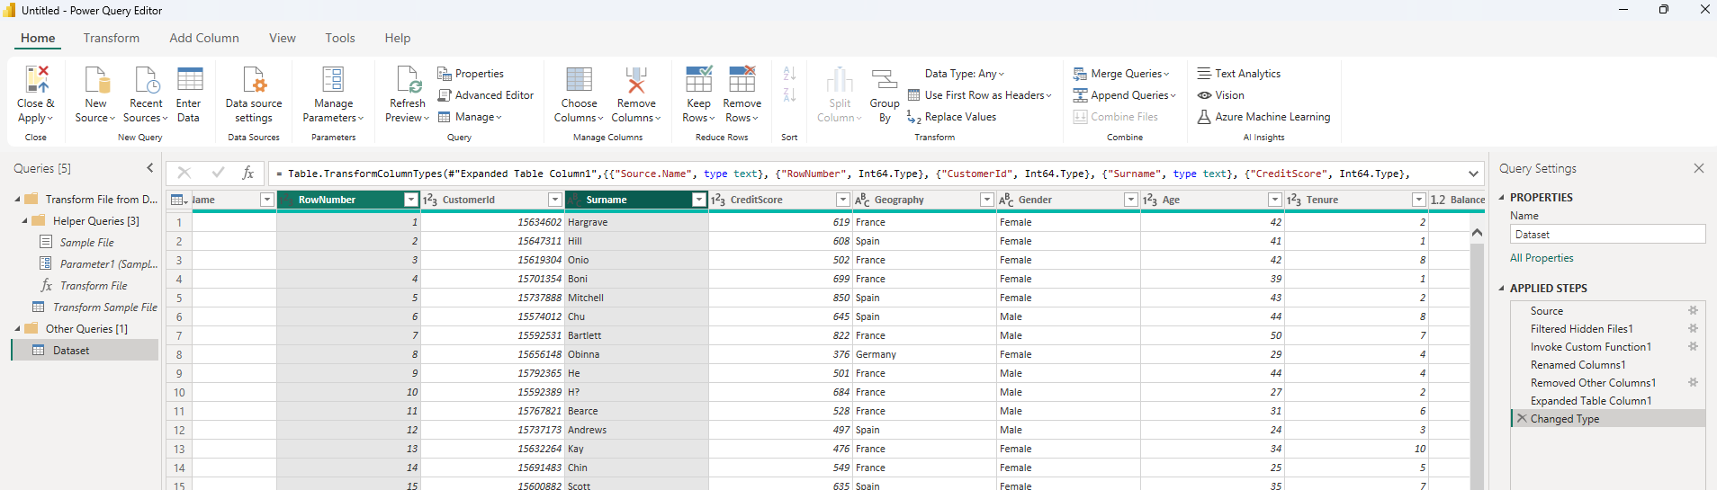

Slide 8
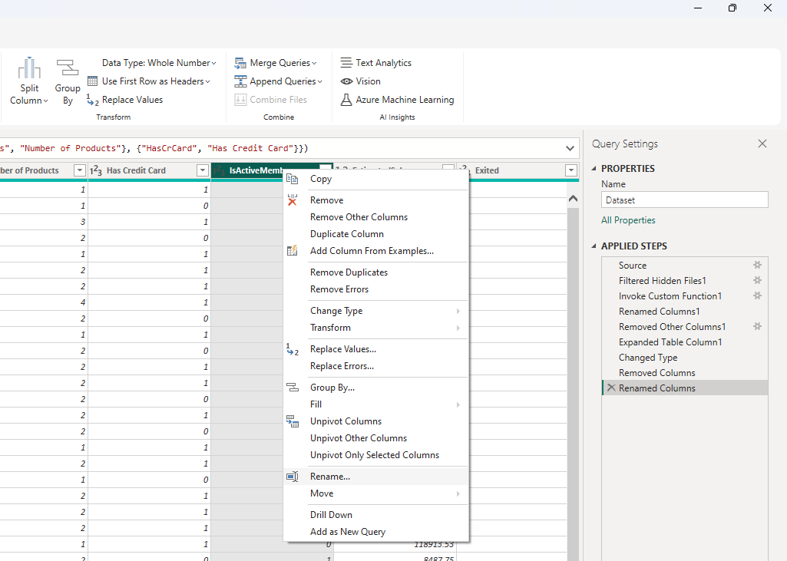
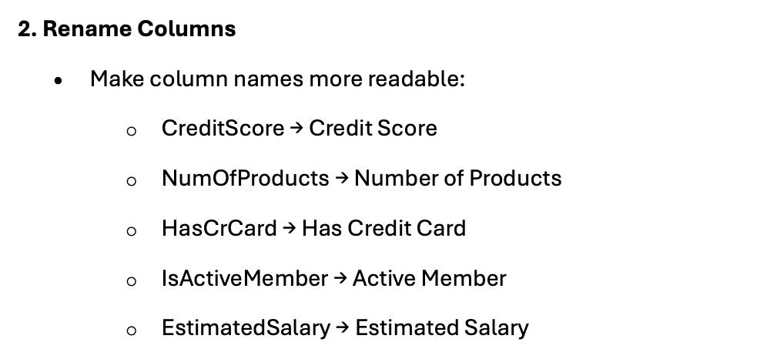

Slide 9
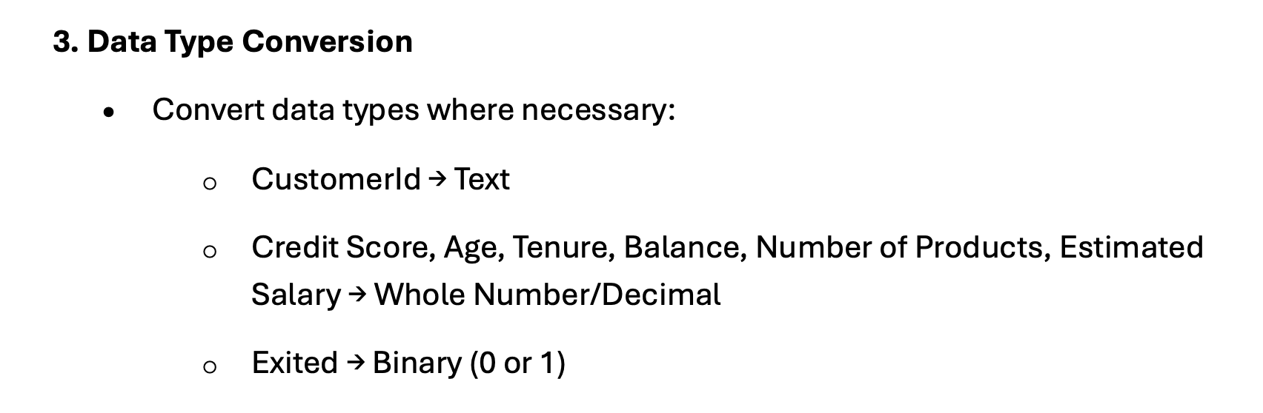
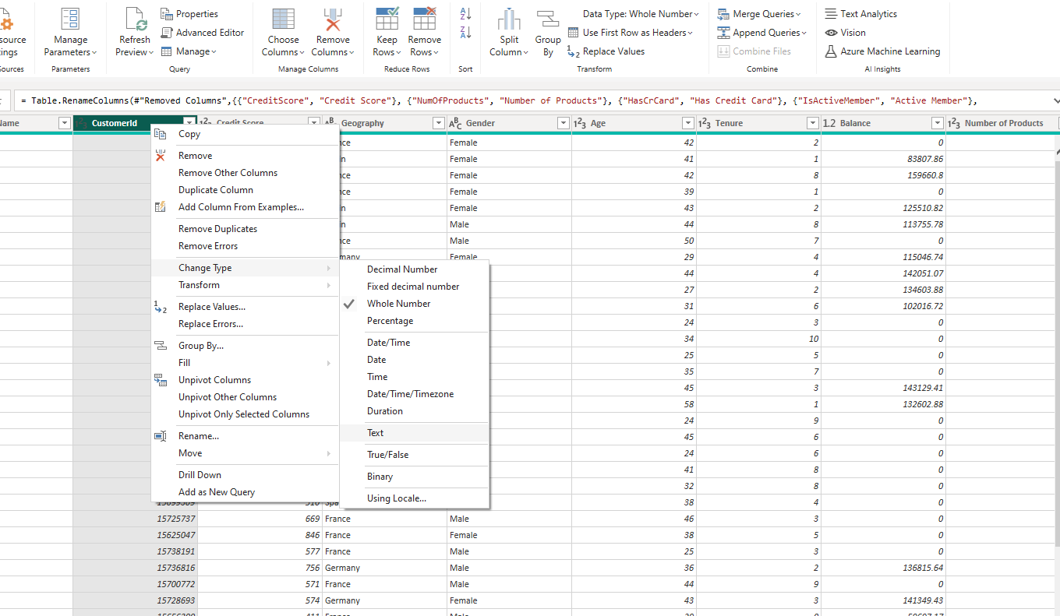

Slide 10

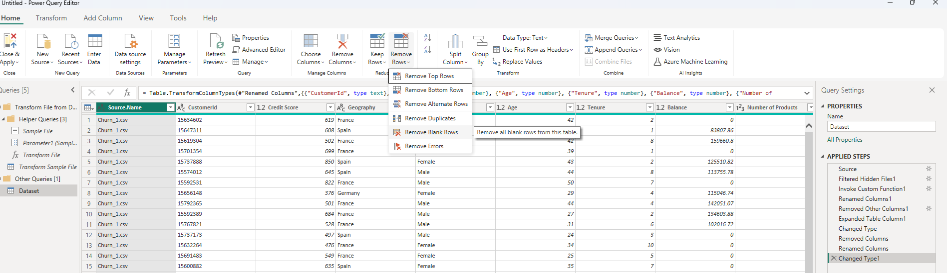

Slide 11
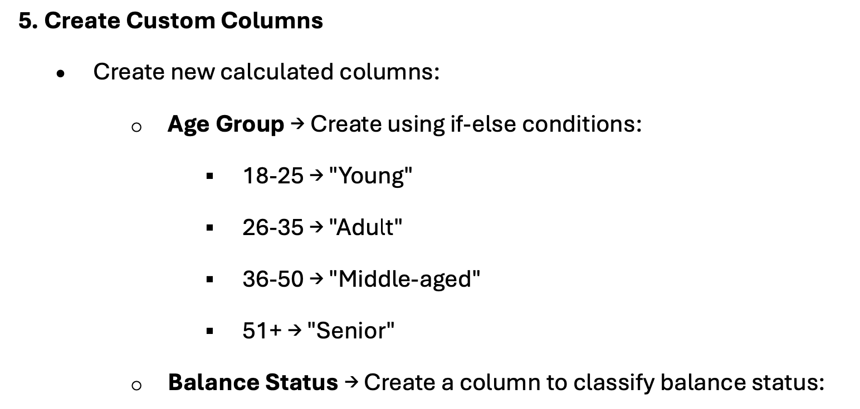
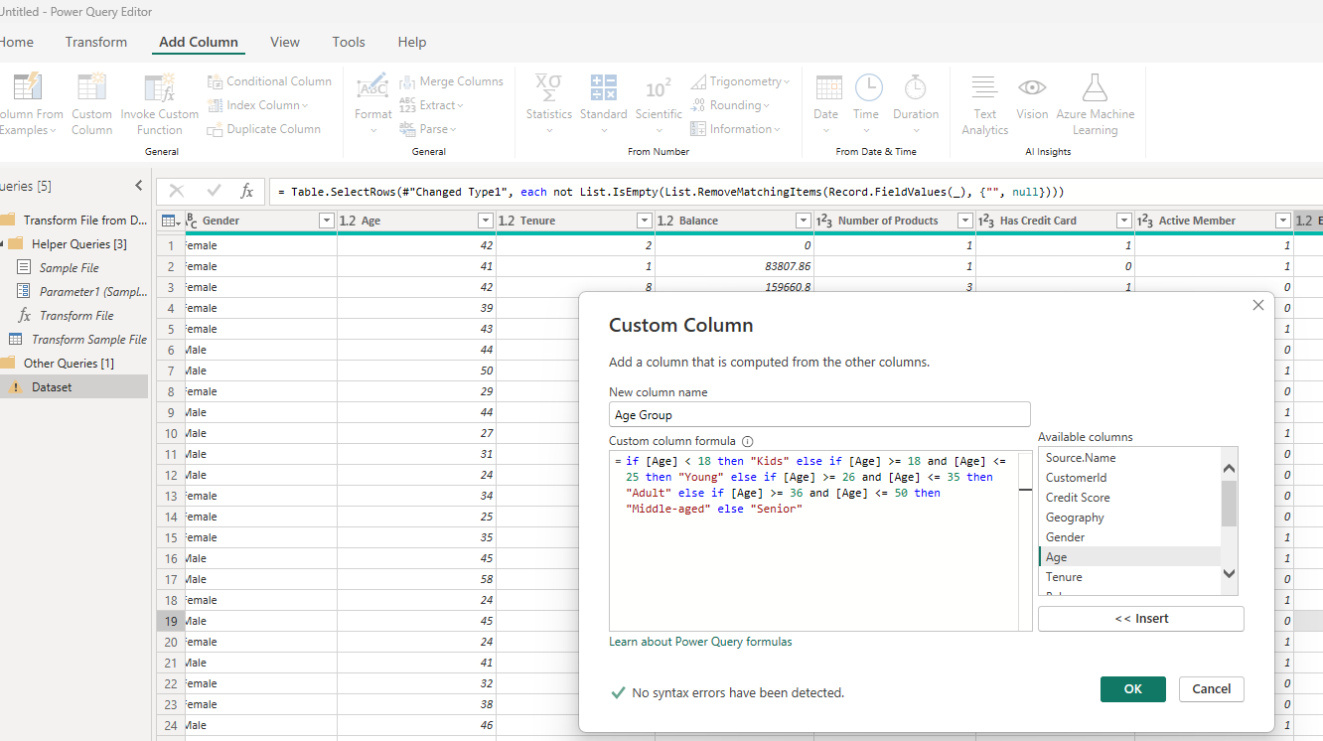
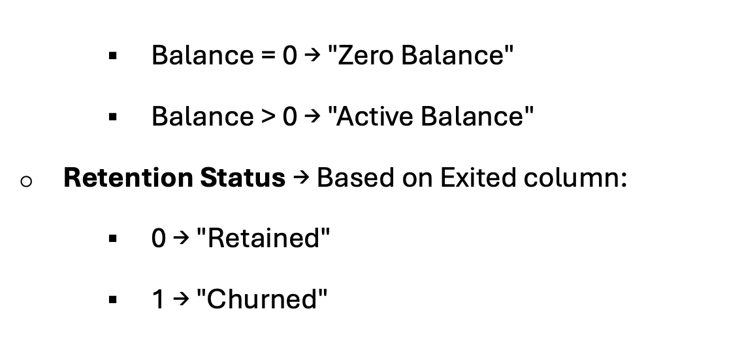

Slide 12
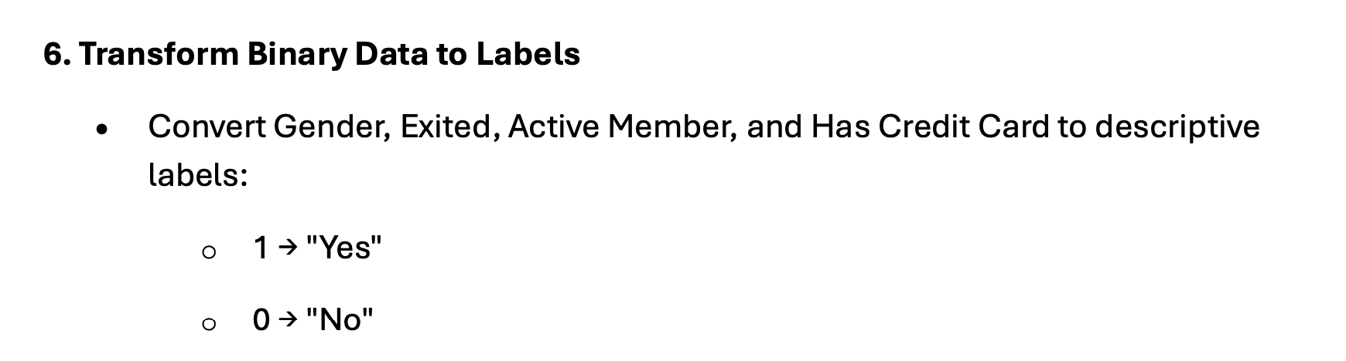
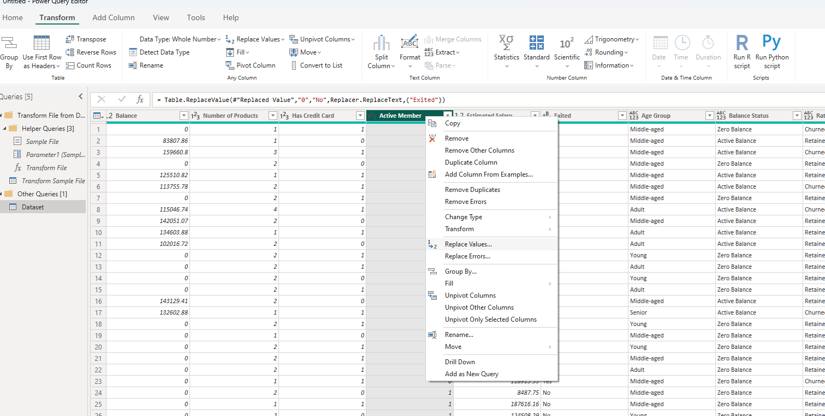

Slide 13
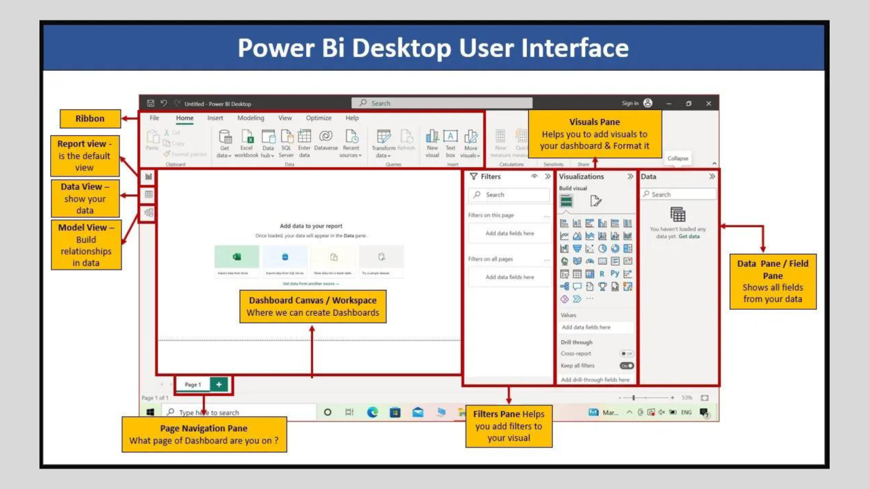

Slide 14
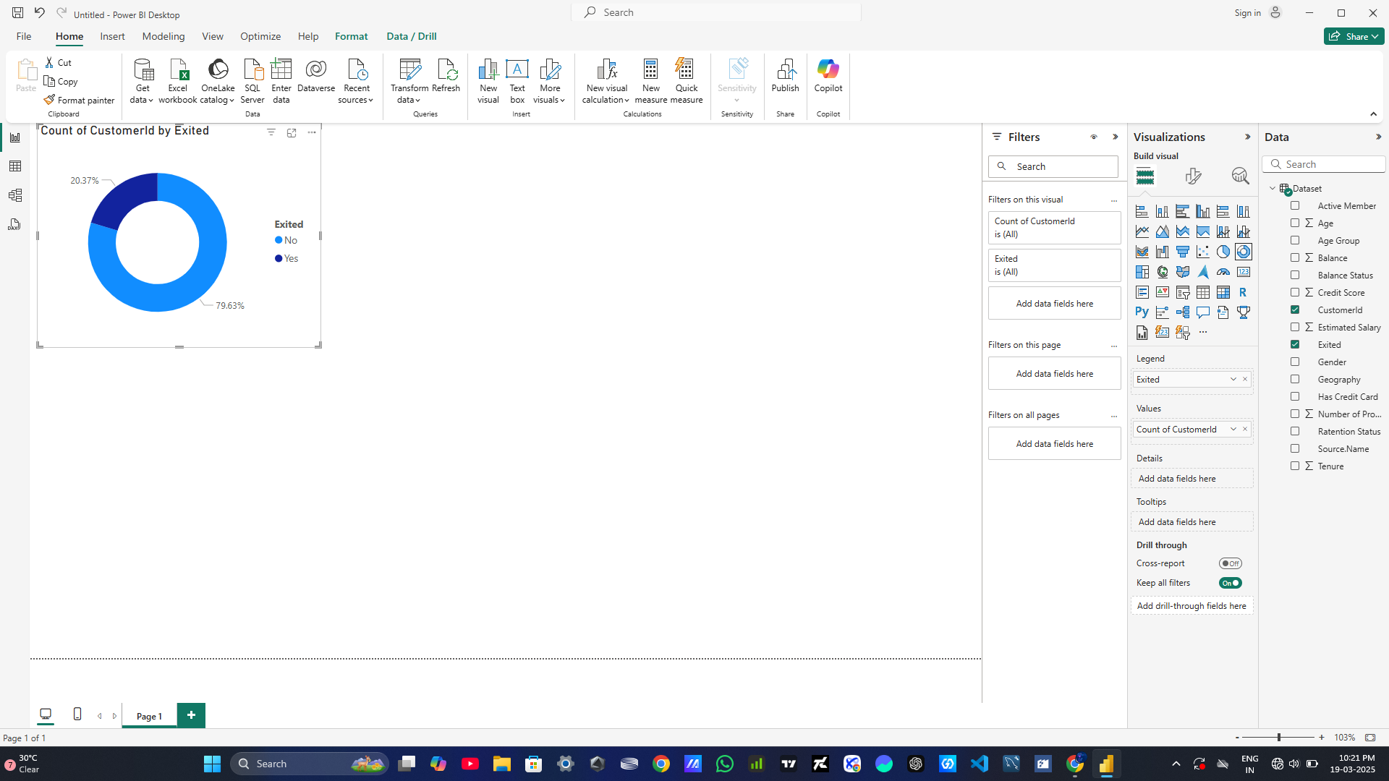

Slide 16

Thank You

