Slide 1
Prediction of the Consumer Price Index of Norway
Time Series Analysis and Prediction Course
Joana Simões, joanasimoes@student.dei.uc.pt

Slide 2
Outline
Introduction
Methods
Results
Discussion
Conclusion and Future Work

Slide 3
Introducion
Consumer Price Index (CPI) of Norway
Data from 1990 until August 2022

Slide 4
State-of-the Art
Most common models
There was no great model that was the best in every case
SARIMA
Long Short-Term Memory (LSTM) Layers
Exponential Smoothing
Common techniques applied
Split data 80-20 into train and test
Use MAPE to select the best models

Slide 5
Methods
Preprocessing of the dataset
Analysis of Time Series (TS) of interest
Division of the TS
Transformation into stationary
Evaluation of the Forecasting Models

Slide 6
Methods – Preprocessing of the data
The original dataset was transformed
Create the European Union CPI
Average of the CPI of the countries in 1990

Slide 7
Methods – Analysis of the TS
Analysis of the overall trend and seasonality
Check stationarity of the TS
DF statitical test
H0: The TS is non-stationary
H1: The TS is stationary
95% significance level

Slide 8
Methods – Division into Train – Test
80-20 split of the data
80 % for training
From this, 15 % were used to validation
20 % for testing

Slide 9
Methods - Transformation into stationary
2 aproaches
1st approach
Model-fitting to remove trend
Filtering to remove seasonality
2nd approach
Differencing

Slide 10
Methods – Forecasting models
Models evaluated
Univariate
ARIMA
SARIMA
Triple Exponential Smoothing
RNN’s (LSTM and GRU)
Multivariate
SARIMAX
VARMAX
RNN’s (LSTM and GRU)
Forecast horizon of 1, 3, 6, and 12 months
Grid-search to find the best hyperparameters based on MAPE
15% of the train data to validation

Slide 11
Methods – Multivariate models
European Union CPI
United States CPI

Slide 12
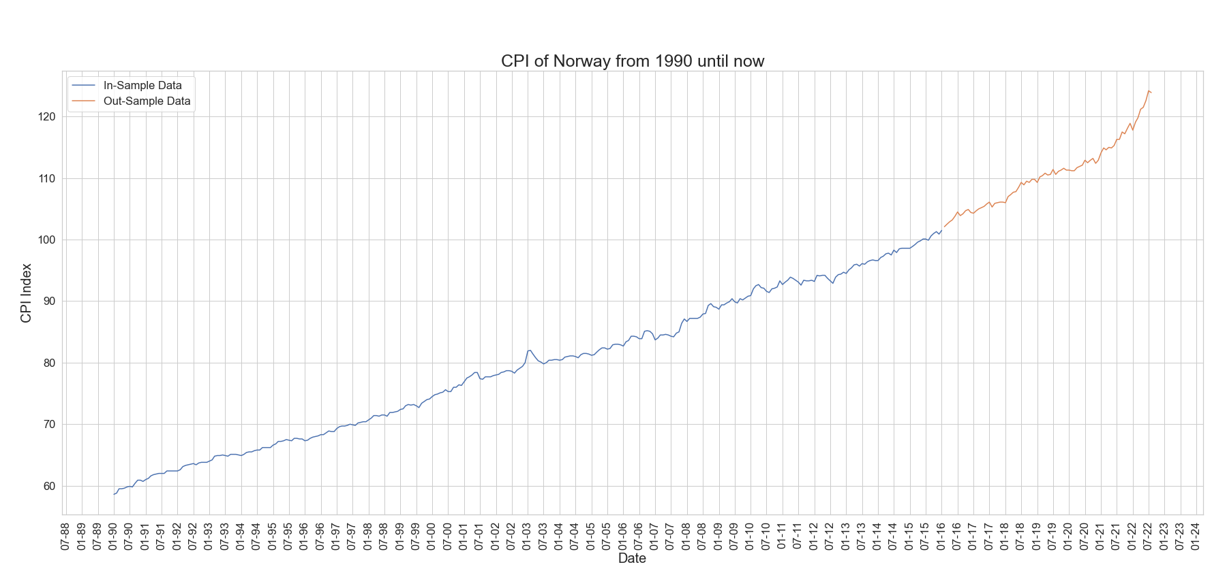
Results – overall TS

Slide 13
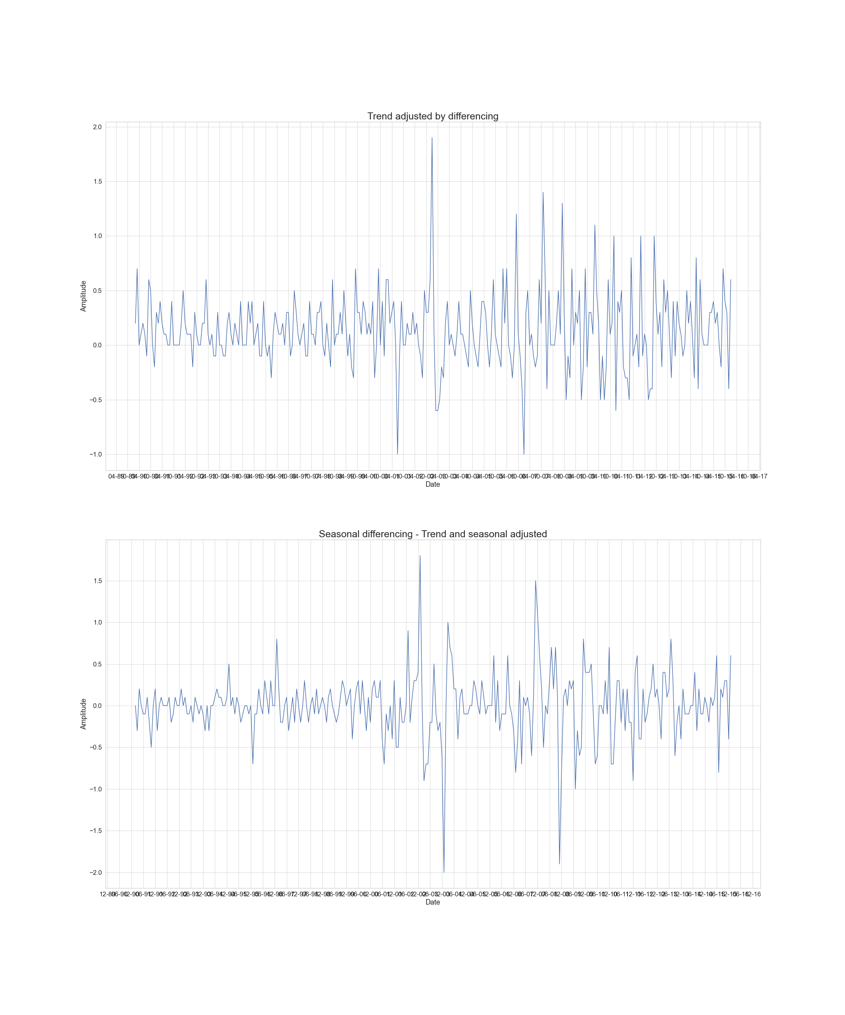
Results - Differencing
1st order differencing to remove trend
1st order differencing with a period of 12 to remove seasonality
Trend Adjusted
Seasonal Adjusted

Slide 14
Results – DF test of the TS
 | Original TS | After Differencing | After Model-fitting and filtering | Stationary TS Test
ADF statistic | 1.0 | -7.24 | -17.22 | -2.99
p-value | 0.99 | 0.0 | 0.0 | 0.03
Critical Value 1% | -3.45
Critical Value 5% | -2.87
Critical Value 10% | -2.57

Slide 15
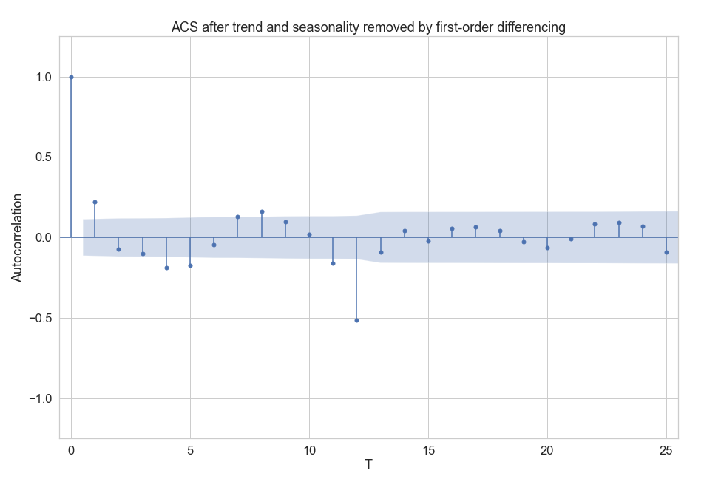
Results - ACS

Slide 16
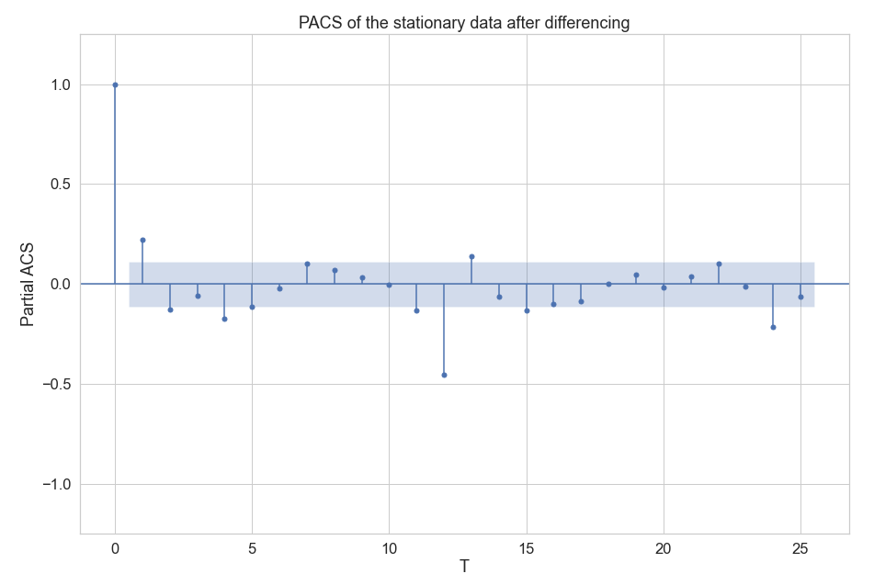
Results - PACS

Slide 17
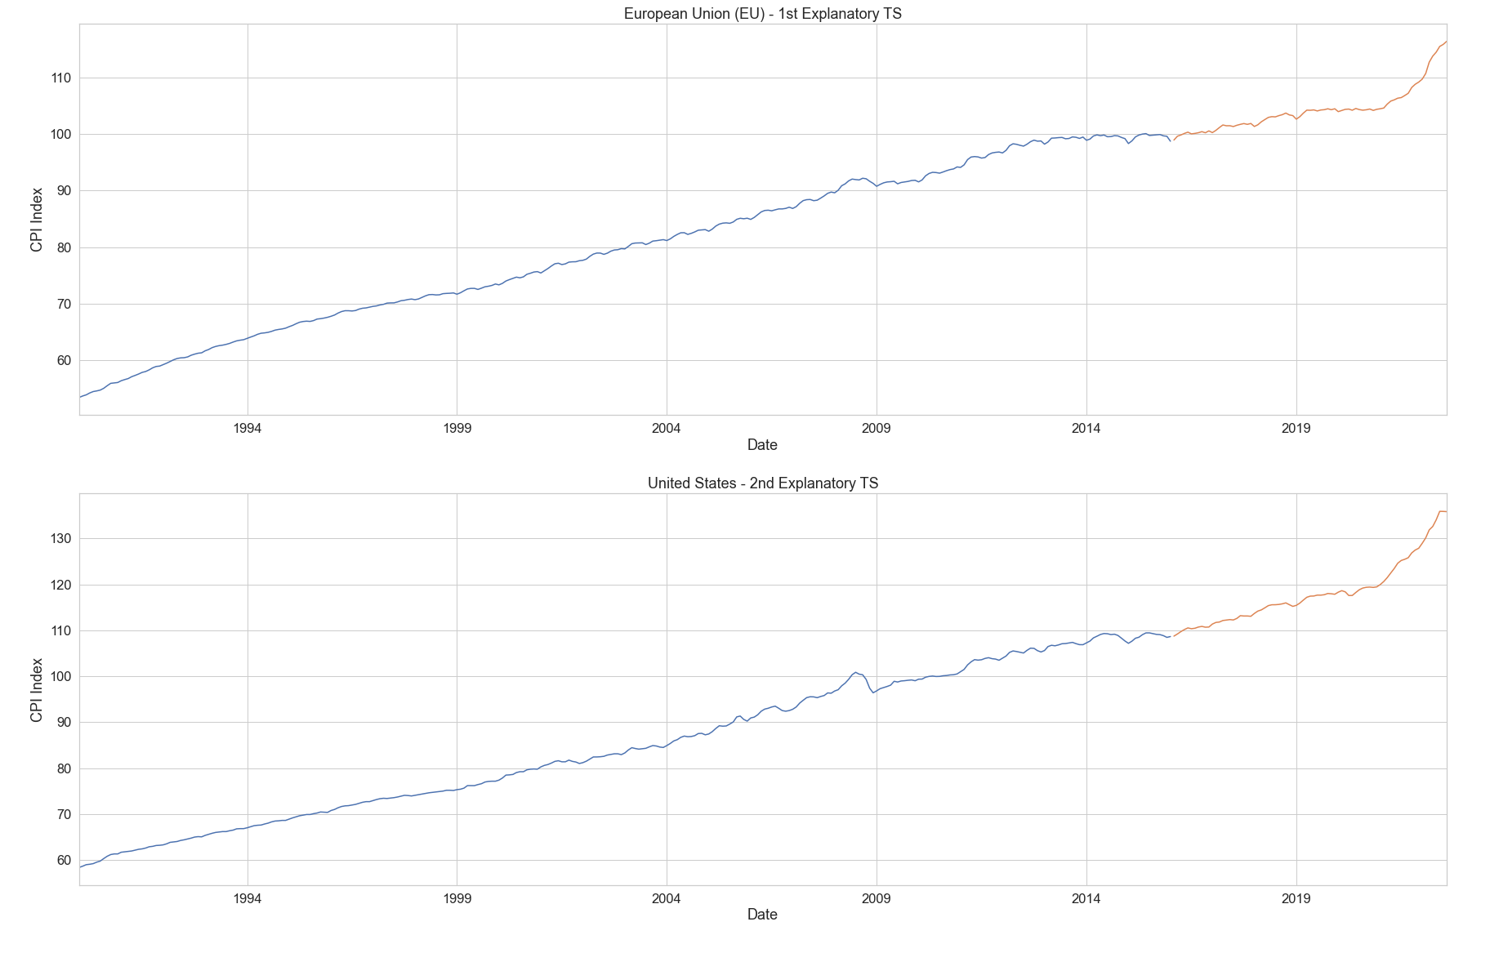
Results – Explanatory TS

Slide 18
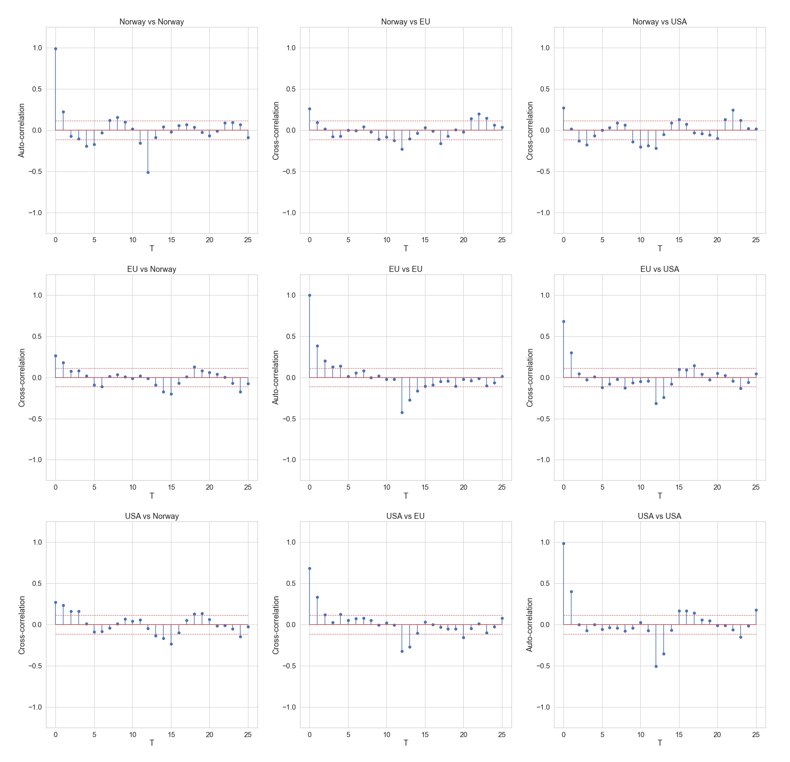
Results – Cross-correlation

Slide 19
Results – Models Performance
Model | Forecast Horizon | MAPE | MAE | MSE | RMSE | R2
ARIMA(2, 0, 4) | 6 | 0.010 | 1.160 | 2.449 | 1.565 | 0.916
SARIMA(4, 1, 2) x (3, 1, 0, 12) | 3 | 0.005 | 0.553 | 0.659 | 0.811 | 0.977
Triple Exponential Smoothing | - | 0.024 | 2.666 | 10.212 | 3.196 | 0.648
SARIMAX (1, 1, 0) x (1, 1, 1, 12) | 3 | 0.004 | 0.442 | 0.328 | 0.573 | 0.989
VARMAX(1, 2) | 12 | 0.039 | 4.459 | 36.533 | 6.044 | -0.259
GRU non-stationary univariate | 1 | 0.021 | 2.350 | 8.399 | 2.898 | 0.710
GRU non-stationary multivariate | 1 | 0.032 | 3.599 | 17.075 | 4.132 | 0.411
GRU stationary univariate | 1 | 0.057 | 6.560 | 69.528 | 8.338 | -1.397
GRU stationary multivariate | 1 | 0.119 | 13.575 | 292.058 | 17.090 | -9.067

Slide 20
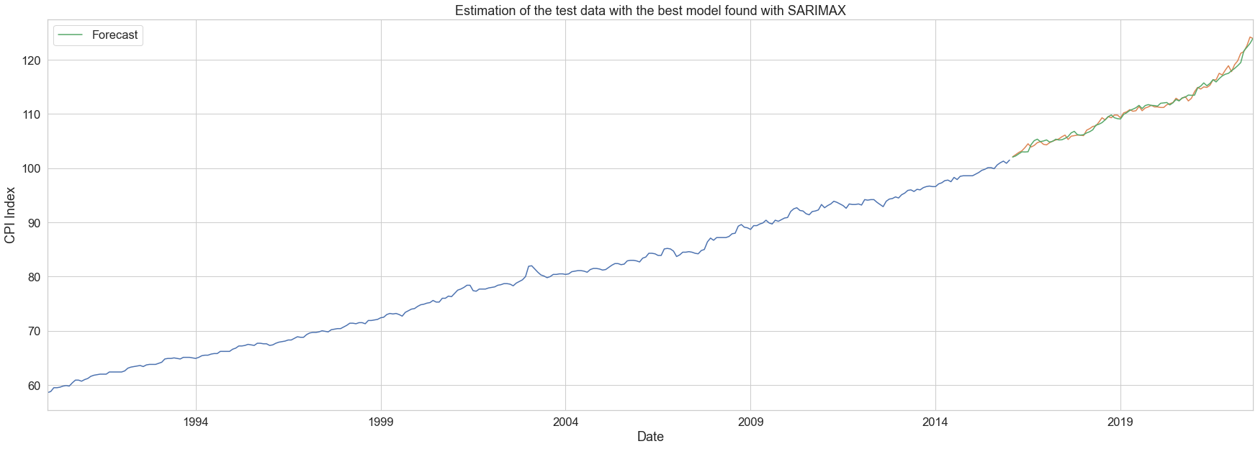
Results - Forecasting

Slide 21
Discussion
The best model is the multivariate SARIMAX
Additional TS could be benefitial
In some applications the SARIMA model
It only uses the TS of interest
Other CPI could not be available
The RNN’s may need more data
Exponential Smoothing should have obtained better results

Slide 22
Conclusion
SARIMAX was the winner
Uses information about the European Union and United States

Slide 23
Thank You!

