Slide 1
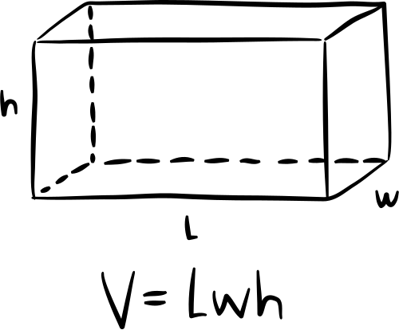
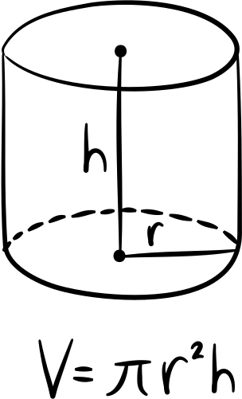
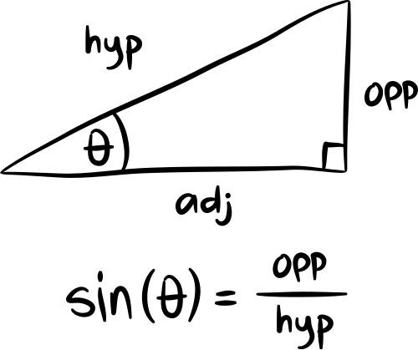
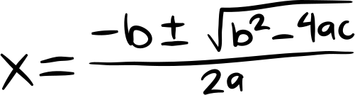
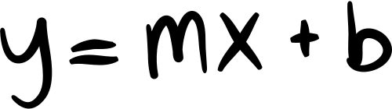
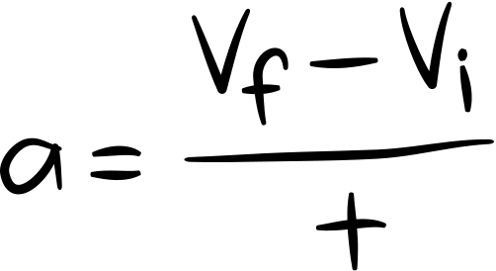
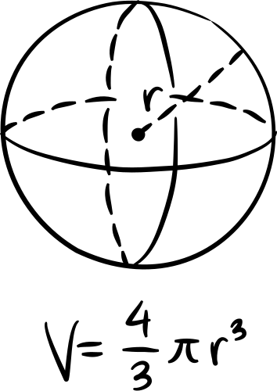
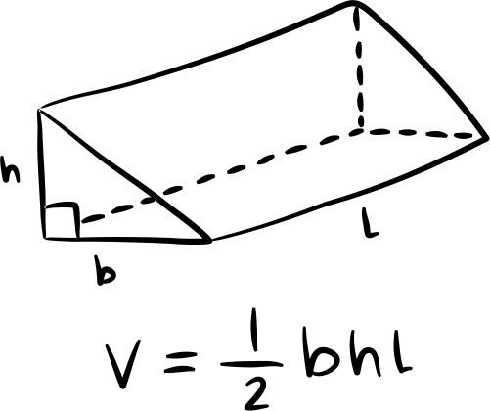
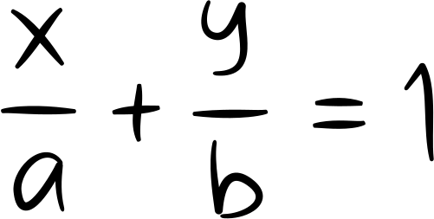

Linear Algebra
1-1 ~ 1-3

Slide 2
Big PICTURE
linear system 怎麼解 ?
matrix 運算

Slide 3
linear system

Slide 4
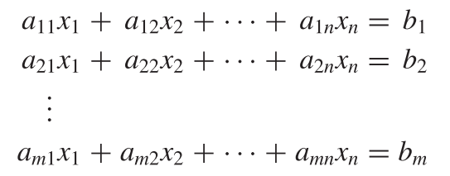
Linear system:

Slide 5
how to solve ?

Slide 6
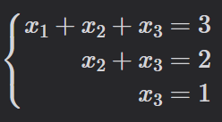
Examples:
what are x1, x2, x3 ?

Slide 7
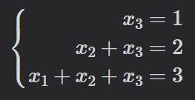
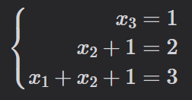
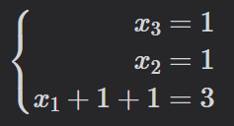
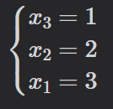
Answers:
back substitute
other method ?

Slide 8
matrix FORM ?

Slide 9
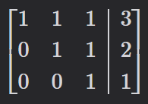
Matrix:
SAME
coefficient matrix
arugument matrix

Slide 10
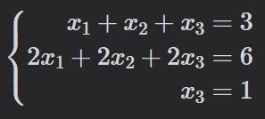
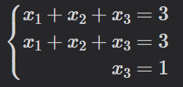

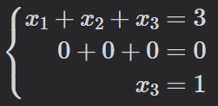
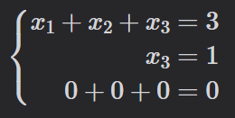
Another example
original
(2) divide 2
(2) = (2) - 1 * (1)
exchange((2), (3))

Slide 11
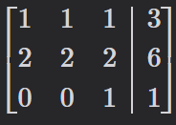
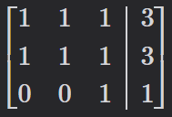
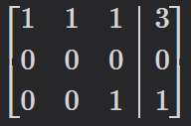
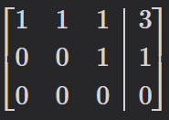
matrix solution
original
(2) divide 2
(2) = (2) - 1 * (1)
exchange((2), (3))

Slide 12
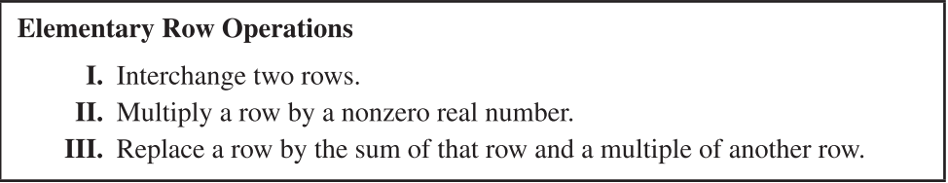
row operation

Slide 13
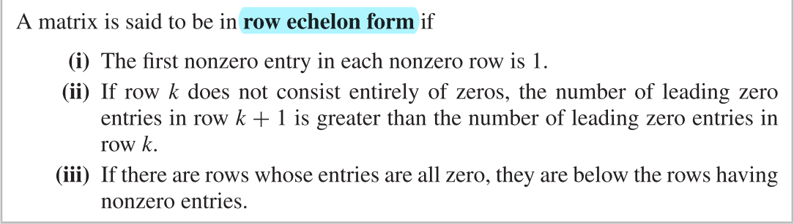
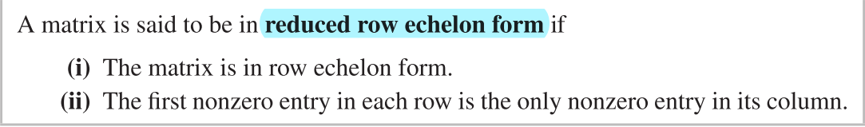
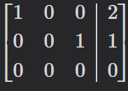
row echelon form
Gauss-reduction
row reduced echelon form (rref)
Gauss-Jordan-reduction

Slide 14
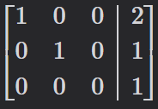
RREF unique solution ?

Slide 15
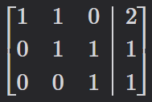
SO, when unique solution ?
strickly triangular matrix

Slide 16
solution case
consistent
unique solution
infinite solution
non-consistent (no solution)

Slide 17
matrix arithmetic

Slide 18
operation
Addition
Subtraction
Multiplication
Transpose

Slide 19
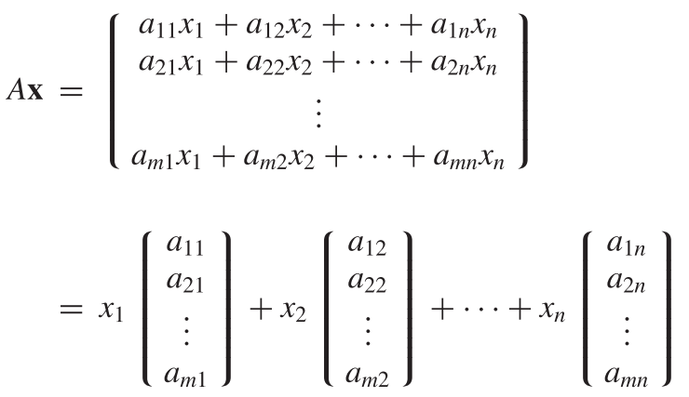

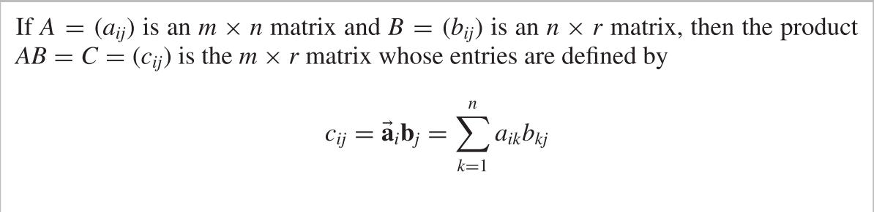
matrix multiplicaiton
row vector
column vector

Slide 20
vector:
column vector
row vector

Slide 21
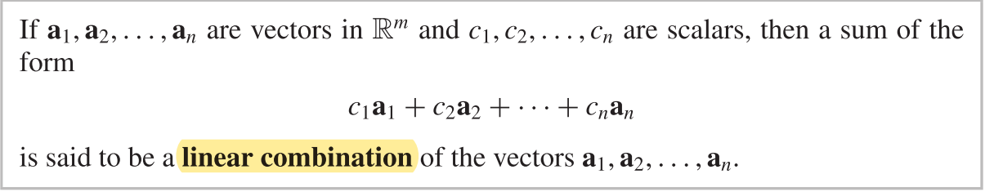
Linear Combination:

Slide 22
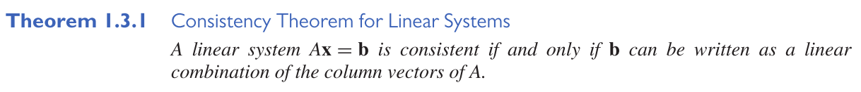
Ax=b consistent

Slide 23
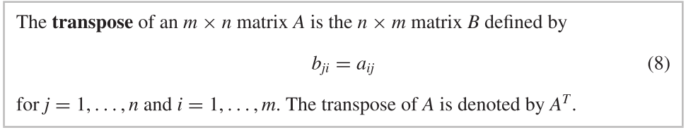
transpose
symmetric

Slide 24
end

Slide 25
Linear Combination:
column vector
row vector

Slide 26
transpose
b is con
transpose

Slide 27
Key Words:
Addition
Subtraction
Multiplication
Division
add
altogether
and
both
in all
sum of
total
increase
take away
difference
fewer
gave away
less
how much more
change
decrease
multiply
each
twice
product
in all
double
divide
each
quotient
share equally
goes into

Slide 28
Practice:
Twice the sum of 5 and b
12 decreased by n
40 shared equally among v

Slide 29
Answers:
2 ( 5 + b )
12 - n
40 ÷ v

Slide 30
Word Problem
Write and expression to solve.
Rachel and her 3 friends each bough lemonade for 2 dollars. How many money was spent?

Slide 31
Examples:
The sum of 65 and p
a less than 55
65 + p
55 - a

Slide 32
Answer
( 1 + 3 ) x 2

Slide 33
Learning Target:
I will be able to write and match simple numerical expressions.

