Slide 1
2026.8.15
交大100 數學
LA : ch2

Slide 2
1

Slide 3
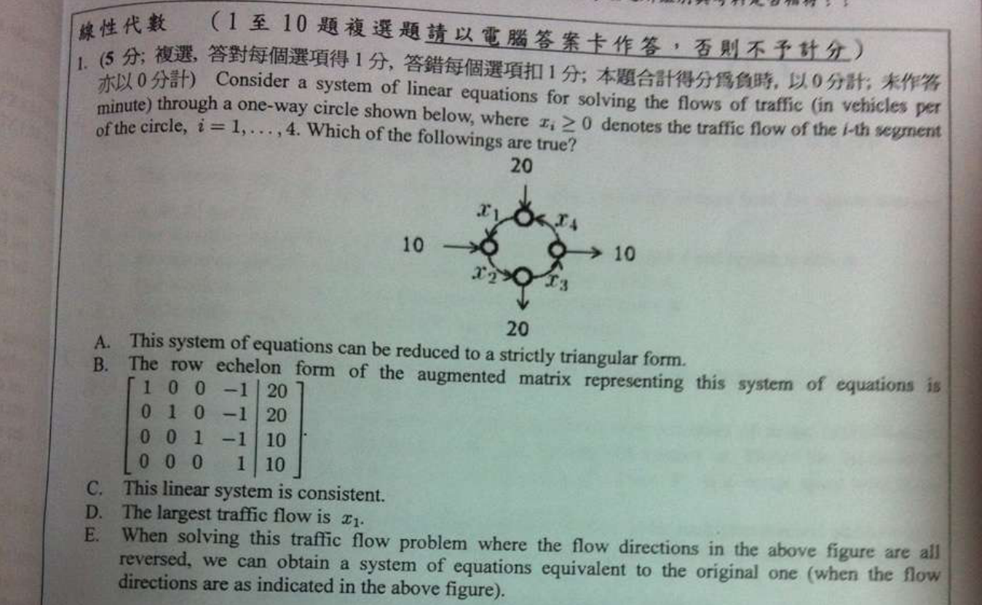
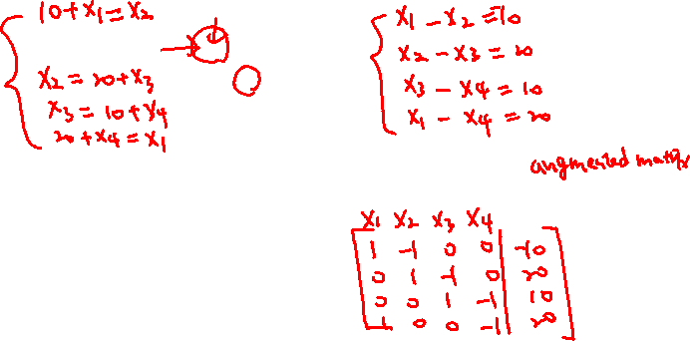

Slide 4
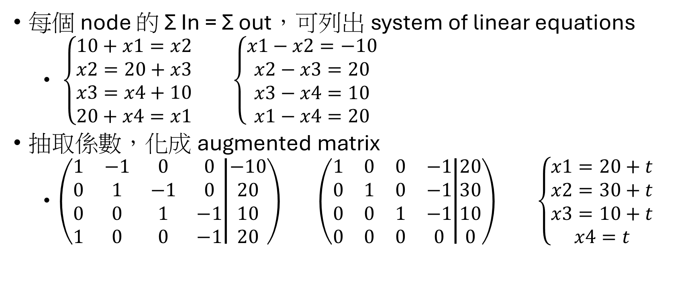
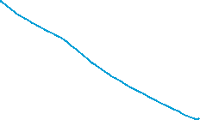

sol
每個 node 的 Σ In = Σ out，可列出 system of linear equations
$\left\{\begin{aligned}10+x1=x2 \\ x2=20+x3 \\ x3=x4+10 \\ 20+x4=x1\end{aligned}\right.$ $\left\{\begin{aligned}x1−x2=−10 \\ x2−x3=20 \\ x3−x4=10 \\ x1−x4=20\end{aligned}\right.$
抽取係數，化成 augmented matrix
$\left(\begin{matrix}1 & −1 & 0 & 0 \\ 0 & 1 & −1 & 0 \\ 0 & 0 & 1 & −1 \\ 1 & 0 & 0 & −1\end{matrix} | \begin{matrix}−10 \\ 20 \\ 10 \\ 20\end{matrix}\right)$ $\left(\begin{matrix}1 & 0 & 0 & −1 \\ 0 & 1 & 0 & −1 \\ 0 & 0 & 1 & −1 \\ 0 & 0 & 0 & 0\end{matrix} | \begin{matrix}20 \\ 30 \\ 10 \\ 0\end{matrix}\right)$ $\left\{\begin{aligned}x1=20+t \\ x2=30+t \\ x3=10+t \\ x4=t\end{aligned}\right.$
(D) $x2$ 最大
Reduced row echelon form
(C) 有解(consistent) : 無限多解
不可化成 Strictly triangular form
(rank(A) = 3 < 4 = rank(A|b) )
Notes:
我做一頁要 45min …

Slide 5
sol
(E) reversed in/out，會列出一樣的 system of linear equation
Notes:
我做一頁要 45min …

Slide 6
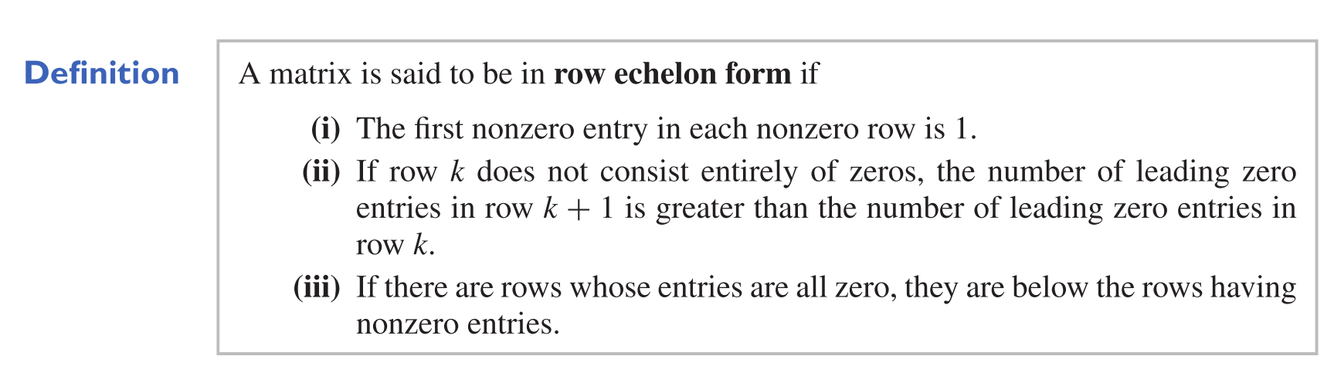
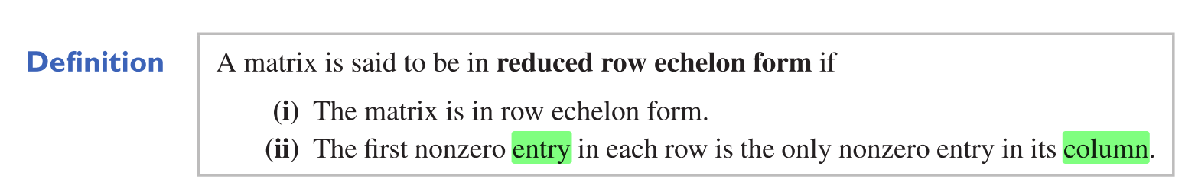

Row Echelon form
Reduced Row Echelon form
(using Gauss-Jordan reduction)

Slide 7
2

Slide 8
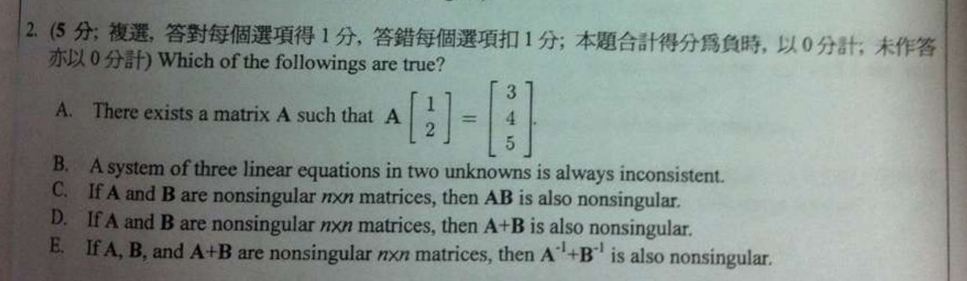

Slide 9
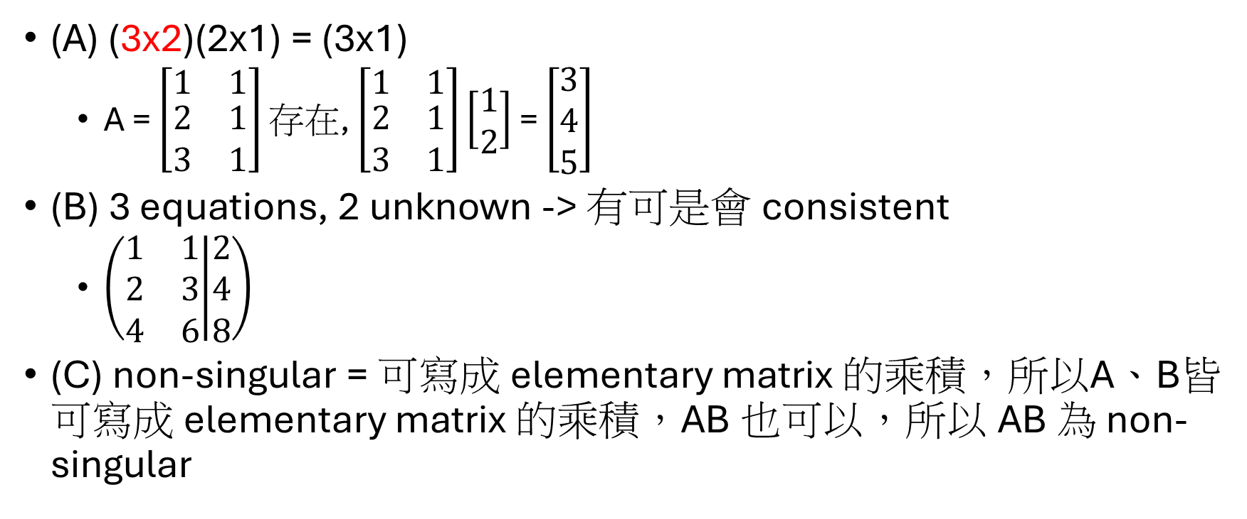
sol
(A) (3x2)(2x1) = (3x1)
A = $\left[\begin{matrix}1 & 1 \\ \begin{aligned}2 \\ 3\end{aligned} & \begin{aligned}1 \\ 1\end{aligned}\end{matrix}\right]$ 存在, $\left[\begin{matrix}1 & 1 \\ \begin{aligned}2 \\ 3\end{aligned} & \begin{aligned}1 \\ 1\end{aligned}\end{matrix}\right]\left[\begin{aligned}1 \\ 2\end{aligned}\right]$ = $\left[\begin{aligned}3 \\ 4 \\ 5\end{aligned}\right]$
(B) 3 equations, 2 unknown -> 有可是會 consistent
$\left(\begin{matrix}1 & 1 \\ 2 & 3 \\ 4 & 6\end{matrix} | \begin{matrix}2 \\ 4 \\ 8\end{matrix}\right)$
(C) non-singular = 可寫成 elementary matrix 的乘積，所以A、B皆可寫成 elementary matrix 的乘積，AB 也可以，所以 AB 為 non-singular
Notes:
我做一頁要 45min …

Slide 10

sol
(D) A + B 就不一定會 nonsingular
e.q. A=$\left[\begin{matrix}1 & 0 \\ 0 & −1\end{matrix}\right]$, B=$\left[\begin{matrix}−1 & 0 \\ 0 & 1\end{matrix}\right]$, A+B=$\left[\begin{matrix}0 & 0 \\ 0 & 0\end{matrix}\right]$
(E) 一個小技巧 $\left(A^{−1}+B^{−1}\right)=A^{−1}\left(A+B\right)$ $B^{−1}$
因為 (A+B) 可逆，並且 A、B 可逆，可逆矩陣相乘依然可逆
Notes:
我做一頁要 45min …

Slide 11
3

Slide 12
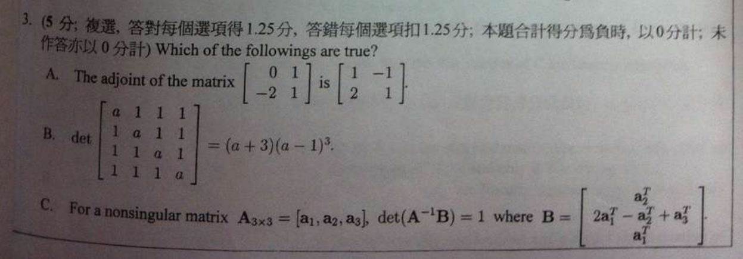
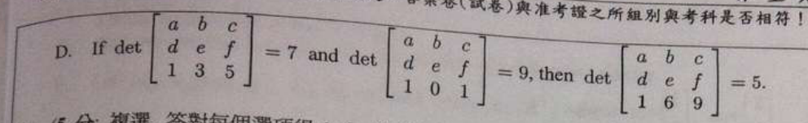
Notes:
35min

Slide 13

sol
(A) adjoint
$\operatorname{cof}\left(a_{11}\right)={(−1)}^{1+1}∙1=1$
$\operatorname{cof}\left(a_{12}\right)={(−1)}^{1+2}∙\left(−2\right)=2$
$\operatorname{cof}\left(a_{21}\right)={(−1)}^{2+1}∙1=−1$
$\operatorname{cof}\left(a_{22}\right)={(−1)}^{2+2}∙0=0$
$\operatorname{adj}\left(A\right)=\left[\begin{matrix}cof(a_{11}) & cof(a_{21}) \\ cof(a_{12}) & cof(a_{22})\end{matrix}\right]=\left[\begin{matrix}1 & −1 \\ 2 & 0\end{matrix}\right]$
transpose

Slide 14

sol
(B) $\left|\begin{matrix}a & 1 & 1 & 1 \\ 1 & a & 1 & 1 \\ \begin{aligned}1 \\ 1\end{aligned} & \begin{aligned}1 \\ 1\end{aligned} & \begin{aligned}a \\ 1\end{aligned} & \begin{aligned}1 \\ a\end{aligned}\end{matrix}\right|$
$=\left|\begin{matrix}a+3 & a+3 & a+3 & a+3 \\ 1 & a & 1 & 1 \\ \begin{aligned}1 \\ 1\end{aligned} & \begin{aligned}1 \\ 1\end{aligned} & \begin{aligned}a \\ 1\end{aligned} & \begin{aligned}1 \\ a\end{aligned}\end{matrix}\right|$
$=\left(a+3\right)\left|\begin{matrix}1 & 1 & 1 & 1 \\ 1 & a & 1 & 1 \\ \begin{aligned}1 \\ 1\end{aligned} & \begin{aligned}1 \\ 1\end{aligned} & \begin{aligned}a \\ 1\end{aligned} & \begin{aligned}1 \\ a\end{aligned}\end{matrix}\right|$
$=\left(a+3\right)\left|\begin{matrix}1 & 1 & 1 & 1 \\ 0 & a−1 & 0 & 0 \\ \begin{aligned}0 \\ 0\end{aligned} & \begin{aligned}0 \\ 0\end{aligned} & \begin{aligned}a−1 \\ 0\end{aligned} & \begin{aligned}0 \\ a−1\end{aligned}\end{matrix}\right|=(a+3){(a−1)}^{3}$

Slide 15
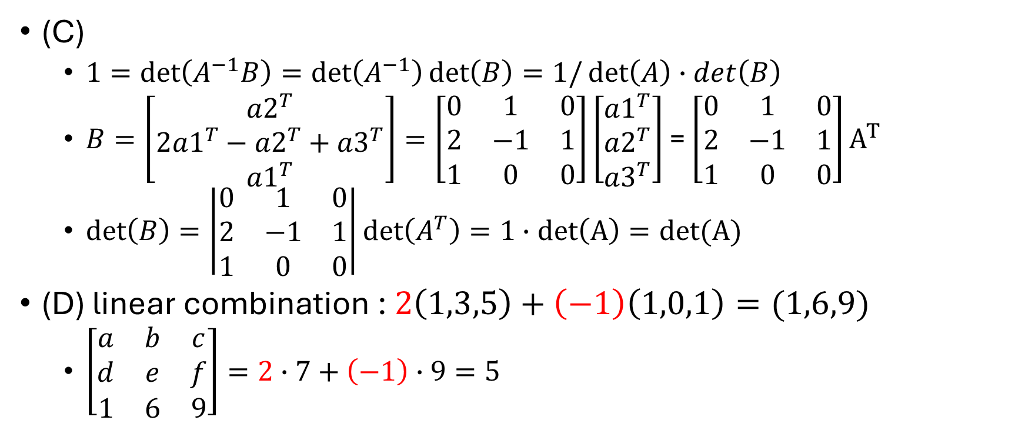
sol
(C)
$1=det\left(A^{−1}B\right)=\det\left(A^{−1}\right)\det\left(B\right)=1/\det\left(A\right)∙det\left(B\right)$
$B=\left[\begin{matrix}\begin{aligned}{a2}^{T} \\ 2{a1}^{T}−{a2}^{T}+{a3}^{T} \\ {a1}^{T}\end{aligned}\end{matrix}\right]=\left[\begin{matrix}0 & 1 & 0 \\ 2 & −1 & 1 \\ 1 & 0 & 0\end{matrix}\right]\left[\begin{aligned}{a1}^{T} \\ {a2}^{T} \\ {a3}^{T}\end{aligned}\right]$ = $\left[\begin{matrix}0 & 1 & 0 \\ 2 & −1 & 1 \\ 1 & 0 & 0\end{matrix}\right]A^{T}$
$\det\left(B\right)=\left|\begin{matrix}0 & 1 & 0 \\ 2 & −1 & 1 \\ 1 & 0 & 0\end{matrix}\right|det\left(A^{T}\right)=1∙det\left(A\right)=det(A)$
(D) linear combination : $2\left(1,3,5\right)+\left(−1\right)\left(1,0,1\right)=(1,6,9)$
$\left[\begin{matrix}a & b & c \\ d & e & f \\ 1 & 6 & 9\end{matrix}\right]=2∙7+\left(−1\right)∙9=5$

Slide 16
4

Slide 17
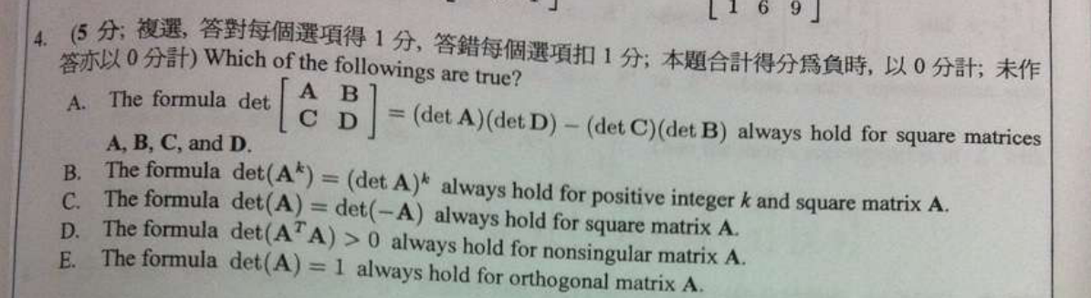

Slide 18
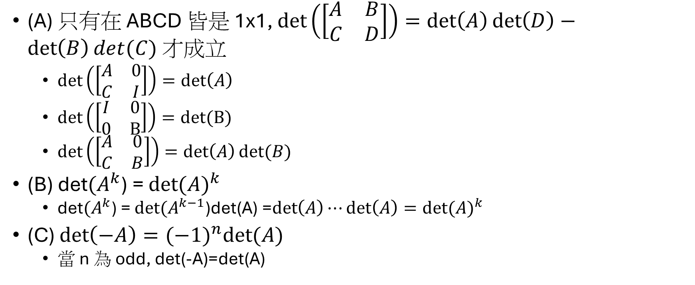
sol
(A) 只有在 ABCD 皆是 1x1, $det\left(\left[\begin{matrix}A & B \\ C & D\end{matrix}\right]\right)=\det\left(A\right)\det\left(D\right)−\det\left(B\right)det(C)$ 才成立
$det\left(\left[\begin{matrix}A & 0 \\ C & I\end{matrix}\right]\right)=\det\left(A\right)$
$det\left(\left[\begin{matrix}I & 0 \\ 0 & B\end{matrix}\right]\right)=det⁡(B)$
$det\left(\left[\begin{matrix}A & 0 \\ C & B\end{matrix}\right]\right)=\det\left(A\right)det⁡(B)$
(B) det${(A}^{k}$) = ${det⁡(A)}^{k}$
det${(A}^{k}$) = $det{(A}^{k−1}$)det(A) =$\det\left(A\right)⋯\det\left(A\right)={det⁡(A)}^{k}$
(C) $\det\left(−A\right)={(−1)}^{n}det⁡(A)$
當 n 為 odd, det(-A)=det(A)

Slide 19

sol
(D) $\det\left(A^{T}A\right)=\det\left(A^{T}\right)det\left(A\right)={det⁡(A)}^{2}>0$
(E) orthogonal $A^{T}A=I$

Slide 20
Ch1: system of linear equations
CH2: determinant
性質
應用: adjoint matrix
一定要是方陣才有 determinant

