Slide 1
考研

Slide 2
LA

Slide 3
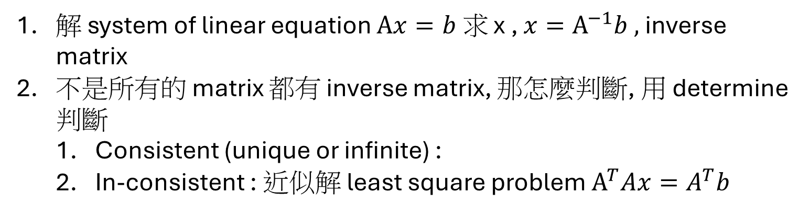
LA
解 system of linear equation $Ax=b 求$ x , $x=A^{−1}b ,$inverse matrix
不是所有的 matrix 都有 inverse matrix, 那怎麼判斷, 用 determine 判斷
Consistent (unique or infinite) :
In-consistent : 近似解 least square problem $A^{T}Ax=A^{T}b$

Slide 4
LA - decomposition
LU factorization
Only using row operation 3, find U
Then find L
QR (Gram-Schmidt process)
fdfd
SVD

Slide 5
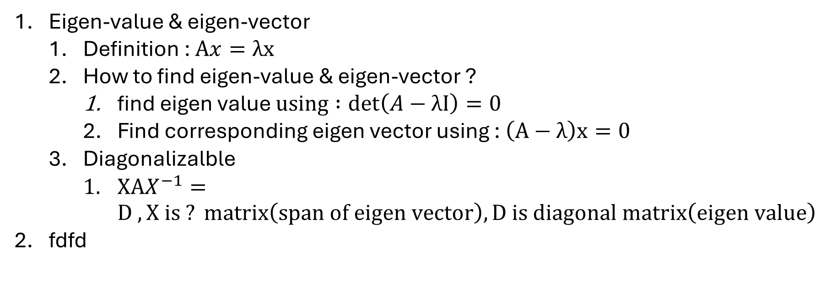
LA – 特例
Eigen-value & eigen-vector
Definition : $Ax=λx$
How to find eigen-value & eigen-vector ?
$\text{find} \text{eigen} \text{value} using :det\left(A−λI\right)=0$
Find corresponding eigen vector using : $\left(A−λ\right)x=0$
Diagonalizalble
$XAX^{−1}=D , X is ? matrix\left(span of eigen vector\right), D is diagonal matrix\left(eigen value\right)$
fdfd

Slide 6
DM

Slide 7
DM – 數論
Pigeon-hole theorem

Slide 8
DM - graph
Property
Connectivity
Articulation point
DFS/BFS
MST(Minimum Spanning Tree)
Kruskal
Prim
Solin
Application
Vertex coloring problem
NP-hard
Planar

Slide 9
DM - tree
Property
Connectivity
Articulation point
DFS/BFS
MST(Minimum Spanning Tree)
Kruskal
Prim
Solin
Operation
Traversal : (1) pre/in/post-order (2)
Application
Vertex coloring problem
NP-hard
Planar

Slide 10
AM

Slide 11
AM - graph
MST(Minimum Spanning Tree)
Shortest Path Problem
Max flow problem

Slide 12
AM – NP hardness
reduction
Definition
Example
TSP(Travel Salesman Problem)

Slide 13
AM – NP hardness
reduction
Definition
Example
TSP(Travel Salesman Problem)

Slide 14
DS

Slide 15
OS

Slide 16
CO

Slide 17
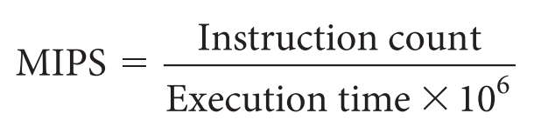
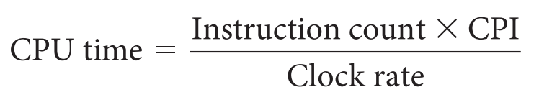
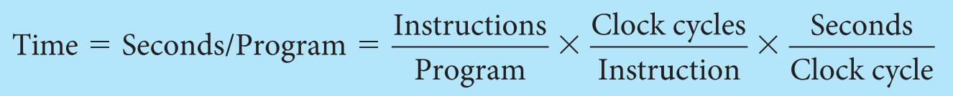
CO – CPU performance
MIPS (Million Instructions per second)

Slide 18
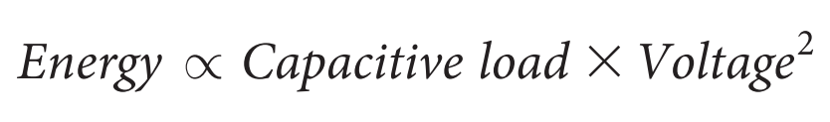
CO – power wall
Dynamic power consumption (CMOS)

Slide 19
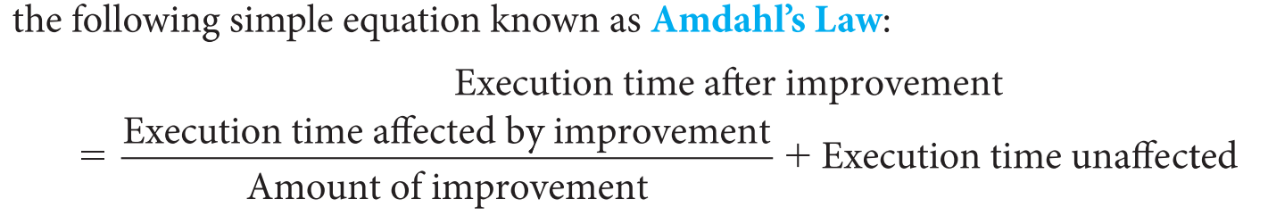
CO – pitfall (不是越多 CPU 就能有更好的效能)
Amdahl’s law

Slide 20
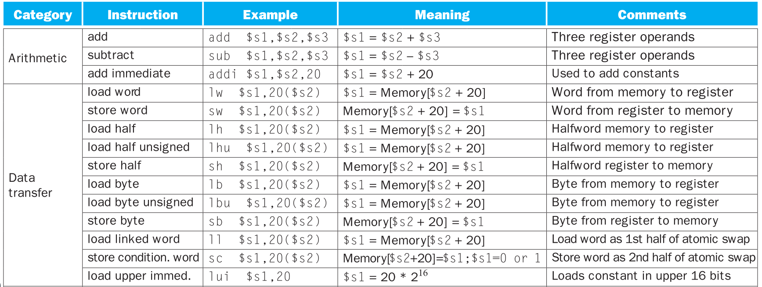
CO – instruction

Slide 21
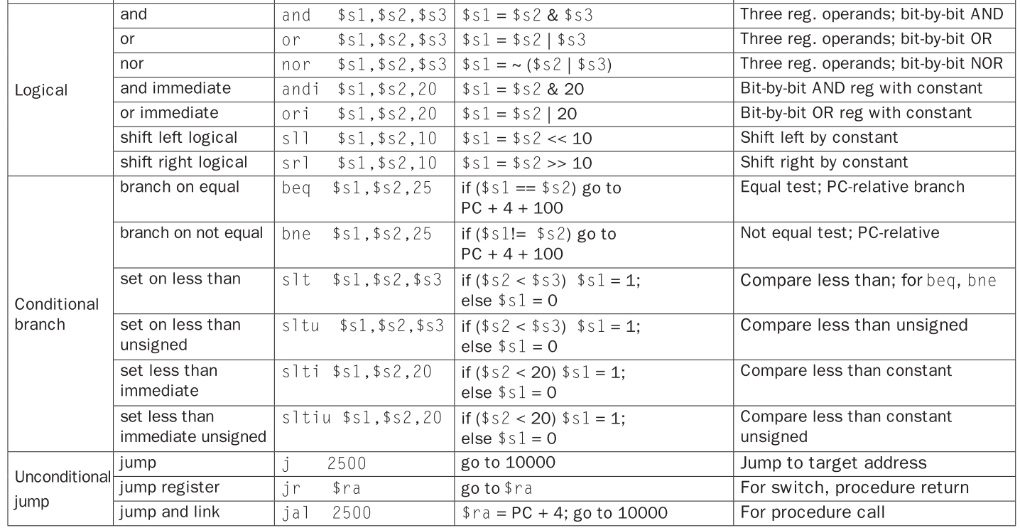

Slide 22
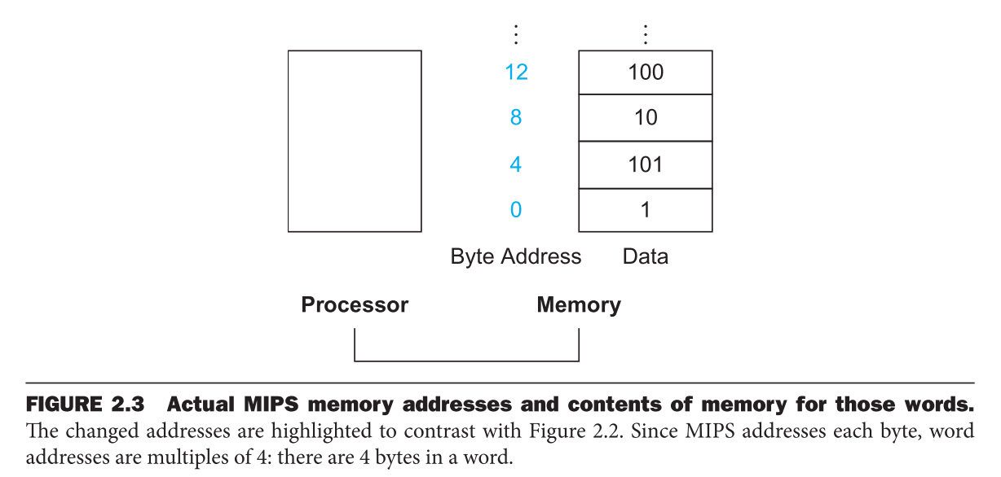
CO – instruction
WORD = 32 bits
Register
$s0, $s1 … for variables in C
$t0, $t1 … for temporary register
Data transfer instruction(move data between memory & register)
Load : copy data from memory to register
Store : copy data from register to memory
Alignment
1 WORD = 4 bytes
Big endian(MIPS) , Little endian

Slide 23


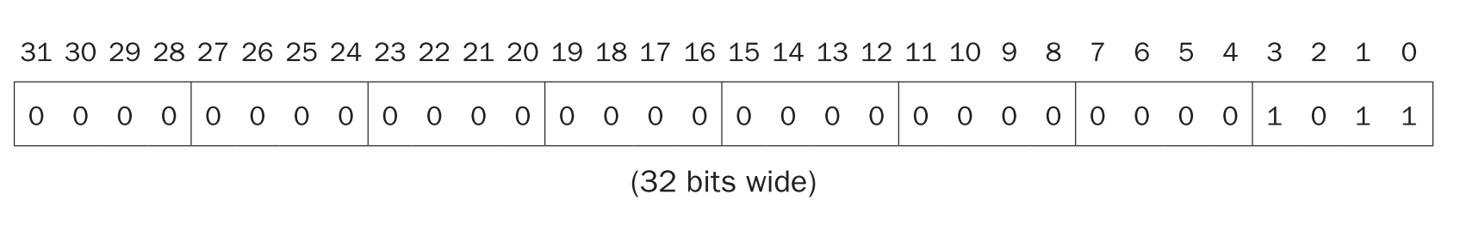
CO – instruction
Two’s complement
Sign + magnitude
Sign extension (ex. 16-bit to 32-bit)
Positive(0) ->直接前面補 0
Negative(1) -> 直接前面補 1
most significant bit (leftest)
Least significant bit (rightest)

Slide 24


CO – instruction
Two’s complement
Sign + magnitude
Sign extension (ex. 16-bit to 32-bit)
Positive(0) ->直接前面補 0
Negative(1) -> 直接前面補 1

Slide 25
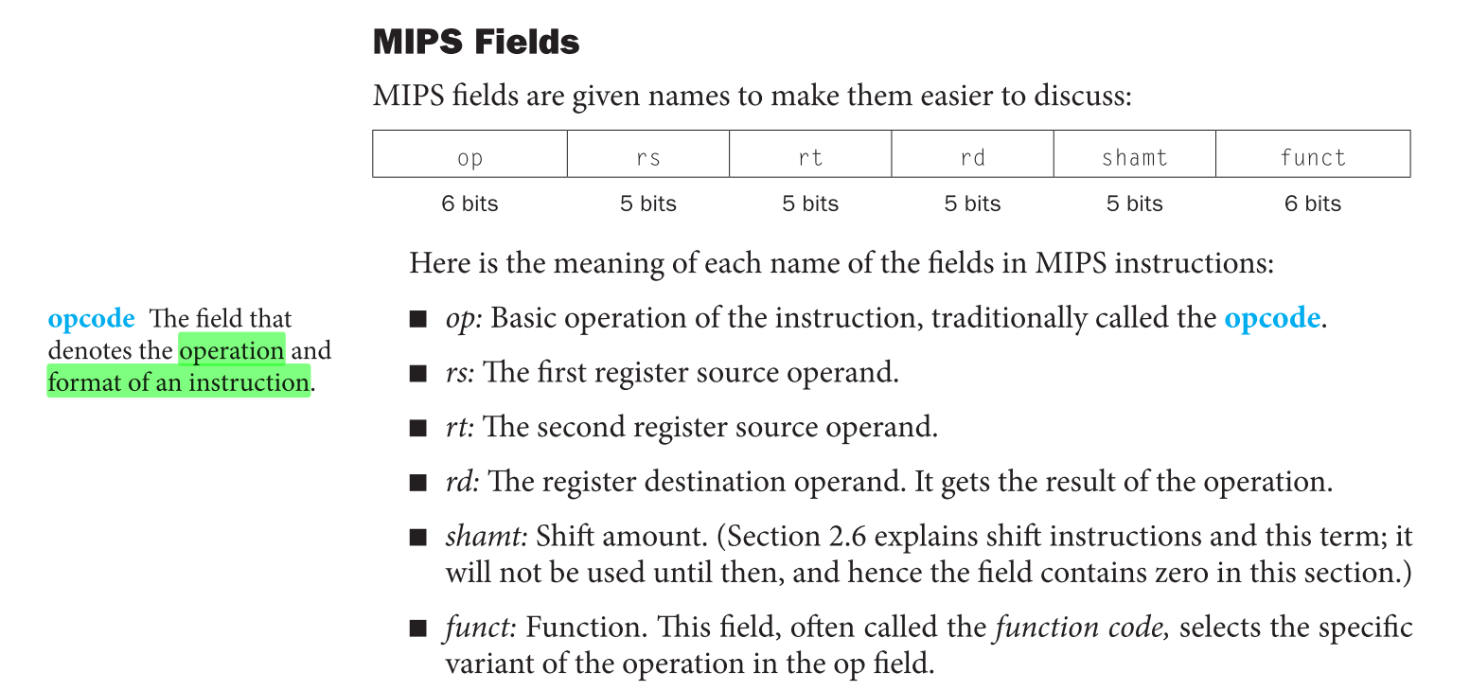
CO – to machine code
dd

Slide 26
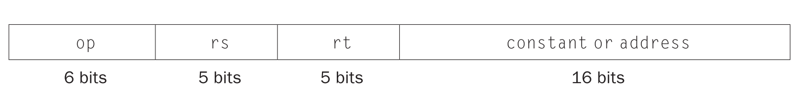
CO – to machine code
R-type (Register)
I-type (Immediate)

Slide 27
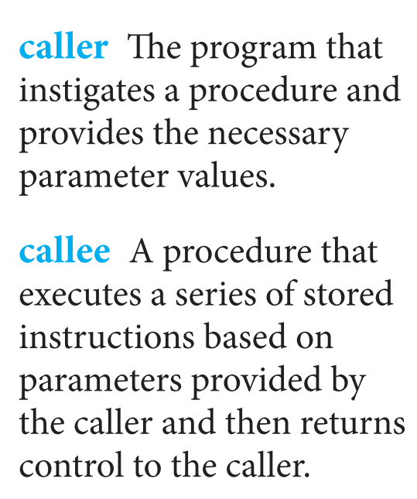
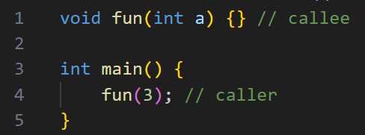
CO – support procedure
Function (or procedure)
Implement using stack (push parameter to stack before entering function)

Slide 28
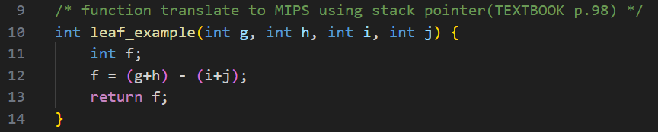
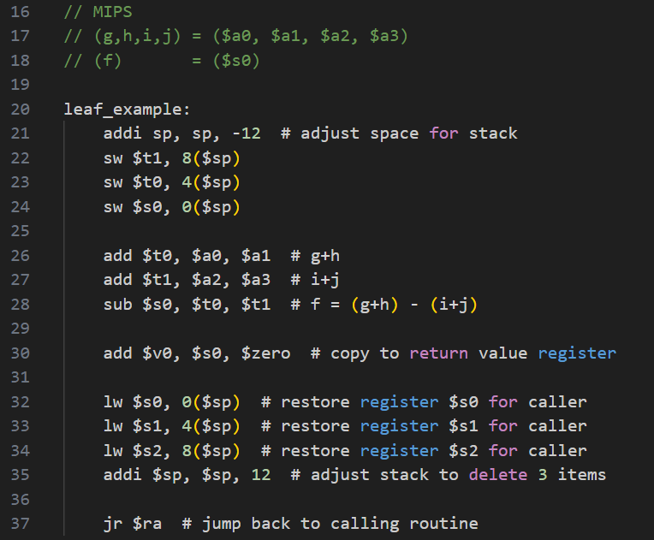
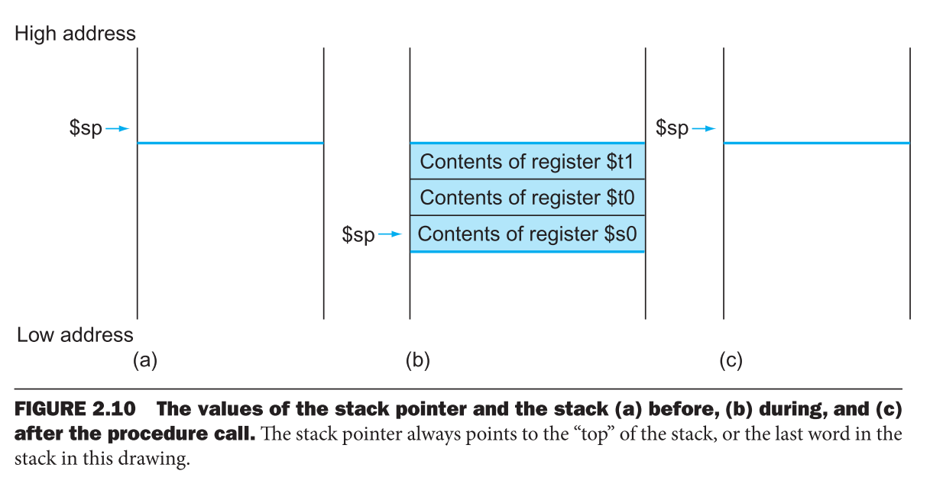

Slide 29
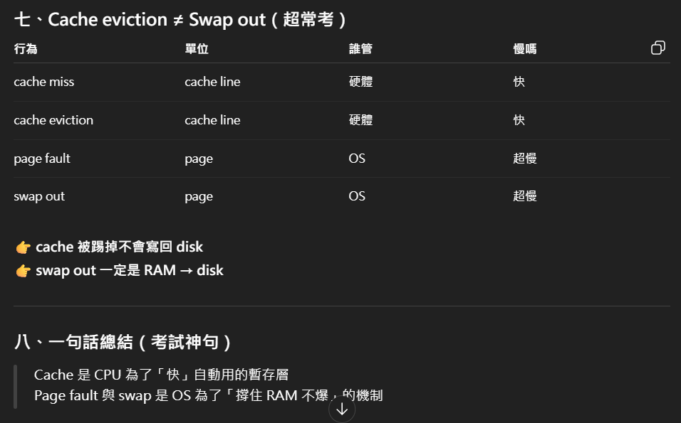
CO – cache v.s. memory

Slide 30
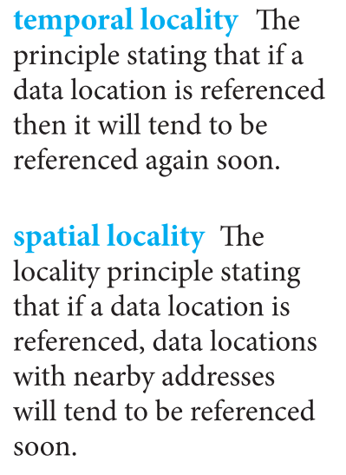
CO – memory
Locality
Temporal locality (locality in time)
Spatial locality (locality in space)

Slide 31
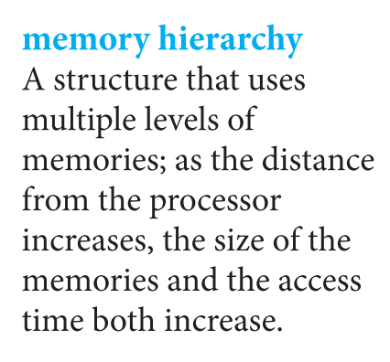
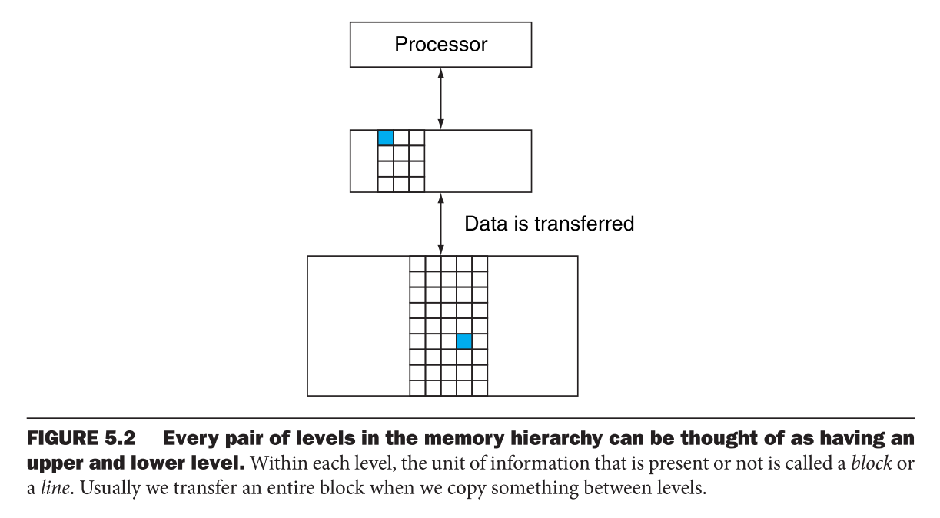
CO – memory hierarchy
fd

