Slide 1
Machine Learning & Artificial Intelligence Internship Project
Project Title : Employee Attrition Prediction
Intern Details :
Name : Puja Kumari Oram
Reg NO : 2505260015
Department : MCA 2nd year
Organization: RIMS Cybernetics, Rourkela
Academic year : 2026 – 2027
Guided by : Prof. Bibhudendu Panda

Slide 2
Introduction:
Employee attrition refers to employees leaving an organization.
High attrition affects productivity and increases costs.
This project uses Machine Learning to predict employee attrition and help improve employee retention.
Goal: Predict employees who are likely to leave the organization.

Slide 3
Problem Statement :
Employee departure negatively impacts workforce performance in an organization.
Dependance on manual assessment and feedback mechanisms.
Need of a prediction model which will predict the number of employees to resign from an organization, allowing organizations to implement retention strategies.

Slide 4
Objectives of the project :
Dataset Collection
Analyse Employee dataset
Identify factors influencing Attrition
Building a prediction model
Assistance in decision making

Slide 5
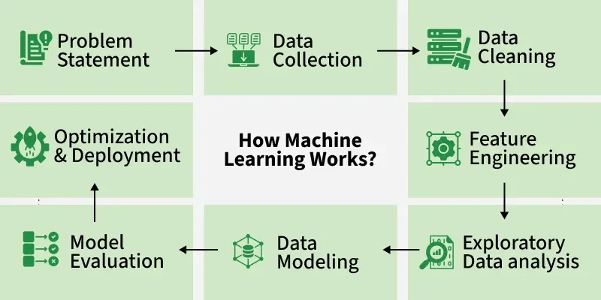
Steps in Machine Learning:

Slide 6
Dataset Description :
1. Dataset Source : Kaggle, Employee_Attrition csv file
2. Records & features :
- Total records : 1029 Employees
- Total features : 34 predictor variables
- Target Variable : Attrition(Yes/No)
- Dataset Type : Classification Dataset

Slide 7
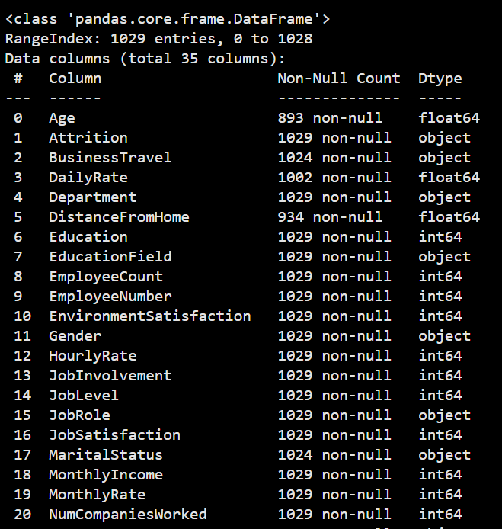
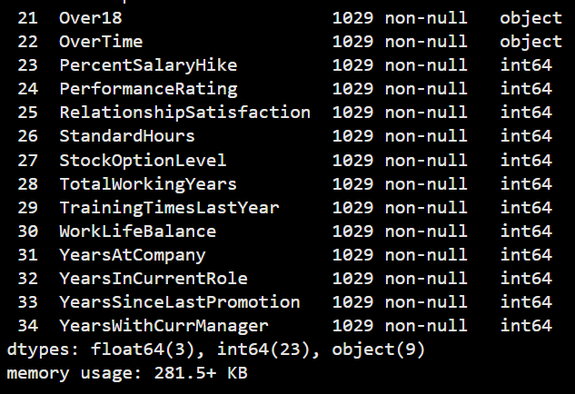
Features in dataset

Slide 8
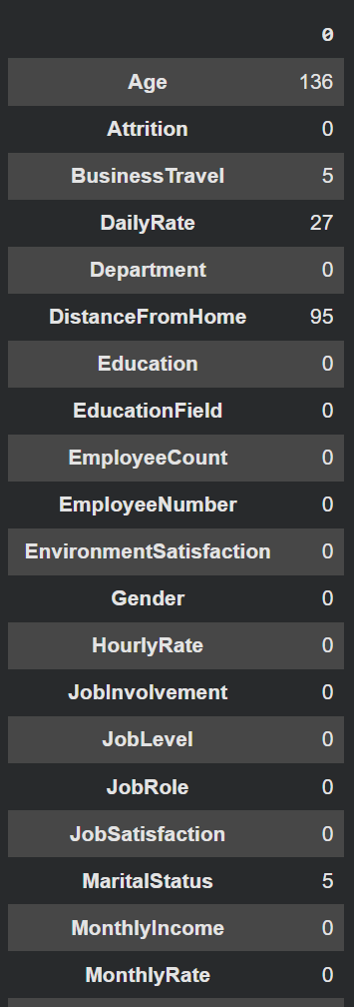
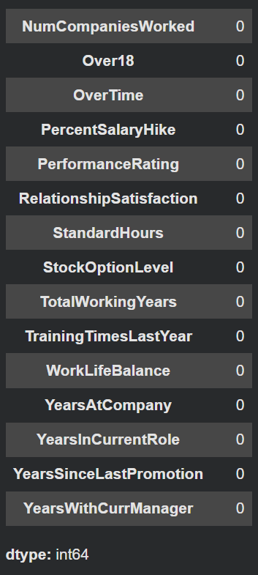

Data Preprocessing:
Searching of missing values -
Code
The following columns has missing values:
1. Age - 136
2. BusinessTravel - 5
3. DailyRate - 27
4. DistanceFromHome - 95
5. MaritalStatus - 5

Slide 9
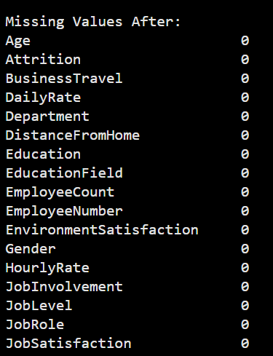
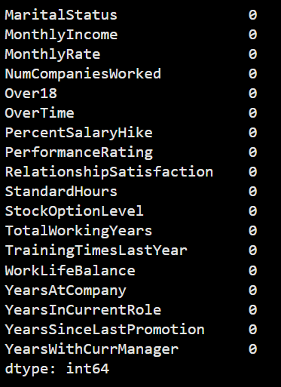
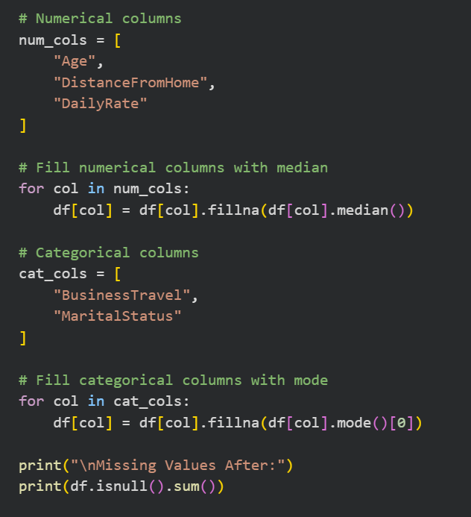
Treatment of missing values -
Code
Outputs

Slide 10
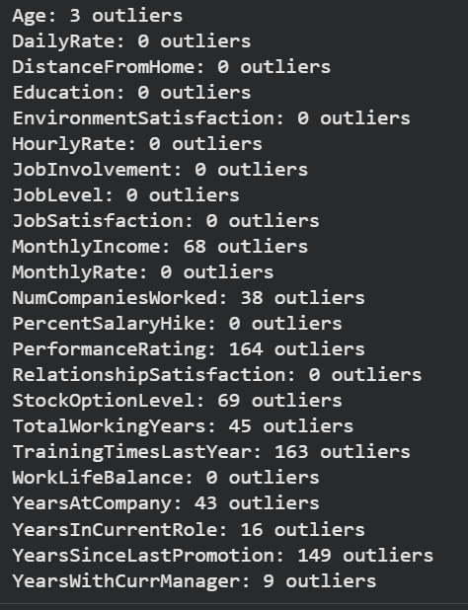
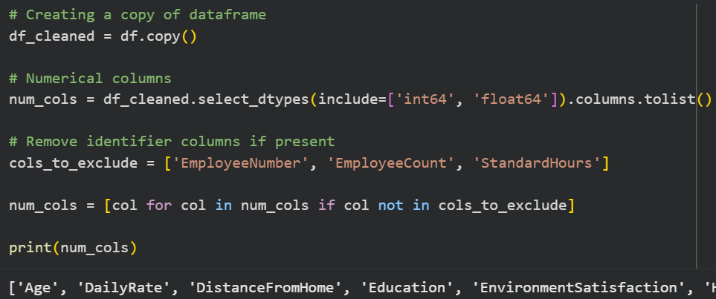
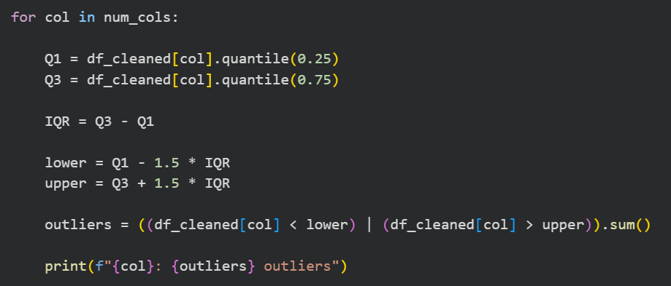
Outliers Treatment -
Output

Slide 11
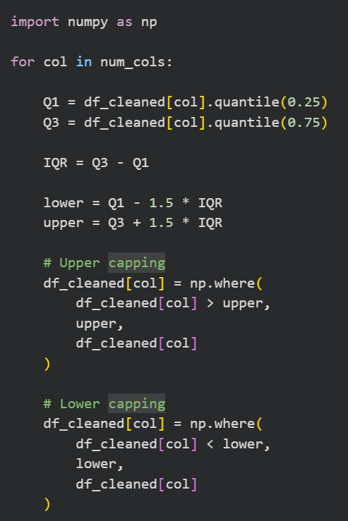
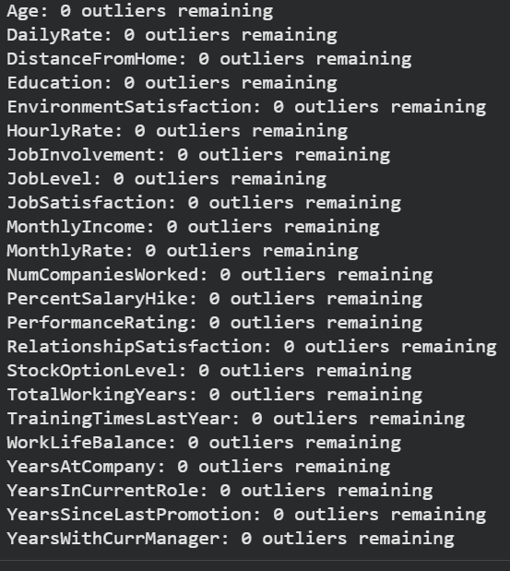
IQR Capping
Output

Slide 12
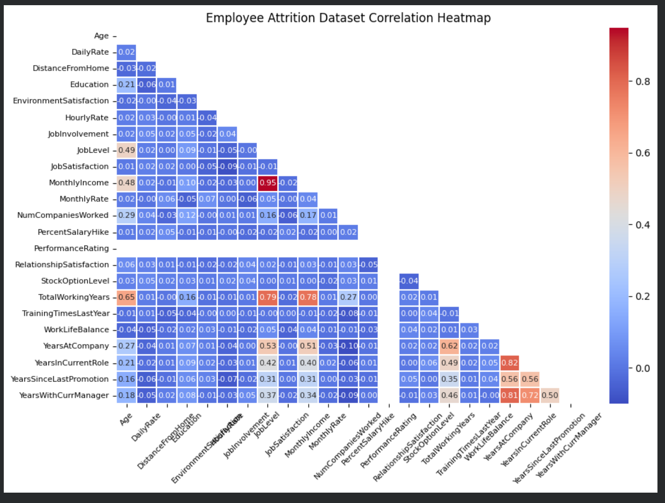

Slide 13
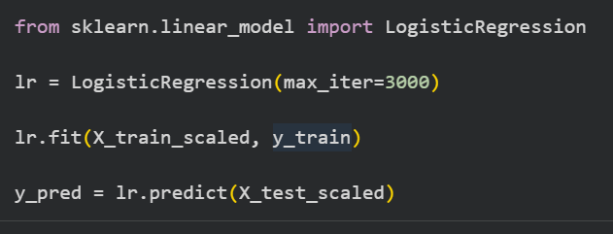
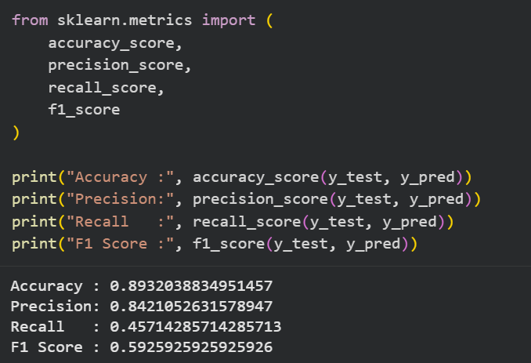
Machine Learning Model Used & Evaluation Metrics

Slide 14
Conclusion:
This project aims to develop a machine-learning based predictive model.
Initial stages of this project have been completed.
Upon completion, the system will be integrated into a web application for easy use.

Slide 15
Future Work:
Complete model training and performance evaluation.
Optimize the prediction model for better accuracy and F1-score.
Develop and test the Flask web application.
Deployment of the application on render.

