Slide 1


In-House Report on Machine Learning for analyzing the Impact of “Work from home" during lockdown Submitted to Amity University Uttar Pradesh
In partial fulfillment of the requirements for the award of the degree of Bachelor of Technology in Computer Science and Engineering by ABHISHEK SINHA A12405218054 Under the guidance of Dr. Shweta Shrivastava AMITY DEPARTMENT OF COMPUTER SCIENCE AND ENGINEERING AMITY SCHOOL OF ENGINEERING AND TECHNOLOGY AMITY UNIVERSITY UTTAR PRADESH MAY 2020

Slide 2
Contents
1. ABSTRACT 2. INTRODUCTION 3. PROJECT OBJECTIVES 4. TECHOLOGY AND SOFTWARE USED 5. DATA COLLECTION 6. PYTHON LIBRARY USED IN PROJECT 7. WORKING 8. CONCLUSION

Slide 3
ABSTRACT
In this research paper, we will study and analyse the impact of “Work from home" during lockdown with the data set collected, Sentiment analysis and other News reports. We will be using the analysed and studied data to make an applicable decision that can be used to track the current scenario of Work from home impact on day to day life of people.
The importance of this project is depicted as the need for study of the data collected from social media platforms like Facebook, WhatsApp, Google forms, News websites. We will also study and understand how this lockdown is affecting our day to day lives and is or not helpful to bring the far one of the family back in contact. We will also study how this work from home thing had its impact on students and earning sectors.

Slide 4
INTRODUCTION
As we all know how this pandemic (COVID-19) has caused disaster and is continuously spreading. For safety we have to stay home and work from home to stop the spread of covid-19. Not only Education sector, also several IT solutions and business also got affected due to Lockdown.
This project is basically based on data collection and analytics to determine some information about the affected one due to this lockdown, and making predictions using machine learning.

Slide 5

PROJECT OBJECTIVES
FOLLOWING ARE THE OBJECTIVES TO MAKE THIS PROJECT:
1. STUDY THE IMPACT OF COVID LOCKDOWN ON STUDENTS AND OTHER SECTORS.
2 MAKE PREDICTIONS WHETHER OR NOT A STUDENT WILL ACHIEVE HIS/HER GOAL
WHICH HE SET BEFORE LOCKDOWN
3. ANALYSE WHETHER THE LOCKDOWN WAS GOOD OR BAD FOR STUDENTSAND
OTHER SECTORS.

Slide 6


TECHOLOGY AND SOFTWARE USED
Learning:
1. Python language 2. Naive Bayes Classifier in Python 3. Data collection Tool Used: 1. PyCharm
2. Python 3.8
3. Google forms

Slide 7
DATA COLLECTION
For Data collection I used Google forms .
Added some questions related to this lockdown
And circulated among students as a Survey
Collected a total of 52 responses and exported into an excel sheet.

Slide 8
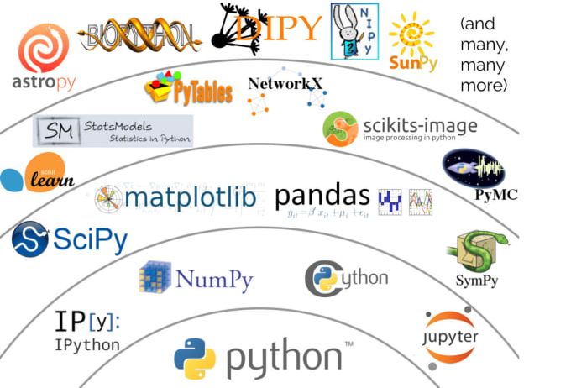
PYTHON LIBRARY USED IN PROJECT
1. NUMPY
2. PANDAS

Slide 9
WORKING
Firstly data is collected from Google Forms.
Exporting the Responses in Excel Sheet for CUI Work.
Analyzing the answers.
Using Naive Bayes in python to predict some self generated questions from the data
Collected.

Slide 10
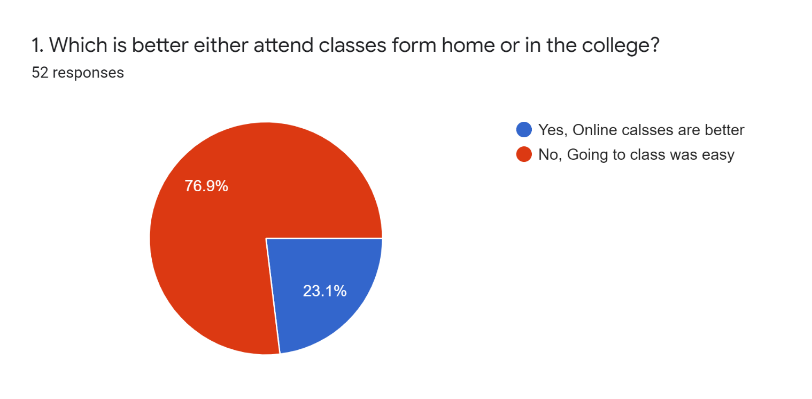
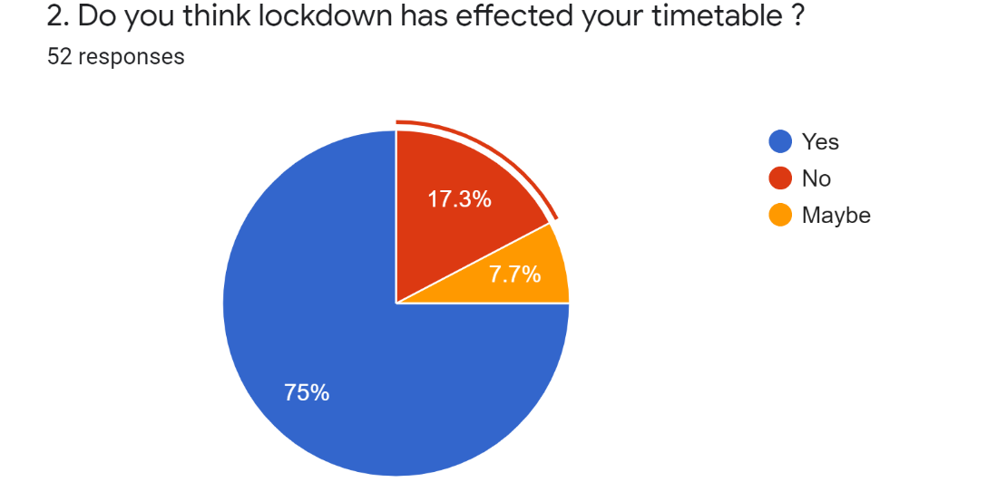
Survey Sentiment Analysis
To reveal the challenges faced while working from home during this lockdown we created a survey. This survey covered all the normal questions that were faced by students in the starting of the lockdown. A total of fifty two responses were collected in the google feedback form .

Slide 11
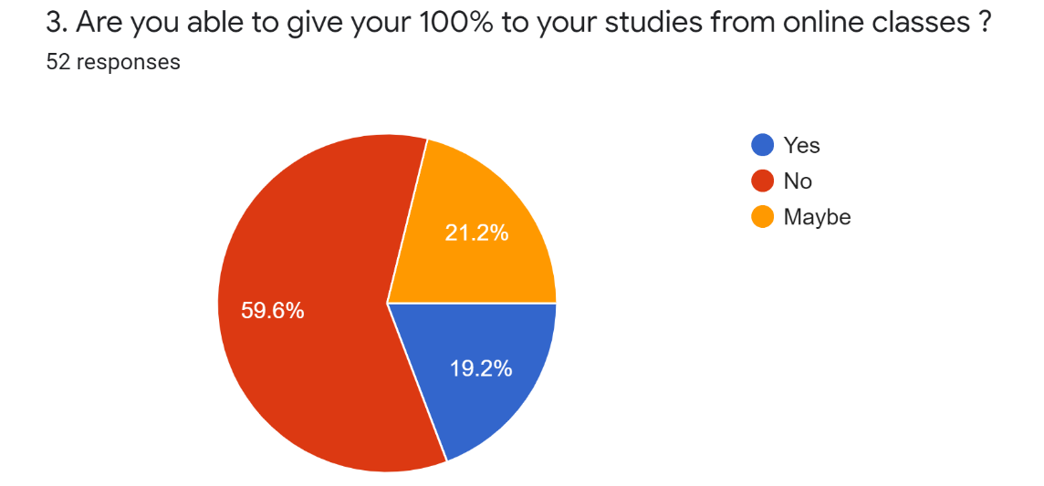
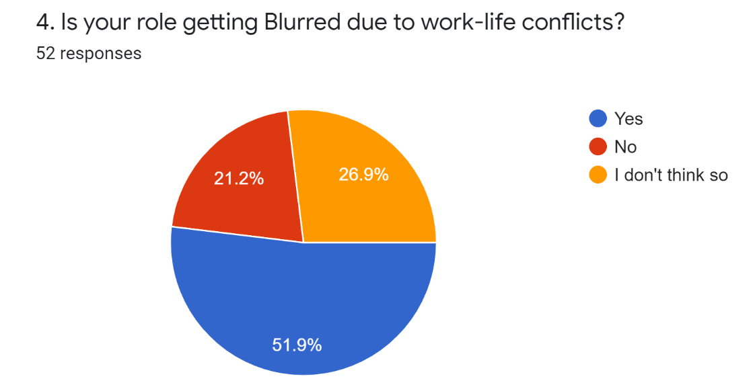
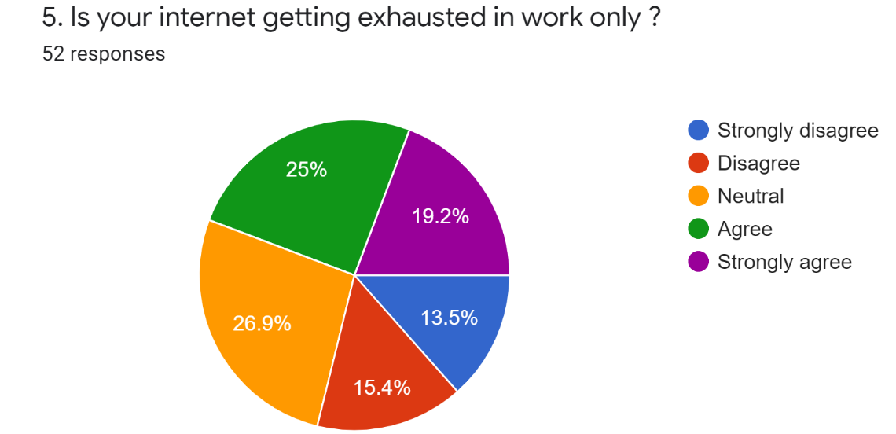
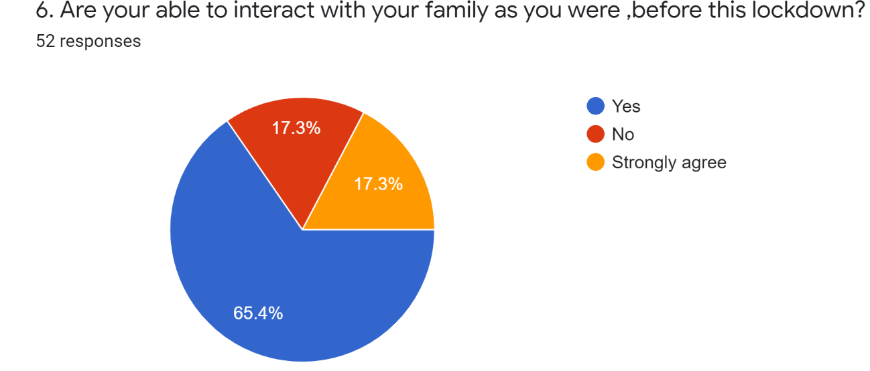

Slide 12
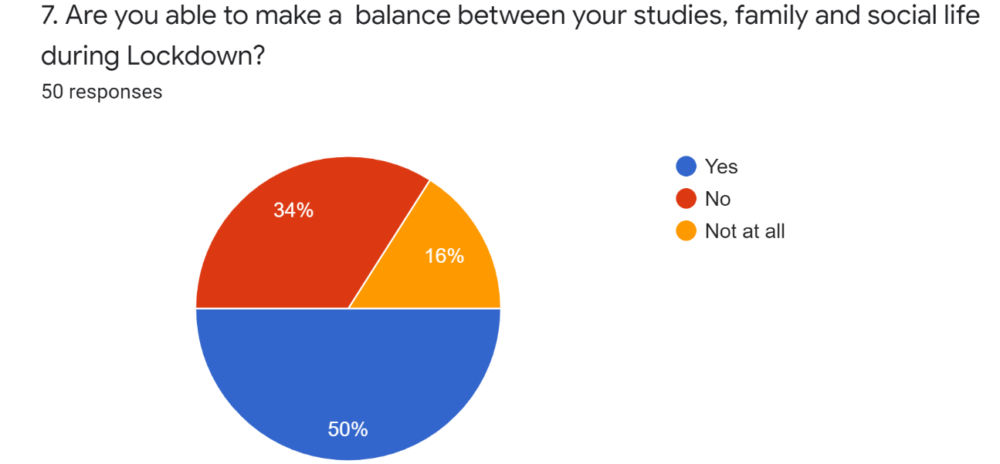
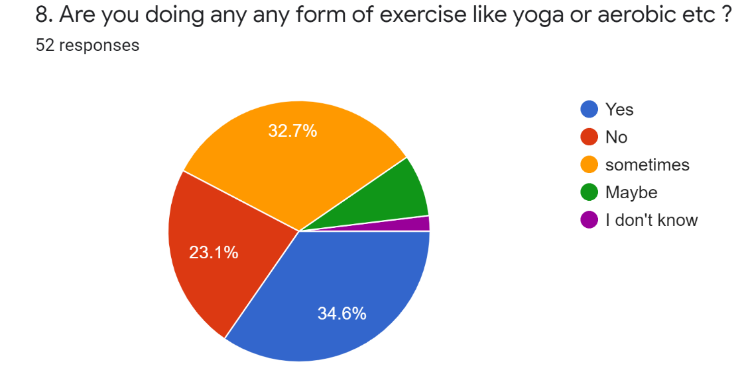
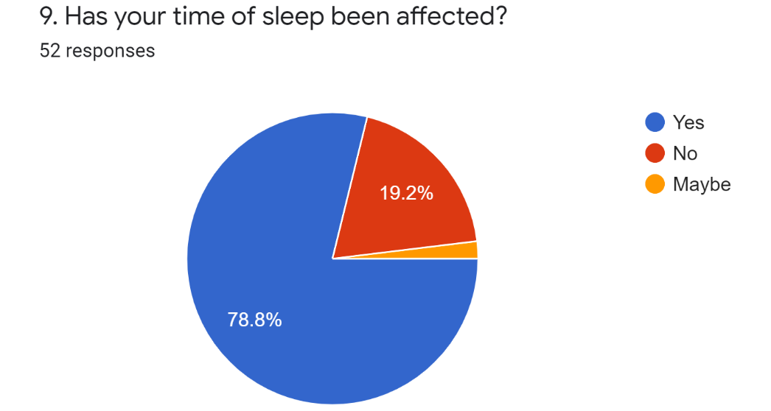
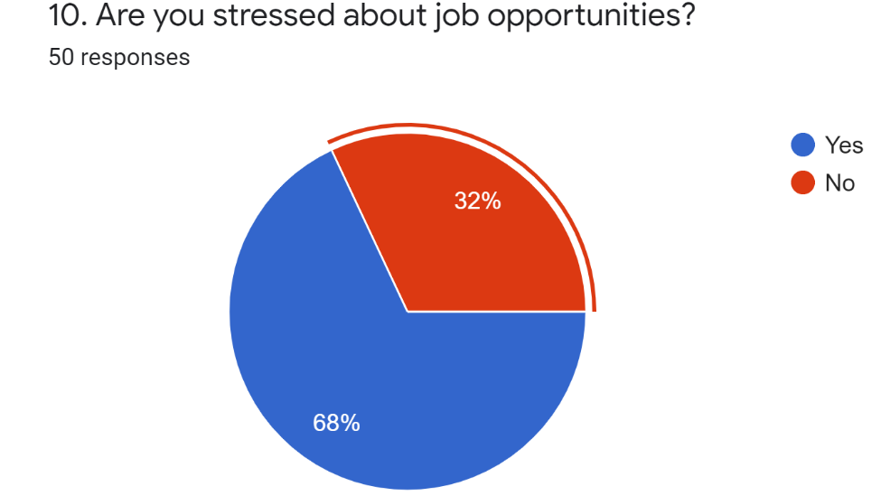

Slide 13
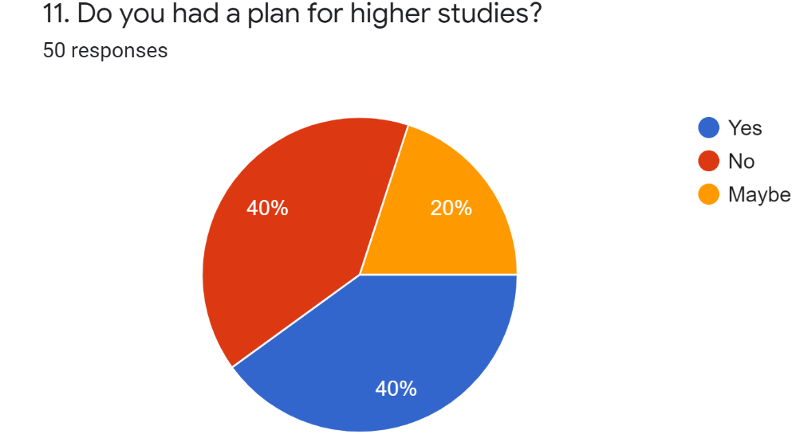
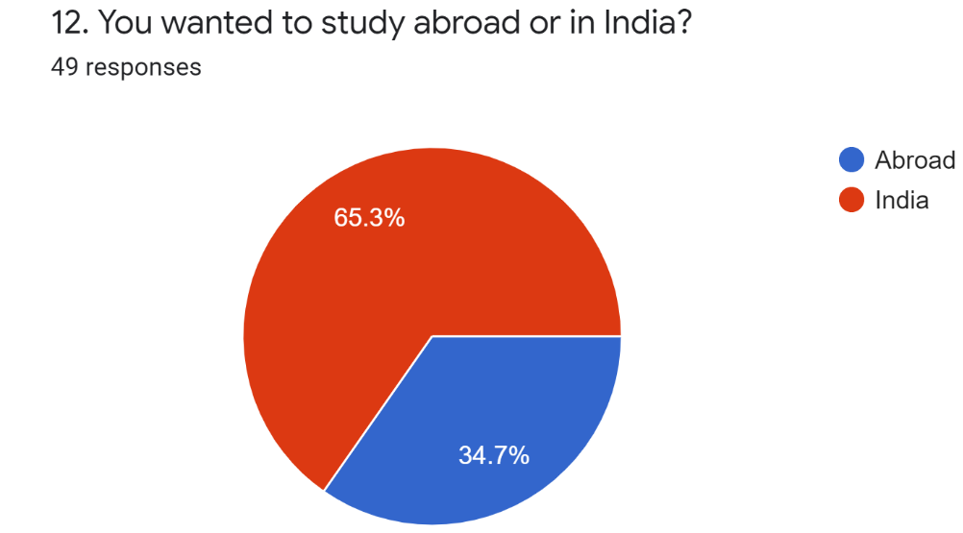
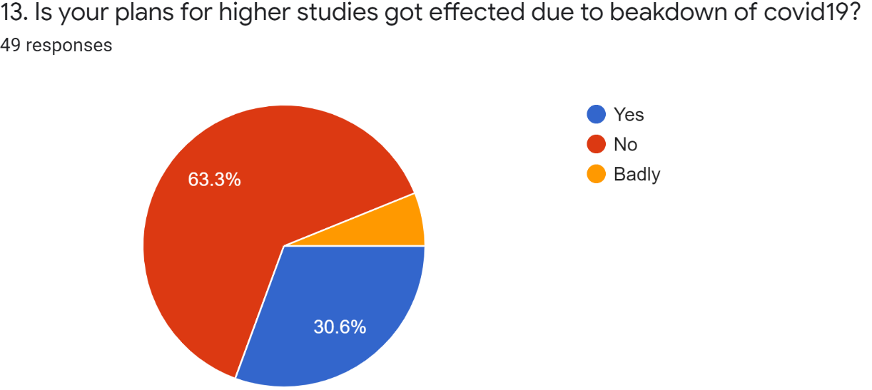
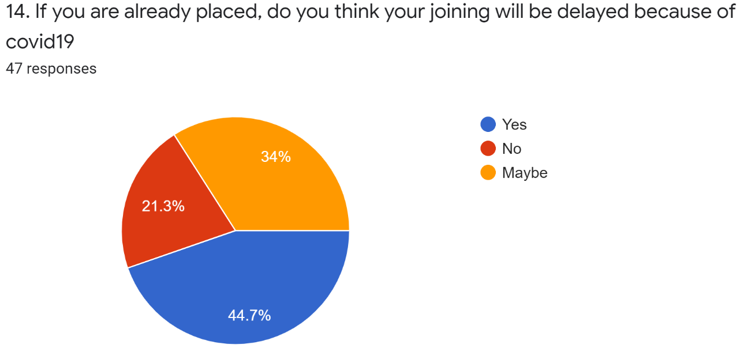

Slide 14
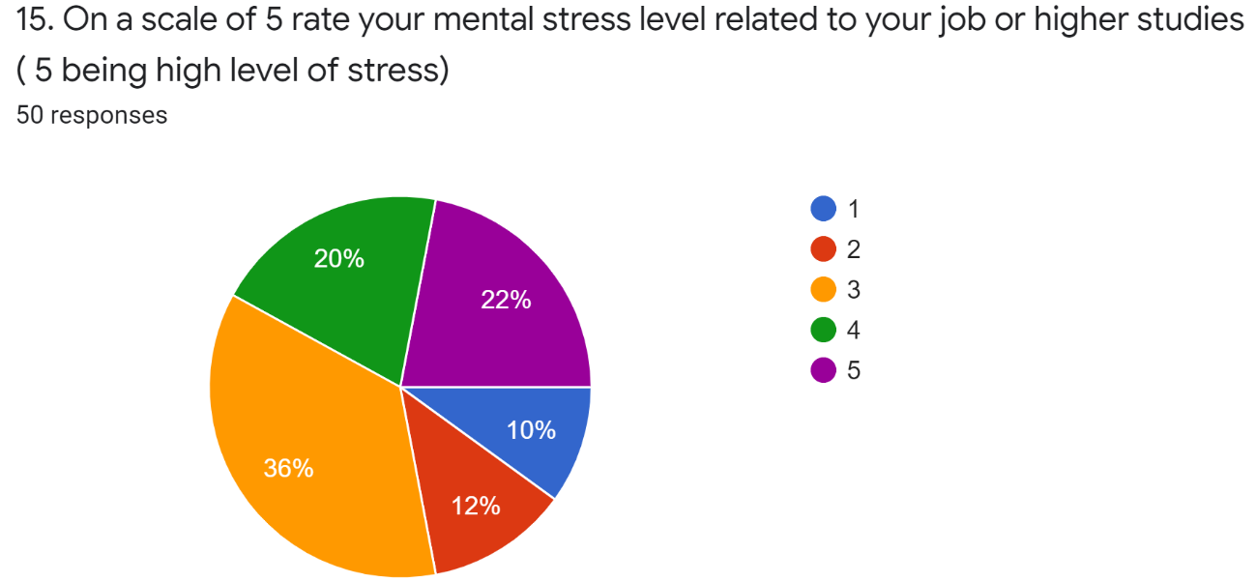
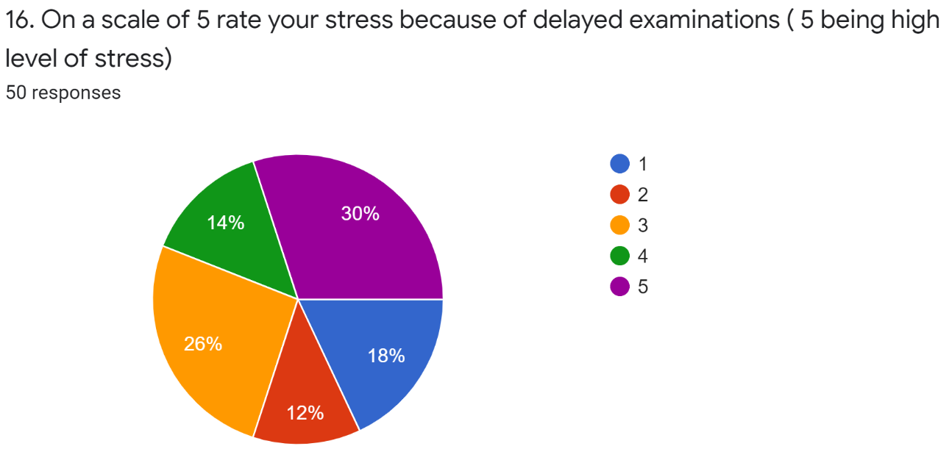
All these questions were exported and analysed in the report.

Slide 15
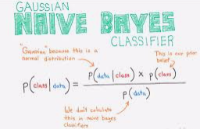
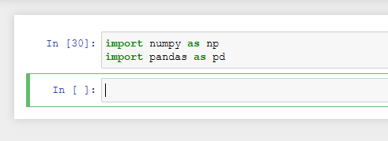
Using Naive Bayes to predict some conditions in Python
Imported NumPy and Pandas in Jupiter.

Slide 16
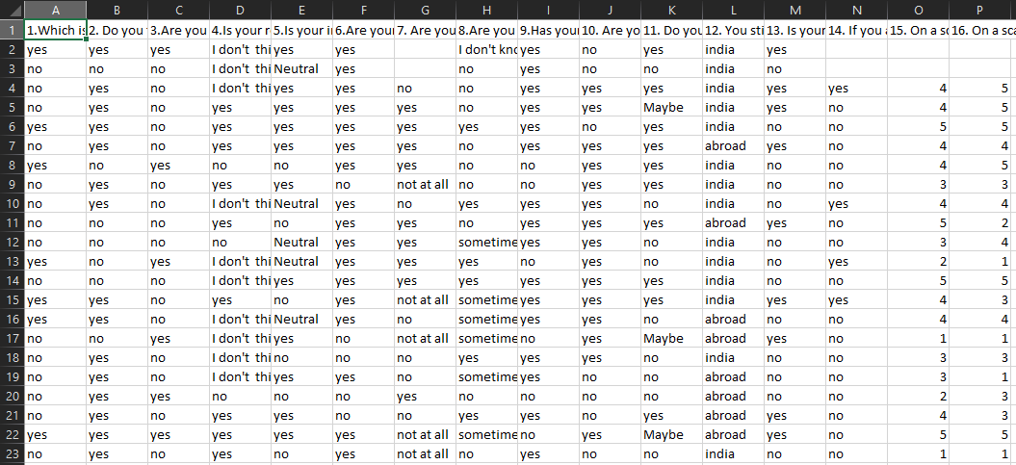
Downloaded the responses in excel

Slide 17
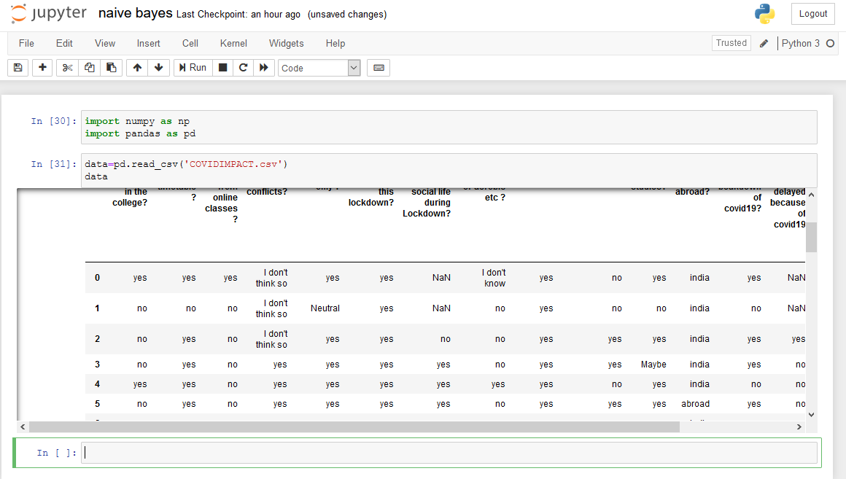
Then imported the data set using:
data=pd.read_csv('COVIDIMPACT.csv')

Slide 18
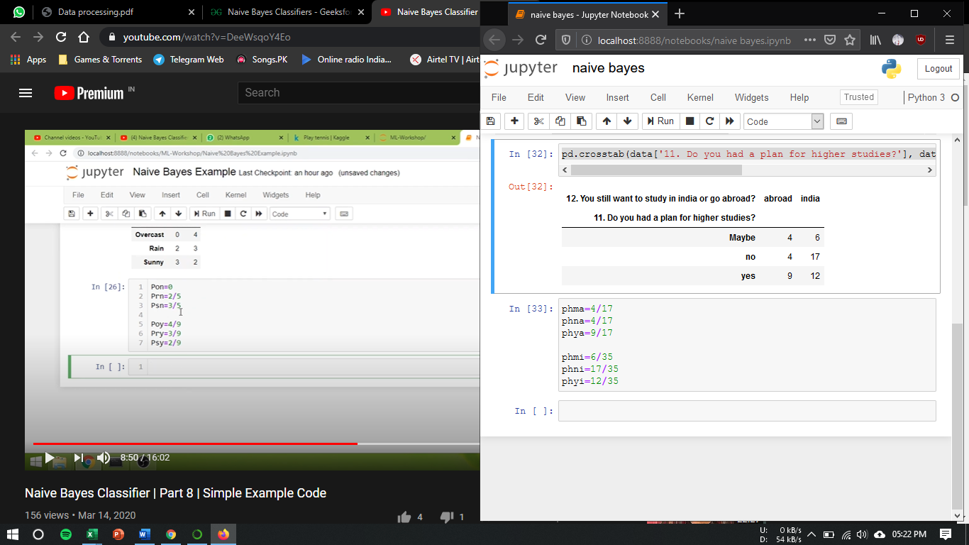
Extracted outlook for questions
: pd.crosstab(data[‘question 1'], data[‘question2’])

Slide 19
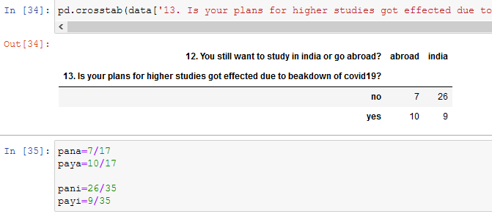
Extracted outlook for questions
: pd.crosstab(data[‘question 2'], data[‘question3’])

Slide 20

Calculated the probability for each condition using shown method:

Slide 21
CONCLUSION
According to survey most of the students were easy to go to college for study as online classes affected their daily life. Most of the students stressed about job even if they were giving there hundred percent to studies. Not even in only Education sector but also in many IT sectors also people with high skills but from rural area with less or no internet connectivity are facing problem while working from home. Also excluding IT sector, small business which do not involve IT face a lot of problem as they are not able to work from home as no hardware can be established in home, for example retail store co-workers, cement factories workers, labours.
With the help of Naive Bayes Classifier I was able to successfully predict some conditions related to the survey.

Slide 22
THANK YOU

