Slide 1

Data Analysis
Presentation
ApexPlanet Software Pvt. Ltd.
PRESENTED BY: PUJA RANI PADHY
Capstone Portfolio Presentation

Slide 2


Internship Overview
Completed multiple data analysis tasks including data cleaning, EDA, dashboard creation, and hypothesis testing.

Slide 3

Tools & Technologies
Python
Pandas
Matplotlib
Seaborn
SQL
Power BI
GitHub

Slide 4
Task 1: Data Wrangling
Performed data cleaning and preprocessing.
Handled missing values.
Prepared dataset for analysis using Python and Pandas.

Slide 5
Task 2: Exploratory Data Analysis
Analyzed dataset patterns.
Created visualizations such as histograms, scatter plots, and heatmaps.
Identified key trends and insights.

Slide 6
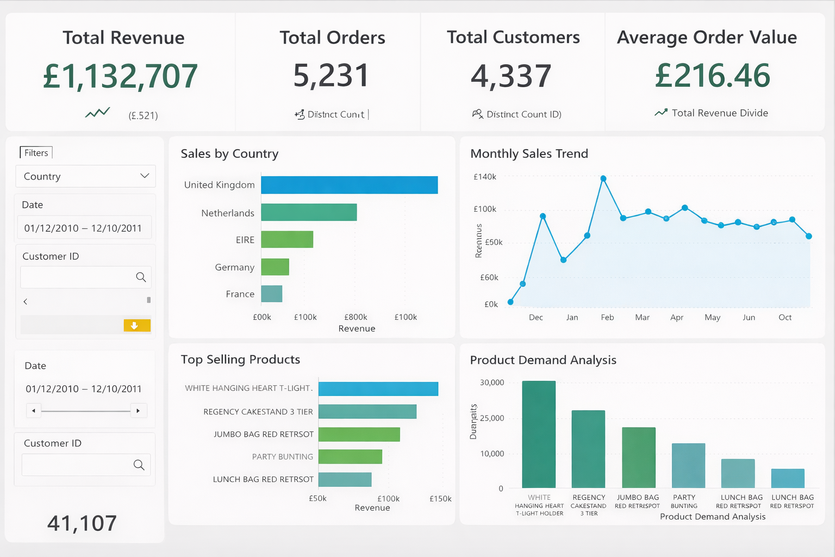
Task 3: Business Intelligence Dashboard
Built an interactive Power BI dashboard.
Displayed key metrics and business insights.
Enabled data-driven decision making.

Slide 7

Performed statistical testing using Python.
Validated assumptions using statistical methods.
Interpreted results to support business insights.
Task4: Hypothesis Testing

Slide 8
Thynk Unlimited
Key Insights
Identified important trends in the dataset.
Visualized patterns to support decision-making.
Used dashboards to communicate insights effectively.

Slide 9

Thynk Unlimited
I created a personal portfolio website using GitHub Pages to showcase my Data Analyst Internship projects.
Website:
https://pujaranipadhy.github.io/PujaPadhy-DataAnalyst-Internship-Portfolio/
Portfolio Website

Slide 10

Skills Gained
Data Analysis
Data Visualization
Statistical Analysis
Business Intelligence
Problem Solving

Slide 11
Conclusion
This internship helped strengthen my data analysis skills and practical experience using real-world datasets.
Thank you
-

