Slide 1
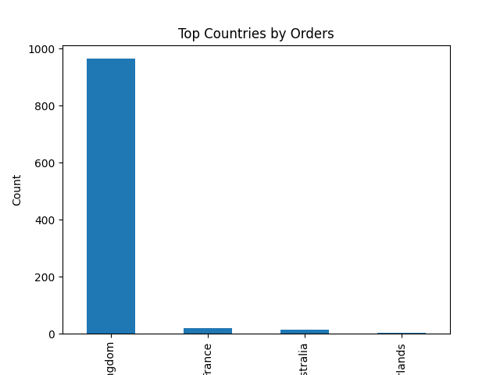
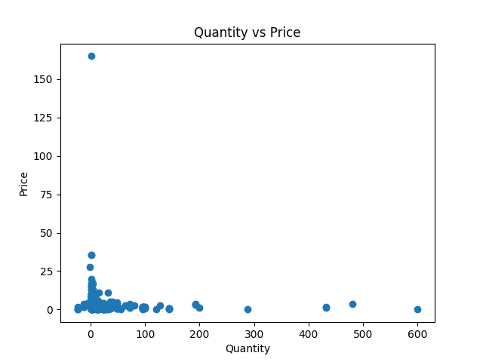
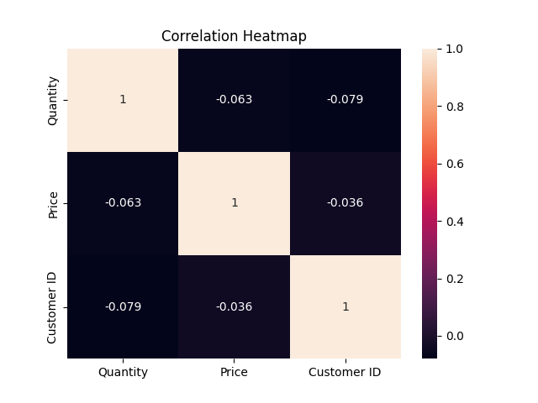
Retail Sales Business Intelligence Dashboard
Total Sales
24506.25
Total Quantity Sold
12785
Total Customers
48
Average Product Price
3.0371100000000006
Sales by Country (Bar Chart)
Quantity vs Price (Scatter Plot)
Insert Correlation Heatmap Image Here

