Slide 1
BY SO MANY SIGNIFICANT OTHERS
AND ME.
B
I
O
I
N
F
O
R
M
AN
T
INTRODUCTION
C
S

Slide 2
Presentation Overview
02
Biological data
in vivo, in vitro, and in silico processes
What can bioinformatics do for you?
Integration of various subjects in this realm
Data stored in various databases and its types
Some examples of databases
KEY TOPICS

Slide 3
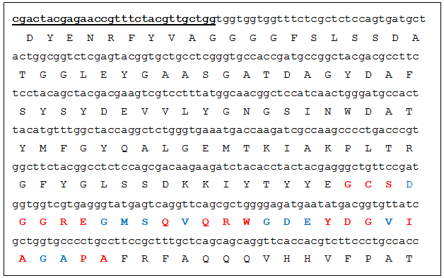
Biological data
03
WHAT IS BIOLOGICAL DATA?
HOW DO WE OBTAIN BIOLOGICAL DATA?

Slide 4
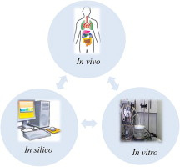
in vivo: inside the organism.
in vitro: in a false environment, mimicking the original.
in silico: inside a computer
04

Slide 5
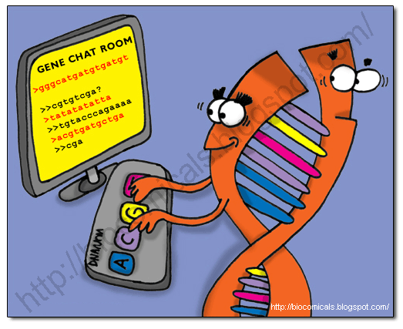
What can bioinformatics do for you?
05
  Sequence analysis
  Sequence comparison
  Structural analysis
  Finding the family and domain of a protein
  Showing 3D structures of a protein
  Nucleotide and protein sequencing

Slide 6

When the witch stirs the cauldron!
MATHEMATICS
PHYSICS
BIOLOGY
BIOINFORMATICS
CHEMISTRY
COMPUTER SCIENCE
STATISTICS

Slide 7
TYPES OF BIOLOGICAL DATABASES
  Different kinds of data are stored in a database, eg nucleotide sequences, protein sequences, organisms they are retrieved from, etc.
  Data can visualized, annotated, and worked upon from a database.
  Databases are updated regularly by the founder organization.
07
  Primary Databases
  Composite Databases
  Literature Databases
  Structural Databases
  Secondary/Derived Databases
  Protein Sequence Databases
  Genome Databases
Data into databases

Slide 8
  Primary Databases - Nucleotide sequence databases, eg: GenBank, DDBJ, EMBL
  Composite Databases - Composite databases have been created to simplify the sequence search for a query in a single compilation in the context of the many different primary database searches, by merging a variety of different primary resources. These databases are non-redundant and render sequence searching, eg: OWL
  Literature Databases - Various publications can be found here, eg: PLoS, Biomed Central, PubMed
  Structural Databases - Protein structure databases, eg: PDB
  Secondary/Derived Databases - Contains information from the primary databases along with some specific data, eg: SWISS-PROT, PIR
  Protein Sequence Databases - Contains protein sequences, eg: Uni-Prot
  Genome Databases - Contains genomic sequences of various organisms, eg: ICTV, MBGD
08
More on databases.

