Slide 1
Transformation from INDEPENDENT SET→CLIQUE by Puja Sridhar(ps1393)

Slide 2
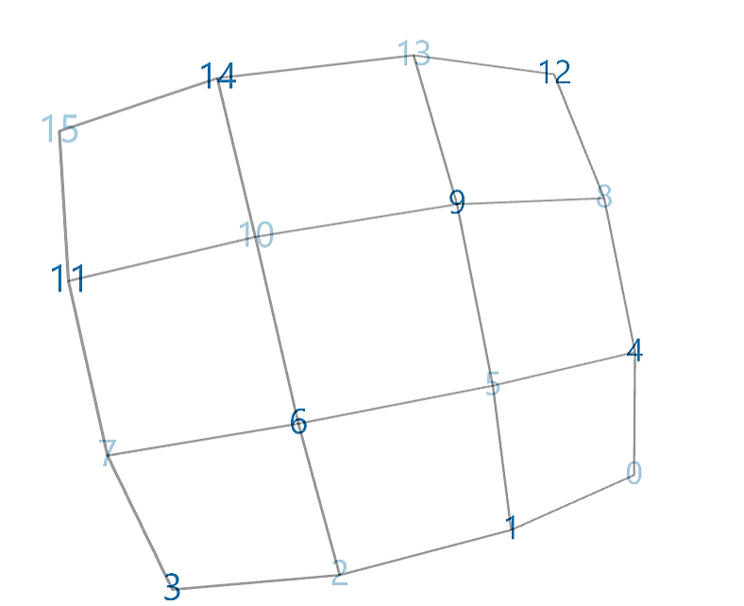
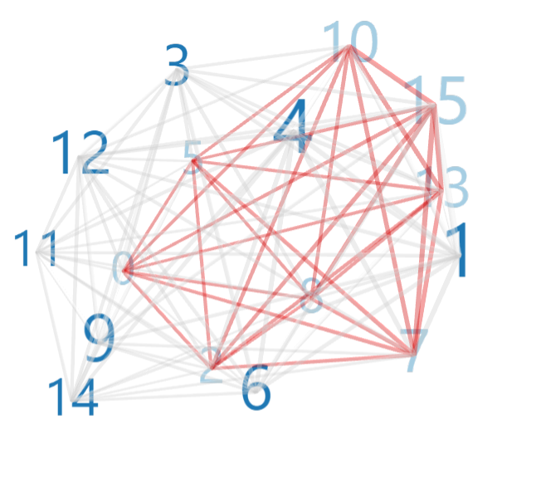
INPUT GRAPH
TRANSFORMED INPUT GRAPH

Slide 3
About the complexity of the code used For Finding Independent sets(n vertices and size k): Time complexity: O(V^k * k^2), where V is the number of vertices and k is the size given. For finding Cliques(n vertices, size k): Time complexity: O(V^k * k^2), where V is the number of vertices and k is the size given. For whole code: Time complexity: O(V^k * k^2), where V is the number of vertices and k is the size given.
About Input Graph
About Transformed Input Graph
This is an input graph generated by given input.
The light blue nodes indicates independent set nodes and dark blue nodes are nodes that are not there in independent set list.
This is an output graph generated by finding the complement graph of the input graph.
The light blue colored nodes represents the clique nodes and red edges represents the edges between these clique nodes which are not present in input graph.

