Slide 1
Department of Artificial Intelligence and Machine Learning
AGENT OPTIMIZATION USING GENETIC ALGORITHM
Submitted By
Student Name: Mrinal Durani USN: 1BY19AI034
Student Name: Puja S. USN: 1BY19AI040
Student Name: Rtwick George Moses USN: 1BY19AI043
Student Name: Siddharth Arora USN: 1BY19AI054
Under the guidance of:
Dr. Anupama H S
Assistant Professor of AI&ML
BMSIT&M
2020-21
EVEN Semester

Slide 2
Department of Artificial Intelligence and Machine Learning
Contents
Introduction
Objective
Literature Survey
Existing Systems
Limitations of Existing Systems
Proposed Methodology
System Architecture
Subject Mapping
References

Slide 3

Department of Artificial Intelligence and Machine Learning
Introduction
A Neural Network is a series of algorithms that endeavors to recognize underlying relationships in a set of data through a process that mimics the way the human brain operates.
Genetic Algorithms are probabilistic search methods; i.e. the states which they explore are not determined solely by the properties of the problems rather a random process helps to guide the search.

Slide 4
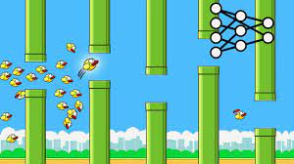

Department of Artificial Intelligence and Machine Learning
Objective
The objective of this project is to create a dynamic system to improve agents in a given environment to perform a certain set of tasks using the genetic algorithm approach to optimize the neural networks to find suitable architecture and optimal agents
This Program is constructed where we train a Neural Network for it to play Flappy Bird the Game

Slide 5
Department of Artificial Intelligence and Machine Learning
Literature Survey
Deep reinforcement learning using genetic algorithm for parameter optimization -IEEE (Feb 2019)
Scalability and optimisation of a committee of agents using genetic algorithm - EEE Dept Imperial College London
Genetic algorithm optimisation of an agent-based model for simulating a retail market - AJ Heppenstall (University of Leeds) (Dec 2007)
UAV cooperative multiple task assignments using genetic algorithms
- IEEE (June 2005)
5. Playing games with genetic algorithms
- Robert Marks (Jan 2002)
6. Generating war game strategies using a genetic algorithm
- Robert Mccartney (Feb 2002)

Slide 6
Department of Artificial Intelligence and Machine Learning
Existing Systems
In 1987 the first published research appeared which used the Genetic Algorithm[5].
Current systems use neural networks or other means to create agents for certain agents[2]
NP problems also use genetic algorithm to estimate answers[4]
dynamic environments which have the issue of uncertainty like war games also exploit it and can be successfully navigated by simulating using the genetic approach[6]

Slide 7
Department of Artificial Intelligence and Machine Learning
Limitation of Existing Systems
The major issue for past systems is deciding the architecture of the neural network and whether to have multiple or a singular unified architecture.
Metric | Dynamic approach | Static Approach
Accuracy | Higher accuracy | lower accuracy
Computational difficulty | Lager computational Load | Lesser computational Load
Size of data stored | Lager amount of data | Lesser amount of data
Dynamic Environment | Are more adapt to these environments | Are Less adapt to these environments
Rate of improvement | Lesser likelihood to plateau | higher likelihood to plateau

Slide 8
Department of Artificial Intelligence and Machine Learning
Proposed Methodology
The proposed methodology works by trying to continuously evaluate the agents and classes and allocate resources based on improvement of performance.
Hench we hope to have the benefits of a static which is low computational load and processing .
And the flexibility offered by a dynamic system along with its accuracy , adaptability and flexibility to changing environment stimula .

Slide 9
Department of Artificial Intelligence and Machine Learning
Proposed Methodology
Initialization Phase : here the system randomly creates agents for specific architectures.
Training Phase : this phase takes the agents and architectures and agents and trains each individual architecture a set number of times .
Evaluation Phase : here each architecture is sorted based on the rate of improvement after the training phase and is then given the next number of times is is allowed to train for example the most improved will be given the ability to train 10 times the next 5 and so on and so forth.
The Control Loop: this decides when the max number of training cycles are done and exits both the training phase and evaluation phase to give us the final agent which is most optimal for the environment.

Slide 10
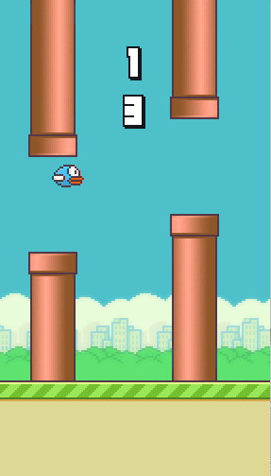
System Elements
Agent
Class of agents with identical architecture
Collection of different classes with various architectures
Gameplay Environment

Slide 11
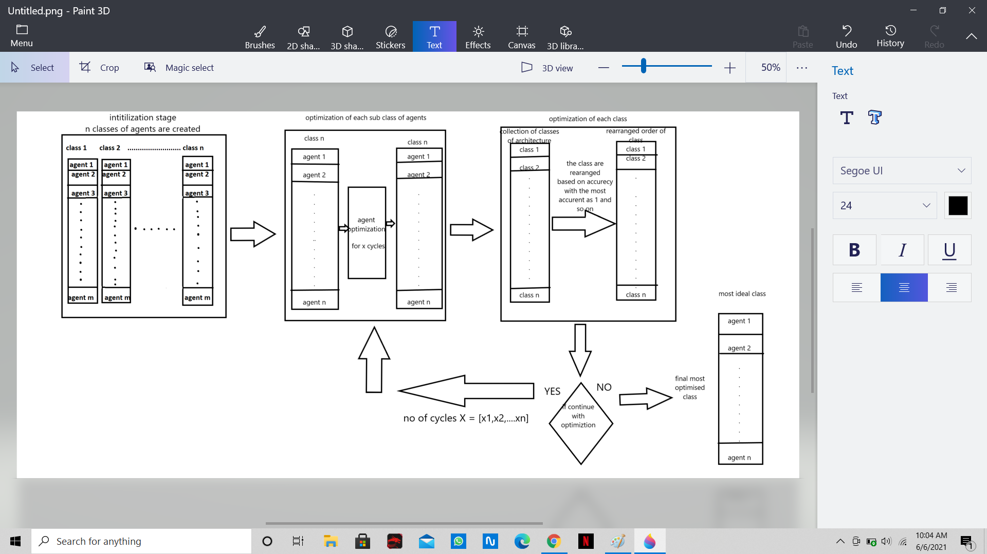
Department of Artificial Intelligence and Machine Learning
System Architecture

Slide 12
Department of Artificial Intelligence and Machine Learning
Subject Mapping

Slide 13
Department of Artificial Intelligence and Machine Learning
Thank You

