Slide 1
Department of Artificial Intelligence and Machine Learning
AGENT OPTIMIZATION USING GENETIC ALGORITHM
Submitted By
Student Name: Mrinal Durani USN: 1BY19AI034
Student Name: Puja S. USN: 1BY19AI040
Student Name: Rtwick George Moses USN: 1BY19AI043
Student Name: Siddharth Arora USN: 1BY19AI054
Under the guidance of:
Dr. Anupama H S
Associate Professor of AI&ML
BMSIT&M
2020-21
EVEN Semester

Slide 2
Department of Artificial Intelligence and Machine Learning
Contents
Introduction
Objective
Literature Survey
Existing Systems
Limitations of Existing Systems
Proposed Methodology
System Elements
System Architecture

Slide 3

Department of Artificial Intelligence and Machine Learning
Introduction
A Neural Network is a series of algorithms that endeavors to recognize underlying relationships in a set of data through a process that mimics the way the human brain operates.
Genetic Algorithms are probabilistic search methods; i.e. the states which they explore are not determined solely by the properties of the problems rather a random process helps to guide the search.

Slide 4
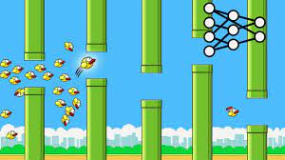

Department of Artificial Intelligence and Machine Learning
Objective
The objective of this project is to create a dynamic system to improve agents in a given environment to perform a certain set of tasks using the genetic algorithm approach to optimize the neural networks to find suitable architecture and optimal agents
This Program is constructed where we train a Neural Network for it to play Flappy Bird the Game

Slide 5
Department of Artificial Intelligence and Machine Learning
Literature Survey
Deep reinforcement learning using genetic algorithm for parameter optimization -IEEE (Feb 2019)
Scalability and optimisation of a committee of agents using genetic algorithm - EEE Dept Imperial College London (May 2007)
Genetic algorithm optimisation of an agent-based model for simulating a retail market - AJ Heppenstall (University of Leeds) (Dec 2007)
UAV cooperative multiple task assignments using genetic algorithms
- IEEE (June 2005)
5. Playing games with genetic algorithms
- Robert Marks (Jan 2002)
6. Generating war game strategies using a genetic algorithm
- Robert Mccartney (Feb 2002)

Slide 6
Department of Artificial Intelligence and Machine Learning
Existing Systems
In 1987 the first published research appeared which used the Genetic Algorithm[5].
Current systems use neural networks or other means to create agents for certain agents[2]
NP problems also use genetic algorithm to estimate answers[4]
Dynamic environments which have the issue of uncertainty like war games also exploit it and can be successfully navigated by simulating using the genetic approach[6]

Slide 7
Department of Artificial Intelligence and Machine Learning
Limitation of Existing Systems
The major issue for past systems is deciding the architecture of the neural network and whether to have multiple or a singular unified architecture.
Metric | Dynamic approach | Static Approach
Accuracy | Higher accuracy | lower accuracy
Computational difficulty | Lager computational Load | Lesser computational Load
Size of data stored | Lager amount of data | Lesser amount of data
Dynamic Environment | Are more adapt to these environments | Are Less adapt to these environments
Rate of improvement | Lesser likelihood to plateau | higher likelihood to plateau

Slide 8
Department of Artificial Intelligence and Machine Learning
Proposed Methodology
The proposed methodology works by trying to continuously evaluate the agents and classes and allocate resources based on improvement of performance.
Hench we hope to have the benefits of a static which is low computational load and processing .
The flexibility offered by a dynamic system along with its accuracy , adaptability and flexibility to changing environment stimula .
This is done in four phases:
1. Initialization phase
2. Training phase
3. Evaluation phase
4. The control loop

Slide 9
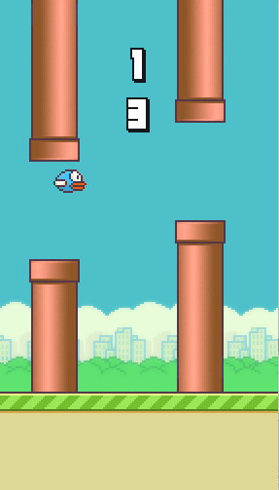
System Elements
Agent
Class of agents with identical architecture
Collection of different classes with various architectures
Gameplay Environment

Slide 10
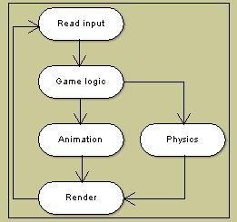
System Elements
Multithreading:
1).In computer architecture, multithreading is the ability of a central processing unit (CPU) (or a single core in a multi-core processor) to provide multiple threads of execution concurrently, supported by the operating system.
Advantages: If a thread gets a lot of cache misses, the other threads can continue taking advantage of the unused computing resources, which may lead to faster overall execution, as these resources would have been idle if only a single thread were executed. Disadvantages: Multiple threads can interfere with each other when sharing hardware resources such as caches or translation lookaside buffers (TLBs). As a result, execution times of a single thread are not improved and can be degraded, even when only one thread is executing, due to lower frequencies or additional pipeline stages that are necessary to accommodate thread-switching hardware.

Slide 11

System Elements
Pygame:
Pygame was originally written by Pete Shinners to replace PySDL after its development stalled. It is a cross-platform set of Python modules designed for writing video games.
Pygame uses the Simple DirectMedia Layer (SDL) library, with the intention of allowing real-time computer game development without the low-level mechanics of the C programming language and its derivatives.
Notable games using Pygame :-
Flappy Bird
Snake and Ladders
Retro Racing Games

Slide 12
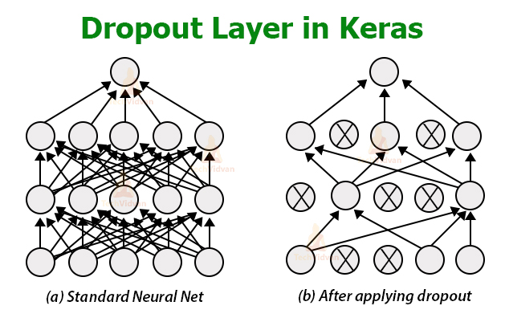
System Elements
Keras
It is an open-source software library that provides a Python interface for artificial neural networks. Keras acts as an interface for the TensorFlow library. It helps us to develop and evaluate deep learning models. It wraps the efficient numerical computation libraries Theano and TensorFlow and allows you to define and train neural network models in just a few lines of code.

Slide 13
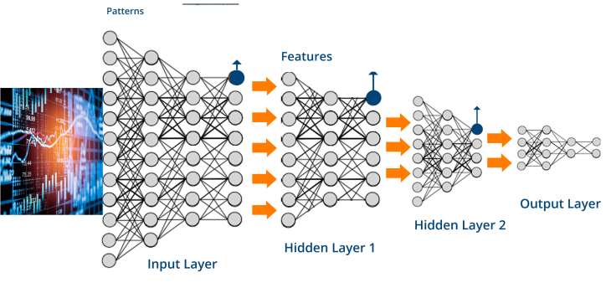
System Elements
TensorFlow
TensorFlow is a free and open-source software library for machine learning. It can be used across a range of tasks but has a particular focus on training and inference of deep neural networks.
TensorFlow is a symbolic math library based on dataflow and differentiable programming. It is used for both research and production at Google.
It was developed by the Google Brain team for internal Google use and released under the Apache License 2.0 in 2015.
Applications : Among the applications for which TensorFlow is the foundation, are automated image-captioning software, such as DeepDream

Slide 14
Genetic Algorithm
A Genetic Algorithm implements the model of computation by having arrays of bits or characters (binary string) to represent the chromosomes. Each string represents a potential solution.
The basic process for a genetic algorithm is
Initialization
Evaluation
Crossover
Mutation

Slide 15
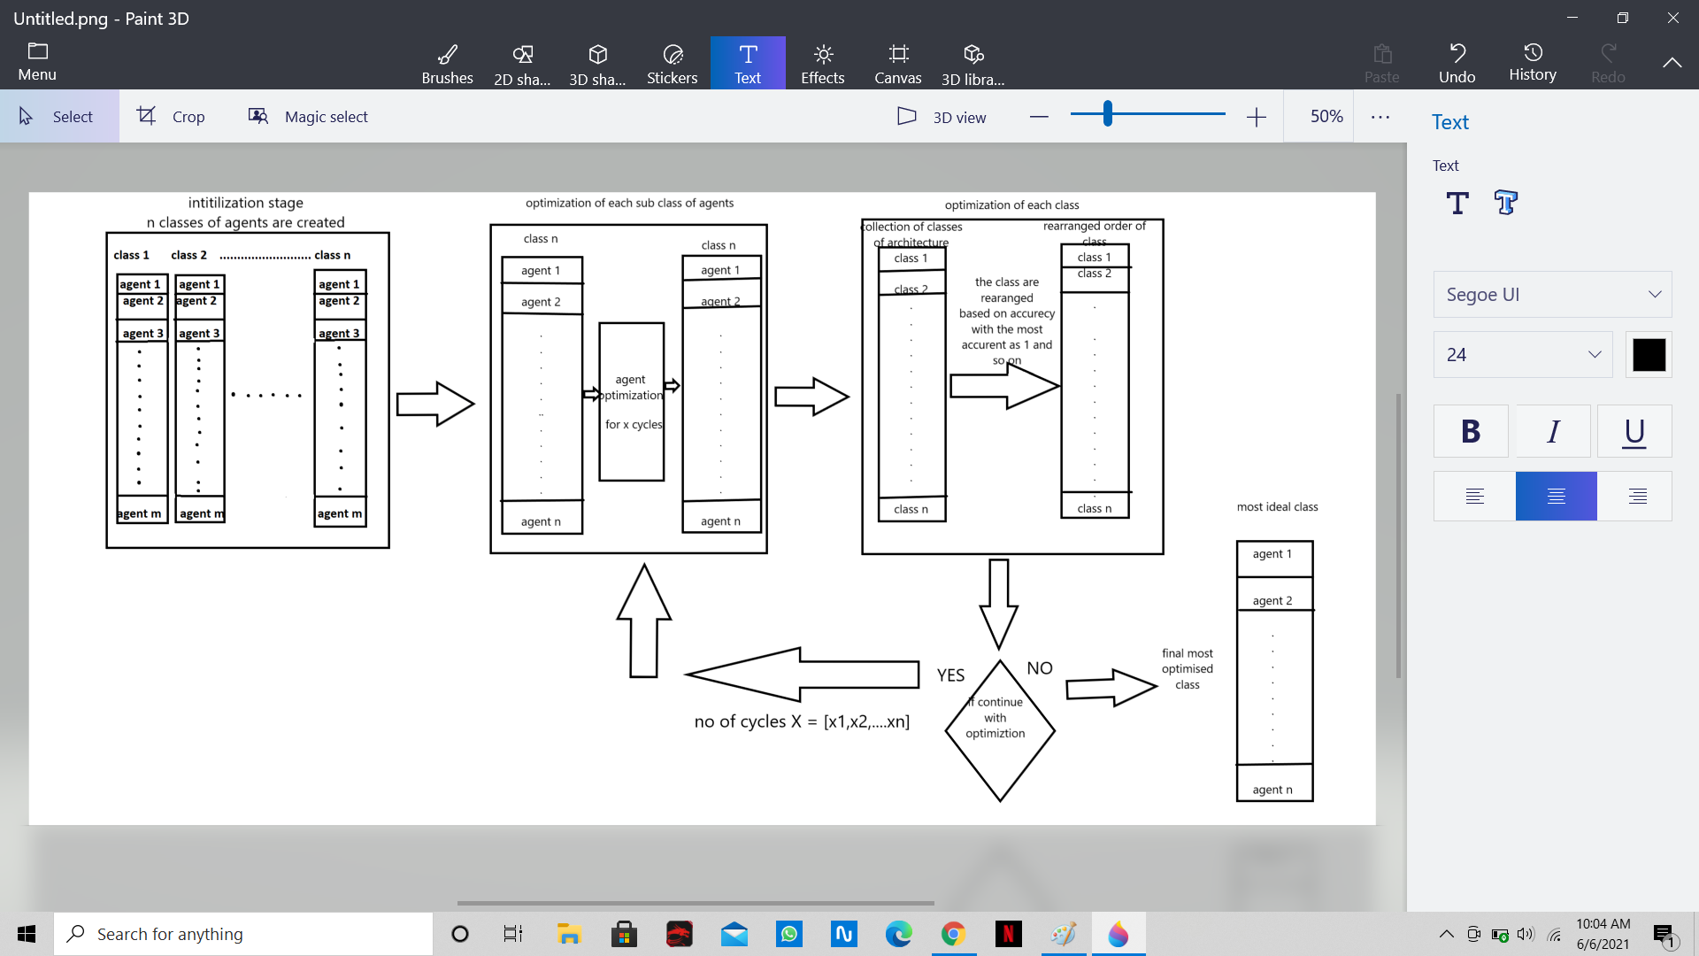
Department of Artificial Intelligence and Machine Learning
System Architecture

Slide 16
Department of Artificial Intelligence and Machine Learning
Subject Mapping
Engg Math's IV – Probability of Solutions
DAA - Greedy method for problem solving
OOC - Objects building block, Code written in fffffffffC/C++
MES – Parallelism
OS – Multi-Threading
DC - Layered Architecture of the Project

Slide 17
Department of Artificial Intelligence and Machine Learning
Thank You

