Slide 1
PROFIT PREDICTION BY USING VARIOUS REGRESSION MODELS
By,
Puja S

Slide 2
CONTENTS
ABSTRACT
INTRODUCTION
PROBLEM STATEMENT
EXISTING METHOD
PROPOSED METHODOLOGY
RESULTS
CONCLUSION
REFFERENCES

Slide 3
ABSTRACT
A regression is a statistical technique that relates a dependent variable to one or more independent variables.
A regression model is able to show whether changes observed in the dependent variable are associated with changes in one or more of the explanatory variables.
It does this by essentially fitting a best-fit line and seeing how the data is dispersed around this line.
Regression helps economists and financial analysts in things ranging from asset valuation to making predictions.
In order for regression results to be properly interpreted, several assumptions about the data and the model itself must hold.

Slide 4
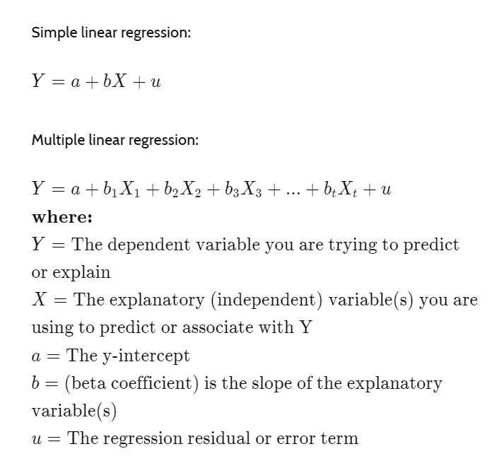
INTRODUCTION

Slide 5
TYPES OF REGRESSION MODEL

Slide 6
PROBLEM STATEMENT
In the given dataset, R&D Spend, Administration Cost and Marketing Spend of 50 Companies are given along with the profit earned. The target is to prepare an ML model which can predict the profit value of a company if the value of its R&D Spend, Administration Cost and Marketing Spend are given.
i) Construct Different Regression algorithms
ii) Divide the data into train set and test set
iii) Calculate different regression metrics
iv) Choose the best model
Language: Python or R

Slide 7
EXISTING METHOD
NAME OF PAPER NAME | SUBMITTED TO | YEAR OF PUBLICATION | NAME OF AUTHOR(S)
Startup Profit Predictor Using Machine Learning Techniques | LNNS | September 2022 | Manasi Chhibber
Predicting startup survival using first years financial statements | University of Zaragoza | August 2020 | Taylor and Francis
Predicting customer retention and profitability by using random forests and regression forests techniques | Empirical study | August 2005 | Dirk Van den Poel
Startups profit prediction using Multiple Linear Regression | IEEE | November 2021 | Aman Preet Gulati

Slide 8
PROPOSED METHODOLOGY
The steps involved in this project are given below:
Firstly, the dataset is examined to get insights about what kind of data is present.
Secondly, the dataset is split into train set and test set.
Thirdly, the various regression models are fitted into the data.
Fourthly, the scores for training and testing set is found out for each regression model
Along with the scores , the RMSE and the cross val score is also found out for each regression model
Finally, the best model is chosen based on the scores of the model

Slide 9
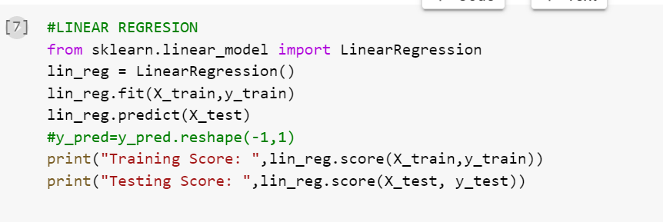
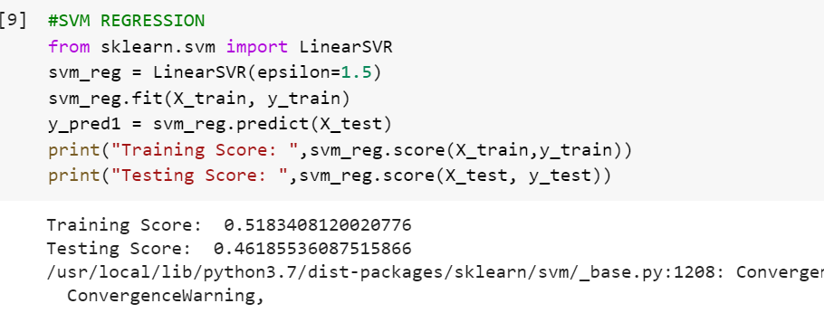
METHODOLOGY

Slide 10
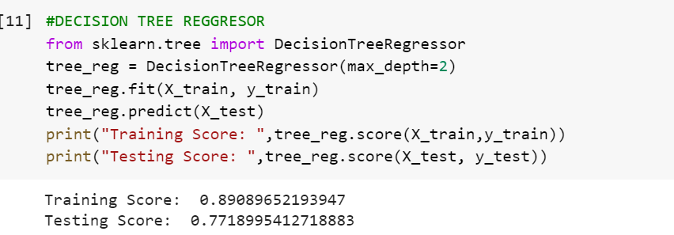
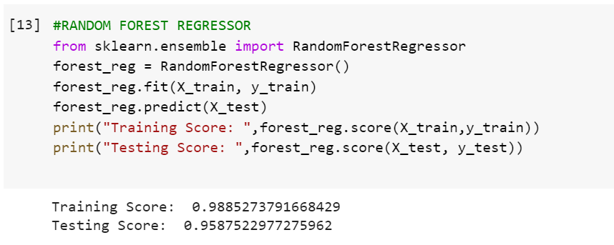

Slide 11
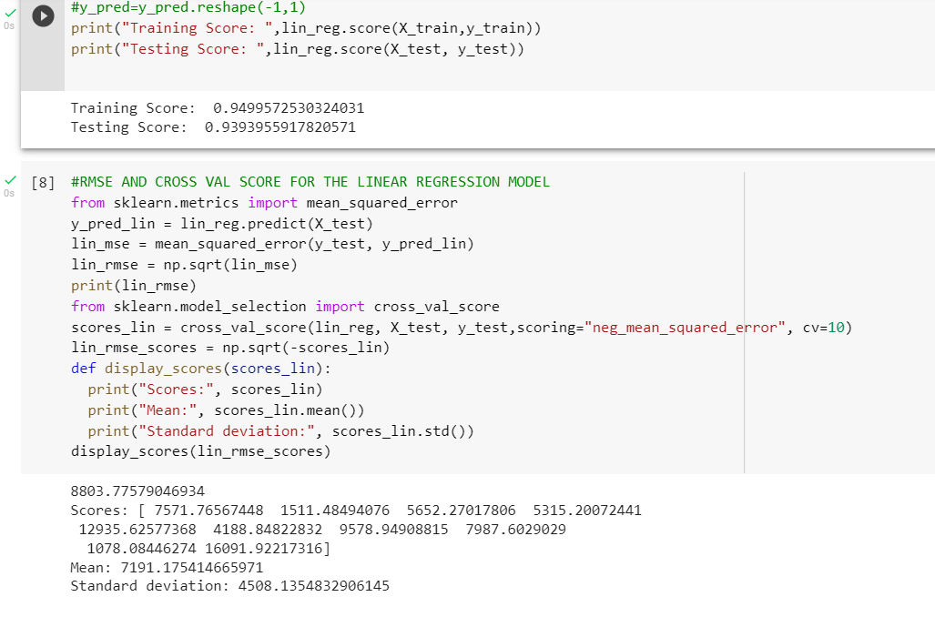
RESULTS

Slide 12
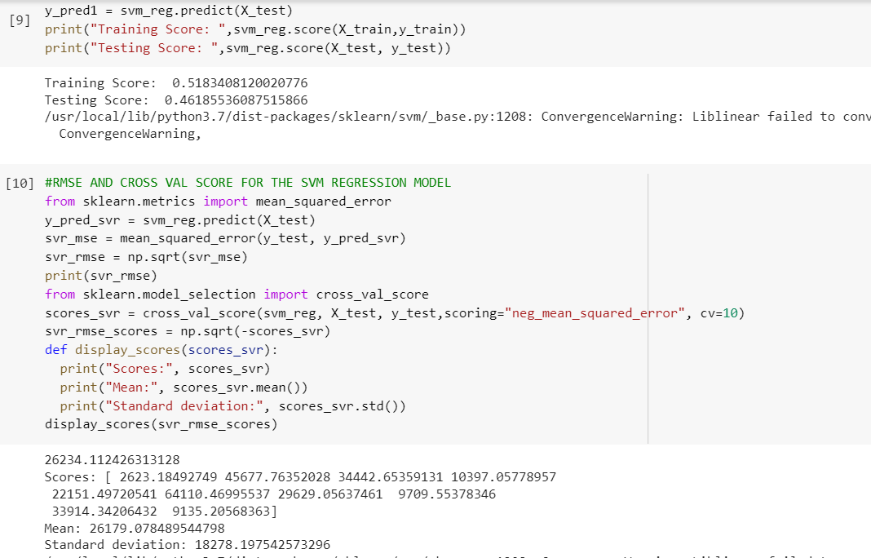

Slide 13
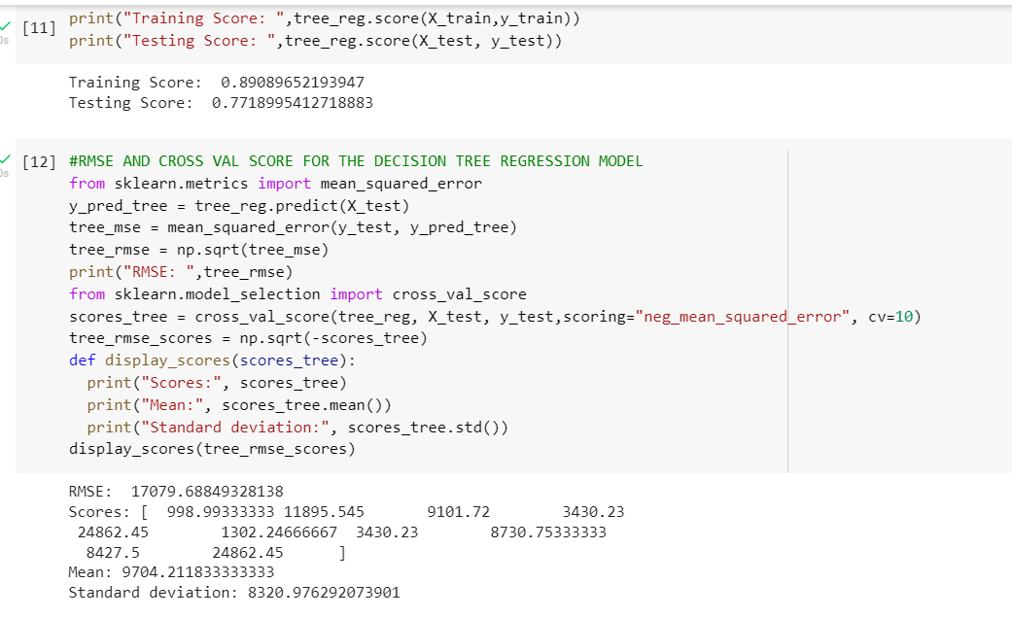

Slide 14
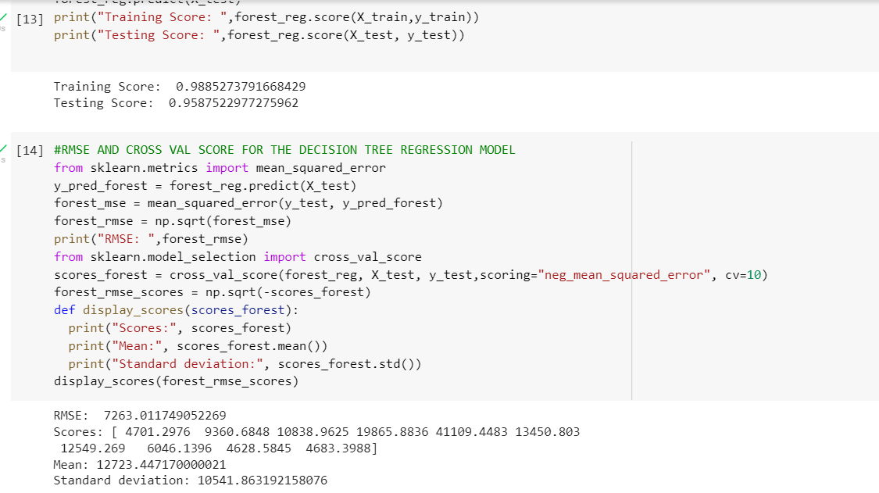

Slide 15
CONCLUSION
The prediction of profit across 50 startups is found using four different regression model.
The four models are:
Linear regression
SVR
Decision Tree regressor
Random forest regressor
The best model is the Linear regressor as the score of the model is around 93% which is the best compared to the rest

Slide 16
THANK YOU

