Slide 1
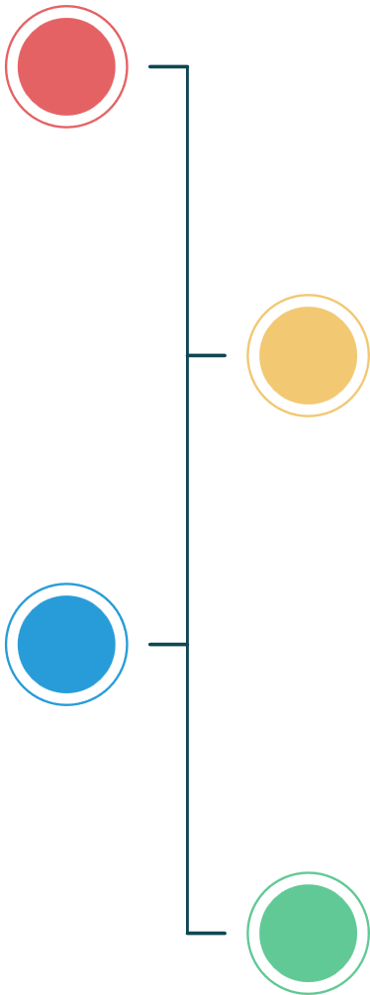


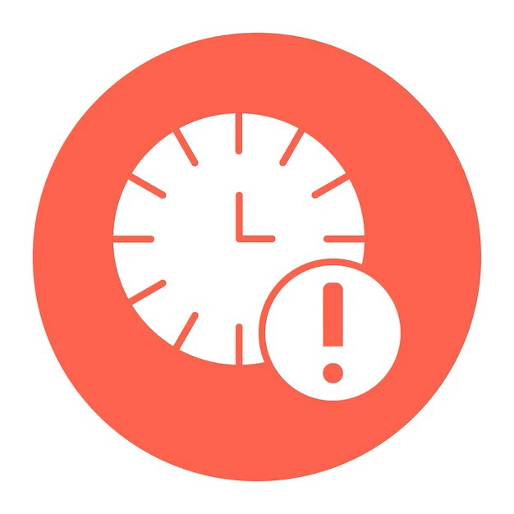




Problem Statement
SilverCare - Automated, Intelligent, and Wearable Monitoring System
The Challenge: With the increasing elderly population, many senior citizens live alone without continuous
supervision, leading to safety risks such as:
Frequent Falls- leading cause of serious health complications.
Delayed Assistance– senior citizens are unable to seek immediate help.
Unnoticed Instability & Prolonged Inactivity – gradual imbalance and abnormal movements go unnoticed also, early warning signs of health issues are missed.
Medication Non-Adherence –elderly individuals often forget to take medicines on time, leading to missed doses.
Without an intelligent and reliable monitoring solution, senior citizens remain vulnerable to preventable injuries and delayed medical intervention

