Slide 1
Exhaust Gas Analysis

Slide 2
Topics covered
Evaporative loss control device
Noise pollution and its control
Reactive mufflers

Slide 3
Evaporative loss control device
What is EVAP?
The EVAP system is also called the charcoal canister system
The EVAP system is used to reduced the evaporative losses of the system.
Its design to capture vapor from the fuel tank and keep them from leaking out into the atmosphere.

Slide 4
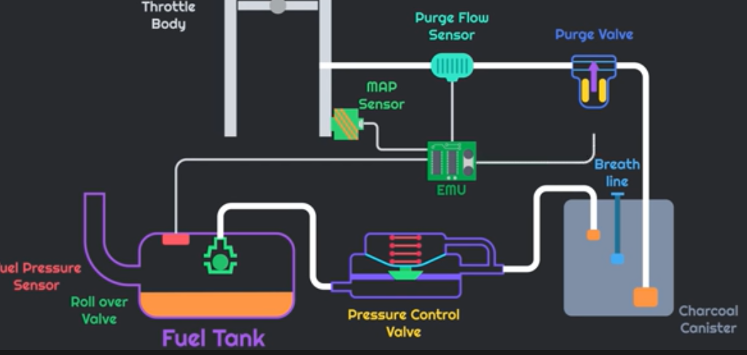
WORKING:

Slide 5
Sansor
Fuel pressure sensor
MAP sensor
Purge flow sensor
Valve
Roll over valve
Pressure control valve
Purge valve

Slide 6
If the engine is off condition and the fuel starts the vaporizing then the vapor will go roll over valve to pressure control valve.
and when we starts the engine EMU will opens the solenoid valve and the vacuum of the throttle body will goes charcoal canister to pressure control valve.
And the pressure control valve will open and which allows to hydrocarbon with air going into throttle body.
if the purge solenoid valve will open or close then charcoal canister stored the hydrocarbons.

Slide 7
Noice pollution and its control:
Direct noise abatement at the source
vehicles (power and wind source)
Tires
Indirect noice abatement at the source
speed
surface

Slide 8
Vehicle
Trucks contribute a disproportionate amount of noise not only because of their large engine, but also their high of the diesel stack and their aerodynamic drag significant interior noise is usually present inside the moving vehicle, infact passengers are generally not aware that these levels are high because experience has led motorist to expect levels commonly exceeding 65dBA.
Tires
Tire types can cause 10 dBA variations in noise,

Slide 9
Speed
since sound energy roughly doubles for each increment of ten miles an hour in vehicle velocity; an exception to this rule occurs at very low speeds where braking and acceleration noise dominate over aerodynamic noise.
Surface
Roadway surface types contribute to different noise levels Of the common types of surfaces in modern cities, there is a 4 dB.
chip seal type and grooved roads being the loudest.
and concrete surfaces without spacers being the quietest.

Slide 10
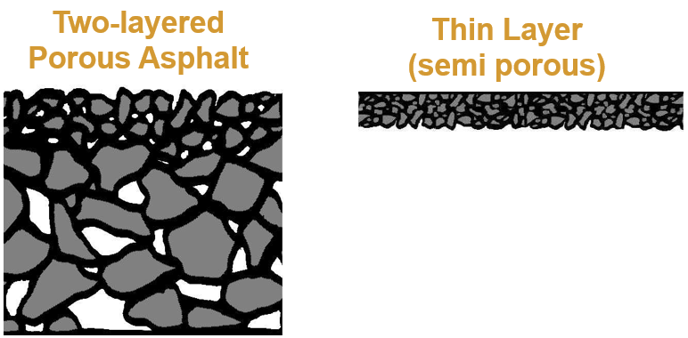
Controls:
Implementing the surface road
application of semi porous thin layers (very smooth surface texture

Slide 11
Choose fuel efficient vehicle
Choose a green vehicle that are most efficient and less noise polluting.
electric vehicle
plug-in-hybrid vehicle
hydrogen fuel cell vehicle and
cleaner burning gasoline vehicle

Slide 12
Reactive mufflers
Sound and vibration – noise is the characterized as undesirable sound
Automobile noise – engine exhaust noise is one of the major concern of every automobile company
Noise reduction – motivation behind a reactive mufflers is to decrease vehicle exhaust noise.

Slide 13
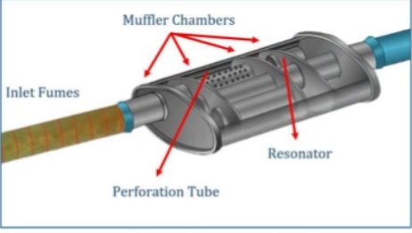
What is reactive muffler?
The geometrical shape of the reactive mufflers consists of numerous chamber, flow diffusers, tuned resonated cyclinders,and discharge tube connected with the outlet connection pipe

Slide 14
1-Aerodynamic consideration with backpressure
Flow of the exhaust gases from the mufflers to Create the less pressure in mufflers.
the extra static pressure generated by the mufflers on the vehicle engine through restrication in flow of exhaust fumes to achieve higher noise reduction may result in higher backpressure to the engine.
2-Mechanical consideration
Material selection ,which decide the mufflers durability
Majorly two types of material used in manufacturing the reactive muffler which include stainless steel and the aluminum.

Slide 15
3-economical consideration:
Less expansive with design cost, material cost and fabrication cost
The performance of muffler may matter by its cost.

Slide 16


