Slide 1
Content Based Image Retrieval system
Group : 34
ANKITA CHANDRA(IIT2018053)
AYUSHI GUPTA(IIT2018118)
PUJA KUMARI(IIT2018191)

Slide 2
Change management infographics
It is the application of computer vision techniques to the image retrieval problem, that is, the problem of searching for digital images in large databases.
"Content-based" means that the search analyzes the contents of the image rather than the metadata such as keywords, tags, or descriptions associated with the image.
The term "content" in this context might refer to colors, shapes, textures, or any other information that can be derived from the image itself.

Slide 3
Content Comparison using Image Distance Measure
Measures of Image distance
Colour
Texture
Shape
It measures look for visual patterns in images and how they are spatially defined.
Shape does not refer to the shape of an image but to the shape of a particular region that is being sought out.
Computing distance measures based on color similarity is achieved by computing a color histogram for each image that identifies the proportion of pixels within an image holding specific values.

Slide 4
Dataset Description
We are using corel dataset consists of around 1000 images.
Each image in the dataset is of 384 * 256 or 256 * 384 size-wise.
Corel dataset is of the following semantic categories: Mountains and Snow,people and villages in Africa, Dinosaurs, monuments, Buses, Food, Elephants,Horses, Beach and Flowers.

Slide 5
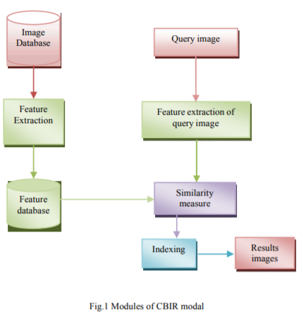
Methodology

Slide 6
Feature Extraction: In this module the features of interest are calculated for image database.
Feature extraction of query image: This module calculates the feature of the query image. Query image can be a part of image database or it may not be a part of image database.
Similarity measure: This module compares the feature database of the existing images with the query image on basis of the similarity measure of the interest
Indexing: This module performs filtering of images based on their content would provide better indexing and return more accurate results. Retrieval and Result: This module will display the matching images to the user based on indexing of similarity measure

Slide 7
Extracting Colour Images
The M * N input RGB image I will be transformed into YCbCr color space.
Following the image transformation, the portion of YCbCr is separated before the application of the canny edge detector to the portion of the image Y
The edge obtained in the previous step is then merged with the unobtrusive Cb and Cr.
Then, the synthesized image is transformed into a single RGB image.
Next, each RGB component is broken down into separate R, G, and B component, followed by the histogram calculation for each portion within RGB image.
For feature performance enhancement, separate wavelet transform is used on each obtained histogram.
The feature vector for each image is computed in the repository.

Slide 8
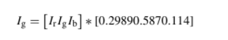
Extracting Shape Features
The RGB color image is converted to grayscale image. For this purpose, the formula proposed by Craig is used as shown below :
Ig denotes the combined 2D matrix; Ir.Ig.Ib represents the components of color which form the colored image; Ig is denoted as the gray-level combined image.
During the preprocessing step, the median filter is used to decrease noise.
Accordingly, the neutrosophic clustering algorithm is then utilized for separating the pixels with very close values and for ignoring indeterminate pixels from the gray image.
As the final task, the Canny edge method is used. This is for finding out the boundaries surrounding the identical pixels. In this work, the Canny edge method was employed to extract the shape features. This is followed by the extraction of the shaped content indices. These indices are stored inside the database in feature vector form.

Slide 9
Extracting Texture Features
We are using GLCM for texture feature extraction. Accordingly, the following are the steps of the texture features extraction using GLCM:
Converting the color image into a grayscale image.
The input image is filtered by the 5×5 Gaussian filter.
The filtered image is split into blocks of 4×4.
GLCM computes energy, standard deviation, mean value, homogeneity and contrast for each block. Computation is made to these features in accordance with four directions namely diagonal (45◦ and 135◦), vertical (0◦) and horizontal (90◦) directions.
The extracted features are stored in the database.

Slide 10
Similarity measure
We are measuring similarity between descriptors using cosine similarity between the features extracted by the dataset and features in the given input image.

Slide 11
Implementation
For retrieving the images color, edge & texture features are considered.
At first , initial setup is done .
We downloaded the dataset , it consist of around 1000 images.
Dataset has 1 query and other comparing similarity images
Global & Local features are extracted calculated and these are stored.
Cosine similarity is calculated between the feature vector of query image and database images
Sorted the distance in ascending order and Top K images ais selected.

Slide 12
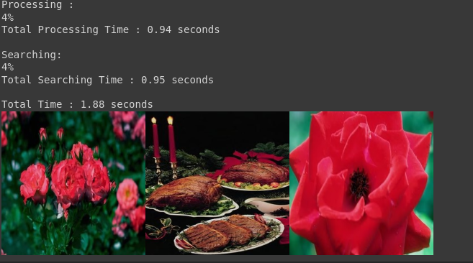
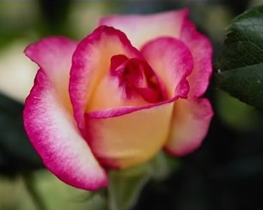
Results
Input
Output

Slide 13
Conclusion
A query image can be retrieved efficiently from a large database.
The retrieved result images often contain the similar content against the query image when compared with the Database.
The result can be improved in future by introducing feedback and user’s choice in the system.

Slide 14
References
http://www.acsij.org/documents/v2i4/ACSIJ-2013-2-4-214.pdf

Slide 15
THANK YOU!

