Slide 1
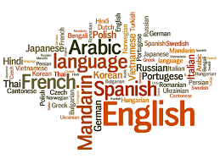
Language Identification Model
Group No : 13
Group Members :
Ankita Chandra(IIT2018053)
Ayushi Gupta (IIT2018118)
Puja Kumari (IIT2018191)

Slide 2
Introduction
Language identification refers to the problem of detecting the language(s) in the textual document based on the script used for writing and observing the diacritics particular to a language.
In our project we have presented a model to detect the language of a text accurately and efficiently.
Language Identification typically acts as a pre-processing stage for both human listeners (i.e. call routing to a proper human operator) and machine systems (i.e. multilingual speech processing systems).

Slide 3
Problem statement
The focus of this project lies on the identification of efficient algorithms (in terms of memory requirements) by exploiting the knowledge about languages and their structures.
We are comparing results of Naive Bayes algorithm and KNN Algorithm.
What’s new?
We are applying it on different feature set which consists of:
Unigram Model
Mixture(Uni+Bi) Top 1%
Mixture(Uni+Bi) Top 50

Slide 4
Language Modelling Methods Available
The first stage is the modelling stage, where language models are generated. Such models consist of entities, representing specific characteristics of a language.The different approaches are:
Unigrams
Bigrams
N Gram Based Approach:

Slide 5
N-Grams
An N-gram is a combination of N tokens.
N-gram is basically set of occurring words within given window .
n=1 ,it is Unigram .
n=2 , it is bigram .
n=3 , it is trigram .
Language model is generated from a corpus of documents using N-grams instead of complete words.

Slide 6
Unigrams
It solely uses words up to a selected length to construct the language model .
The unigram language model makes the following assumptions:
The probability of each word is independent of any words before it.
Instead, it only depends on the fraction of time this word appears among all the words in the training text.

Slide 7
Bigrams
A bigram is an n-gram for n=2 .
A bigram or digram is a sequence of two adjacent elements from a string of tokens , which are typically letters, syllables, or words.
Language models are generated based on specific amount of words, having the maximum frequency of all words occurring in a text or document.

Slide 8
Dataset Description
The dataset we will be using is available on kaggle website. The dataset contains text information of about 22 different languages.
The dataset has 22,000 rows and 2 columns.
The different languages present in our dataset are as follows:
'Arabic', 'Spanish', 'Swedish', 'English', 'Estonian', 'Tamil', 'Indonesian', 'Pushto', 'Dutch', 'French', 'Japanese', 'Turkish', 'Hindi', 'Latin', 'Persian', 'Romanian', 'Russian', 'Chinese', 'Portuguese', 'Korean', 'Urdu', 'Thai'

Slide 9
Requirements
The following python libraries will be required to make our model:
Pandas
Numpy
Sklearn
Matplot
seaborn
We will use google colab for our project implementation.

Slide 10
PROPOSED METHODOLOGY
STEP 01
Data Preprocessing
STEP 02
Feature extraction
Unigram
Mixture of Unigram and Bigram(Top 1%)
Mixture of Unigram and Bigram(Top 50)
STEP 03
Classification
Naive Bayes
KNN Model
STEP 04
Text 04 Venus has a beautiful name, but it’s terribly hot, even hotter than Mercury

Slide 11
Data Preprocessing
Data preprocessing makes our dataset suitable for the further steps .
In this steps we remove any special symbols, punctuations ,extra space etc if present in our text as it is not required in the classification part.
We then remove any numbers if present in our text,and we also remove any english letters if present in our text.

Slide 12
Feature Extraction

Slide 13
Unigram Model
The unigram model is also known as the bag of words model. Estimating the relative likelihood of different phrases is useful in many natural language processing applications, especially those that generate text as an output.
Using Uni-Grams allows us to identify all languages, which consist of unique symbols.
The Uni-Gram-approach might also be useful, if languages share common symbols, like the Latin symbols which are used in a lot of Indo-European languages including e.g. Romance (Italian, Romanian, Spanish, ...)
Unfortunately, using Uni-Grams we might face some issues, when we try to distinguish between languages having the same root, like for the Romance languages: Italian, Spanish, French, Portuguese, Catalan etc.

Slide 14
Why not Bigram?
The next larger piece of information are Bi-Grams. Unfortunately, using Bi-Grams might already blow up the required resources. So we should restrict ourselves here, to use only those, occurring most frequently.
But for the languages consisting on a few letters only, using Bi-Grams is very helpful. Since the most frequently used Bi-Grams differ a lot.
Whereas for Japanese and Chinese we can not find any Bi-Grams occuring at least in 1% of the cases.

Slide 15
Mixture of Unigram and Bigram
When we restrict ourselves to a limited number of features, it is important, that we will capture details for each language. Since Chinese consists of >3,000 of different symbols, the probability of the most frequently used Chinese Uni-Grams might be below the top 1000 used Bi-Grams of the other languages.
Using top 1%: We are using a lot of features per language, which might be already a good solution. But choosing around 3079 features is already a lot. And therefore the calculation is still expensive. It is possible to start the calculation based on around 3079 features so we delivered the results.

Slide 16
Taking top 50 per language:
We can restrict ourselves to the top 50 Uni- & Bi-Grams per language. This will lead to max of 22*50=1100 features. So, when dealing with the top-50-approach on these 22 languages, we will effectively use 564 features only. We built the data set for the models, based on our 564 features. From a theoretical perspective, it is most efficient to use a Mixture of the most common Uni-Grams and Bi-Grams.

Slide 17
Classification using Naive Bayes
First we normalize the data.
We have splitted data into 80:20 ratio for training and testing respectively
After extracting the required features using Unigram Model, Mixture 1% model and Mixture top 50 model we will train our model using naive bayes algorithm.

Slide 18
Classification using KNN model
First we normalize the data.
We have splitted data into 80:20 ratio for training and testing respectively
After extracting the required features using Unigram Model, Mixture 1% model and Mixture top 50 model, we will train our model using KNN algorithm.
We are taking the value of k=5 which is default

Slide 19
Results

Slide 20
Below is the ranking according to the weighted F1 scores we obtained
0.9751510056992273 NB on Mix Top 50
0.9746025107937131 NB on Mix Top 1%
0.9739276244435526 kNN on Mix Top 1%
0.972350612063613 kNN on Mix Top 50
0.9545028869296119 kNN on Unigram
0.9201996483569281 NB on Unigram

Slide 21
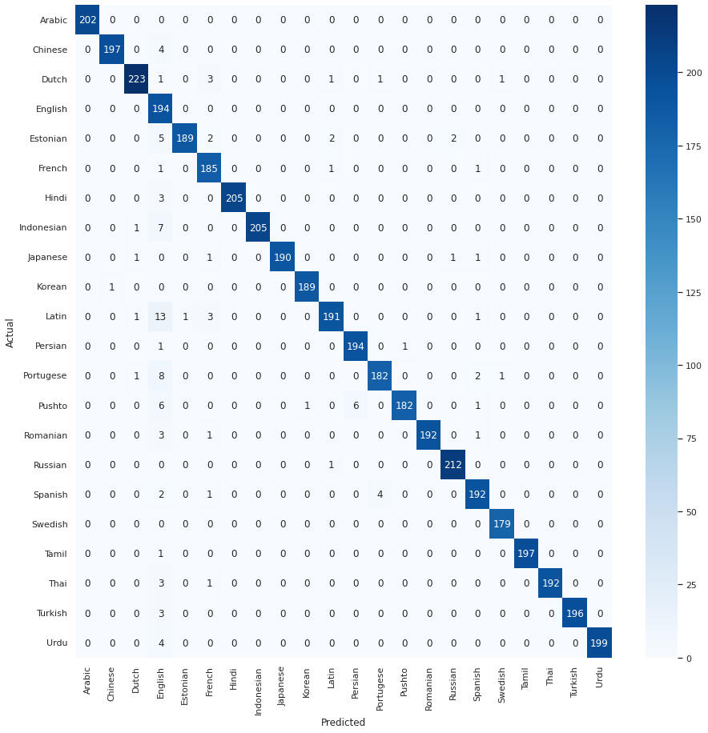
We obtained the confusion matrix of Naive Bayes classification model using top 50 dataset of the mixture of Unigram and bigram model.

Slide 22
Conclusion
We saw how we trained using dataset extracted using Unigram, mixture of 1% and mixture of top 50 on Naive Bayes and kNN model . The best accuracy we got was from mixture of top 50 model using naive bayes.

Slide 23
References :
https://ieeexplore.ieee.org/stamp/stamp.jsp?tp=&arnumber=9399594
http://citeseerx.ist.psu.edu/viewdoc/download?doi=10.1.1.414.1623&rep=rep1&type=pdf
https://citeseerx.ist.psu.edu/viewdoc/download?doi=10.1.1.362.2541&rep=rep1&type=pdf
http://citeseerx.ist.psu.edu/viewdoc/download?doi=10.1.1.682.1583&rep=rep1&type=pdf

Slide 24
THANK YOU!

