Slide 1

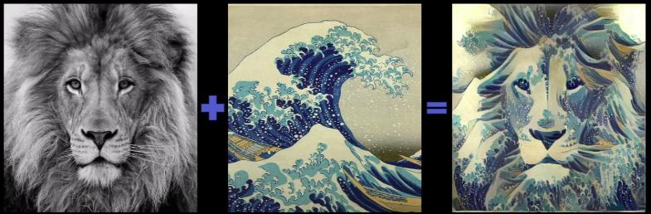
Theme based Colorization

Slide 2
Group Members :
Nehal Singh (IIT2018119)
Puja Kumari (IIT2018191)
Prabha Kumari (IIT2018195)
Akshat Solanki (IEC2018055)
Under the Supervision of :
Dr. Satish Singh

Slide 3
Introduction
Problem Statement- We will try to build the enhancement method using two images, a content image and a reference style (like a famous artist's work), and blend them together to make the resulting image look like a content image, but a "painted" style reference image style..
Solution Proposal- In other important areas of visual acuity such as visual acuity and facial recognition have recently demonstrated a class of biologically inspired visual models called Deep Neural Networks. Here we will use a Deep Neural Network based system that creates high quality visual images.
The system uses neural presentations to isolate and reassemble the content and style of inappropriate images, providing a neural algorithm for the creation of artistic images.

Slide 4
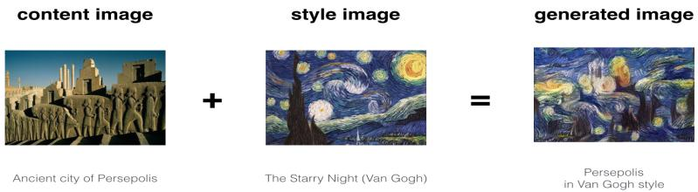
Motivation
In fine art, especially painting, humans have mastered the skill to create unique visual experiences through composing a complex image.
There exists no artificial system with similar capabilities.
So, we are going to make such model which can generate new images of high perceptual quality that combine the content of an arbitrary photograph with the appearance of numerous well known artworks.

Slide 5
Description of existing methods
Most previous texture transfer algorithm are used for style transfer.In present deep learning based technique show better success rates than traditional texture methods.
Recent methods for style transfer typically train convolutional neural network using a per-pixel loss between the output and ground truth image.
So In this project we are going to use convolutional neural network for image transformation task and train using perceptual loss function with VGG19 model.

Slide 6
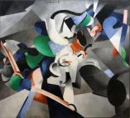
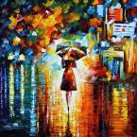
Description of Dataset
Our dataset consist of content image and style images .
For content images we will be taking different images from net
For style image we will take famous painting like udnie , rain_princess etc.

Slide 7
Description of Code availability
There are research papers and codes available which resembles to our problem statement.
However most of them need high GPU to run and cannot be run on our system. So we will be trying to implement the Gatys’ Research paper.
There are some research papers which we use in order to understand algorithm.
Research paper :
[1508.06576] A Neural Algorithm of Artistic Style
Perceptual Losses for Real-Time Style Transfer and Super-Resolution
[1607.08022] Instance Normalization: The Missing Ingredient for Fast Stylization
We will implement this project using CNN with VGG19 model and show this project through web application for better understanding.

Slide 8
Summary of proposed plan
Our main aim will be to produce a mixed image out of two images provided, i.e a content image and a style image. Mixed image contains style (such as texture, colour) from style image and content from content image.
Style Transfer
Technique of re-composing images in the style of other images
CNN
The class of Deep Neural Networks that are most powerful in image processing task.
We would like to present it with web-UI to make it user friendly.

Slide 10
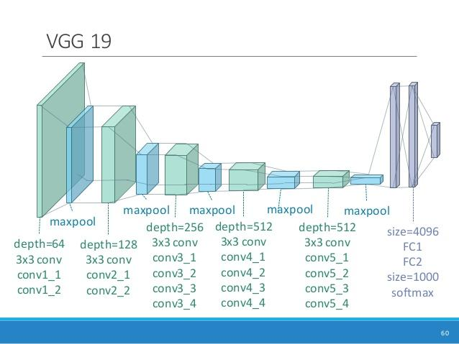
CNN
CNN consists of layers of small
computational units that process
visual information hierarchy in a
feed-forward manner
Each layer of units can be understood as
a collection of image filters, each of which
extracts a certain feature from image.
Output of each given layer consists of feature-maps : differently filtered versions of the input image.
We will be using pretrained VGG model :
http://www.vlfeat.org/matconvnet/models/beta16/imagenet-vgg-verydeep-19.mat

Slide 11
Methodology
The input image is transformed into representations that increasingly care about the actual content of image as compared to its detailed pixel values.
We refer to Feature responses in higher layer of the network as content representations.
The ,4_2,5_2 convolution layer of pre-trained VGG-19 network is used as content extractor.
Extraction of content from the image.

Slide 12
Methodology
"To obtain a representation of the style of an input image, we use correlations between the different filter responses over the spatial extent of the feature maps. We obtain a stationary, multi-scale representation of the input image, which captures its texture information but not the global arrangement"
These correlations between feature maps in known as gram matrix.
The layers used for calculation of gram matrix are 1_1, 2-1, 3_1, 4_1, 5_1 with varied style weight constant for each layer.
This constant can be seen as a hyperparameter used for changing style levels
Extraction of style from the image.

Slide 14
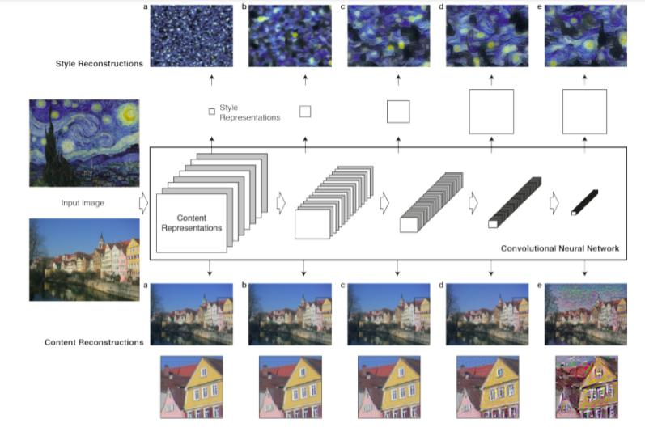

Slide 15


The feature space provided by the 16 convolutional and 5 pooling layers of the 19 layer VGG Network.
jbj as input image , is encoded in each layer of the CNN by the filter responses to that image.
A layer with N_{L} distinct filters has N_{L} feature maps each of size M_{L}, where M_{L} is the height times the width of the feature map.
So the responses in a layer L can be stored in a matrix :
where is the activation of the i^{th} filter at position j in layer L
Content Loss
Let P be the original image and X , the image that is generated and P and F their respective feature representation in layer. We then define the squared-error loss between the two feature representations as the content loss.

Slide 16



Style Loss
Let A be the original image and X ,the image that is generated and A_{i} and G_{i} their respective style representations in layer i. The contribution of that layer to the total loss is then
Loss :
is Gram matrix ,where is the inner product between the vectorised feature map i and j in layer l .
To generate the images that mix the content of a photograph with the style of a painting , we jointly minimise the distance of a white noise image from the content representation of the photograph in one layer of the network and the style representation of the painting in a number of layers of the CNN.

Slide 17

So let p be the photograph and a be the artwork. The loss function we minimise is
𝞪 and 𝛃 are hyper-parameters
𝞪 is Content weight
𝛃 is Style weight

Slide 18
Experimental Setup
Following are the prerequisites for the project
python (Anaconda) [V 3.5.4]
tensorflow [V 1.4.0]
numpy [V 1.13.3]
PIL [V 4.2.1]
matplotlib [V 2.0.2]

Slide 19
IMPLEMENTATION

Slide 20
First step was to read content and style images.
If multiple style images are used , definingweight for each style image, else by default equal weights are assigned.
Defining
CONTENT LAYERS = (’relu4_2’, ’relu5_2’)
STYLELAYERS=(’relu11_’,’relu2_1’,’ relu3_1’, ’relu4_1’, ’relu5_1’).
Neuralstyle.py is called with parameters “content image”, “style image”, “checkpoints-outputformat”, “checkpoint iterations number”.
The stylize() function from Stylize.py is called which yields tuples(iteration,image,lossvals) at every iteration.
Normalization of style layer weights is done.
Compute content features and Style features infeed forward mode.
Make stylized image using back propagation
Calculate content and style loss.

Slide 21
Calculate total variation denoising and then total loss. Total variation denoising is decreasing high frequency artifacts by using an explicit regularization term on the high frequency components of the image.
Setup optimizer as adam’s optimizer and start optimization for each iteration. To optimize itwe use a weighted combination of the two losses to get the total loss.
trainstep = tf.train.AdamOptimizer(learningrate,beta1, beta2, epsilon).minimize(loss)
Luminosity transfer steps
Convert stylized RGB→grayscale according to Rec.601 luma (0.299, 0.587, 0.114)
Convert stylized grayscale into YUV(YCbCr)
Convert original image into YUV (YCbCr)
Recombine(stylized YUV.Y, original YUV.U, original YUV.V)
Convert recombined image from YUV back to RGB
Save image for specific iteration in numpy array,and then save the image in path with
Def imsave(path,img):img=np.clip(img,0,255).astype(np.uint8)Image.fromarray(img).save(path, quality=95)

Slide 22
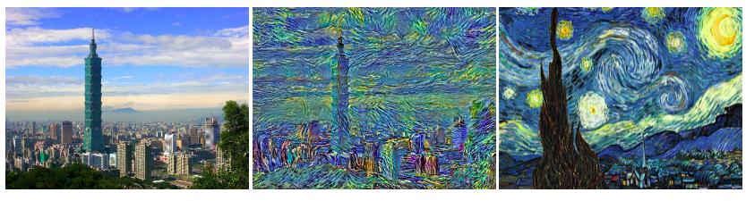
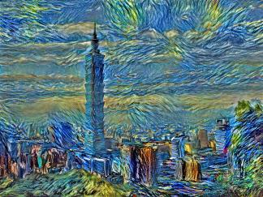
Results

Slide 23
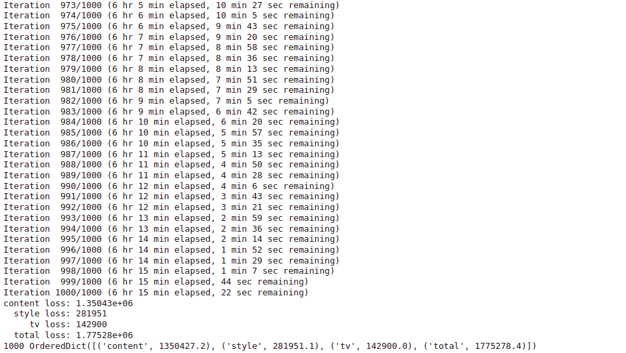
Results

Slide 24
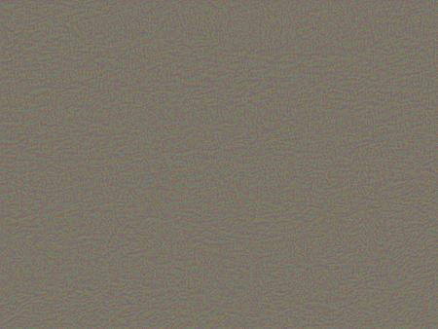
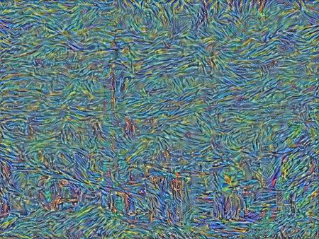
Images generated at each 100 iterations
Iteration - 0 Iteration - 100

Slide 25
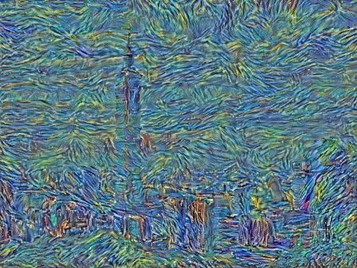
Images generated at each 100 iterations
Iteration - 200 Iteration - 300

Slide 26
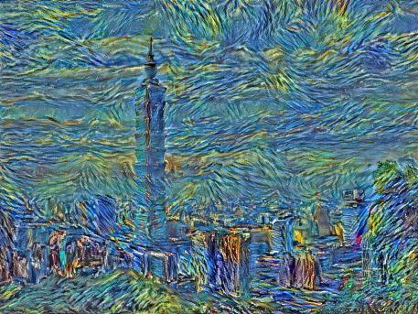
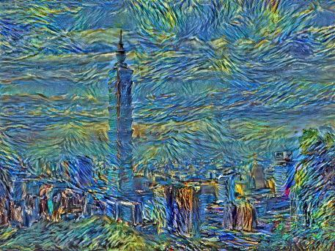
Images generated at each 100 iterations
Iteration - 400 Iteration - 500

Slide 27

Images generated at each 100 iterations
Iteration - 600 Iteration - 700

Slide 28


Images generated at each 100 iterations
Iteration - 800 Iteration - 900

Slide 29

Images generated at each 100 iterations
Iteration - 1000

Slide 30
WEB APPLICATION

Slide 31
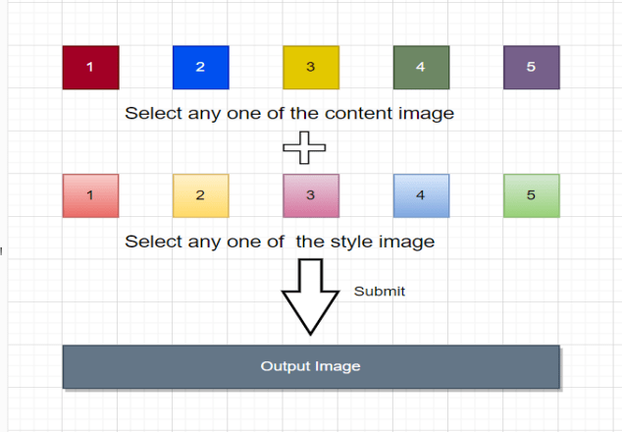
Design of Web Application

Slide 32
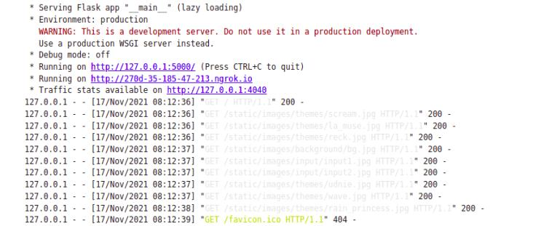
We decided to build a web application for better navigation , which would allow user to select theme and input image and see their output. It was made using Flask,CSS & HTML.

Slide 33
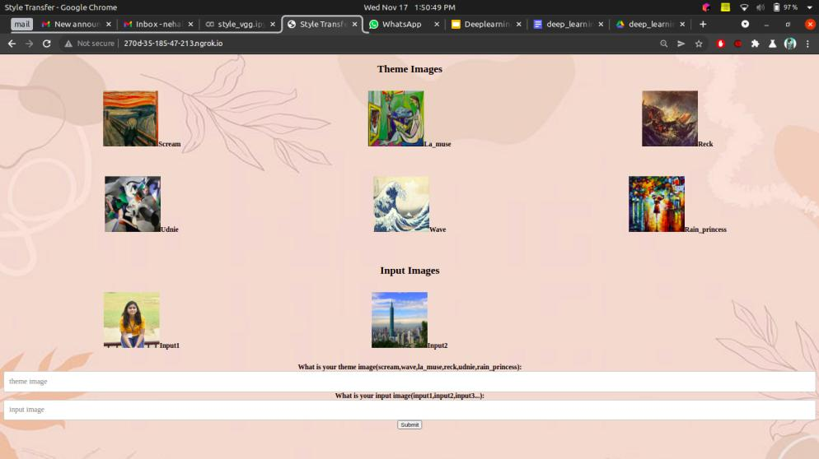

Slide 34
Contribution of Group
We will take help from a research paper name “A Neural Algorithm of Artistic Style” (A Neural Algorithm of Artistic Style).
We will show this project through a web application for ease of the user. There user can select content image image and style image and can see their output.

Slide 35
Contribution of Individual members
There are following tasks which we have to do in this project :
Training for Style Image
Testing for Style Image
Evaluation of checkpoint created using content image
Creation of web application
We will start our work from training of model.

Slide 36
Limitations of proposed work
Since convolutional neural networks are typically used for image-classification, we are generally dealing with high-dimensional data (images). We generally need a large amount of data for a convolutional neural network to work effectively.
It takes a very long time to train a convolutional neural network, especially with large datasets. In order to speed up the process we need specific type of hardware such as a GPU.
CNN are generally bad at handling rotation and scale-invariance without explicit data augmentation.
High computational cost.

Slide 37
Conclusion
In this project we will generate a mixed image out of two images provided, i.e a content image and a style image using CNN with VGG19 model. Here, a mixed image contains style (such as texture, colour) from style image and content from content image.
For showing this project we built a web application , which would allow users to select themes and input images and see their output. It was made using Flask,CSS & HTML. We also calculate the content and style loss for computing the final loss that is 1.77528e+06 .

Slide 38
References
Neural style transfer :Tensorflow core.
Neural style transfer
Logan Engstrom. Fast style transfer.
lengstrom/fast-style-transfer: TensorFlow CNN for fast style transfer ⚡🖥🎨🖼 ,2016
Leon A. Gatys, Alexander S. Ecker, and Matthias Bethge. A neural algorithm of artistic style, 2015.
Justin Johnson, Alexandre Alahi, and Li Fei-Fei. Perceptual losses for real-time style transfer and super-resolution. In European Conference on Computer Vision, 2016.
Dmitry Ulyanov, Andrea Vedaldi, and Victor Lempitsky. Instance normalization: The missing ingredient for fast stylization, 2017.

Slide 39
Questions?

Slide 40
Thank you !!

