Slide 1
Chain News Monitoring

Slide 2
Supply Chain Due Diligence Act
Act should reduce human right violations within global supply chains
Medium and large companies in Germany will be accountable and must act upon for violations that happen anywhere in their supply chain
Breaking the law can lead to penalties up to 2% of yearly revenue

Slide 3
Project Overview
Infrastructure
(A) Server with database and periodically running tasks to discover
• (B) Discover new news sources
• (C) Assess quality of sources
• (D) Process news sources
(E) Rest-API to get detected relevant sources
NLP
(F) Simple Model to cheaply estimate relevance of an article
(G) Processing of whole article to extract relevant organizations and locations
(H) Bundling of relevant news articles covering the same incident

Slide 4
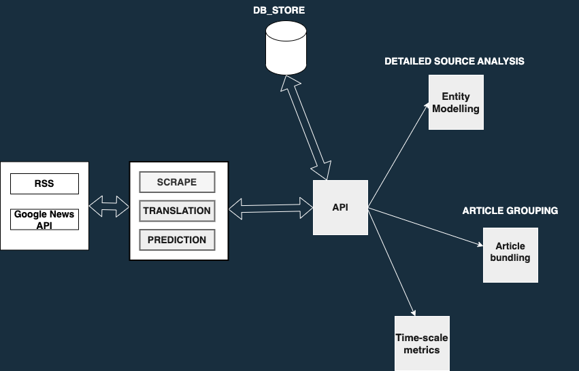
Deployment Overview
Notes:
Why is this required?
Feeds to our downstream objectives:
Process only verified sources for further analysis
Training news bundling model to group articles reporting the same incident.

Slide 5
Classifier
Preprocessing
Doc2Vec
PCA
Logistic Regression w/w Boosting
Prediction
Model | Recall Score | Precision | F1-score
Log. Regression w/w Boosting, n=30 embeding_dim = 100 (PCA) | 0.83 | 0.11 | 0.21
Log. Regression w/w Boosting, n=30 embeding_dim = 300 | 0.80 | 0.09 | 0.17
Log. Regression w/w Boosting, n=30 embeding_dim = 100 (PCA) - New Data | 0.88 | 0.17 | 0.28

Slide 6
Google News API
Search based API
Articles from multiple sources, based on search query

Slide 7


Slide 8

Classifier extracted Keywords

Slide 9
API Endpoints
/items : get first 100 items in the DB
/source: get source metrics in this schema -> [RSS_feed, Total_1, Total_0, Average_Hit_Rate]
Hit rate threshold
Total relevant articles per source
Start and End: Source metrics between specified time period
/getArticles/from={}_to{} : get all articles between these dates in "yyyy-mm-dd"

Slide 10
Features
# Articles : 1,511,992
# Sources : 3828
# Languages Translated: 45
# No of Relevant Articles: 92137
Notes:
Lang detect is at times faulty recognising english as other languages
But it is fine as its being

Slide 11
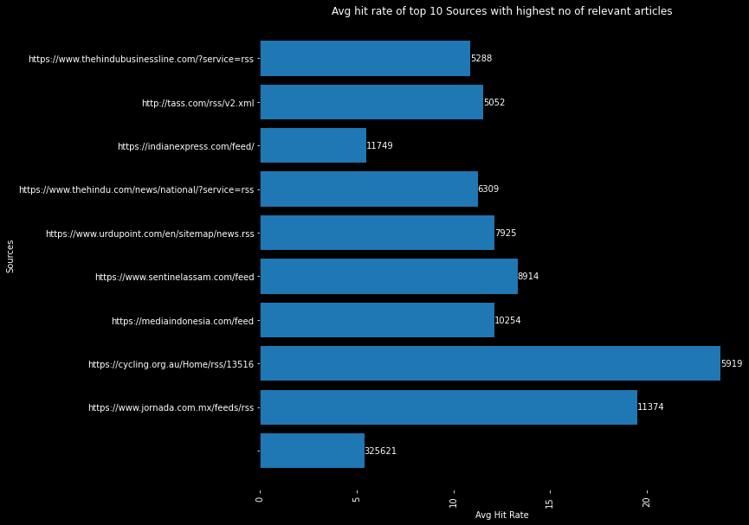
Relevant Sources

Slide 12
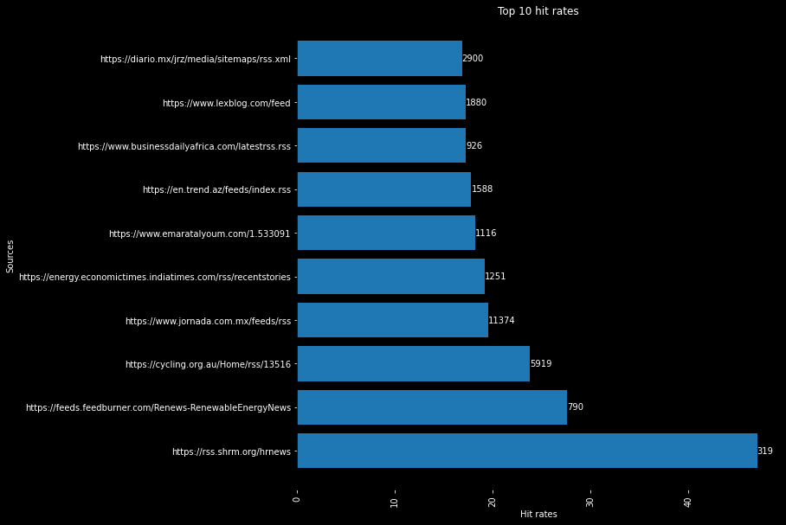

Slide 13
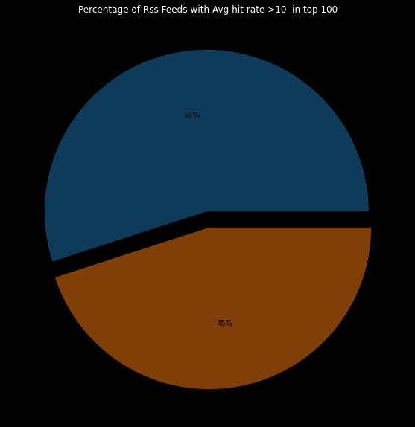

Slide 14


Database Migration

Slide 15


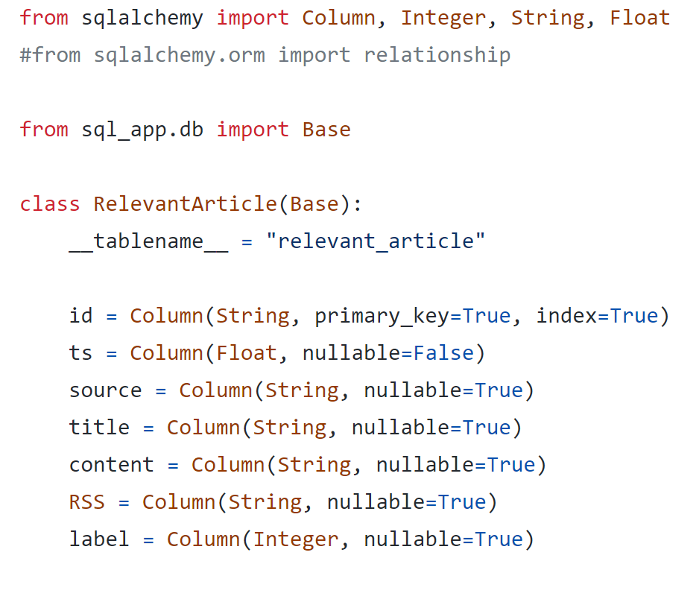
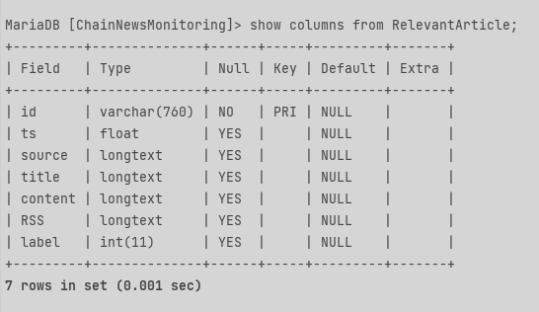
Database Migration

Slide 16




Challenges
Discovering new sources
Classifying existing articles
Migrating data

Slide 17
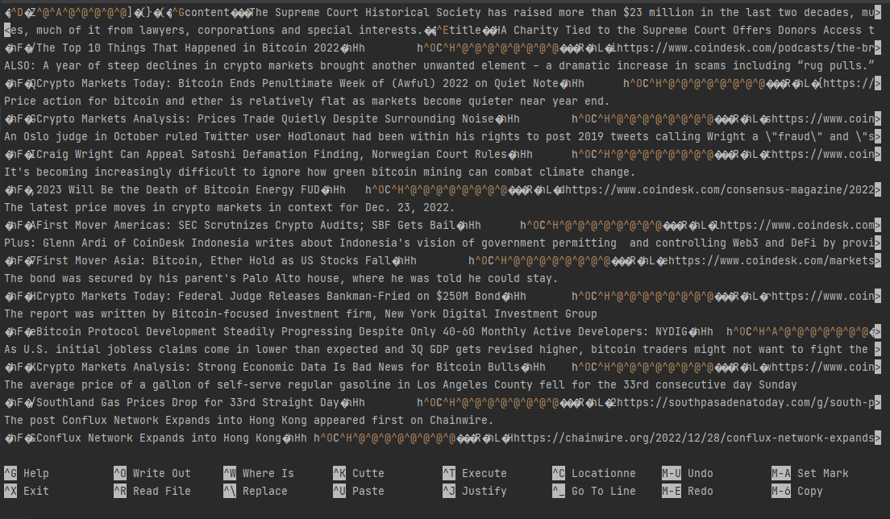
Future Development
Source Analysis
Database optimization

Slide 18
Questions

