Slide 1
Chain News Monitoring

Slide 2
Supply Chain Due Diligence Act
Act should reduce human right violations within global supply chains
Medium and large companies in Germany will be accountable and must act upon for violations that happen anywhere in their supply chain
Breaking the law can lead to penalties up to 2% of yearly revenue

Slide 3
RSS Feed Schema

Slide 4
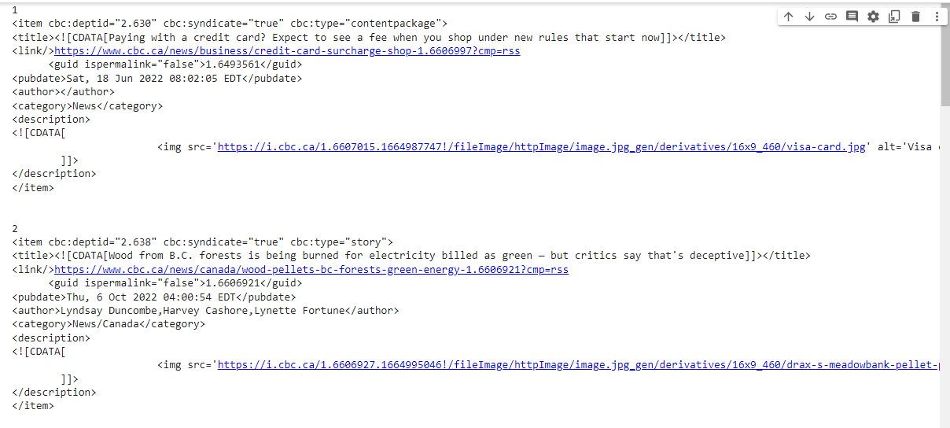

Slide 5
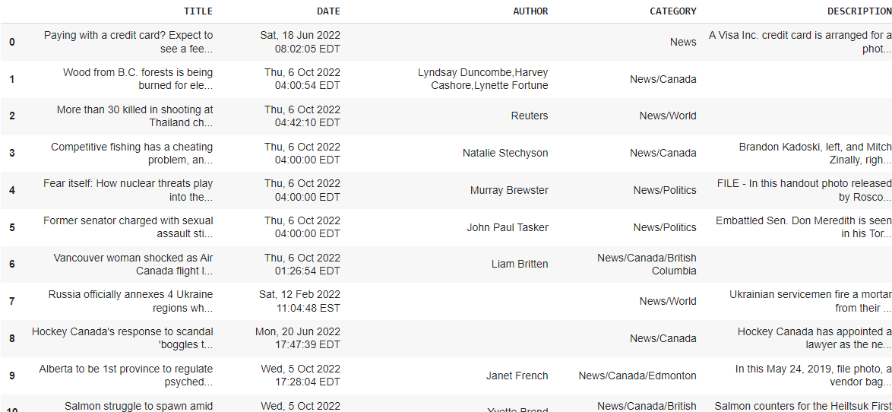

Slide 6
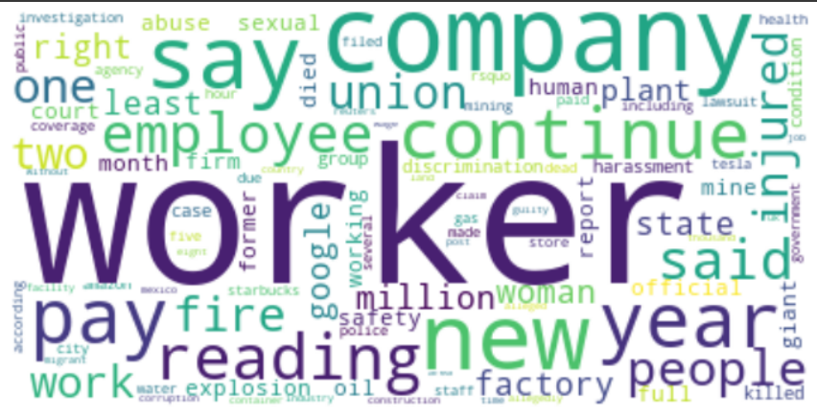
Keyword Identification

Slide 7
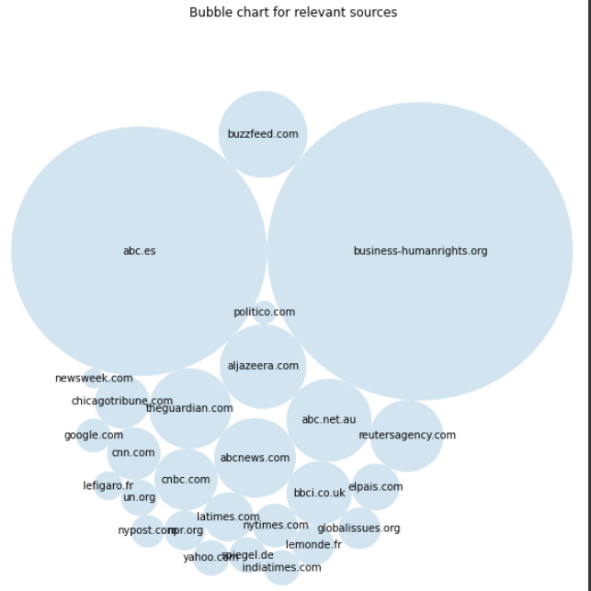
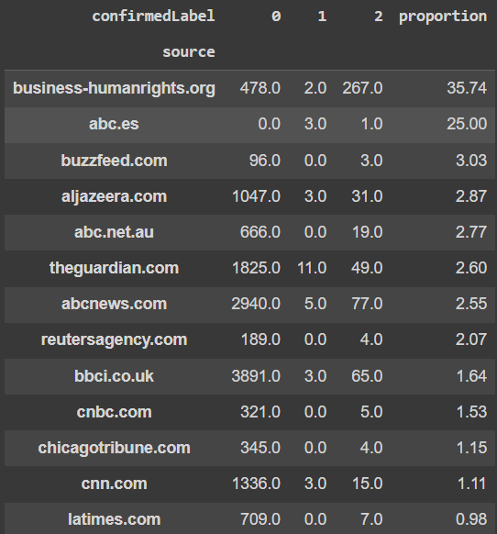
Source Coverage

Slide 8
Classifier Results
Model | Recall Score | Precision | F1-score
XGBoost | 0.00 | 0.00 | 0.00
XG-boost w/w Meta-Cost @r=5, m=50 | 0.1 | 0.53 | 0.17
XG-boost w/w Meta-Cost @r=20, m=50 | 0.35 | 0.19 | 0.25
Support Vector Classification (SVC) | 0.72 | 0.05 | 0.09
SVC w/w Meta-Cost | 0.98 | 0.02 | 0.04
Notes:
tp/fn+tp

Slide 9
Questions

