Slide 1
Chain News Monitoring

Slide 2
Supply Chain Due Diligence Act
Act should reduce human right violations and pollution within global supply chains
Medium and large companies in Germany will be accountable and must act upon for violations that happen anywhere in their supply chain
Breaking the law can lead to penalties up to 2% of yearly revenue

Slide 3
Project Overview
Infrastructure
(A) Server with database and periodically running tasks to discover
• (B) Discover new news sources
• (C) Assess quality of sources
• (D) Process news sources
(E) Rest-API to get detected relevant sources
NLP
(F) Simple Model to cheaply estimate relevance of an article
(G) Processing of whole article to extract relevant organizations and locations
(H) Bundling of relevant news articles covering the same incident

Slide 4
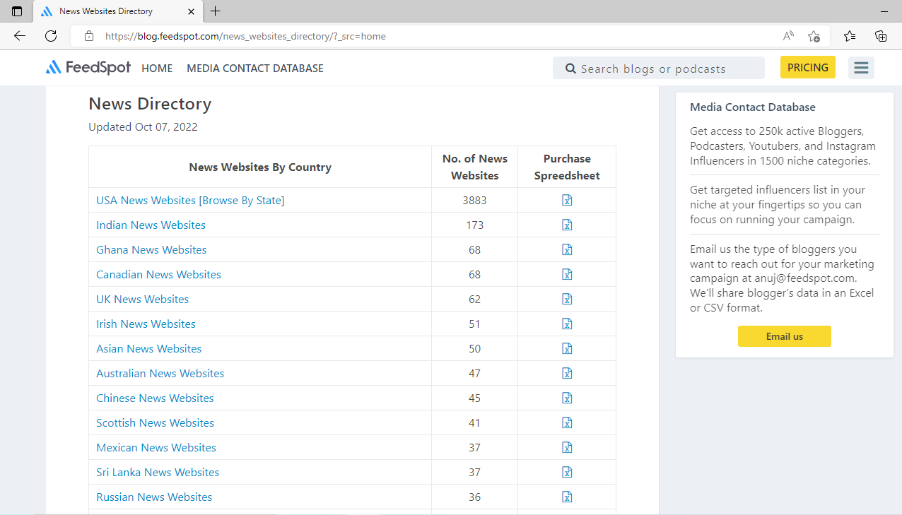
Scraper

Slide 5


Slide 6
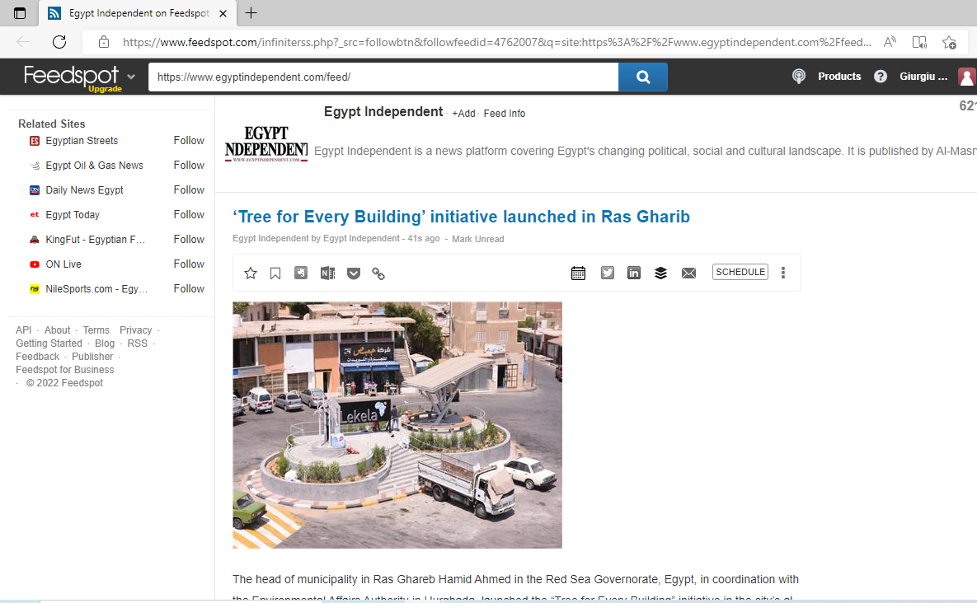

Slide 7
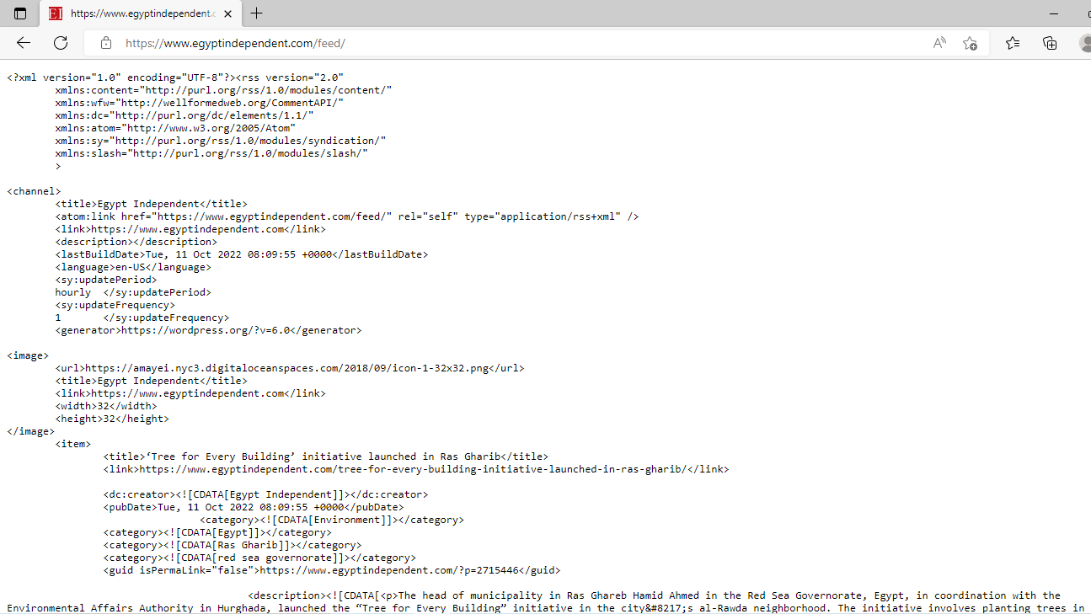

Slide 8
Storing Scraped Data
Scraped Data is stored in local Database presently.
CRUD operations and querying is handled through an API client.
Features:
POST and GET scraped data
Query meta-data metrics :
Sources scraped
Articles per Source

Slide 9
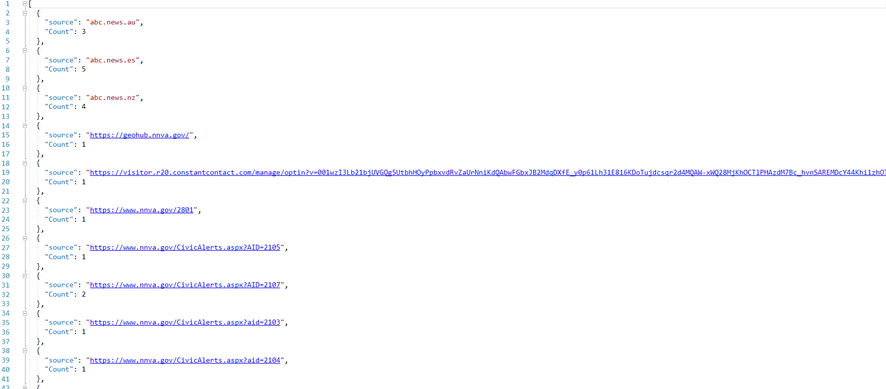

Slide 10
Keyword Classifier (Baseline Classifier)
Key word / (combination of key words)
Preprocessing
Prediction

Slide 11
Results
Model | Recall Score | Precision | F1-score
Baseline | 0.36 | 0.04 | 0.07
XGBoost | 0.00 | 0.00 | 0.00
XG-boost w/w Meta-Cost @r=5, m=50 | 0.1 | 0.53 | 0.17
XG-boost w/w Meta-Cost @r=20, m=50 | 0.35 | 0.19 | 0.25
Support Vector Classification (SVC) | 0.72 | 0.05 | 0.09
SVC w/w Meta-Cost | 0.98 | 0.02 | 0.04
Notes:
tp/fn+tp

Slide 12
Results on Scraped Data
Classifier | 0 | 1
Baseline | 2853 | 276
SVC | 2430 | 699

Slide 13
Some examples of Data labelled relevant
Man lays electric wire to kill wife but mother-in-law gets electrocuted in M.P.
Polish firms may start to cut employment costs says business lobby
LABOUR PAINS: Negotiations lead to withdrawal of suspension notices for maternity ward strike leaders at Dora Nginza Hospital
Business Maverick: Singapore Air won’t fire pregnant flight attendants anymore
ISS TODAY ANALYSIS: Congo Basin’s wildlife guardians in firing line from terror groups and poachers

Slide 14
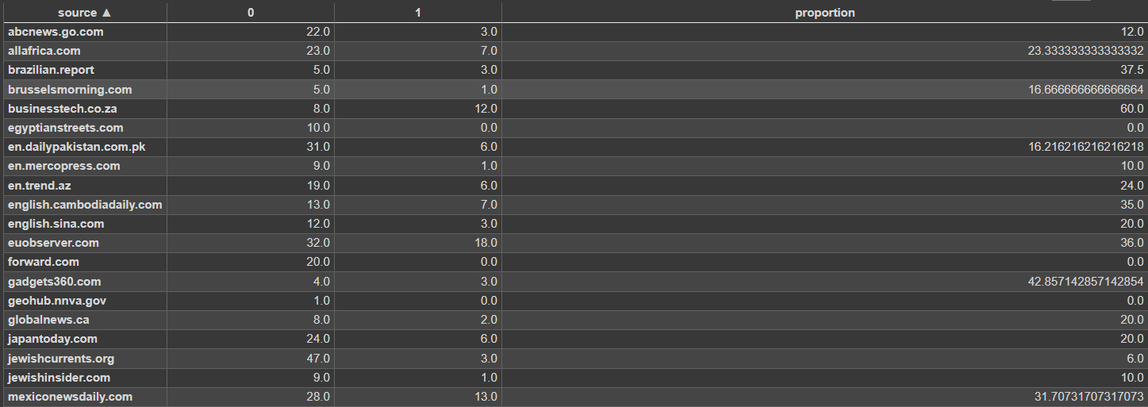

Slide 15
Questions

