Slide 1

ONLINE PAYMENT_FRAUD_DETECTION
NAME: R.PUJITHA
BATCH: 467

Slide 2
AGENDA
• Introduction
• Dataset Overview
• Data Cleaning
• Univariate Analysis
• Bivariate Analysis
• Multivariate Analysis
• Insights & Conclusion

Slide 3
INTRODUCTION
Online payment systems have grown rapidly, increasing the risk of fraudulent transactions.
Manual fraud detection is difficult due to large transaction volumes and complex patterns.
This project focuses on identifying fraudulent online payment transactions using data analysis.
Exploratory Data Analysis (EDA) is used to understand transaction behavior and fraud patterns.
Key features such as transaction type, amount, and balance changes are analyzed.
The project aims to support better fraud detection and improve online payment security.

Slide 4
WHY THIS PROJECT
Online payments are increasing rapidly, leading to a higher risk of fraud.
Fraud causes financial losses and reduces trust in digital payment systems.
Manual fraud detection is difficult due to large transaction volumes.
Data analysis helps identify hidden fraud patterns efficiently.
This project helps improve fraud prevention and strengthen online payment security.

Slide 5
UNDERSTANDING THE DATASET
Dataset Details
Dataset Type: Financial Transaction / Fraud Detection Data
Records: Large dataset (millions of transactions)
Features: 11 columns
Data Types: Numerical & Categorical
Key Columns
step – Time of transaction (hour)
type – Transaction type (TRANSFER, CASH-OUT, etc.)
amount – Transaction amount
oldbalanceOrg / newbalanceOrig – Sender balance before & after
oldbalanceDest / newbalanceDest – Receiver balance before & after
isFraud – Fraud indicator (1 = Fraud, 0 = Not Fraud)
isFlaggedFraud – System-flagged fraud indicator
Initial Observations
Fraud cases are very few (class imbalance)
Fraud mostly occurs in TRANSFER and CASH-OUT
Balance mismatches indicate possible fraud
isFlaggedFraud misses many fraud cases

Slide 6
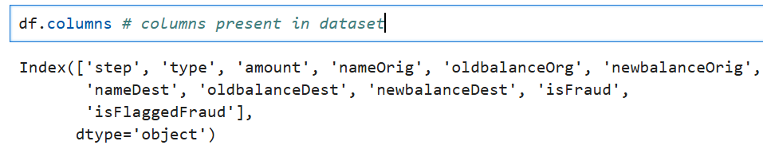
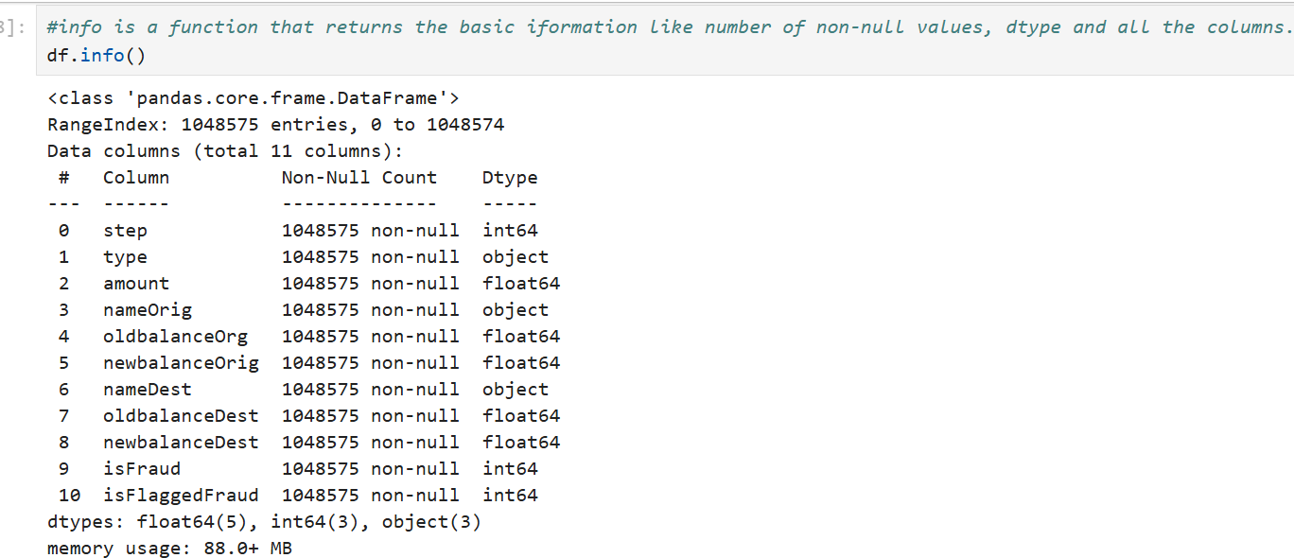
Information about the dataset

Slide 7
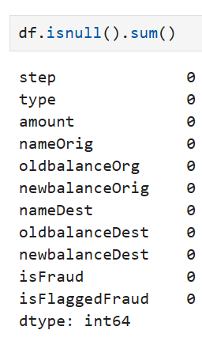
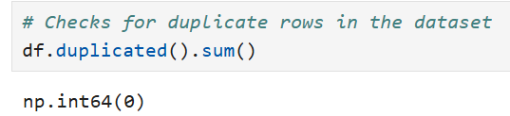
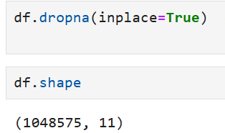
DATA CLEANING
Null Values Checking
Checking the duplicate values
Drop the Null values

Slide 8
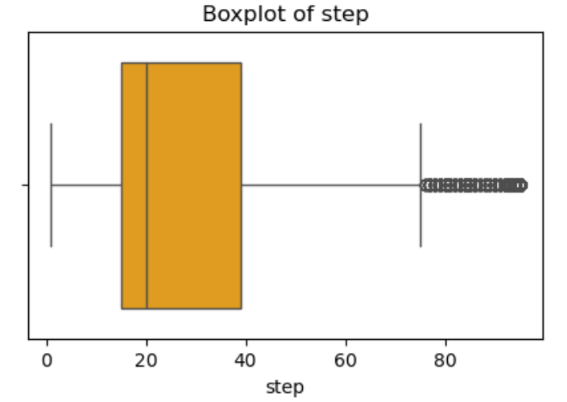
UNIVARIATE ANALYSIS
Most transactions occur in the lower to mid range of step values.
The median lies closer to the lower side, showing more activity in earlier time steps.
The distribution is right-skewed.
There are many outliers on the higher end, representing transactions at later time periods.
The spread is wide, indicating transactions occurred over a long duration.
No abnormal values on the lower side, so early-step data is consistent.

Slide 9
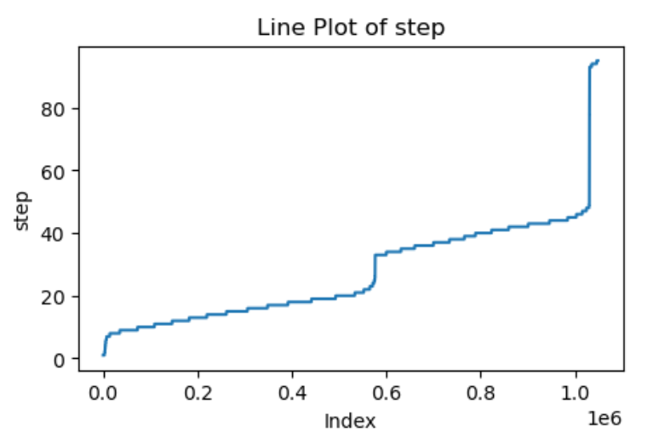
The step values show a clear increasing trend across the index.
This confirms that the data is time-ordered and transactions are recorded sequentially.
The plot has gradual increases with sudden jumps, indicating transitions between different time periods.
Higher step values appear towards the end, meaning later transactions are stored last.
No downward trend is observed, showing no time inconsistency in the dataset.

Slide 10
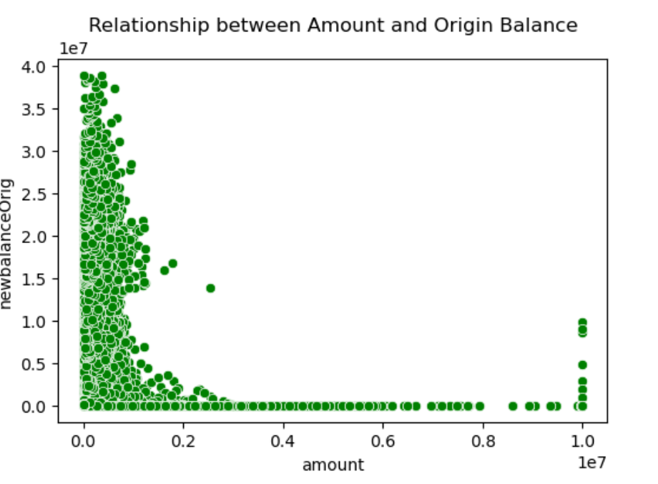
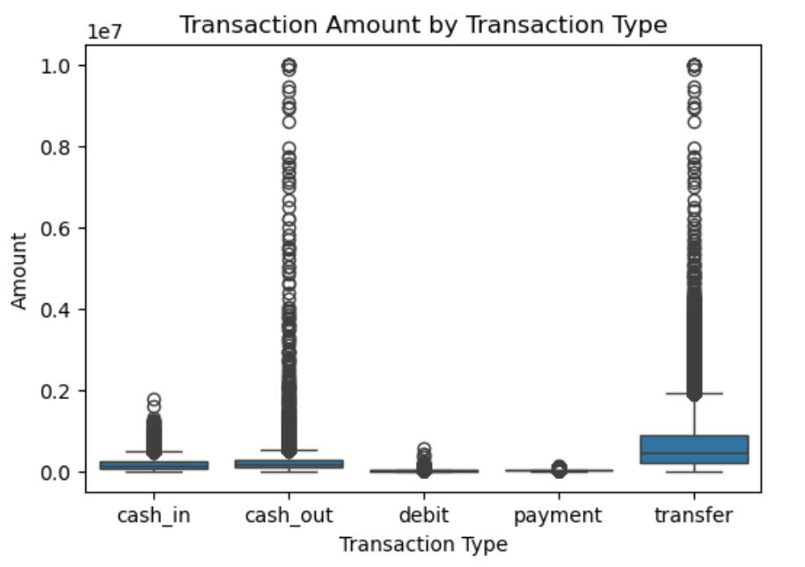
BIVARIATE ANALYSIS
Transfer transactions have the highest amounts.
Cash out transactions also involve large amounts.
Cash in transactions have medium amounts.
Debit and payment transactions have very small amounts.
Most transactions have small amounts
Very few transactions have large amounts
Many transactions leave the origin balance near zero
No clear relationship between amount and balance
Some outliers are present

Slide 11
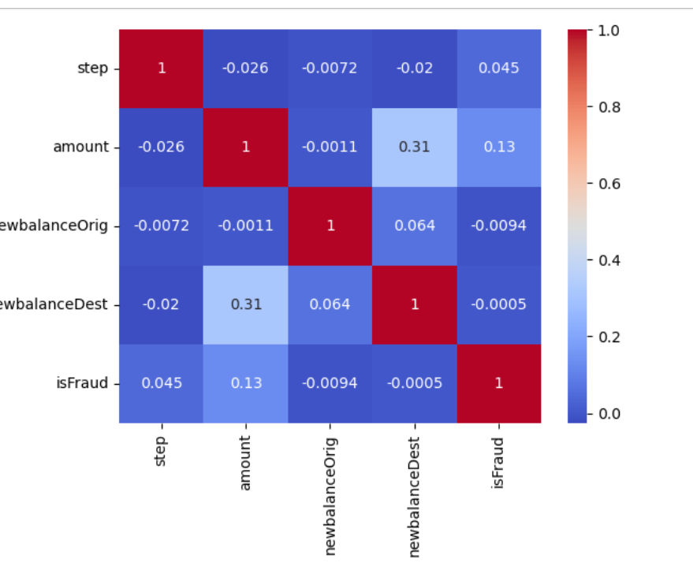
MULTIVARIATE ANALYSIS
Amount and newbalanceDest show a moderate positive correlation, meaning higher amounts increase destination balance.
isFraud has a weak positive relationship with amount, indicating fraud tends to involve higher amounts.
Step has very little correlation with other variables.
newbalanceOrig shows almost no correlation with fraud.
Overall, most features have weak correlations, except amount-related balances.

Slide 12
Insights
Fraud transactions are very few compared to normal ones.
Fraud mostly happens in high-amount transactions.
Transfer and cash-out types are more risky.
Conclusion
Fraud is linked to specific transaction types and large amounts.
Data analysis helps understand and detect fraud.
This project helps improve online payment safety.

Slide 13

THANK YOU

