Slide 1
A Seminar on Advancing Healthcare Privacy with Blockchain and Federated Learning Technologies
Team Details
Kavya Sree(20eg105433)
Thumma Pujitha(20eg105446)
Vanga Akhila(20eg105460)
Project Supervisor
Name: Dr Pallam Ravi
Designation: Assistant professor

Slide 2
Introduction What?
Collaborative Federated Learning combined with Blockchain in healthcare creates a privacy-preserving framework. This synergy allows multiple entities to collaboratively train machine learning models on decentralized data, ensuring data stays local. Blockchain ensures tamper-resistant records and transparent tracking of model updates, enhancing security. Patient privacy is preserved as sensitive health data remains distributed and accessible only for model improvement. This integration addresses privacy concerns while fostering collaborative advancements in healthcare analytics.

Slide 3
WHY?
Decentralized Security
Transparent Accountability
Patient Confidentiality
Data Ownership Empowerment
Regulatory Compliance

Slide 4
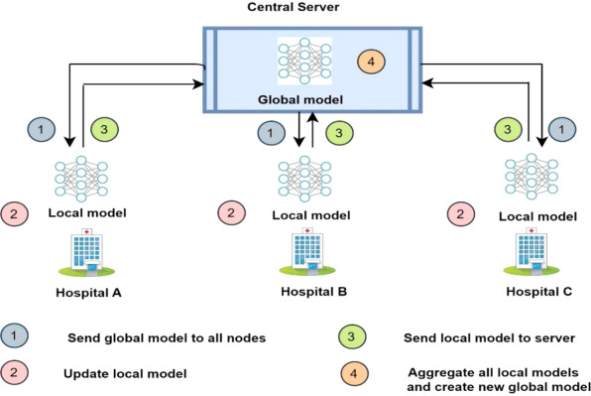
APPLICATIONS
Clinical Research
Disease Prediction and Prevention
Drug Discovery
Interoperable Health Records
Remote Patient Monitoring

Slide 5
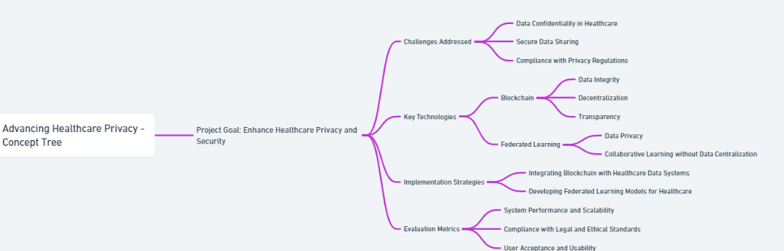
Concept Tree

Slide 6
Literature
Author(s) | Strategies | Advantages | Disadvantages
Dr. Jane Smith | Centralized Data Storage | Simplified management; efficient access control | High risk of data breaches; single point of failure
Doe Dr. John | Standard Encryption Techniques | Enhanced data confidentiality; proven methods | Complex key management; limited internal threat control
Dr. Alan Brown | Role-Based Access Control (RBAC) | Improved data security; prevents unauthorized access | Complex administration; inflexibility
Dr. Rachel Green | Regular Compliance Audits | Ensures legal compliance; identifies risks | Resource-intensive; may miss some issues

Slide 7
Problem Statement
In the healthcare sector, the management and sharing of sensitive patient data pose significant privacy and security challenges. Current systems often lack robust mechanisms to ensure data confidentiality while facilitating efficient data exchange. This project addresses these issues by integrating blockchain and federated learning technologies. These innovations aim to enhance data security, preserve patient privacy, and improve data sharing efficiency across various healthcare platforms, overcoming the limitations of traditional healthcare data management systems in a rapidly evolving digital landscape

Slide 8
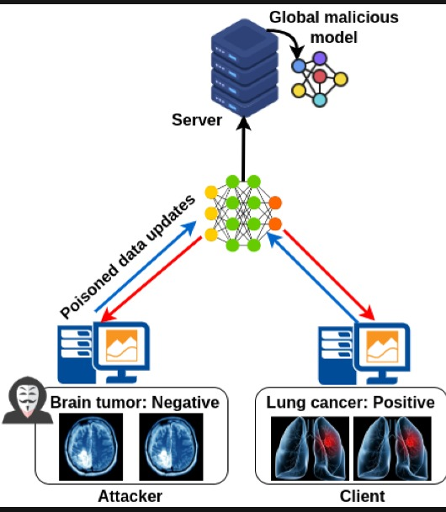
Problem Illustration

Slide 9
Proposed Method
Healthcare Privacy System:-
Step-1: Data Collection and Preprocessing
Step-2: Selection of Blockchain Technology
Step-3: Designing the Federated Learning Framework
Step-4: Integration of Blockchain with Federated Learning
Step-5: Data Preprocessing
Step-6 :Model Evaluation and Validation
Step-7: Deployment and Real-world Testing

Slide 10
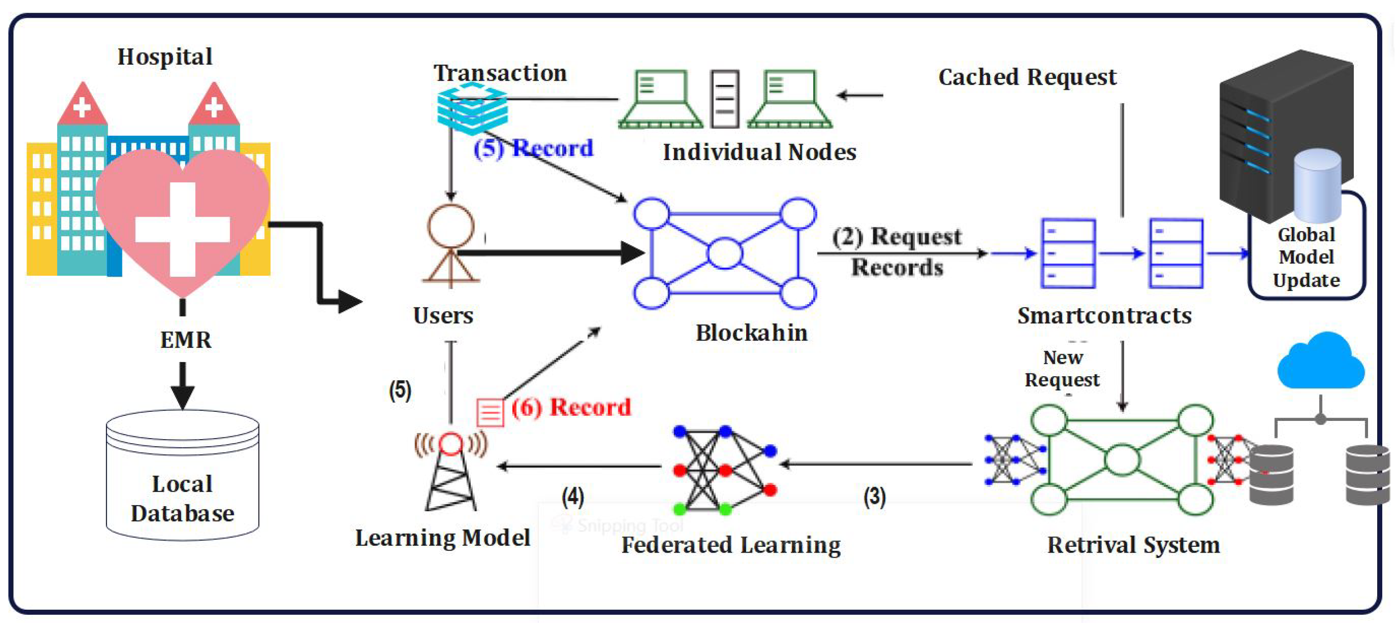

Slide 11
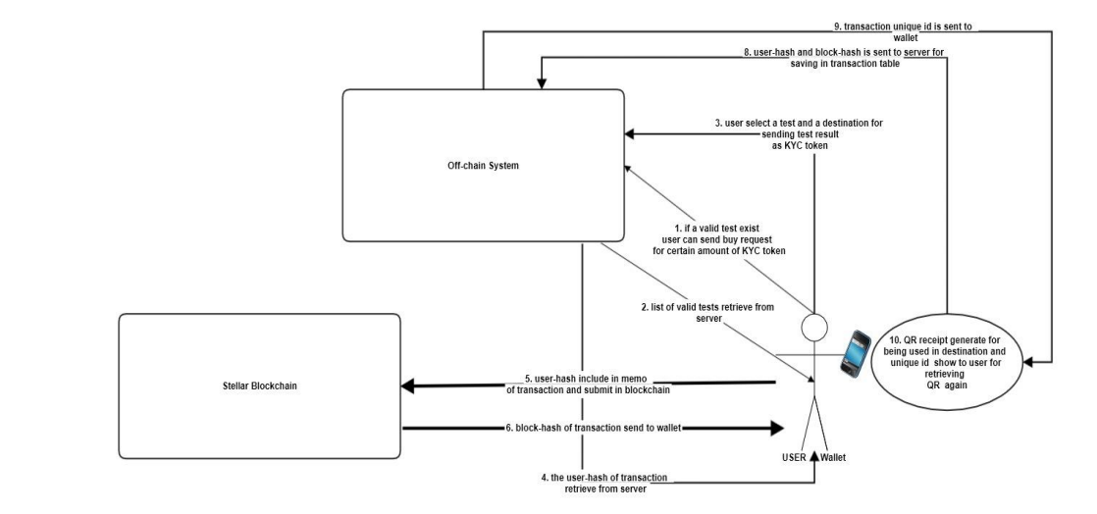
Proposed Method Illustration

Slide 12
Parameter
Blockchain Parameters:
Block Time (T):
Network Hash Rate (H):
Transaction Throughput (TP):
System Performance Metrics:
Latency (L):

Slide 13
Experiment Environment
Python IDE
Jupyter Notebook
Remix IDE
Visual Studio code

Slide 14
Project status
S.No | Functionality | Status (Completed /in-progress/Not started)
1 | Creating smart contract | completed
2 | Creating frontend | progress
3 | Connecting frontend and smart contract | Not completed
4 | Testing | Not completed

Slide 15
References
[1] Z. A. E. Houda, A. Hafid, and L. Khoukhi, “Brainchain - A machine learning approach for protecting blockchain applications using SDN,” in Proc. IEEE Int. Conf. Commun., 2020, pp
[2] D. Ravıetal., “Deep learning for health informatics,” IEEE J. Biomed. Health Inform., vol. 21, no. 1, pp. 4–21, Jan. 2017.
[3] W. Y. B. Lim et al., “Dynamic contract design for federated learning in smart healthcare applications,” IEEE Internet Things J., vol. 8, no. 23, pp. 16853–16862, Dec. 2021.
[4] B. Brik, A. Ksentini, and M. Bouaziz, “Federated learning for UAVsenabled wireless networks: Use cases, challenges, and open problems,” IEEE Access, vol. 8, pp. 53841–53849, 2020
[5] ] S. Samarakoon, M. Bennis, W. Saad, and M. Debbah, “Distributed federated learning for ultra-reliable low-latency vehicular communications,” IEEE Trans. Commun., vol. 68, no. 2, pp. 1146–1159, Feb. 2020

Slide 16
Thank you

Slide 17
Project seminar–I Evaluation
S.No | Rubrics | Marks
1 | Concept Introduction | 4
2 | Literature and Parameter | 5
3 | Problem and Problem Illustration | 8
4 | Proposed Method and Illustration | 8
Total |  | 25

