Slide 1
Advancing Healthcare Privacy with Blockchain and Federated Learning Technologies
Team Details
Kavya Sree(20eg105433)
Thumma Pujitha(20eg105446)
Vanga Akhila(20eg105460
Project Supervisor
Name: Dr Pallam Ravi
Designation: Assistant professor

Slide 2
Introduction
Collaborative Federated Learning combined with Blockchain in healthcare creates a privacy-preserving framework. This synergy allows multiple entities to collaboratively train machine learning models on decentralized data, ensuring data stays local. Blockchain ensures tamper-resistant records and transparent tracking of model updates, enhancing security. Patient privacy is preserved as sensitive health data remains distributed and accessible only for model improvement. This integration addresses privacy concerns while fostering collaborative advancements in healthcare analytics.

Slide 3
Need
Decentralized Security
Transparent Accountability
Patient Confidentiality
Data Ownership Empowerment
Regulatory Compliance

Slide 4
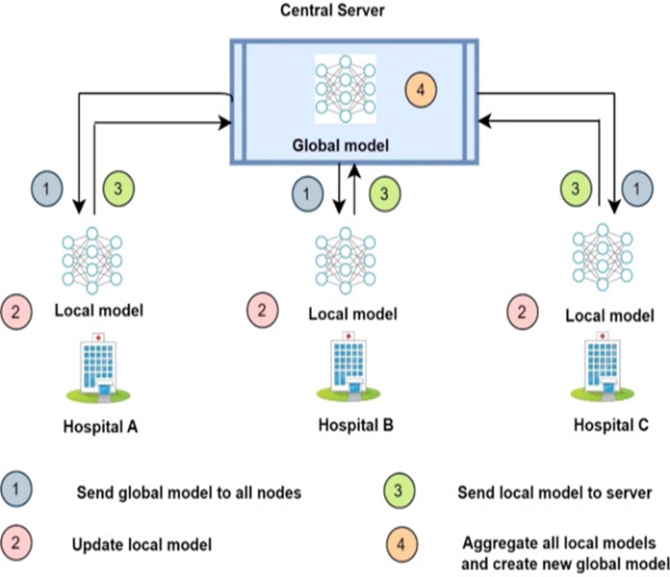
APPLICATIONS
Clinical Research
Disease Prediction and Prevention
Drug Discovery
Interoperable Health Records
Remote Patient Monitoring

Slide 5
Problem Statement
In the healthcare sector, the management and sharing of sensitive patient data pose significant privacy and security challenges. Current systems often lack robust mechanisms to ensure data confidentiality while facilitating efficient data exchange. This project addresses these issues by integrating blockchain and federated learning technologies. These innovations aim to enhance data security, preserve patient privacy, and improve data sharing efficiency across various healthcare platforms, overcoming the limitations of traditional healthcare data management systems in a rapidly evolving digital landscape

Slide 6
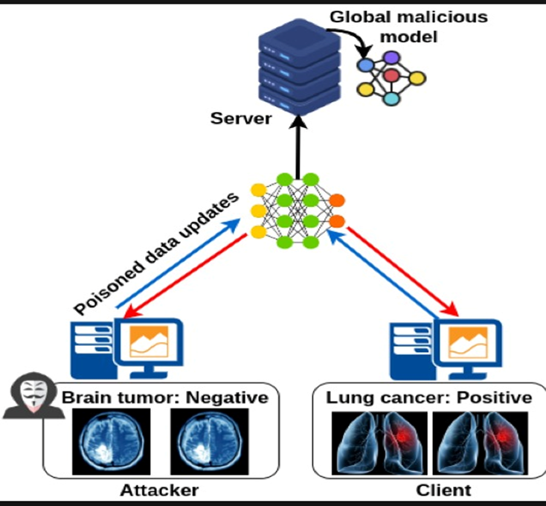
Problem illustration

Slide 7
Proposed Method
Healthcare Privacy System:-
Step-1: Data Collection and Preprocessing
Step-2: Selection of Blockchain Technology
Step-3: Designing the Federated Learning Framework
Step-4: Integration of Blockchain with Federated Learning
Step-5: Data Preprocessing
Step-6 :Model Evaluation and Validation
Step-7: Deployment and Real-world Testing

Slide 8
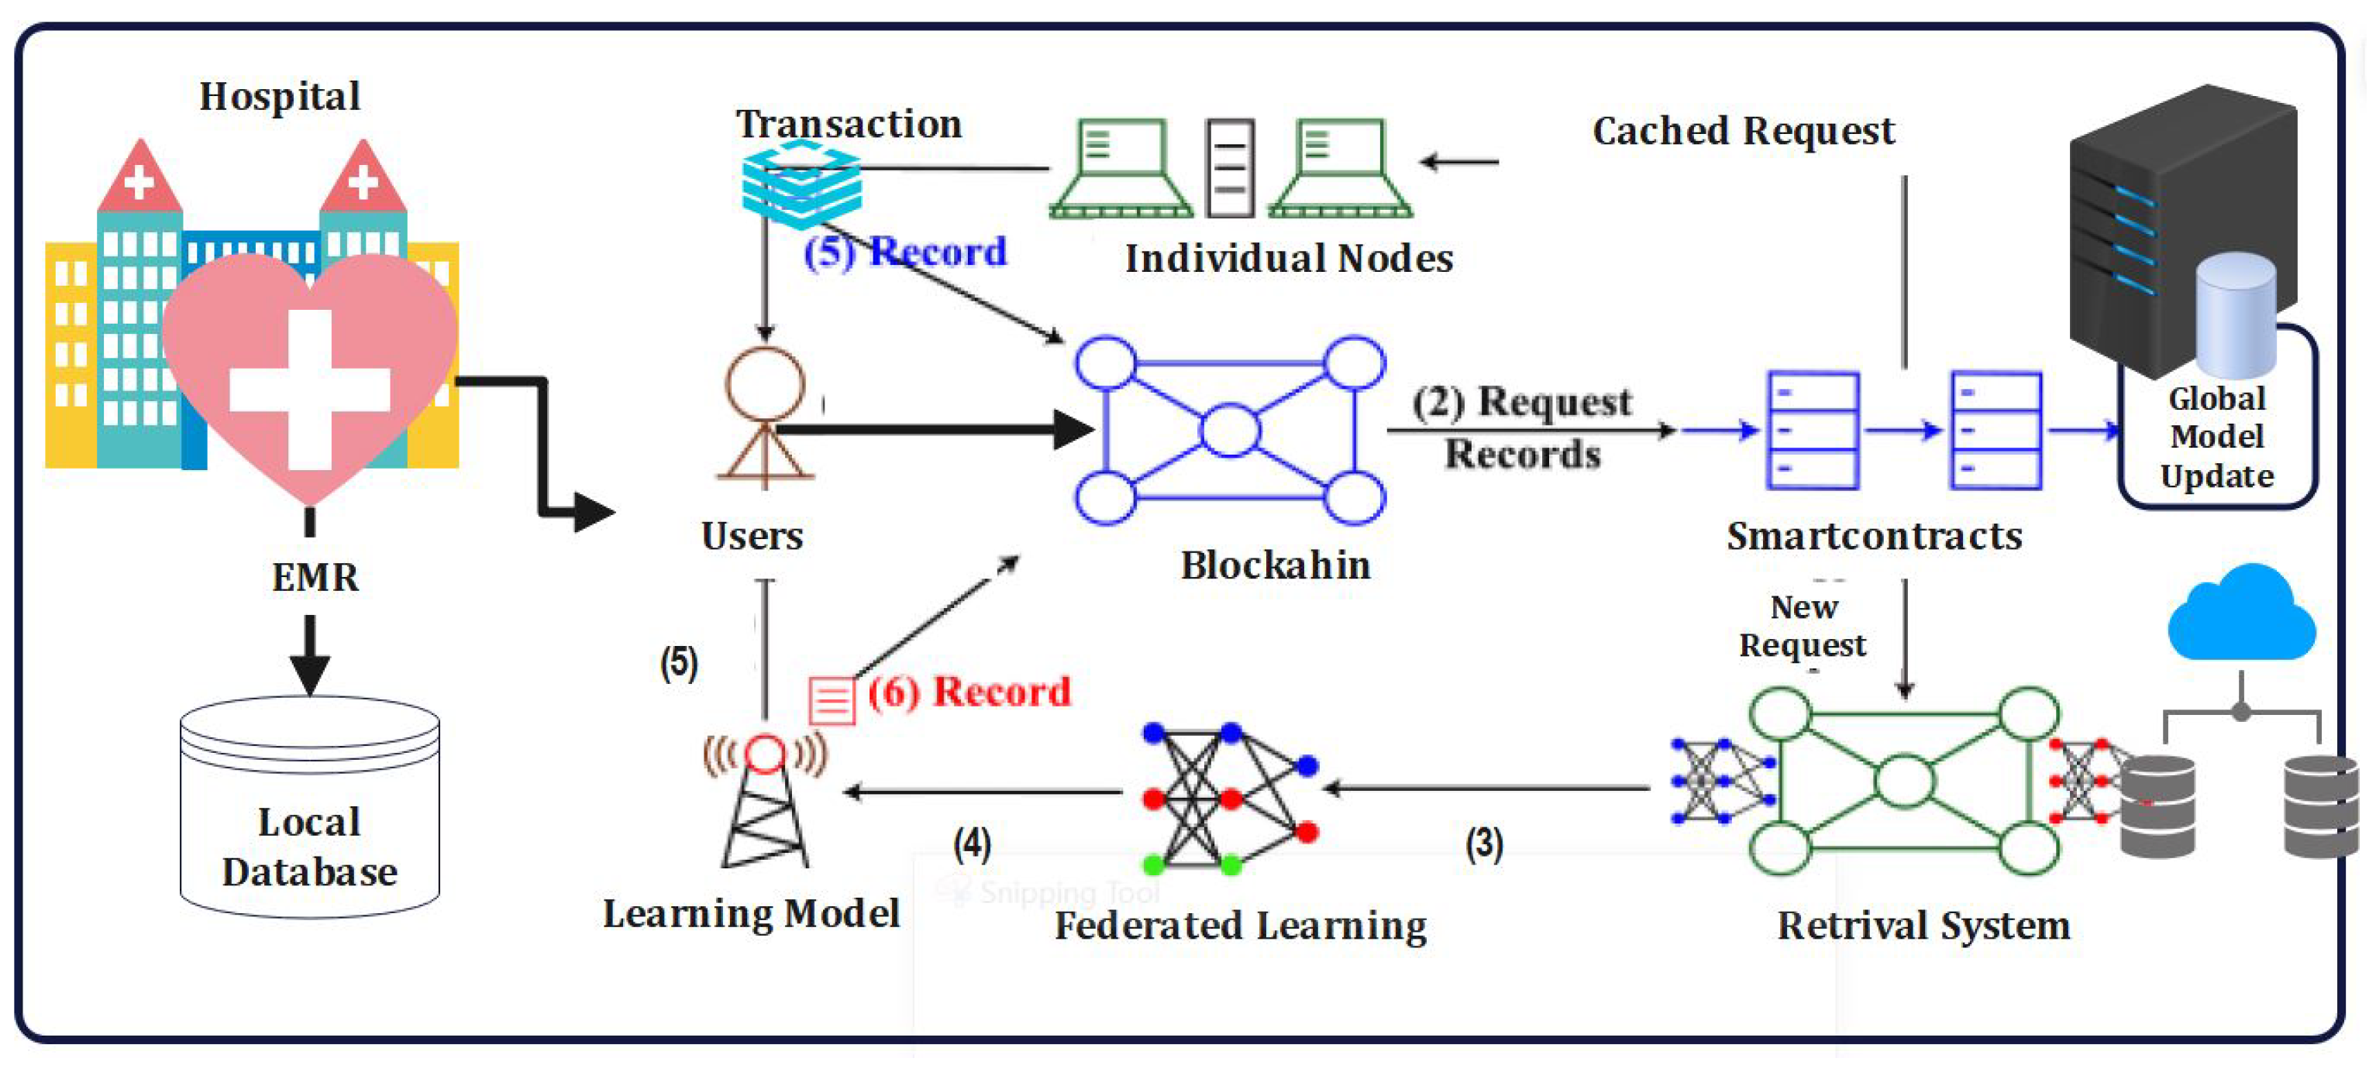

Slide 9
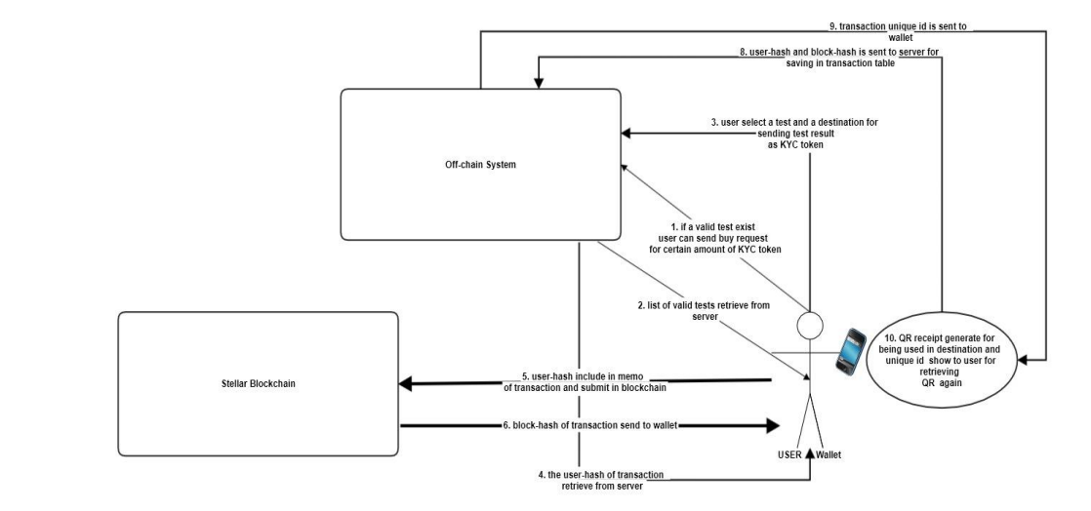
Proposed Method
Illustration :

Slide 10
Experiment Environment
Remix IDE
Visual Studio code
Browser
Meta mask
React JS

Slide 11
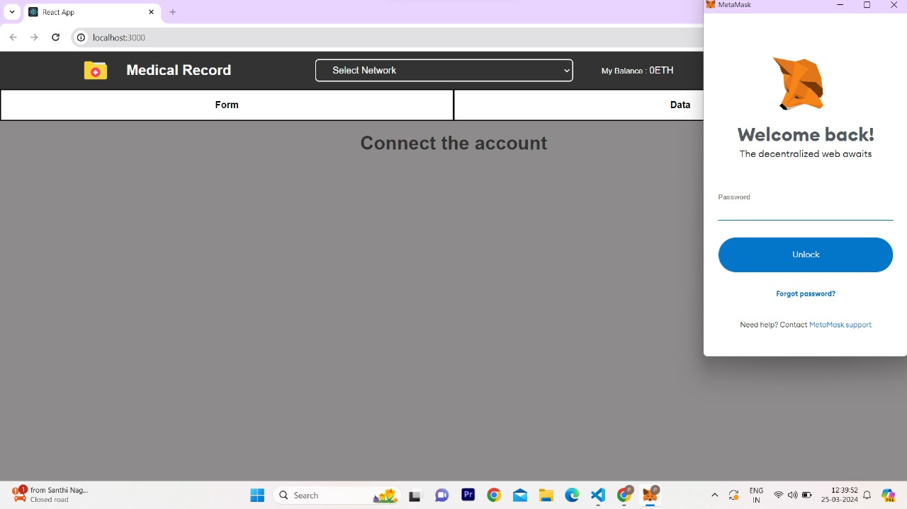
Experiment Screen shorts

Slide 12
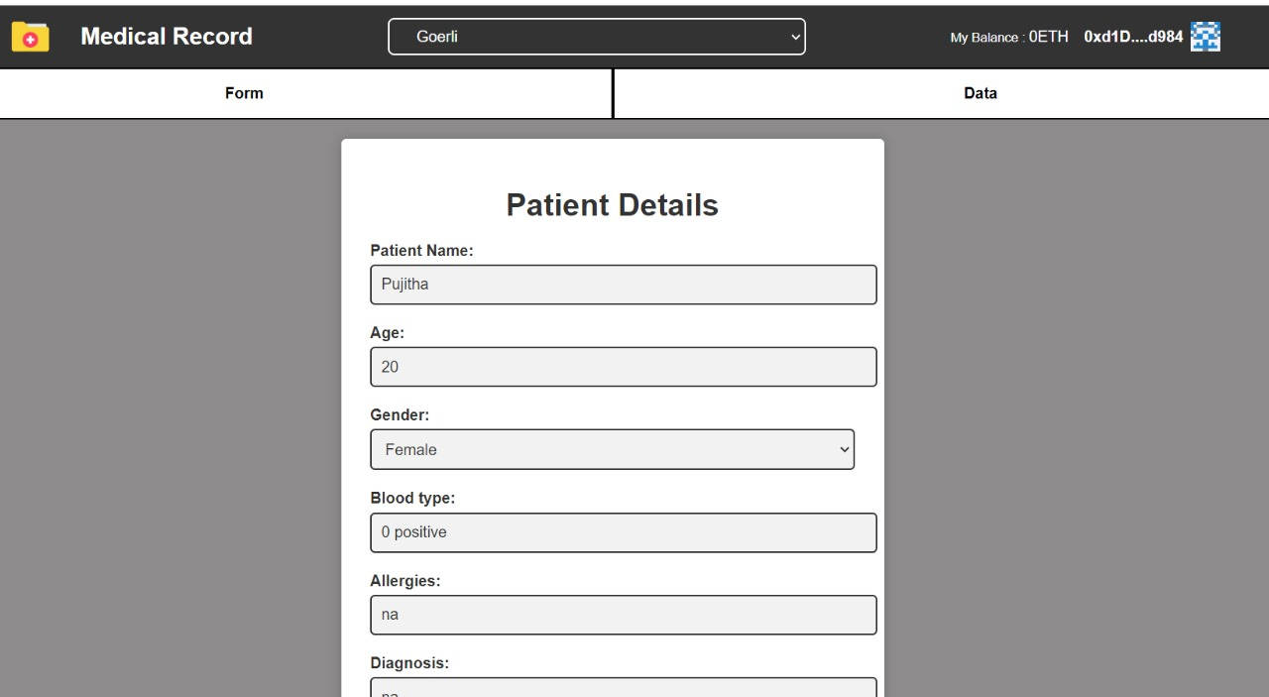
Experiment Results

Slide 13

Experiment Results

Slide 14
Finding
Through our experiments, we have demonstrated that our proposed blockchain-based health system offers substantial improvements in privacy, security, and confidentiality compared to traditional centralized systems. By leveraging blockchain technology, we enhance data protection, integrity, and accessibility while fostering trust and transparency in the patient data.

Slide 15
Justification
Parameters improved by this method:
1.Encryption Key size: 256 bits encryption longer key length for increased security
2.Blockchain technology : Enhanced blockchain with adaptive transaction validation
3.Data trust framework : Comprehensive data trust framework with blockchain auditing

Slide 16
Justification
Parameter Formulas:
1. Block Time(T):
T=Total time / Number of Blocks
2. Network Hash rate(H):
H= Total number of hashes / Total time
3.Transactions Throughput(TP):
TP= Total Transactions/ Total time
4. Latency(L):
L= Total time / Total Processed Transactions

Slide 17
THANK YOU

