Slide 1
Plugin Sonar Frama-C
Sonar Plugin for the code analysis tool: Frama-C

Slide 2

Get started with Sonar Plugin Frama-C
Sonar Server (OPS)
VirtualBox and VMs
Sonar configuration
Deploy & run
Development environment (DEV)
Java JdK
Eclipse

Slide 3
Plugin architecture
languages: Specific Plug-in language
measures: Metrics and computed measures definitions
report: Parse a Frama-C output report
rules: Frama-C rules definition
sensor: Sensor executed by sonar-scanner into Frama-C projects
settings: Plug-in preference

Slide 4
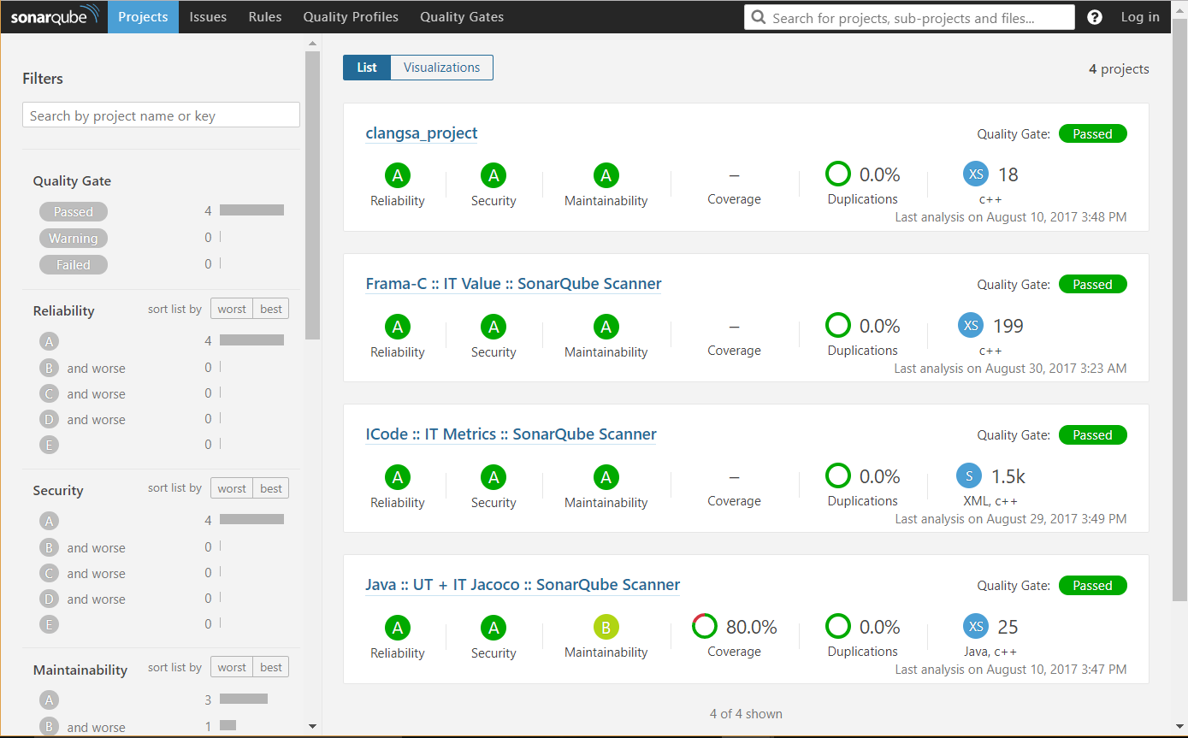
Prepare Frama-c project
Source files:
File name: *.c, *.i
Sonar.properties
Report directory:/oracle
Report files:
Into the report directory
Same name as source file

Slide 5
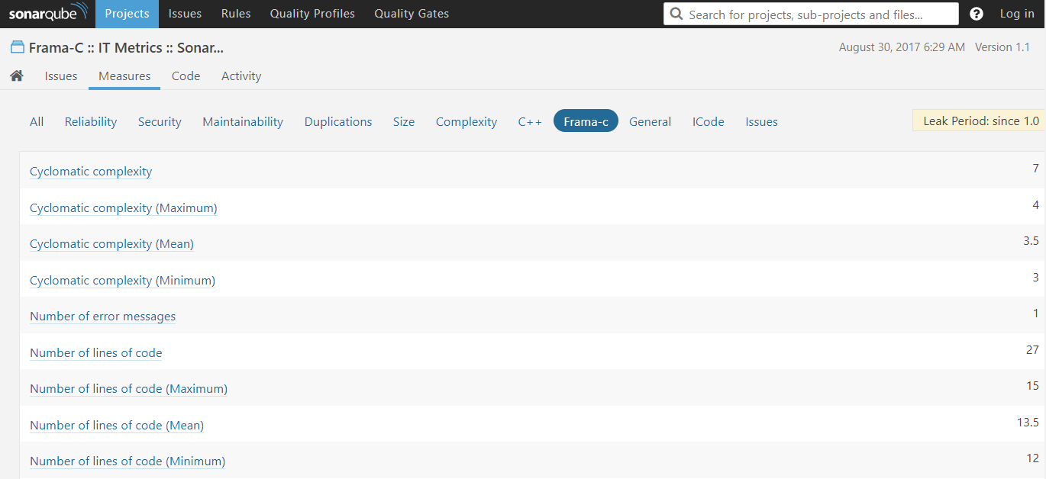
Analyse a Frama-C project
Sonar scanner
Metrics:
Cyclomatic complexity (Sum, Mean, Min, Max)
Line of codes: SLOC (Sum, Mean, Min, Max)
Sonar web

Slide 6
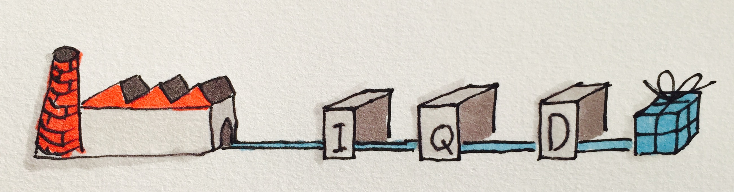
DeVOPS
From a new plugin revision
To a new project analysis into Sonar
=> deploy-plugin.sh

Slide 7

Quality Profiles & Rules
Frama-C default Quality Profile without rules
Create a new Quality Profile
Pattern matching

Slide 8
Frama-C rules & issues
Plug-in resources: framac-rules.xml
Sonar issues
Expected pattern | Rule
[value] warning: | VALUE.0
[value] warning: accessing uninitialized left-value | VALUE.1
[value] warning: signed overflow | VALUE.2
[value] warning: global initialization of volatile variable | VALUE.3
[value] warning: non-finite | VALUE.4
[value] warning: initialization of volatile variable | VALUE.5
[value] warning: pointer comparison | VALUE.6
[value] warning: division by zero | VALUE.7
[value] warning: locals | VALUE.8
[value] warning: detected recursive call | VALUE.9
[value] warning: during initialization of variable | VALUE.10
[value] warning: ignoring non-existing function | VALUE.11

Slide 9
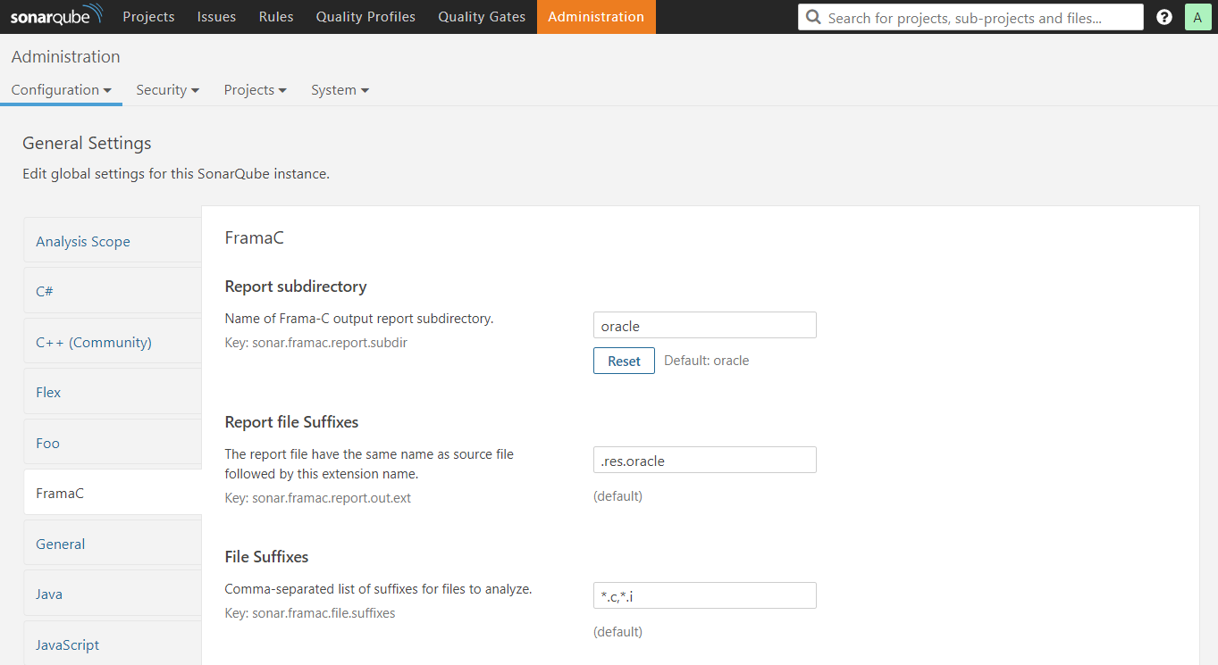
Plugin FRAMA-C preferences
File suffixes for FramaCLanguage
Report file suffixes:
Replace the source file extension
Report sub-directory
Plugin metrics:
Number of error messages
Report files error

Slide 10

Continuous Integration (CI)
Github -> Travis -> sounar.cloud
Create Travis and sonar.cloud account
Configure Travis into Github project
Add sonar.cloud key to .travis.yml
Demo & CNES Github/Travis/etc settings

Slide 11
Conclusion
Generic architecture
Frama-C rules definition with properties file
Simples plug-in preferences
Ready to DevOps & CI
Compliant with ICode requirements ?
How to define a new Frama-C rule ?
How to associate Frama-C warning to a Sonar Rule ?

