Slide 1
Interactive Question & Answer System for Restaurant Information
Satish Kumar, Yagnesh Vadalia, Sriharish Ranganathan

Slide 2
Introduction
Simple and Interactive question and answer chatbot to get restaurant information
Chatbot understands the type of question What, When, Why, Who, Where, Which, How
It ranks the restaurant for the relevant restaurant based on the question parameters and a set of rules defined for each type of question
The system returns the most relevant answer to the question

Slide 3
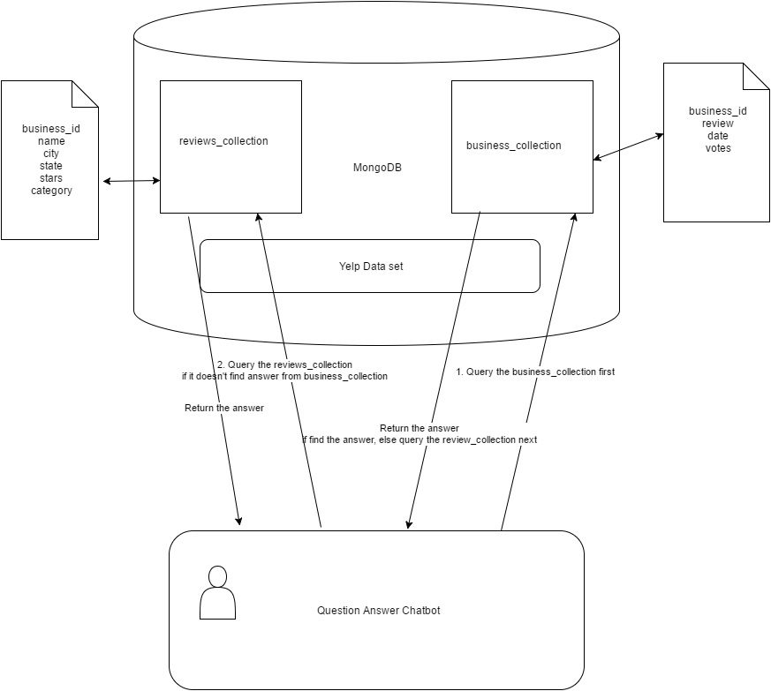
Architecture

Slide 4
Our Progress!
answerBusinessQuestion(question)
First it will check if the question can be answered from the database
If we are not able to get the answer from database, we will get the answer from the reviews.
getNN(text)
Get the question type
getRestaurantName(question)
Get the restaurant name in the question.

Slide 5
Our Progress!
parseQuestion(question)
parse subject, object and nmod from the question
parseQuestionNltk(question)
parse name entity from the question
formQuery(question, quesType,restaurant_name,questionParsed,questionParsedNltk,questionParsedStanford)
It will query MongoDB for getting the answer based on type of question and test present in question

Slide 6
Our Progress!
parse_review(review_filename)
Tokenize all the text present in reviews and store them in dictionary
removeStopWordsAndTagPOS(review_dict)
for each line remove the stopwords and tag the part of speech on the the text without stopwords
data_forward(question,review_dict)
remove stopwords from the questions and find a match of the words in question in review dictionary

Slide 7
Our Progress!
get_bestlines(question,text_list,reviewPOS_dict)
match the words and part of speech in the review text with questions and gives out the best match
wordMatch(question, line, reviewPOS_dict)
Tokenization and Stemming of question text
match all the words in question with the review and score each line of the review.
if we have a verb match we are scoring it more than a normal match
answerThis(question)
It will take a question as input to get the answer from the review dictionary

Slide 8
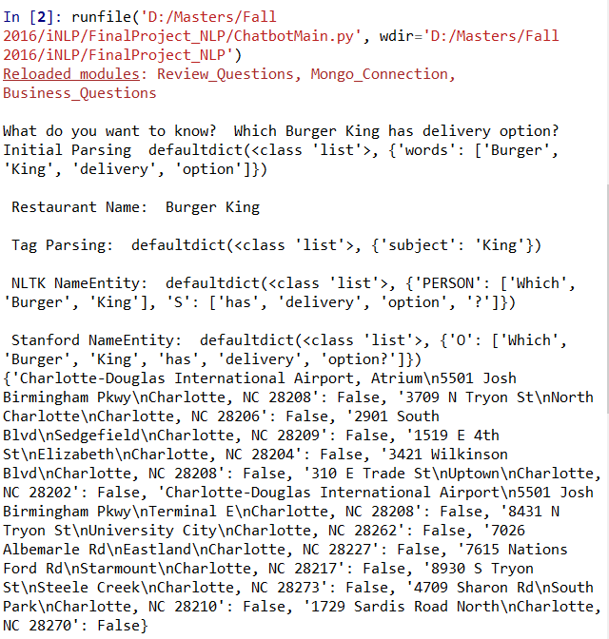
Output – Query from DB

Slide 9
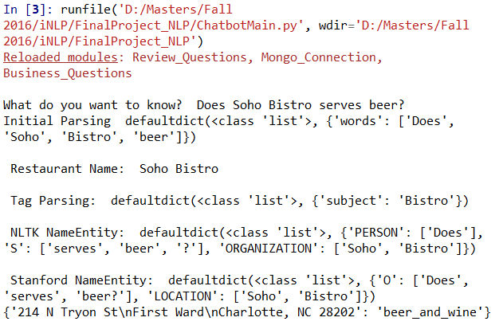
Output – Query from DB

Slide 10
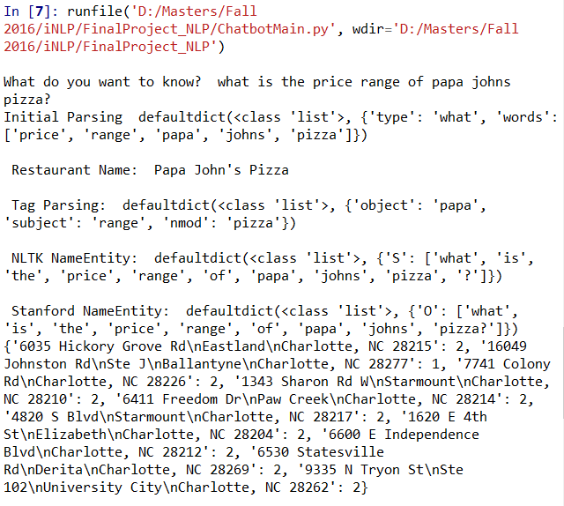
Output – Query from DB

Slide 11
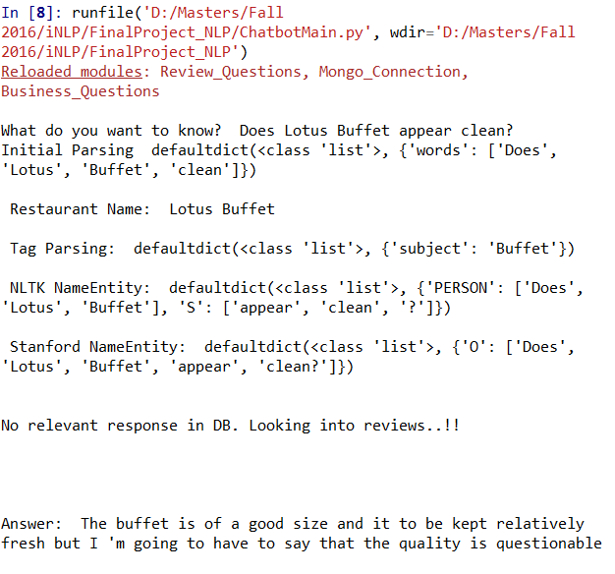
Output – Response from Reviews

Slide 12
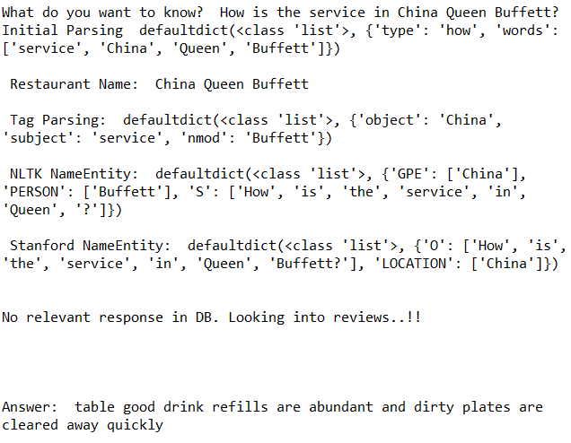
Output – Response from Reviews

Slide 13
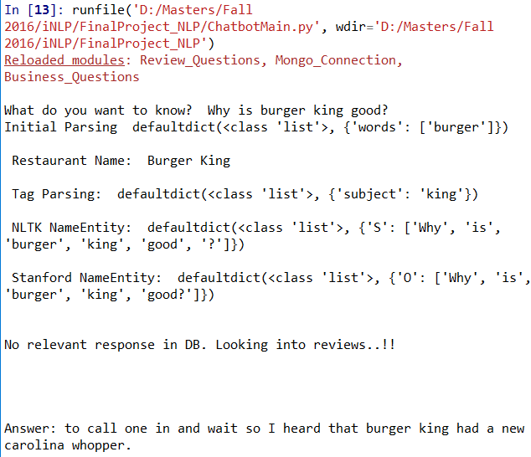
Output – Response from Reviews

Slide 14
What next?
We can try to get restaurant for all the states in the database and have some more scoring techniques.
This may improve accuracy since more reviews are available.

