Slide 1
AI-Powered Study Buddy
CAPSTONE PROJECT
Presented By:
Student Name- P MAHA LAKSHMI
College Name- Swarnandhra College Of Engineering And Technology , Seetharamapuram, Andhra Pradesh.
Department- CSD

Slide 2
OUTLINE
Problem Statement
Proposed System/Solution
System Development Approach
Algorithm & Deployment
Result
Conclusion
Future Scope
References

Slide 3

Problem Statement
Students often struggle to understand complex concepts while studying. Searching online gives long or irrelevant results, and teachers may not always be available. There is a need for a tool that can explain topics in simple terms, summarize study notes, and generate quizzes or flashcards on demand using AI.

Slide 4
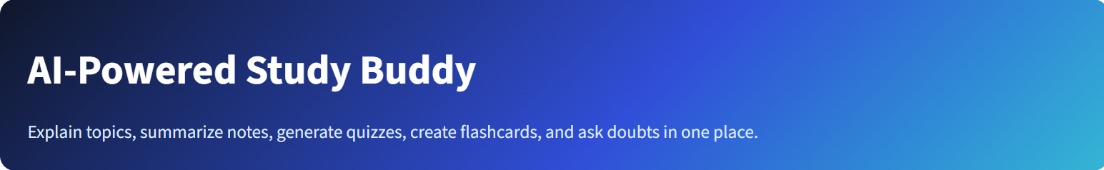
Proposed Solution
• AI-powered learning assistant built with Streamlit and Groq LLM.
• Upload PDF notes or paste study material.
• Generate summaries, quizzes, and flashcards automatically.
• Explain topics at Beginner, Intermediate, and Advanced levels.
• AI Tutor provides personalized doubt-solving support.

Slide 5
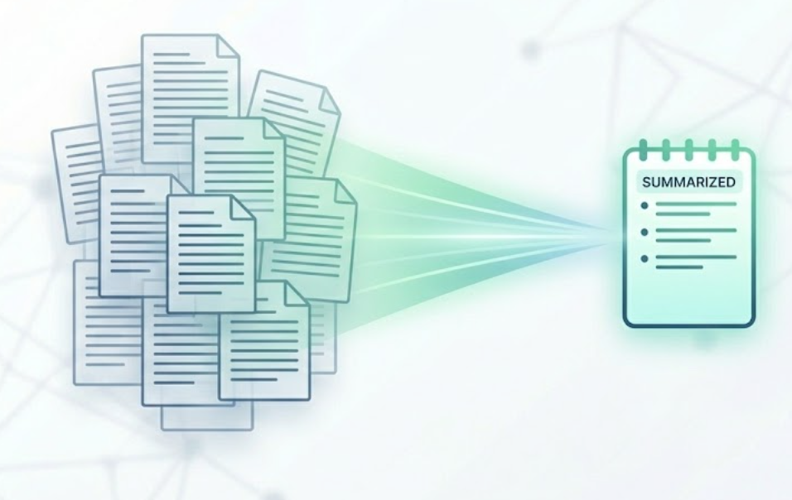
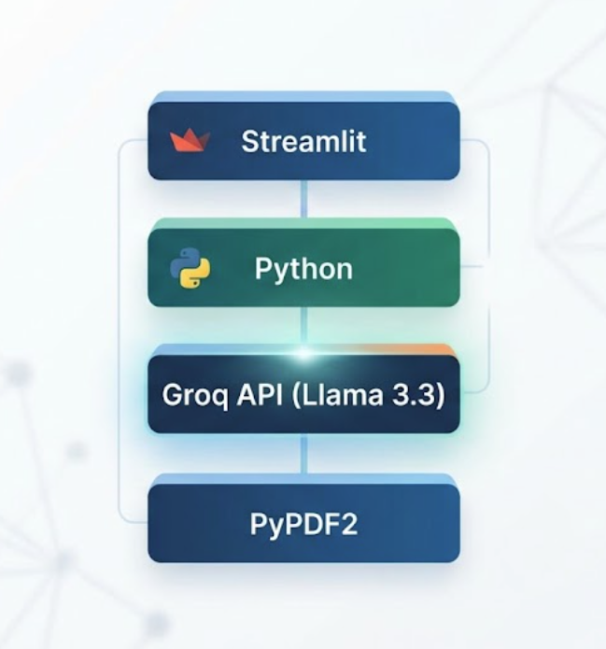
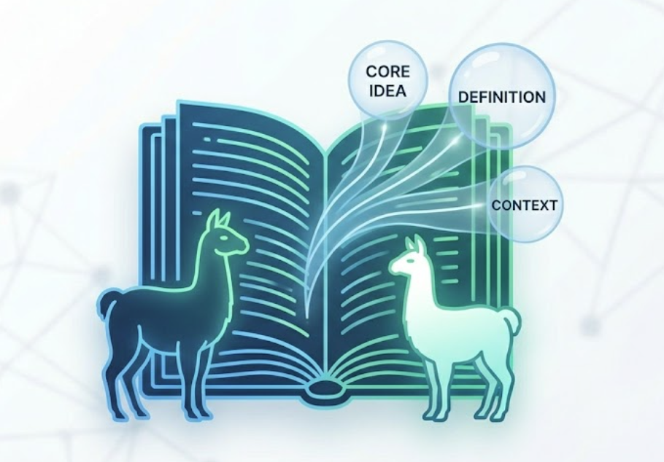
System Approach
Technologies Used:
• Python
• Streamlit
• Groq API (Llama 3.3)
• PyPDF2
• python-dotenv
Modules:
• Topic Explainer
• Notes Summarizer
• Quiz Generator
• Flashcard Generator
• AI Tutor

Slide 6
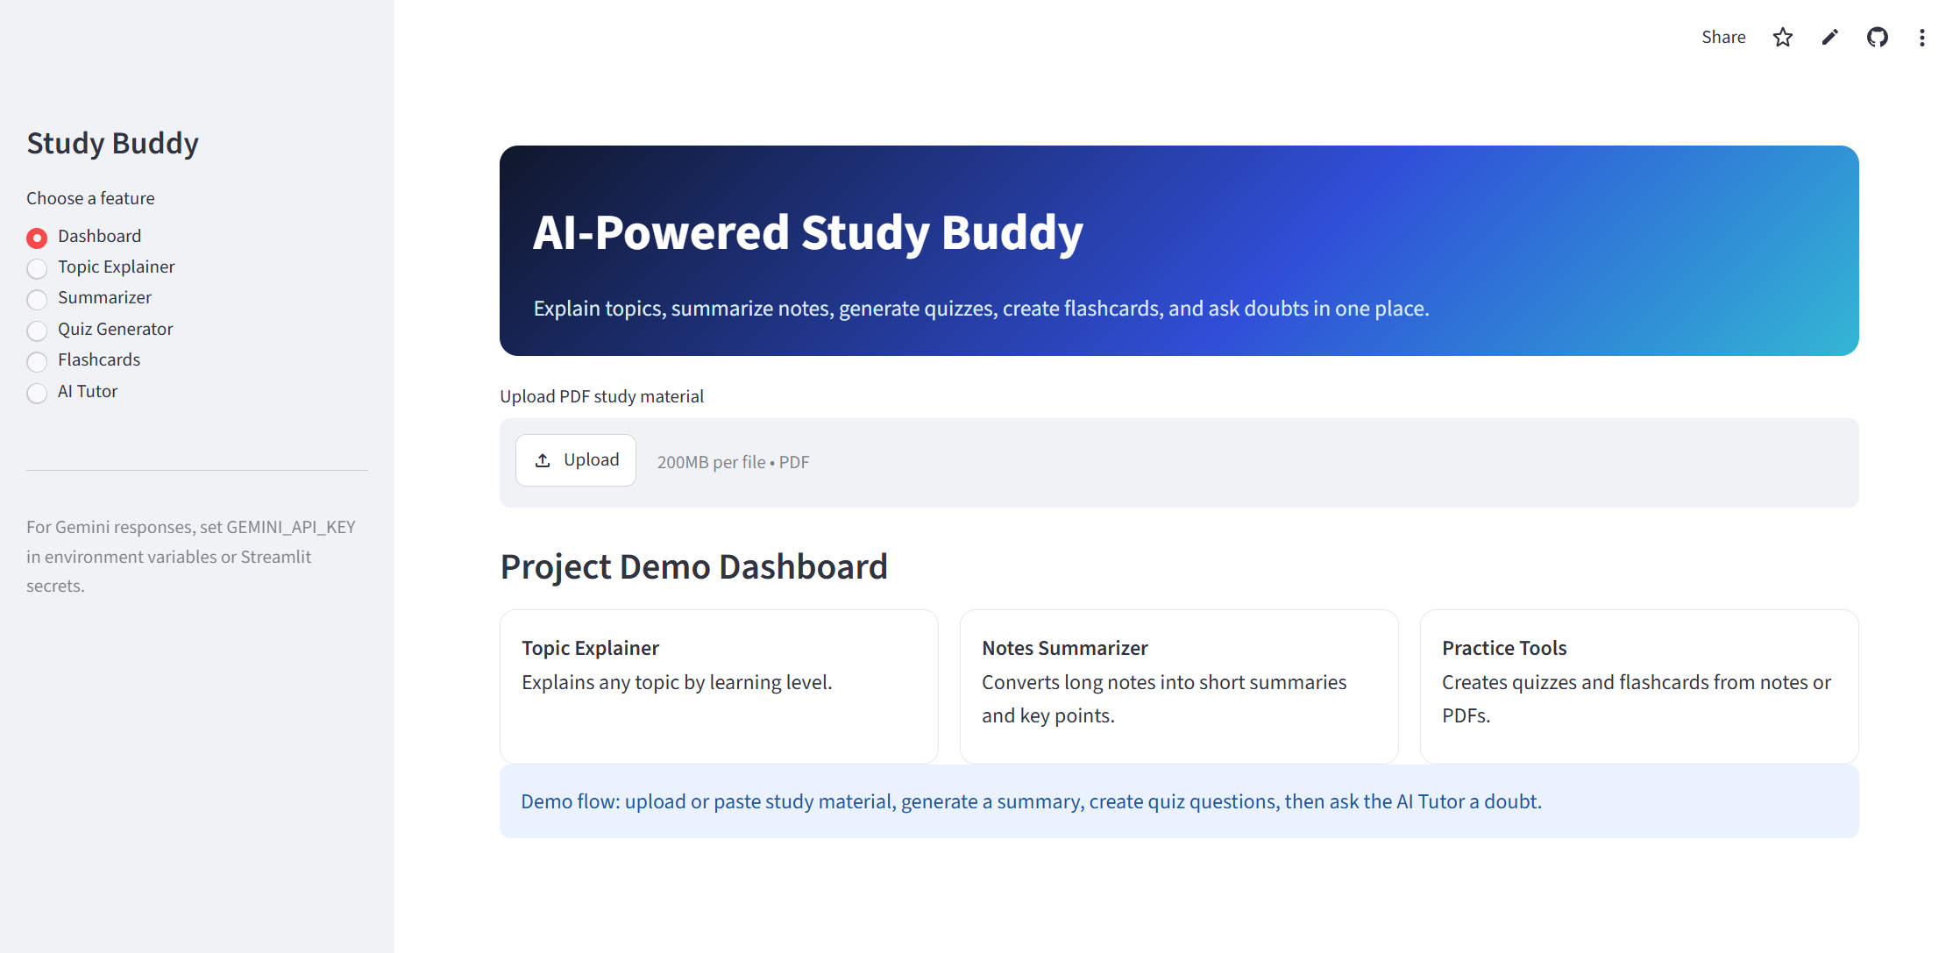
Algorithm & Deployment
Algorithm:
1. User uploads PDF or enters notes.
2. Text is extracted using PyPDF2.
3. Prompt is generated based on selected feature.
4. Groq LLM processes the prompt.
5. Results are displayed in Streamlit UI.
Deployment:
• GitHub Repository
• Streamlit Community Cloud

Slide 7
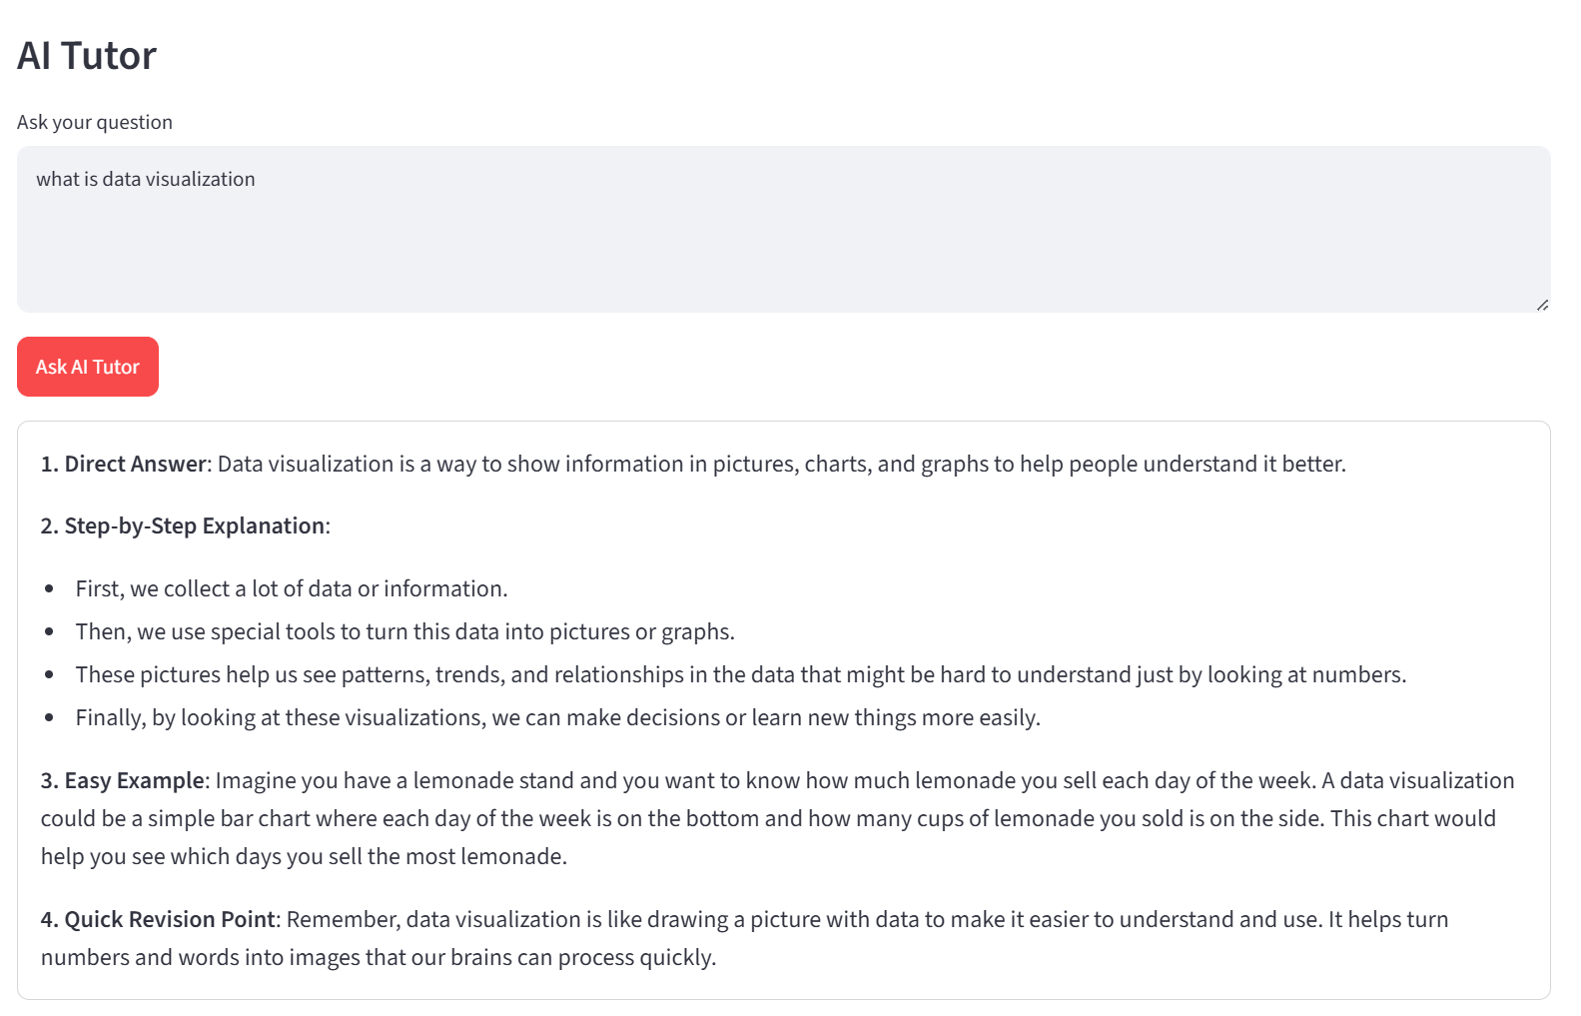
Result
Project Results:
• Successfully summarizes study notes.
• Generates MCQ quizzes with answers.
• Creates revision flashcards.
• Explains complex topics in simple language.
• Provides interactive AI tutoring experience.

Slide 8
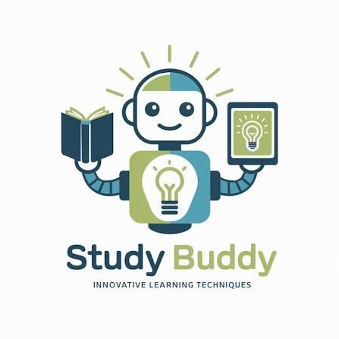
Conclusion
The AI Study Buddy simplifies learning by combining summarization, topic explanation, quizzes, flashcards, and AI tutoring into one platform. It improves learning efficiency and helps students prepare effectively.

Slide 9
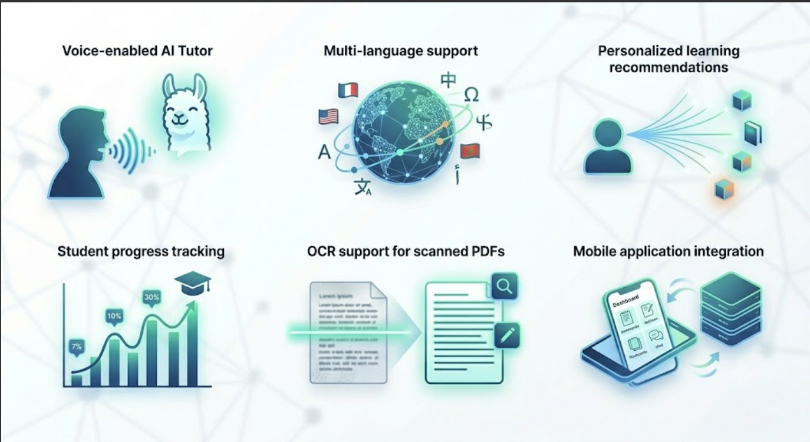
Future scope
• Voice-enabled AI Tutor
• Multi-language support
• Personalized learning recommendations
• Student progress tracking
• OCR support for scanned PDFs
• Mobile application integration

Slide 10
References
Hugging Face – The AI community building the future.
Streamlit • A faster way to build and share data apps
Welcome to Python.org
1. Supervised learning — scikit-learn 1.8.0 documentation

Slide 11
Github link
Github Link : https://github.com/PulagamMahalakshmi/AI-Study-Buddy
Deployment Link: https://pulagammahalakshmi-ai-study-buddy-app-g8uxlu.streamlit.app/

Slide 12
System Architecture
User Input (PDF/Notes)
↓
PyPDF2 Text Extraction
↓
Prompt Engineering
↓
Groq Llama 3.3 Model
↓
Summary • Quiz • Flashcards • AI Tutor

Slide 13
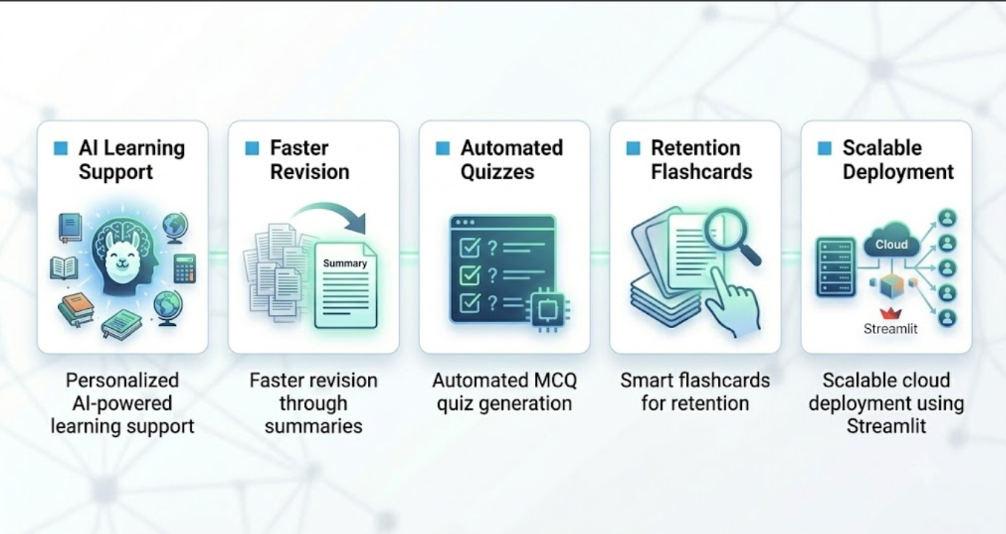
Key Features & Impact
• Personalized AI-powered learning support
• Faster revision through summaries
• Automated MCQ quiz generation
• Smart flashcards for retention
• Scalable cloud deployment using Streamlit

Slide 14
THANK YOU

