Slide 1
Startup Failure Analysis
A data-driven study of 186 failed startups from Failory.com
Source: Failory.com
186 startups
Python · scikit-learn · Streamlit
KNN · Linear Regression

Slide 2
OVERVIEW
Project Overview
End-to-end pipeline from web scraping to interactive dashboard
01 Data Collection
Scraped 186 failed startups from Failory.com using Python & BeautifulSoup. Covered 19 category pages across 8 countries and 11 industries.
02 Cleaning & EDA
Cleaned funding ranges → numeric midpoints, computed lifetime feature, grouped 18 raw failure causes into 6 categories, explored patterns.
03 KNN Classification
Predicted failure cause (6 classes) from funding, industry, and lifetime. k=8, StandardScaler, one-hot industry encoding. Accuracy: 42.1%.
04 Linear Regression
Predicted log(lifetime) from funding and industry. Used log1p transform to handle right-skewed target. R² = 0.396, MAE = 0.386 yrs.

Slide 3
DATA COLLECTION
Web Scraping — Failory.com
Structured extraction of startup post-mortems
Scraping pipeline
Dataset at a glance
Fetched main failures directory to collect all article links
Selected 19 pages: 8 countries + 11 industries
Located startup blocks via CSS class listicle-startup-collection-item
Split text on pipe separator, matched keywords for each field
Applied 1-second delay between requests
Exported 186 records × 10 columns to startup_failures.csv
Metric | Value
Total records | 186 startups
Columns | 10 fields
Year range | 1994 – 2026
Countries | 18
Industries | 15+
Missing (Employees) | ~51%
Failure causes (raw) | 18 labels
Failure causes (grouped) | 6 categories

Slide 4
DATA CLEANING
Cleaning & Feature Engineering
Three key steps before any analysis
Funding → Numeric
Lifetime Feature
Cause Grouping
Ranges like '$1M–$10M' → midpoint (5.5M)
Inequalities '> $50M' → bound value
'$0' → 0 · 'No Data' → NaN
NaN values imputed with column median
Result: Funding_clean in million USD
Lifetime = Closed in − Started in
'Active' replaced with 2026 before subtract
Year columns cast to numeric type
log1p(Lifetime) used as regression target
Addresses right-skew in raw distribution
18 raw labels → 6 broad groups
Market: No Market Need, Competition, Bad Fit, Bad Marketing
Management: Bad Model, Lack of Focus, Pivot failure
Financial: Lack of Funds, Mismanagement
External, Product, Other

Slide 5
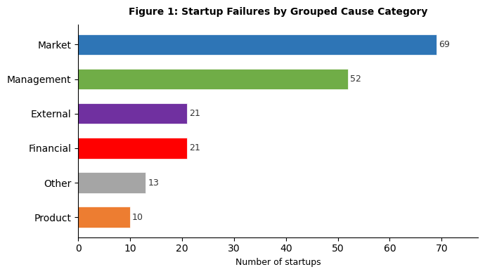
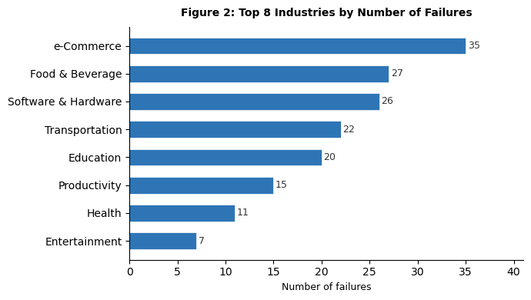
EXPLORATORY ANALYSIS
Failure Causes & Industry Distribution
Market and Management make up 65% of all failures
Market (37%) + Management (28%) = 65% of all failures. This shows most startups fail due to strategic issues — not money. E-Commerce leads industries because it has the most startup activity, not because it has a uniquely high failure rate.

Slide 6
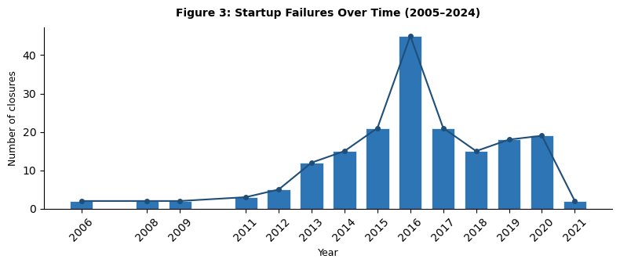
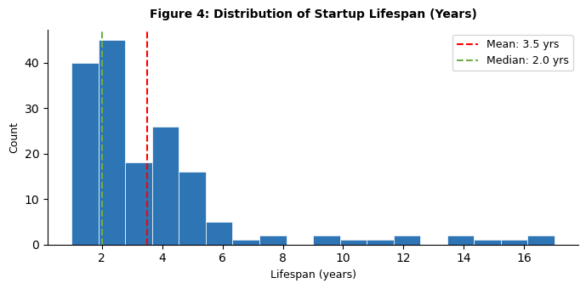
EXPLORATORY ANALYSIS
When Do Startups Fail?
Peak closures 2015–2020 · Median lifespan just 2 years
2 yrs
3.5 yrs
2018
186
Median lifespan
Mean lifespan
Peak failure year
Total in dataset
Half of all startups fail within 2 years. The 2015–2020 peak lags the 2012–2015 funding boom by 3–4 years — consistent with the average startup runway. The log-transformed lifespan is approximately normal, which justified using log1p(Lifetime) as the regression target.

Slide 7
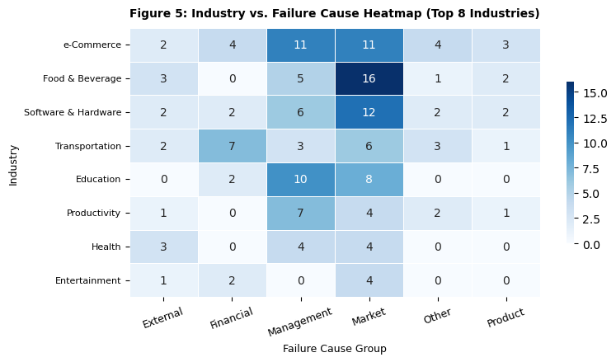
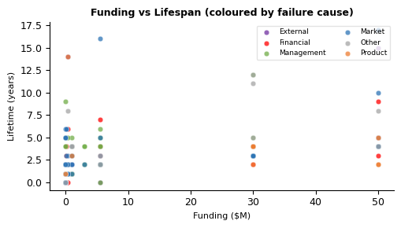
EXPLORATORY ANALYSIS
Industry × Cause & Funding vs Lifespan
Industry determines the type of failure · Funding helps but doesn't guarantee survival
Transportation fails from Financial/External causes; Education fails from Market causes. The scatter shows no strong linear trend — well-funded startups still fail, and some lean startups survive long. Industry type is a better predictor of failure mode than funding level alone.

Slide 8
ML — KNN CLASSIFIER
KNN Classifier — Setup & Encoding
Predicting failure cause from funding, industry, and lifetime
Model configuration
Why these encoding choices?
Parameter | Value / Choice
Algorithm | KNeighborsClassifier (sklearn)
k (neighbors) | 8
Weights | distance
Target (y) | Failure cause- 6 classes
Feature: Funding | Funding_clean — numeric midpoint
Feature: Industry | get_dummies (one-hot, drop_first=True)
Feature: Lifetime | Lifetime (years, numeric)
Scaler | StandardScaler on all features
Train / test split | 80% / 20%, random_state=42
OneHot on Industry prevents KNN treating industries as ordered numbers (e.g., industry 3 ≠ closer to industry 2 than industry 5).
StandardScaler ensures funding ($M) and lifetime (years) don't dominate Euclidean distance over the binary industry columns.
drop_first=True on dummies avoids perfect multicollinearity without changing the model's separability.
k=8. The k vs F1 curve (next slide) shows k=8 gives the highest CV F1 on this dataset.

Slide 9
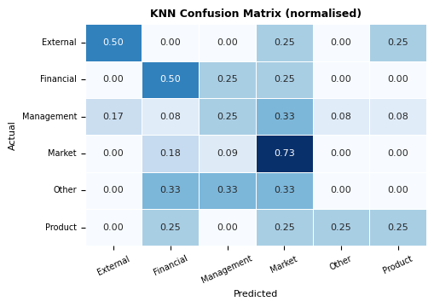
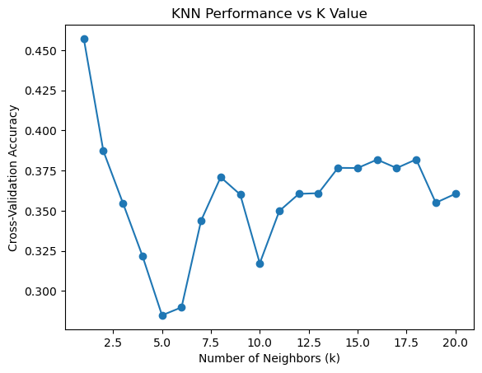
ML — KNN CLASSIFIER
KNN — Results & Interpretation
k=8 · 42.1% accuracy · 2.5× better than random guessing
42.1%
16.7%
2.5×
0.40
Test accuracy
Random baseline
Improvement
Weighted F1

Slide 10
ML — KNN CLASSIFIER
KNN — What the Results Mean
Reading the confusion matrix and per-class performance
Per-class metrics (test set, n=38)
Key observations
Class | Precision | Recall | F1 | Support
External | 0.50 | 0.50 | 0.50 | 4
Financial | 0.29 | 0.50 | 0.36 | 4
Management | 0.50 | 0.25 | 0.33 | 12
Market | 0.50 | 0.73 | 0.59 | 11
Other | 0.00 | 0.00 | 0.00 | 3
Product | 0.33 | 0.25 | 0.29 | 4
Weighted avg | 0.42 | 0.42 | 0.40 | 38
Market class performs best (recall 0.82) — largest class, enough samples for KNN to form clusters.
Management recall is only 0.08 despite 12 samples — many Management cases classified as Market due to feature overlap.
Product and Other get zero predictions — only 3–4 test samples each, no reliable boundary.
42.1% vs 16.7% random — model has genuine predictive signal from funding + industry + lifetime.
Encoding matters: OneHot + StandardScaler were the most impactful decisions.

Slide 11
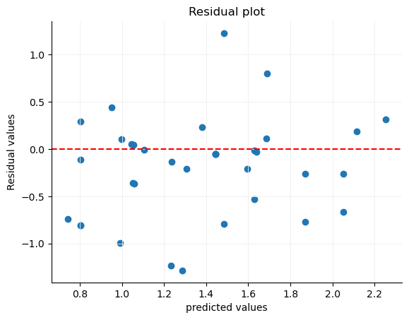
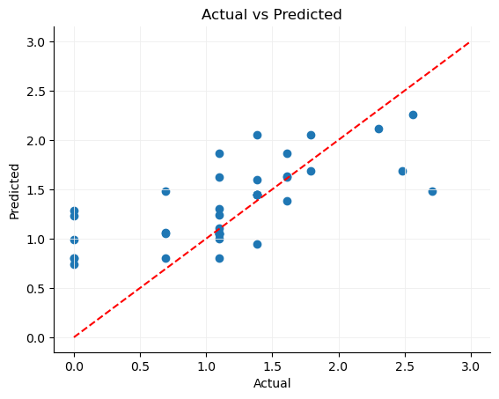
ML — LINEAR REGRESSION
Linear Regression — Setup & Results
Target: log1p(Lifetime) · R² = 0.396 · MAE = 0.386
0.396
0.386 yrs
0.540
log(Lifetime)
R² Score
MAE (log scale)
RMSE (log scale)
Target variable

Slide 12
ML — LINEAR REGRESSION
Regression — Interpretation
What R² = 0.396 means and why log-transform was necessary
Why log-transform the target?
Coefficient interpretation
Raw lifespan is strongly right-skewed — most fail in 1–3 years, a few survive 10–17 years.
Linear regression assumes normally distributed residuals. Skewed target violates this.
log1p(Lifetime) makes the distribution approximately normal (confirmed by histogram in EDA).
After transformation: residuals are more randomly distributed around zero, reducing heteroscedasticity.
Feature type | Effect on lifetime
Funding_clean (positive) | More funding → slightly longer survival
Transportation industry | Positive coef — capital-intensive, slower to fail
Health industry | Positive coef — regulatory barriers slow failure
Social Media | Negative coef — fast-moving, winner-take-all market
E-Commerce | Negative coef — high competition, low barrier to entry
Media | Negative coef — advertising market volatility
Interpreting R² = 0.396
Funding + industry explain 39.6% of variance in log(lifespan).
The other 60.4% is founder quality, market timing, execution — not in the dataset.
39.6% is strong for only 2 feature types with 186 rows.

Slide 13
KEY FINDINGS
Key Findings
Four takeaways from the data
01
Most failures are strategic, not financial
02
The 2-year danger zone
Market (37%) + Management (28%) = 65% of all failures. Startups fail because they build the wrong thing or execute poorly — not because money runs out. Better product validation matters more than raising more capital.
Median lifespan is 2 years. Half of all failed startups closed within their first 2 years. The critical window is months 12–24 post-launch — when initial runway is burning and revenue has not yet been established.
03
Industry determines the type of failure
04
Funding extends the runway but doesn't fix the problem
Transportation → Financial & External causes. Education → Market causes. E-Commerce → Competition. The same industry consistently produces the same failure pattern, making industry a meaningful feature for both classification and regression.
The scatter plot shows wide spread at every funding level. External failures (legal, acquisition) occur at higher average funding — they fail more expensively. A bad market fit funded with $10M still fails; it just takes longer.

Slide 14
CONCLUSION
Conclusion
Full pipeline — from raw HTML to interactive dashboard
Area | Result / Takeaway
Data | 186 startups scraped from Failory.com — 19 category pages, 10 fields, 18 countries
Top finding | 65% of failures are Market or Management — strategic failure dominates over financial
Lifespan | Median 2 yrs — first 2 years are the most critical window for a startup
KNN Classifier | 42.1% accuracy with k=8 · 2.5× random baseline · Market class best (recall 0.73)
Linear Regression | R² = 0.396 · Funding + industry explain 39.6% of log(lifespan) variance
Dashboard | Stream lit app, ML result pages, and live predictor tool

