Slide 1

MALLA REDDY COLLEGE OF ENGINEERING & TECHNOLOGY (Autonomous Institution – UGC, Govt. of India) DEPARTMENT OF COMPUTER SCIENCE AND ENGINEERING
Hand Sign Detection using Computer Vision
Under the Guidance of
Name: Ms. V. Shilpa
Designation: Assistant Professor
Batch No: 21
Names with roll numbers:
P. Yugeshwar – 21N31A05J8
N. Abhinav – 21N31A05F7
P. Manoj Kumar – 21N31A05J9

Slide 2
AGENDA
Abstract
Introduction
Existing system, Disadvantages
Proposed system, Advantages
Software and Hardware Requirements
System architecture
Modules Description(with Algorithms)
UML Diagrams
Output Screens
Conclusions, Future Scope
References

Slide 3
Abstract
Hand Sign Detection is a project that aims to detect the hand gestures that are made by human hands.
It detects the hand signs when it is trained properly with the labeled data.
In this project we used the technology of Computer vision and we used a Machine Learning Technique called Supervised learning.
We took the help of a machine learning website called Teachable Machines, to create model from the trained data.
It gives a .h5 file, using which we can get appropriate outputs in the project.

Slide 4
Introduction
Hand sign detection is a fascinating area of computer vision that involves recognizing and interpreting human hand gestures through images.
This technology has numerous applications, ranging from human-computer interaction and augmented reality till sign language translation and robotics.
Few of its components are Image Acquisition, Preprocessing, Hand Segmentation, Feature Extraction, Gesture Recognition, Post-Processing and Output.
Tools and Libraries used in it are OpenCV, MediaPipe, Tensorflow, Numpy Keras.
Few of its Applications are Sign Language Interpretation, Human-Computer Interaction, Virtual Reality and Robotics.

Slide 5
Existing system
In computer vision, the existing system for hand sign detection typically involves using a camera to capture images, then applying image processing techniques to isolate the hand, extract features like finger positions and joint angles, and finally, use machine learning algorithms to classify the hand gesture based on the extracted features, allowing for recognition of different hand signs.
And on focusing on this issue we came up with a project which will automatically detect the objects (hands in this project) in a picture.

Slide 6
Proposed system
To ease the work of detecting an object we are working on a project in the domain of Computer Vision.
Here we train the machine with some labeled data and when the training is completed properly the model will be able to detect the Object(Which in this case is a hand and its gestures).
We took the help of a machine learning website called Teachable Machines, to create model from the trained data.

Slide 7
Software and Hardware Requirements
Hardware Requirements:
Camera: A camera with at least 720p resolution is required for better accuracy.
Computer/Processor: An Intel i5 or AMD Ryzen 5 processor (or equivalent) or higher is recommended for efficient processing.
GPU: NVIDIA GTX 1060 or higher to accelerate processing.
Memory: At least 8GB of RAM is required to handle the processing of images.
Storage: at least 20GB free storage is required to store the datasets, models, and output results. An SSD is recommended for faster read/write speeds.

Slide 8
Software and Hardware Requirements
Software Requirements:
Operating System: Windows, macOS, or Linux. Ensure that the OS is updated to the latest version.
Python: Python 3.7 or higher. It is recommended to use the latest stable version of Python.
Python Libraries: OpenCV, MediaPipe, NumPy, TensorFlow, Keras.
Integrated Development Environment (IDE): A good IDE or code editor like PyCharm, VSCode, Jupyter Notebook, or Anaconda.

Slide 9
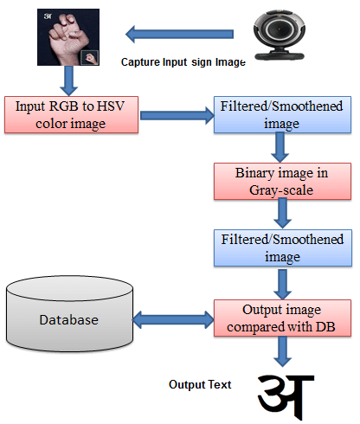
System Architecture

Slide 10
Modules Description :
OpenCV
OpenCV is the huge open-source library for the computer vision, machine learning, and image processing and now it plays a major role in real-time operation which is very important in today’s systems. By using it, one can process images and videos to identify objects, faces, or even handwriting of a human. When it integrated with various libraries, such as NumPy, python can process the OpenCV array structure for analysis. To Identify image pattern and its various features we use vector space and perform mathematical operations on these features.
CVZone
CVZone is an open-source Python library designed to simplify the process of developing computer vision applications. Built on top of OpenCV and Mediapipe, CVZone provides an easy-to-use interface for handling complex tasks like object detection, hand and face tracking, and pose estimation. It abstracts many of the lower-level details, making it more accessible for developers, especially those new to computer vision. CVZone also integrates key machine learning features, allowing users to develop interactive systems quickly with minimal code. The library is particularly popular for real-time applications and interactive projects, such as gesture- based control and augmented reality.

Slide 11
Algorithms and Technologies
Machine Learning:
Machine learning, a subset of artificial intelligence, empowers computers to learn from data and make decisions or predictions without explicit programming. It revolves around developing algorithms and statistical models that can identify patterns and relationships within data. Unlike traditional programming, which relies on predetermined rules, machine learning algorithms refine their performance as they encounter more data, continually learning from experience. At the core of machine learning lies the process of training models on data. This process involves several essential steps, beginning with data collection. Data, sourced from various repositories such as sensors, databases
Computer Vision:
Computer vision is a field of artificial intelligence (AI) that focuses on enabling machines to interpret and understand visual data from the world, such as images and videos. It aims to replicate the capabilities of human vision in computers, allowing systems to analyse and make decisions based on visual inputs. Through a combination of image processing, pattern recognition, and machine learning, computer vision allows machines to detect objects, track movements, and classify images. Its goal is to automate tasks that require visual understanding, making it a critical tool in various technological applications.

Slide 12
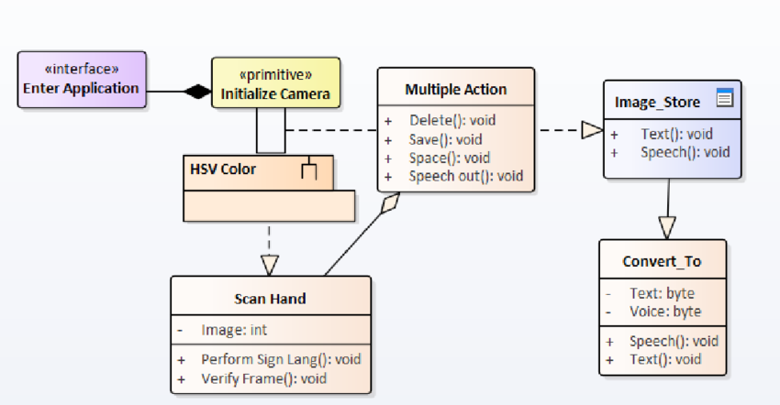
UML Diagrams
Class Diagram:

Slide 13
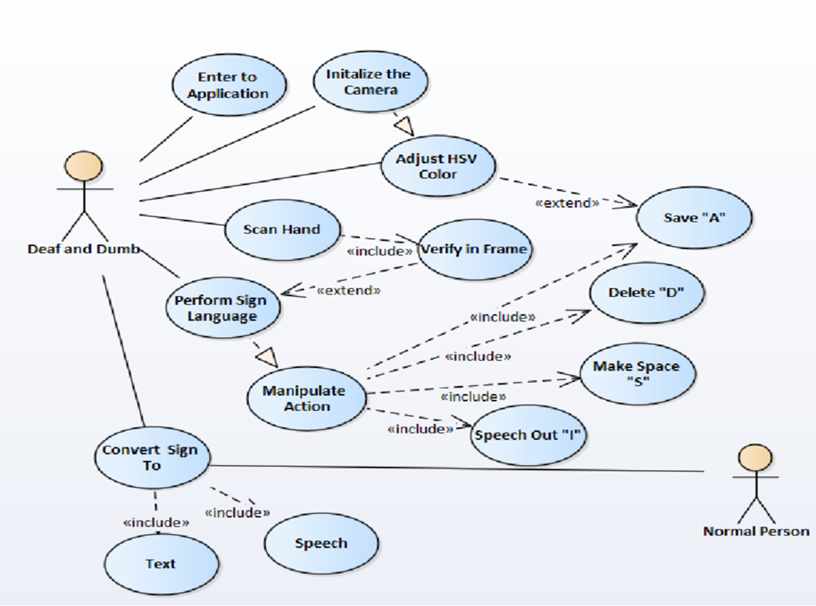
UML Diagrams
Use Case Diagram:

Slide 14
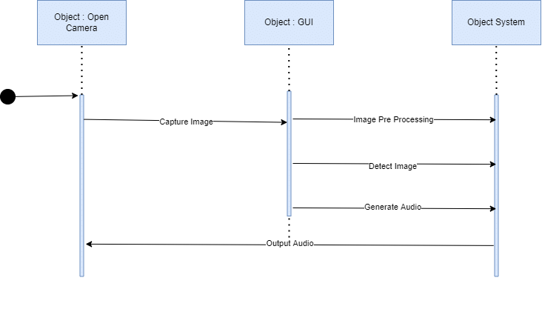
UML Diagrams
Sequence Diagram:

Slide 15
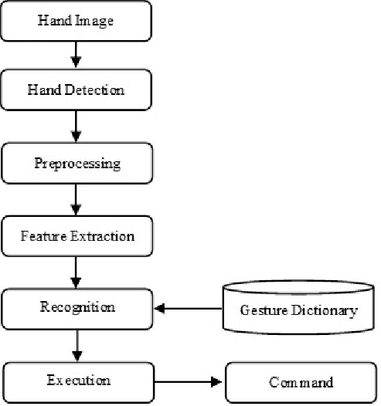
UML Diagrams
DataFlow Diagram:

Slide 16
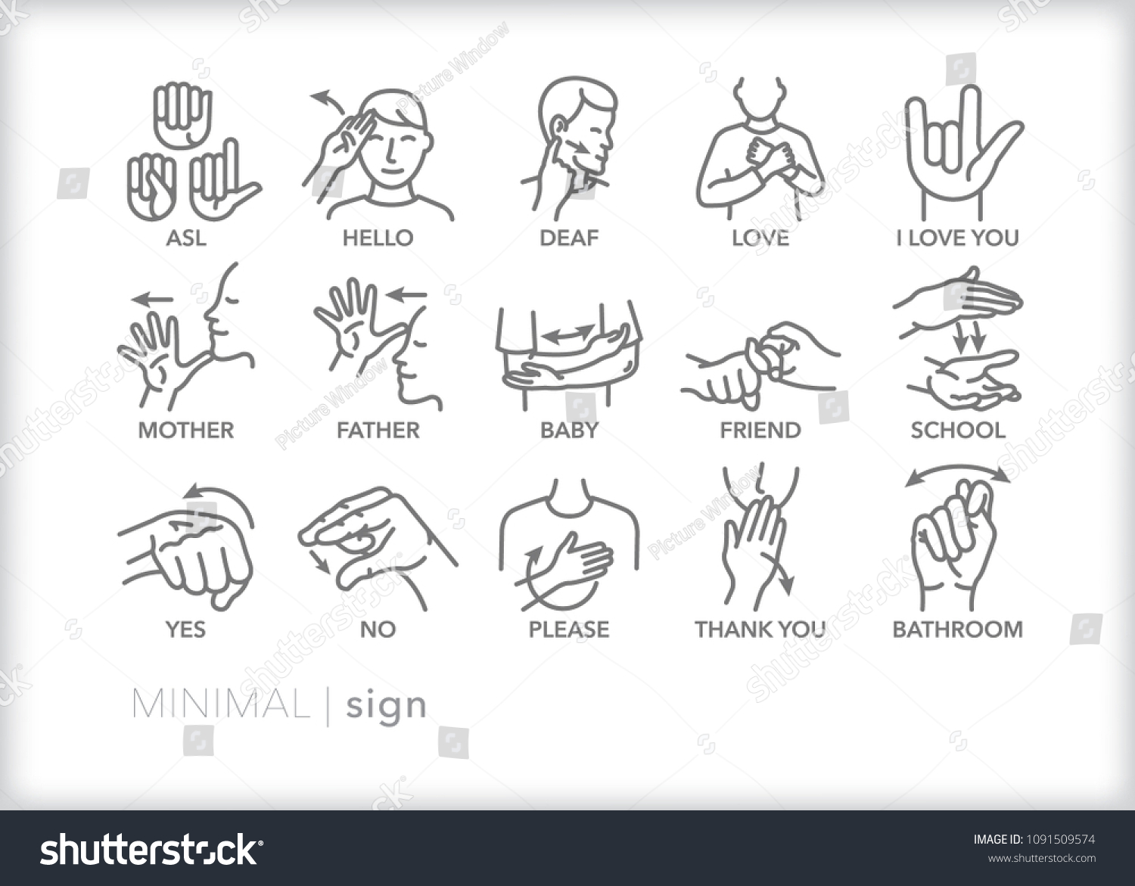

Slide 17
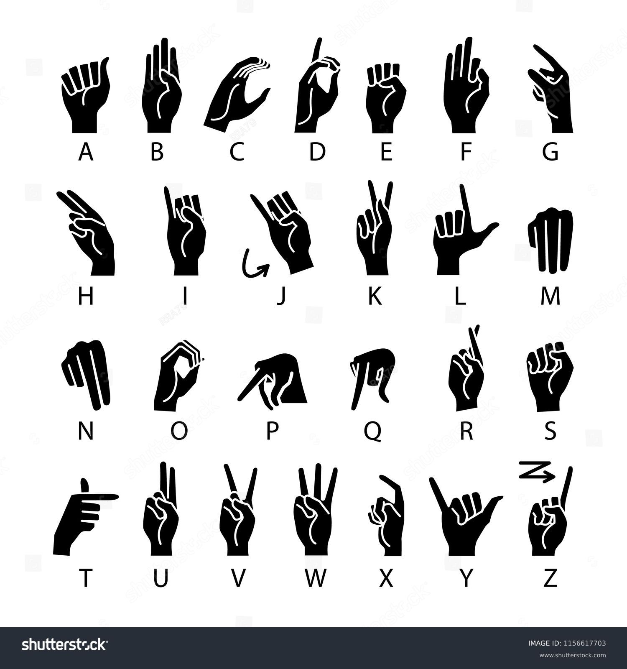

Slide 18
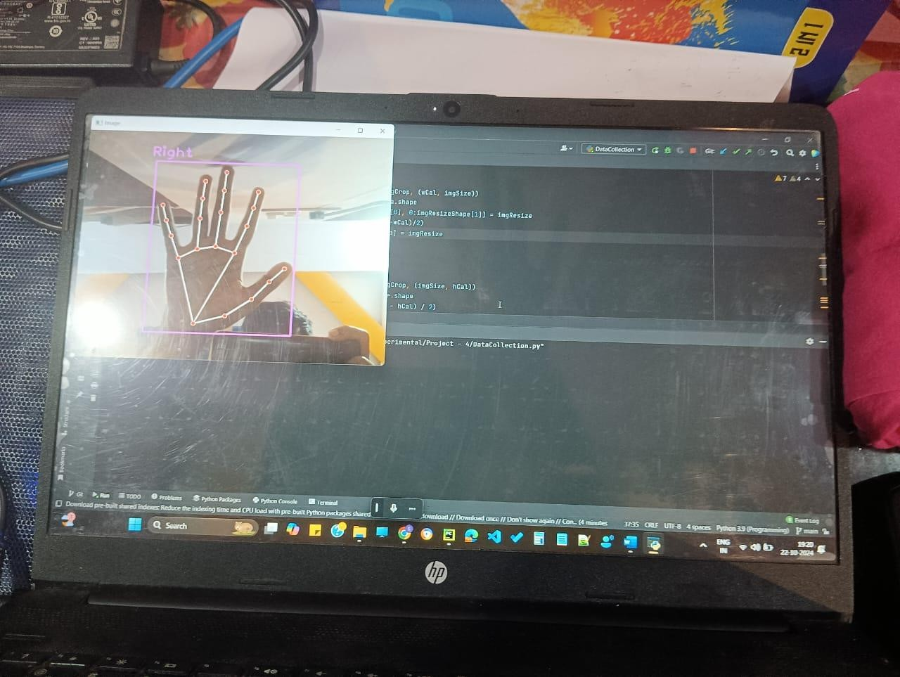
Output Screens / Results :
The above shown output screen is an output of the DataCollection.py file. Here the hand is detected on a basic sense of whether it is right or left hand. This happens by the use of hand detector module in the Python library.
Fig- Detecting Hand

Slide 19
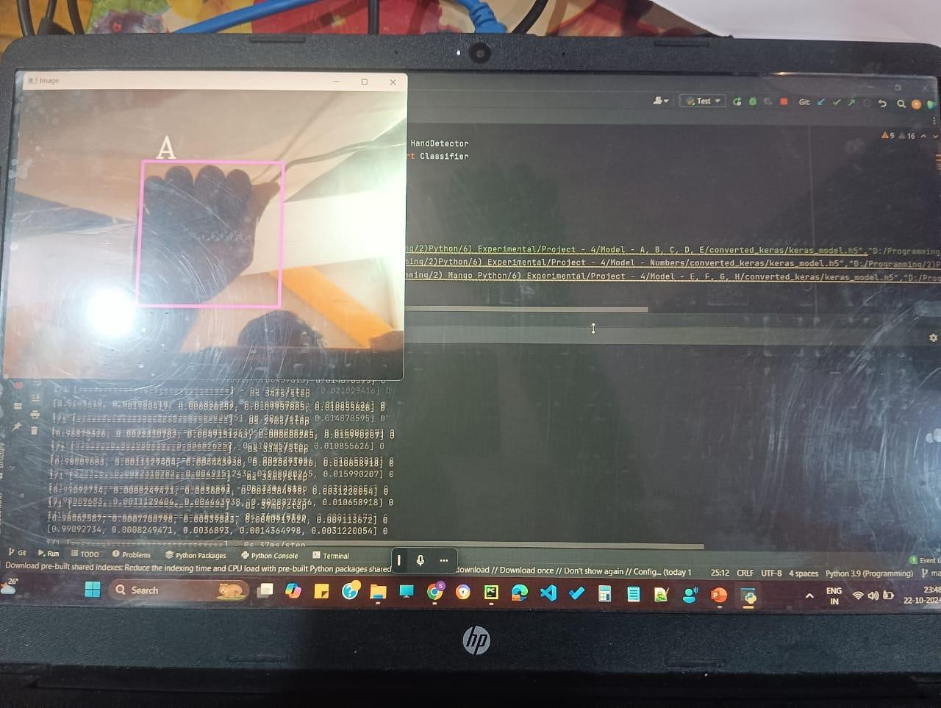
The above shown output screen is an output of the Test.py file. Here the hand is detected based on the training that one gives to the model to recognize that the given gesture is ‘A’. Here the model training is done by using Teachable machines website which is an open source model training website in the AI and ML model training. The underlying concepts in the website are that it uses a classification algorithm to classify the data and train accordingly. And it uses tensorflow.js for client-side processing. It finally uses PoseNet to track the pose of the hand gesture.
Fig – Detecting Letter ‘A’

Slide 20
Conclusion :
The "Hand Sign Detection Using Computer Vision in Python" project successfully demonstrates the power and flexibility of computer vision technologies in creating an intuitive and interactive system for recognizing hand gestures. By leveraging Python’s open-source libraries like OpenCV and TensorFlow, the system can capture live video input, process the data in real-time, and accurately detect hand signs using advanced machine learning techniques. This project highlights how touchless interfaces can significantly enhance user experiences in various applications, from accessibility tools to gaming and robotics.
The accuracy and robustness of the system depend largely on the quality of the training data and the efficiency of preprocessing techniques. Using deep learning models, specifically Convolutional Neural Networks (CNNs), the system can automatically learn and improve its performance by classifying different gestures. This project lays the groundwork for future improvements, such as expanding the gesture library, improving recognition accuracy in more complex environments, or integrating the system with external devices like smart home systems or robots.

Slide 21
Future scope :
Hand sign detection using computer vision has a promising future across several fields, thanks to advancements in AI and deep learning. Here’s a look at the future scope for this technology:
Assistive Technology:
Hand sign detection can make communication easier for people with hearing and speech impairments by translating sign language into text or speech. Enhanced detection systems could improve accessibility, allowing seamless interaction in everyday life and bridging the communication gap.
Human-Computer Interaction (HCI):
Gesture-based interfaces could enable new ways of interacting with computers, smart devices, and AR/VR systems. This has applications in gaming, education, remote work, and navigation, especially in environments where hands-free operation is valuable (e.g., healthcare or manufacturing).
Augmented Reality (AR) and Virtual Reality (VR):
Hand sign detection can enable natural gesture-based controls in AR/VR, making immersive experiences more intuitive and interactive. This has particular relevance in fields like gaming, virtual meetings, and simulations, where lifelike interactions add value.

Slide 22
References :
J Imaging. 2020 Jul 23;6(8):73. doi: 10.3390/jimaging6080073 Hand Gesture Recognition Based on Computer Vision: A Review of Techniques Munir Oudah 1, Ali Al-Naji 1,2, *,Javaan Chahl 2 Copyright and License information PMCID: PMC8321080 PMID: 34460688
Hand Gesture Recognition: A Literature Review August 2012 International Journal of Artificial Intelligence & Applications 3(4):161-174 DOI:10.5121/ijaia.2012.3412
Hand Gesture Recognition Based on Computer Vision: A Review of Techniques Munir Oudah 1, Ali Al-Naji 1,2, *, Javaan Chahl 2
Hand Gesture Recognition System Based in Computer Vision and Machine Learning October 2013 DOI:10.1007/978-3-319-13407-9 21I.Ravi Prakash Reddy, “Trust Rate based SCooperative Neighbor Selection for Reliable Data Transmission in Mobile Adhoc Networks”, International Journal of Research, ISSN No:2236- 6124, IJR Journal, Vol-VII.

Slide 23
THANKYOU

