Slide 1
DAA DevOps – Azure Data Factory
©2022 - Nagarro

Slide 2
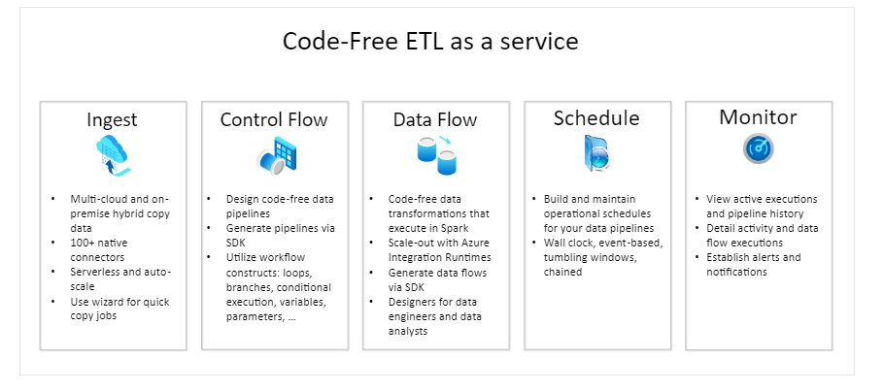
Introduction
Azure Data Factory is a managed cloud service that's built for the complex hybrid extract-transform-load (ETL), extract-load-transform (ELT), and data integration projects.
Data Factory contains a series of interconnected systems that provide a complete end-to-end platform for data engineers.
Azure Data Factory is composed of below key components
Pipelines
Activities
Datasets
Linked services
Data Flows
Integration Runtimes

Slide 3
ADF Structure
ADF Repo
Main/Collaboration
Feature
Create a repository ADF Repo
Under this repo create two branches main and Feature
Maintain main/collaboration branch for latest and tested changes
Branches

Slide 4
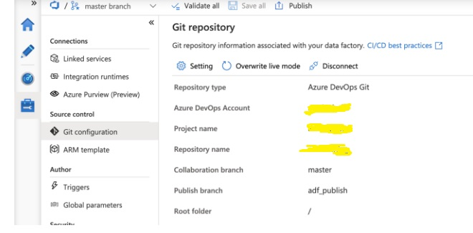
Integrating ADF with Azure Repo
By default, the Azure Data Factory user interface experience authors directly against the data factory service. This experience has the following limitations:
The Data Factory service doesn't include a repository for storing the JSON entities for changes. The only way to save changes is via the Publish All button and all changes are published directly to the data factory service.
The Data Factory service isn't optimized for collaboration and version control.
The Azure Resource Manager template required to deploy Data Factory itself is not included.
To provide a better authoring experience, Azure Data Factory allows to configure a Git repository with either Azure Repos or GitHub.
Purpose:
Ability to track/audit changes
Partial saves
Collaboration and control
Better CI/CD
Ability to revert changes that introduced bugs

Slide 5
Main Branch Structure
Root Folder
dataset
Factory
linkedService
pipeline
Main/Collaboration branch: This branch is used to collaborate with other developers working on the environment. From a workflow point of view, developers work on their individual branches and once the task is completed, a pull request is raised to merge the changes from the “feature” branch into the collaboration branch. Once the PR is approved, the code is moved to the collaboration branch.
Root Folder: In this folder JSON files of the Data Factory components are saved.
Main Branch
Dataset folder
input.json
output.json

Slide 6
CICD for Azure Data Factory
Build Stage
Feature Branch
ADF Utilities NPM Packages and task
Create PR
And
Validate PR
Validate and Generate ARM Templates
Main Branch
Build Artifact
Release Stage
Download Artifact
Build Pulled as Artifact #X
DEV
Release #X
Test
Approve
Prod

Slide 7
Thank You! Looking Forward to hear from you

