Slide 1
Privacy
Prat one by Xiaobao : privacy & Data
Part two by langwang : risk
Part three by
Part four by

Slide 2
Privacy is not just something we enjoy. It is something that is necessary for us to: develop who we are; form an identity that is not dictated by the social conditions that directly or indirectly influence our thinking, decisions, and behaviors; and decide what type of society we want to live in.
Whether we like it or not constant data collection about everything we do shapes and produces our actions. We are different people when under surveillance than we are when enjoying some privacy. And the breathing room provided by privacy is essential to being a complete, fulfilled person.
Quote from theAtlantic.com

Slide 3
How much data has been generated by you so far?
What kind of data do tech giants take from you?
And what does anything above have to do with me?

Slide 4
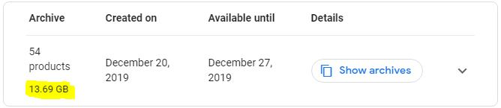
Google
From Aug 1, 2016 to Dec 20, 2019 (1,238 days), I have created an incredible 13,690 MB size of compressed data on Google alone.
Data from takeout.google.com

Slide 5
So I downloaded the whole file and started an investigation on what on earth does Google collect from me.
And the result ?
Astonishing :-)
Google recorded everything it possibly could get from me, including pages I’ve visited, videos I’ve watched and posted, people I’ve contacted, even places I’ve been to; more frightening, Google knows exactly when and where I did all these things.
Take Google search results for example.

Slide 6
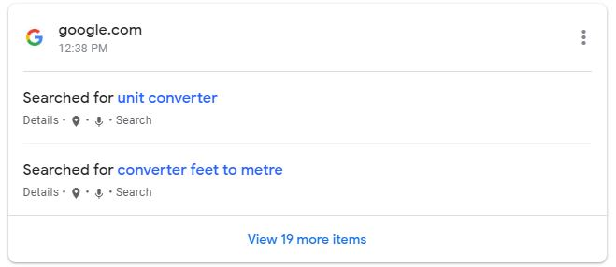
Google knows what did I search, as well as the location and time
Data from myactivity.google.com

Slide 7
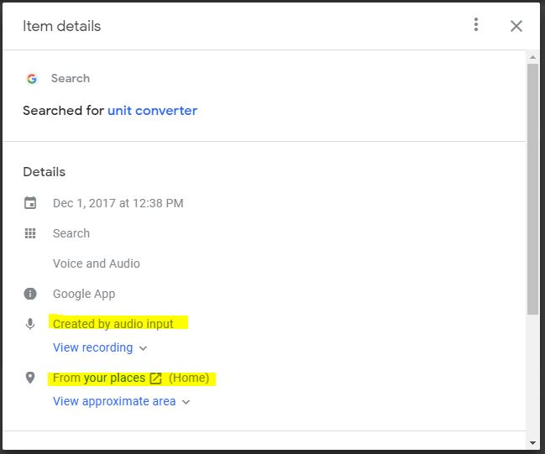
Google knows what did I search, as well as the location and time

Slide 8
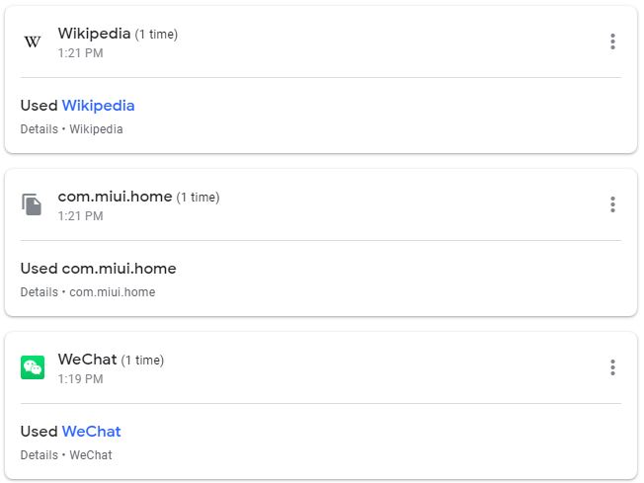
And it also knows what specific app did I open on what time

Slide 9
So what? You might ask, what’s going to happen?
You might think it is a good idea to willfully hand over your data in exchange for personalized coupons or promotions, or to broadcast your location to friends. But consumption -- perusing a store and buying stuff -- and quiet, alone time are both important parts of how we define ourselves.
If how we do that becomes subject to ever-present monitoring it can, if even unconsciously, change our behaviors and self-perception.
Quote from theAtlantic.com

Slide 10
With so much data in hand, assisted by smarter and smarter AI, nothing is impossible.

Slide 11
By tracking your search history, search engines know what you like more than you do. And they are constantly recording your everyday life.
Data from trend.google.com

Slide 12
Ecommerce sites know what you like, and they trick you to add things you think you need(but actually not) to carts filled with ever-growing items.
In billion yuan
Data from reuters.com

Slide 13
So what's the risk of privacy disclosure？

Slide 14
From a small risk point of view, spam emails, spam messages and harassing phone calls will annoy you a lot.

Slide 15
In these events, your property, your life, is not threatened, it's just that your time has been wasted to some extent.

Slide 16
But there are something more harmful than those.

Slide 17
A malicious overdraft of a fake card.
Through the underground black market, your personally identifiable information is sold in large quantities to those who maliciously handle cards, defraud the bank credit after processing a variety of credit cards for malicious overdraft consumption, and then the bank directly to the owner of the default collection letter, let you pay for someone else's malicious consumption

Slide 18
Personal safety can not be guaranteed.
Unlawful elements use these personal privacy, especially the specific opening information, hotel video theft, tracking and stealing, financial lure, PS yellow photos, design traps and other illegal means to seize, extort money, to personal safety and family stability bring great hidden dangers

Slide 19
Control your mind.
By collecting your information, documenting your habits, and using it as a basis to recommend certain articles and videos to guide and even control your thoughts, the consequences are unimaginable

Slide 20
There are many other big and small harms, time relationship, no longer one to repeat.

Slide 21


Slide 22
Thank you!
Privacy.pptx made in collaboration with
郎旺，杨则昕，郑语初.
Bonus content here

