Slide 1



Sustainability in Action: Empowering Activism Through Radical Collaboration

Slide 2
THE PROBLEM
Centralization of Companies
Sustainable
community building

Slide 3
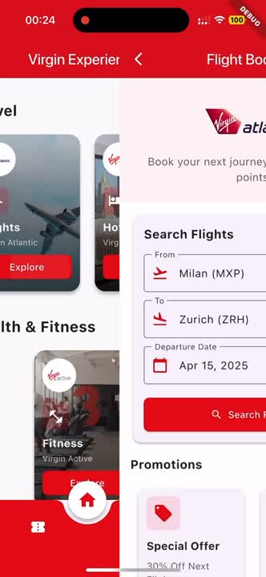
VI HUB
INTUITIVE design
Find what you are looking for or
discover new innovative projects.

Slide 4

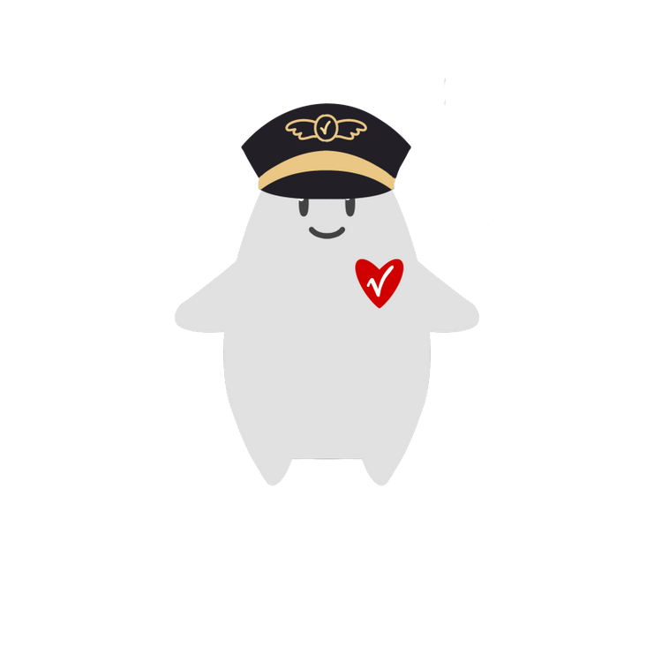

Meet Vi!
CUSTOMIZE your avatar!
Make your profile unique
and recognizable.

Slide 5
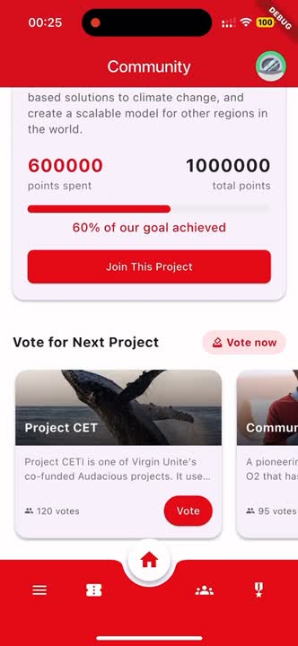
Join a sustainable COMMUNITY
USER AND COMPANY
GROW TOGHETER

Slide 6
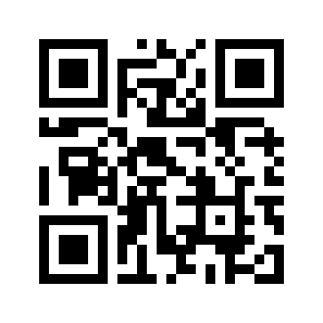
Interact with VIRGIN
Gain new badges
and showcase them!
Scan the QR-codes in the Virgin facilities near you!

Slide 7
Sustainability in Action: Empowering Activism Through Radical Collaboration
THANK YOU!

Slide 8
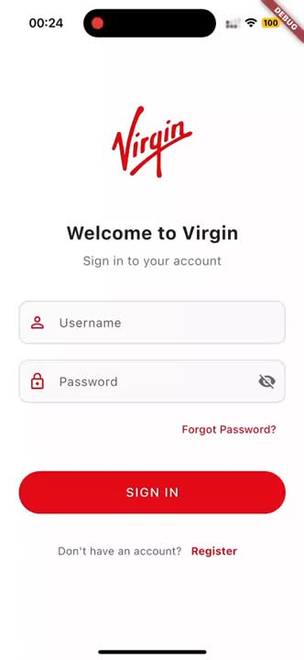
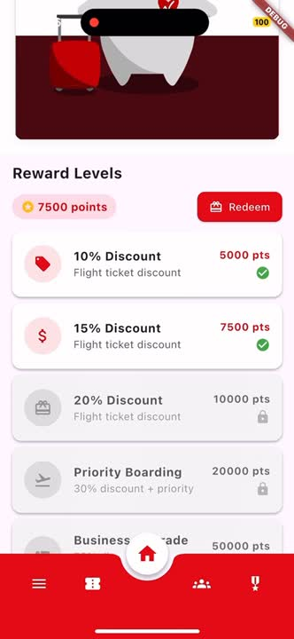
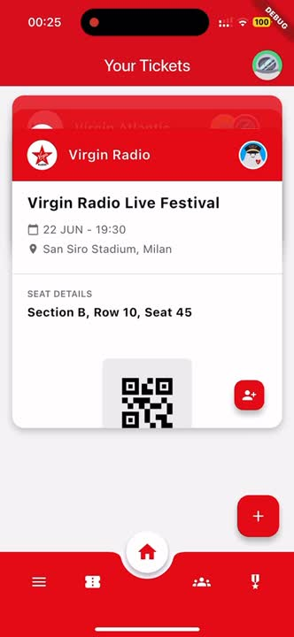
QUESTIONS?

