Slide 1
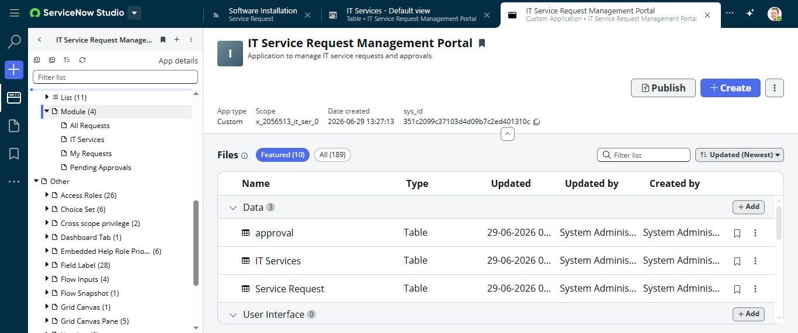
Title
IT Service Request Management Portal
Notes:
Introduce yourself and the project.

Slide 2
Agenda
Project Overview
Problem Statement
Objectives
Architecture
Implementation
Reports
Dashboard
Security
Testing
Conclusion
Notes:
Briefly explain the agenda.

Slide 3
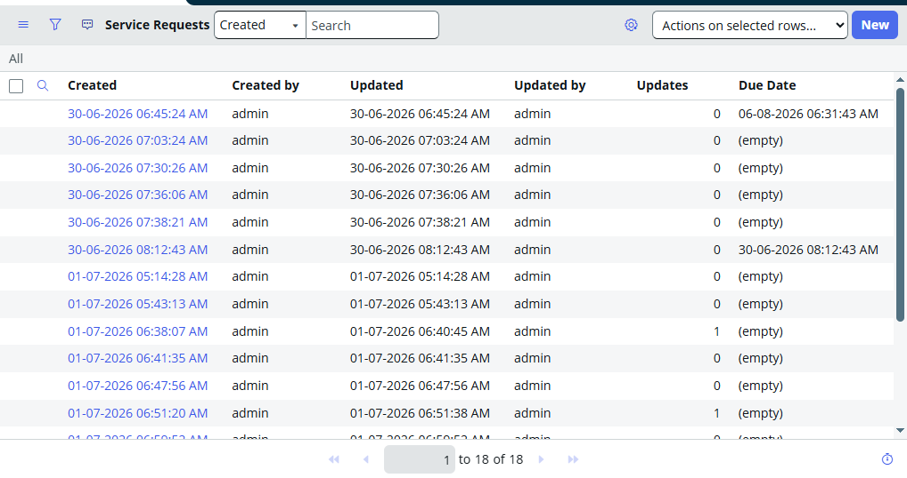
Project Overview
Automates IT service requests using ServiceNow.
Features include workflows, notifications, reports, dashboards and ACLs.
Notes:
Explain the purpose and scope.

Slide 4
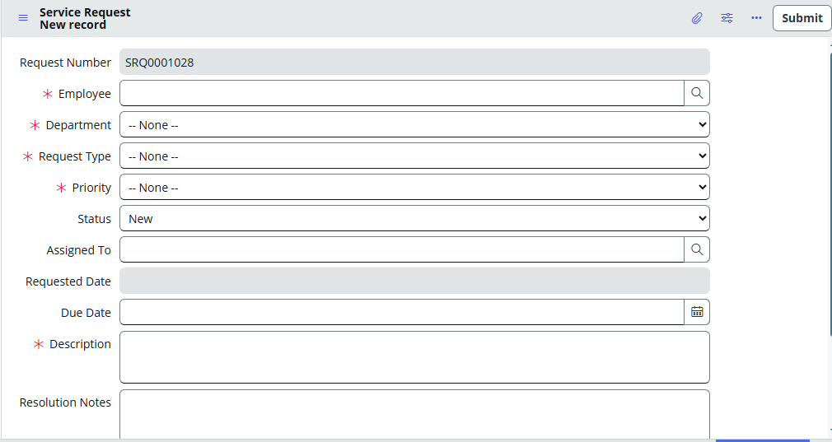
Problem Statement
Manual request management is slow and lacks transparency.
Notes:
Discuss the problem solved.

Slide 5
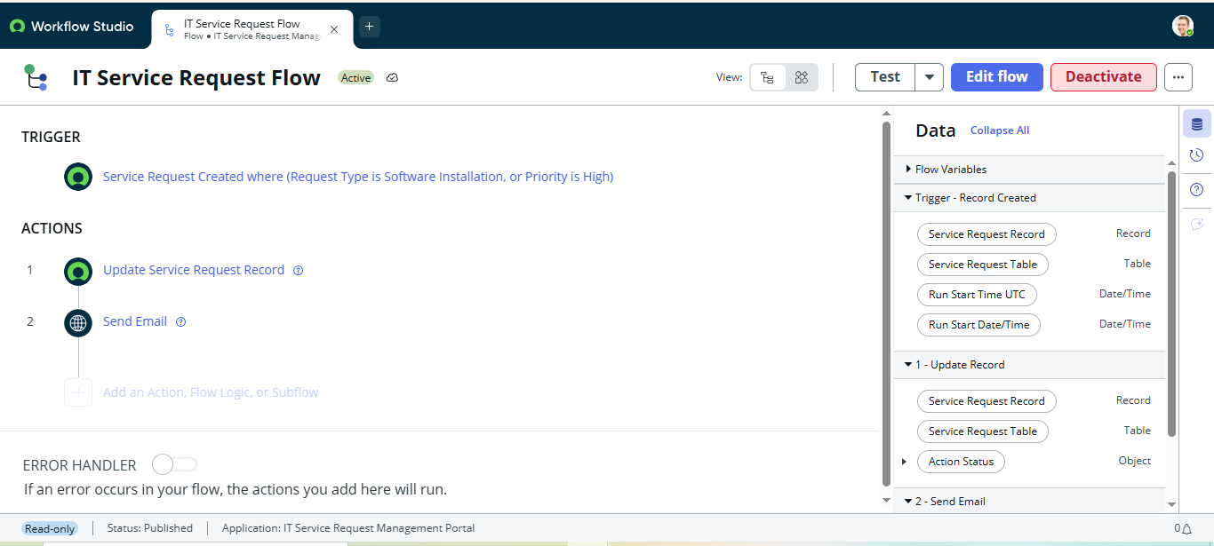
Objectives
• Automate requests
• Track status
• Notify users
• Secure access
Notes:
Describe project goals.

Slide 6
Flow Designer
Workflow automates record processing and notifications.
Notes:
Explain how Flow Designer automates requests.

Slide 7
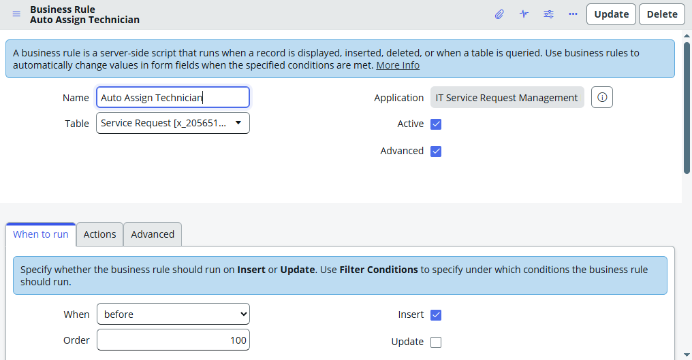
Business Rule 1
Implements server-side validation.
Notes:
Explain first business rule.

Slide 8
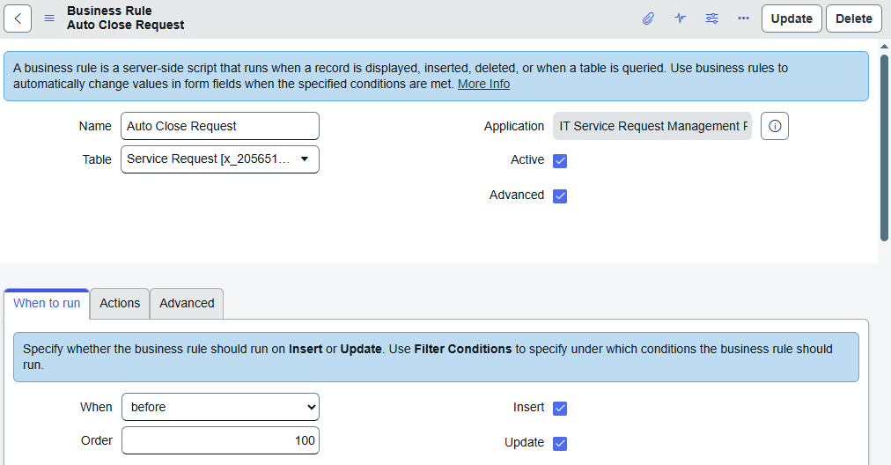
Business Rule 2
Additional automation and business logic.
Notes:
Explain second business rule.

Slide 9
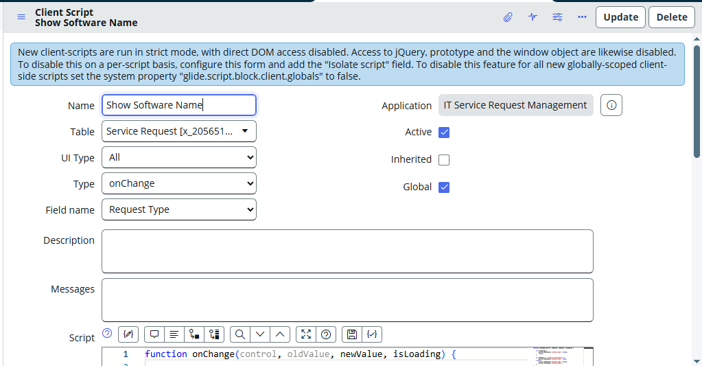
Client Script
Client-side validation and dynamic behavior.
Notes:
Explain client-side validation.

Slide 10
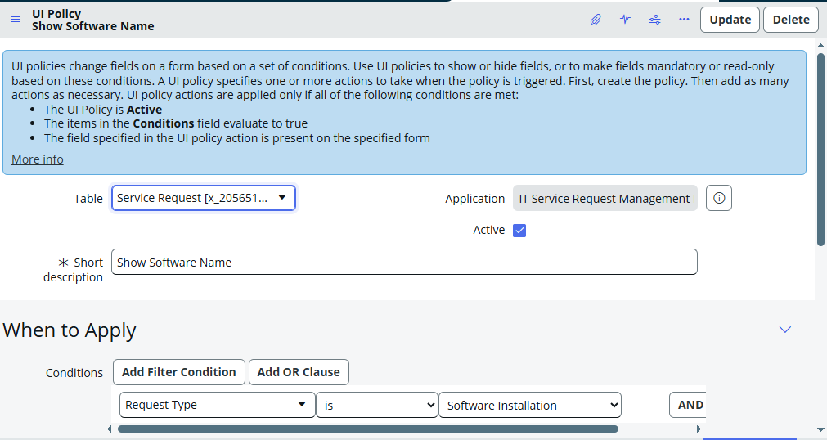
UI Policy
Dynamic mandatory/read-only fields.
Notes:
Explain UI policy behavior.

Slide 11
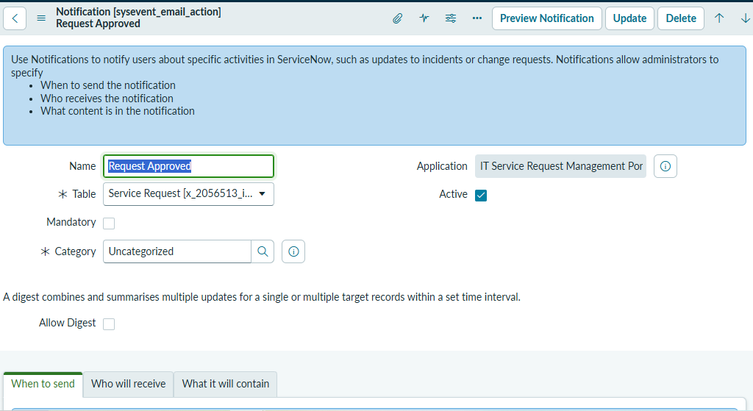
Notifications
Automatic emails for Submitted, Approved and Assigned requests.
Notes:
Discuss notification workflow.

Slide 12
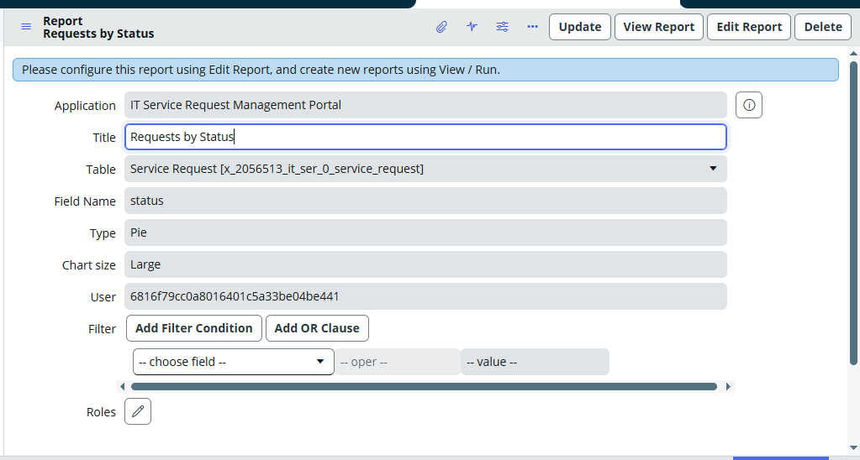
Reports
Status, Priority, Department, Monthly Requests, Technician Workload.
Notes:
Show analytics generated by reports.

Slide 13
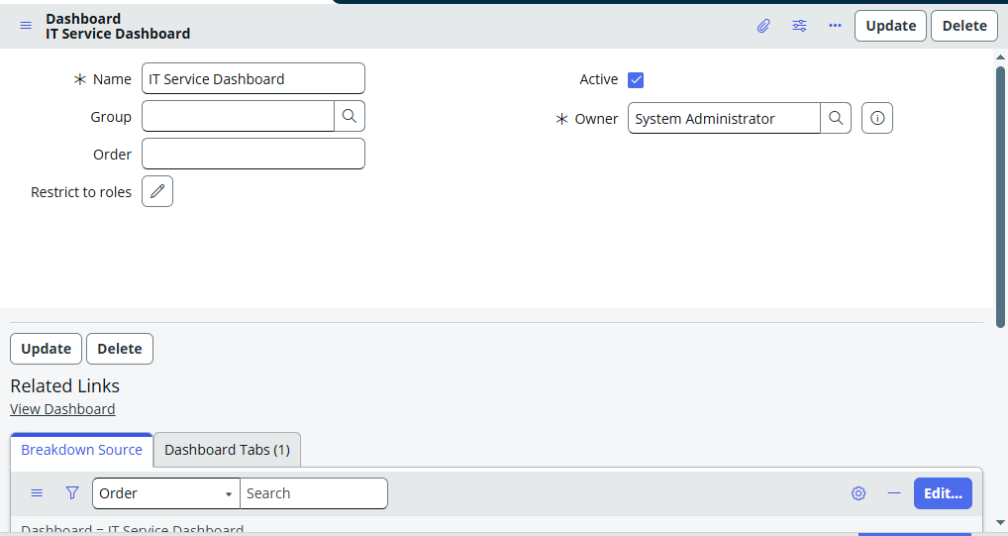
Dashboard
Central monitoring dashboard.
Notes:
Demonstrate dashboard widgets.

Slide 14
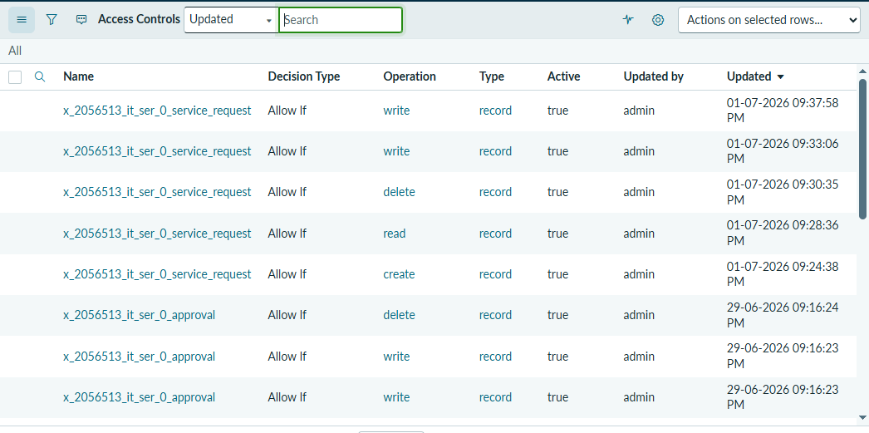
ACLs
Role-based access for Employee, Technician, Manager and Admin.
Notes:
Describe security implementation.

Slide 15
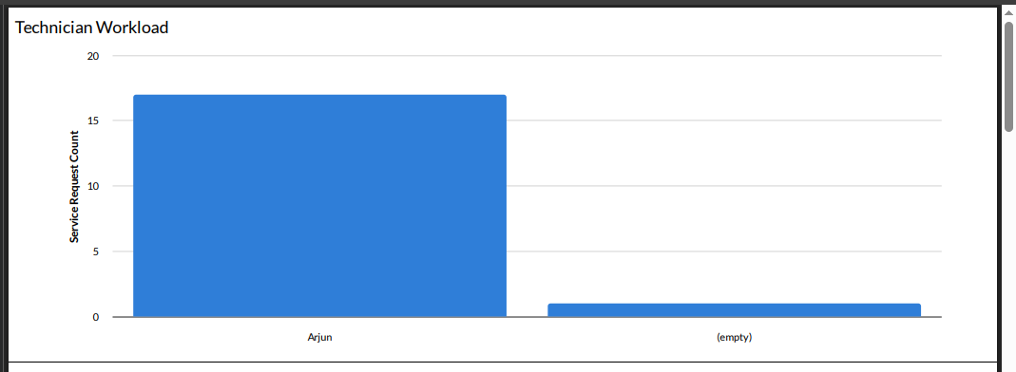
Testing
Verified workflows, notifications, reports and dashboards.
Notes:
Mention testing scenarios executed.

Slide 16
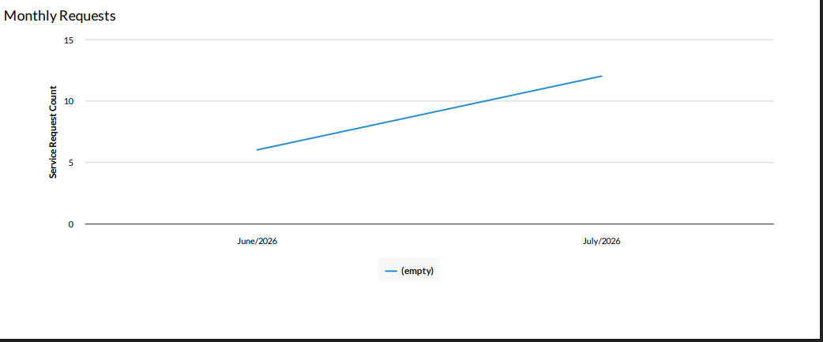
Results
Improved efficiency, tracking and automation.
Notes:
Summarize project benefits.

Slide 17
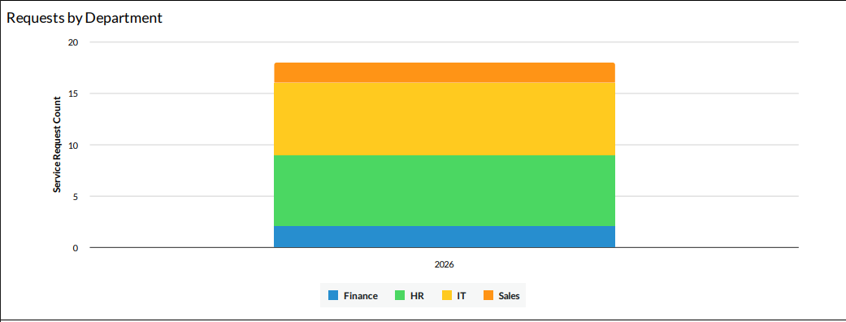
Future Enhancements
CMDB, SLA, Knowledge Base, Virtual Agent, Mobile App.
Notes:
Discuss future scope.

Slide 18
GitHub Repository
README, Screenshots, Documentation and Update Set uploaded.
Notes:
Show GitHub repository contents.

Slide 19
Conclusion
Project successfully developed using ServiceNow best practices.
Notes:
Conclude the presentation.

Slide 20
Thank You
Questions & Answers
Notes:
Invite questions.

