Slide 1
COLLEGE BUS FACILITY SYSTEM
PROJECT MEMBERS:
Puli Sai Teja -12202841
Ritik Kumar -12203738
Gulshan Kumar -12204669

Slide 2
Project Description
The software application has a user-friendly interface that allows students to register and view their personal information such as name, registration number, address and payment details. The system also allows teachers to register and manage their personal information, such as their name, id, address and payment details.
In addition, the system includes a comprehensive database of bus details, including bus routes, schedules, and timings. This database helps students and teachers to plan their travel arrangements efficiently.
The College Bus Facility System project also includes a feature for booking bus and making online payments.
Overall, the College Bus Facility System project aims to provide a comprehensive and user-friendly bus transportation system to college students and teachers, improving their travel experience and ensuring their safety.

Slide 3
Modules
Home Page (by Gulshan Kumar p.g.n:04)
Admin Page (by Gulshan Kumar p.g.n:05)
User Page (by Ritik Kumar p.g.n:06)
Student User (by Ritik Kumar p.g.n:07)
Teacher User (by Ritik Kumar p.g.n:08)
Bus Details (by Puli Sai Teja p.g.n:09)
Bus Booking (by Puli Sai Teja p.g.n:09)
Fee Payment (by Puli Sai Teja p.g.n:10)

Slide 4

.
Home Page
Home Page is the first page in these desktop application ,where there are two options provided to select user and admin. If select user button it will be redirected to the users screen else it will be redirected to the admin page.

Slide 5
Admin Page After entering admin page there is admin login and if admin have not have any account ,signup or registration is provided in this process ,these entered details are stored in the database and can be fetched when admin is logging in. 1. When admin successfully logins ,he can view details of users ,update details of users and delete details of users. 2. For update and delete user registration number has to be entered by admin because registration number is unique for every student.

Slide 6

User Here users are students and teachers for college bus facility system. Teacher and student modules are created to select the bus from source to destination that is college. User login is provided to both student and teacher and users can enter details of fee updation, college bus available or not and see list of buses to college

Slide 7

Student User Student user is first user. Student have to login and register before opening bus booking and fee details page with proper credentials. Student can only book bus that already fixed by the admin. If bus location is not available he will be alerted that no bus available for this location. After selecting bus location he can proceed with payment.

Slide 8

Teacher User Teacher is second user after student. Teacher can be added ,updated ,viewed and deleted by the admin .Teacher and student both are provided with similar user page to book bus and pay the bus fee payment but in the admin part it was allocated separately to both user and teacher .

Slide 9

Bus Details Bus details is the one of the module were admin can fix the bus details allocate bus driver ,bus, stops, bus origin, bus destination .user has to enter the details that is fixed by the admin and fee payment of bus stops is allocated by the admin how much each and every stop cost that amount is directly fechted to user while booking bus and user can proceed with payment.

Slide 10
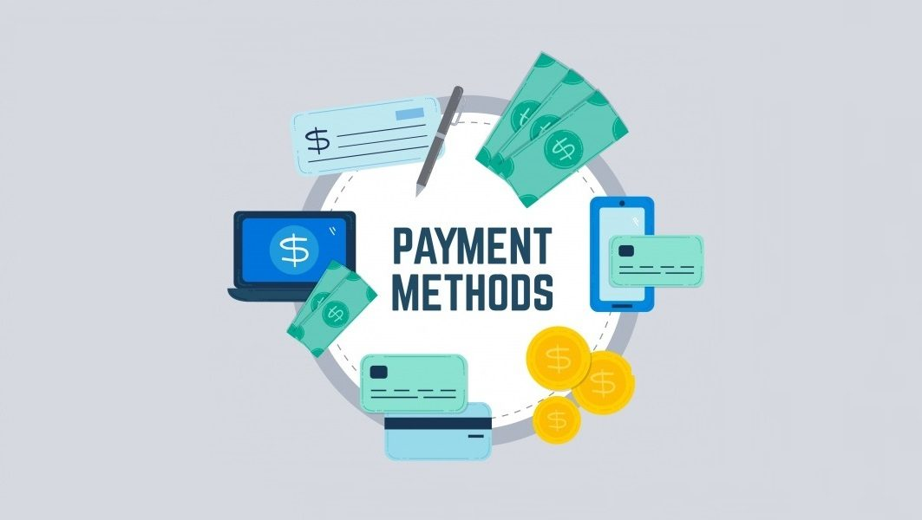
Fee Details Fee details are allocated by admin for each and every stop ,if stops are not available then user will be alerted by the no buses are available at this location .When user is booking bus, payment will be automatically popup in the fee payment page that is fixed by the admin and user have to pay that amount according to his choice

Slide 11
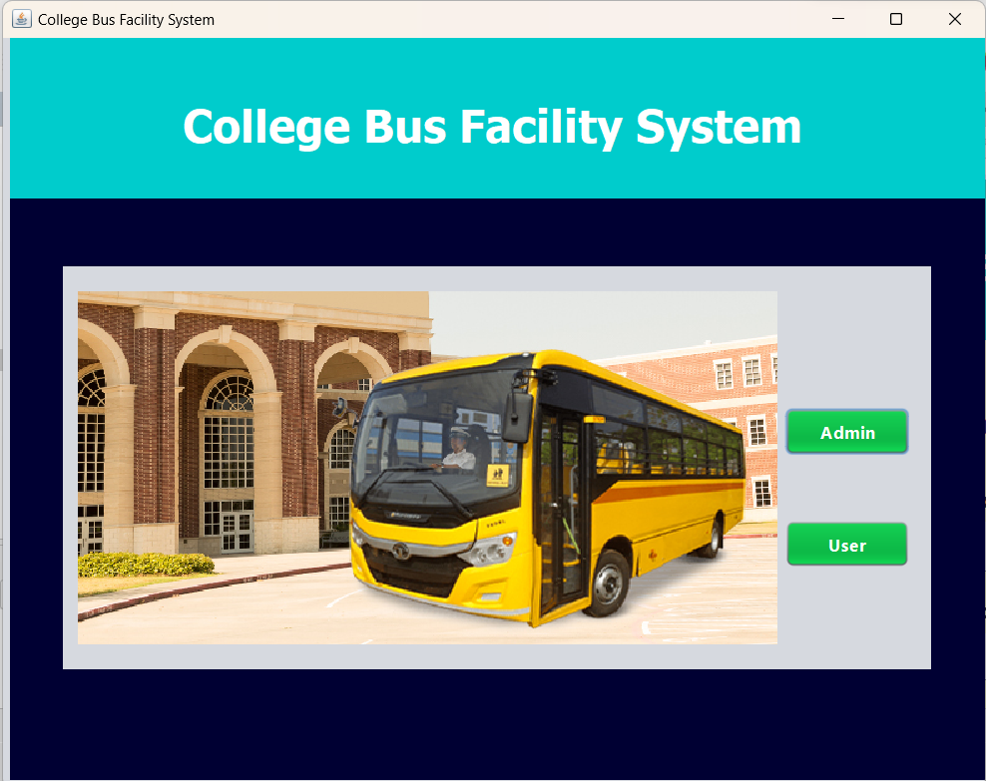
Home Page

Slide 12
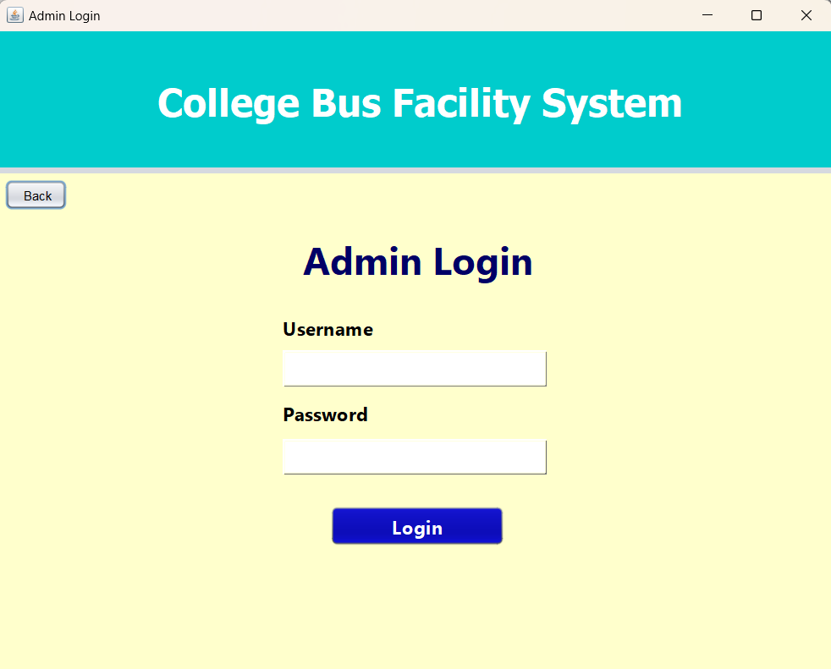
Admin Page

Slide 13
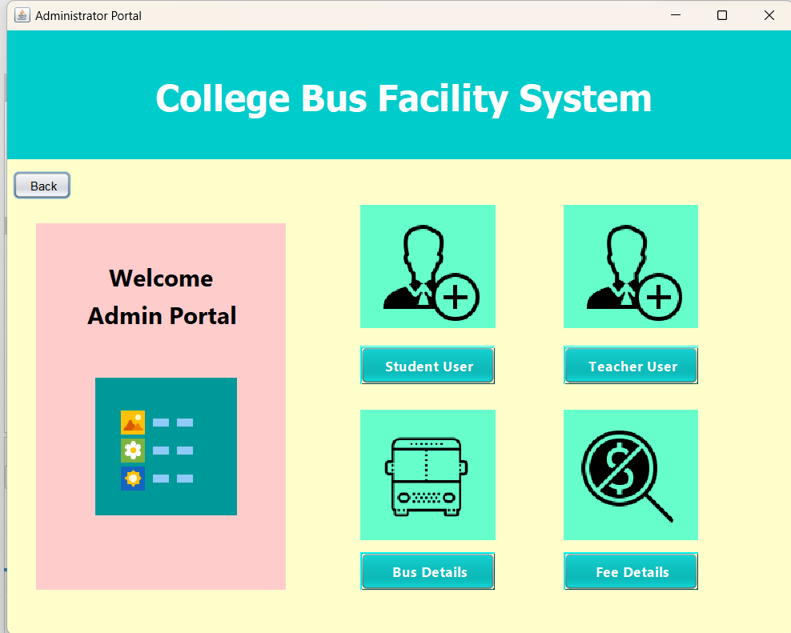
Admin Portal

Slide 14
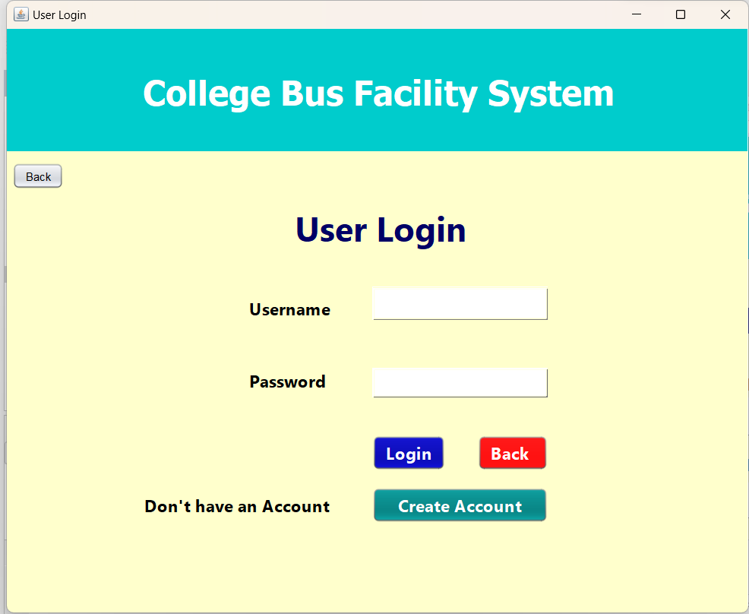
User Page

Slide 15
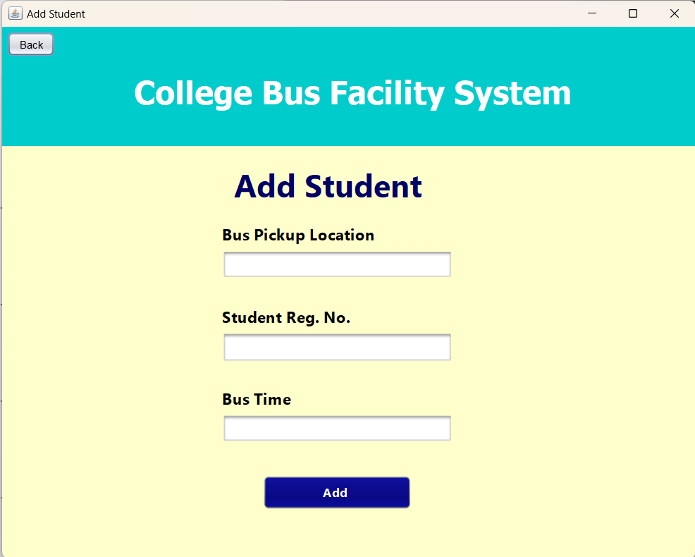
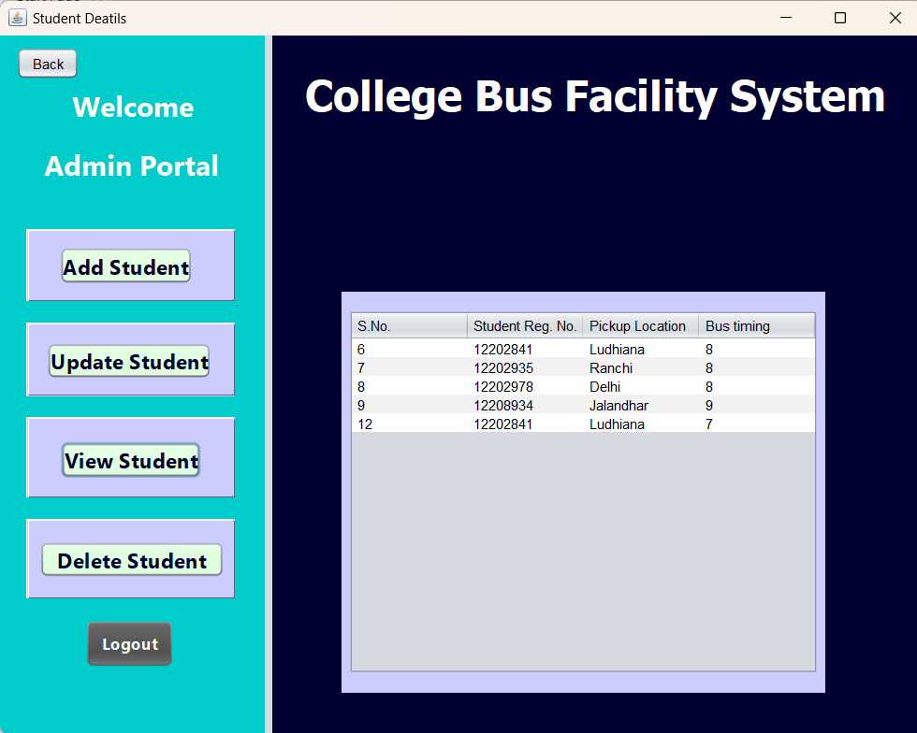
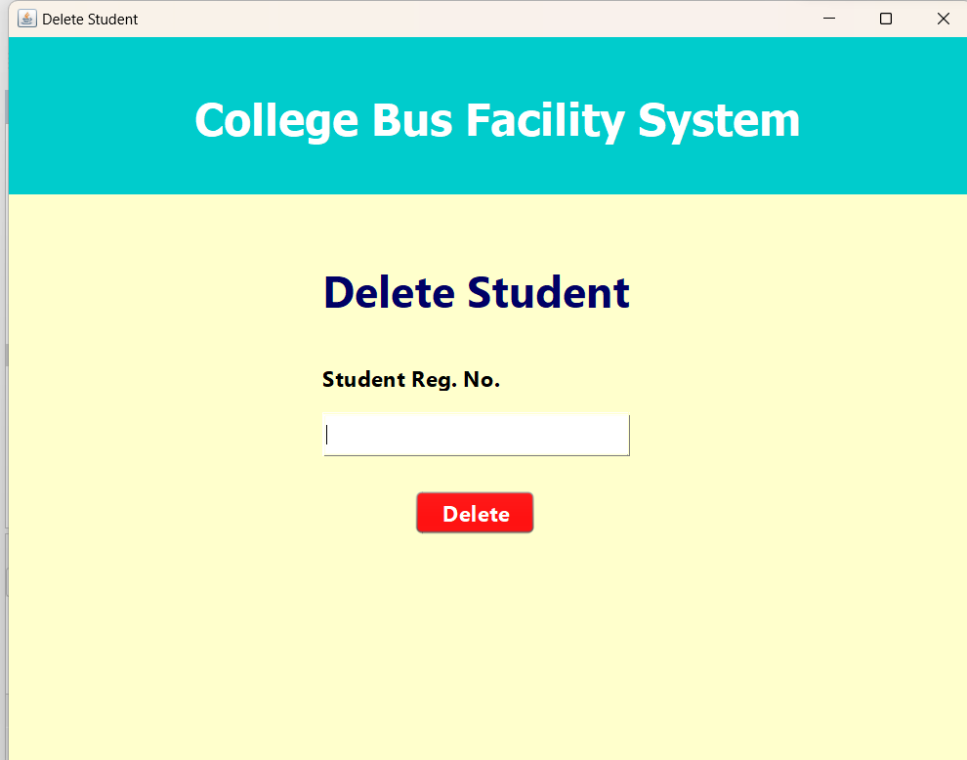
Student User

Slide 16
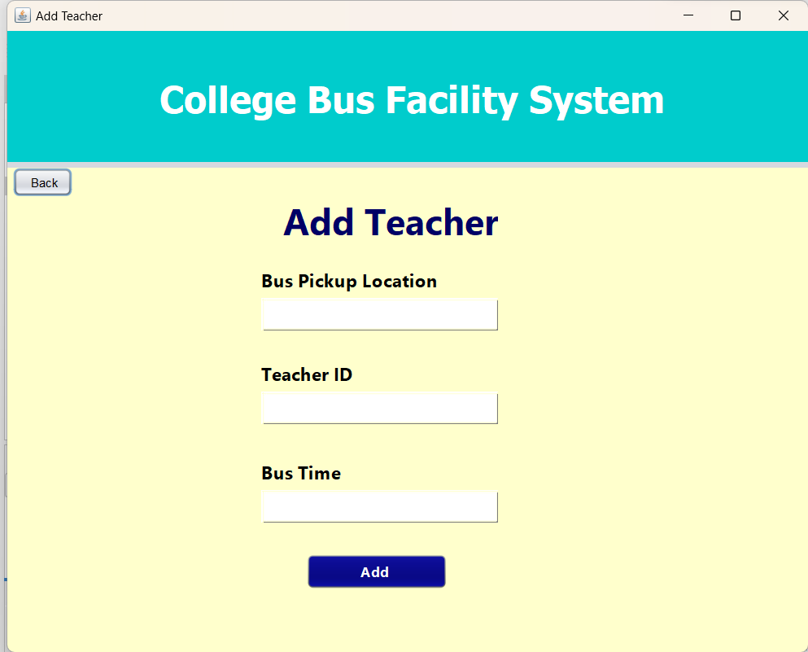
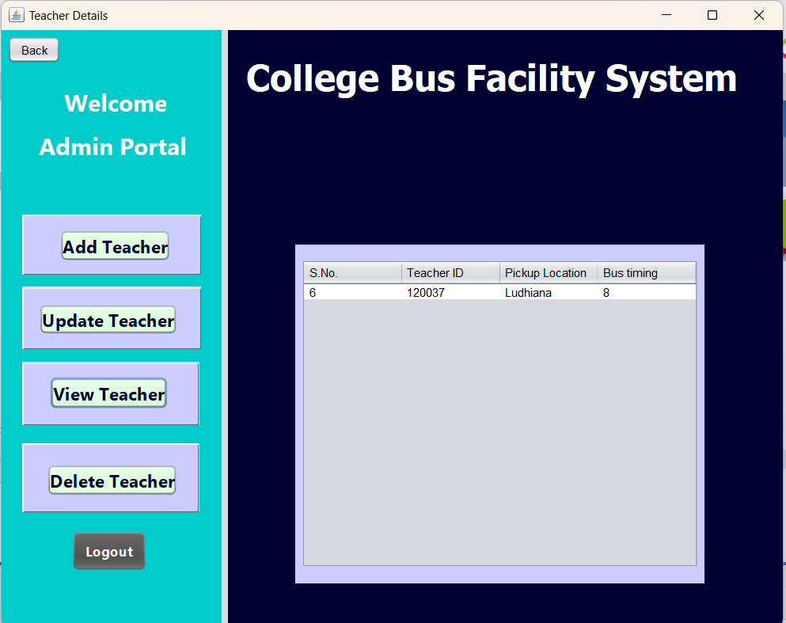
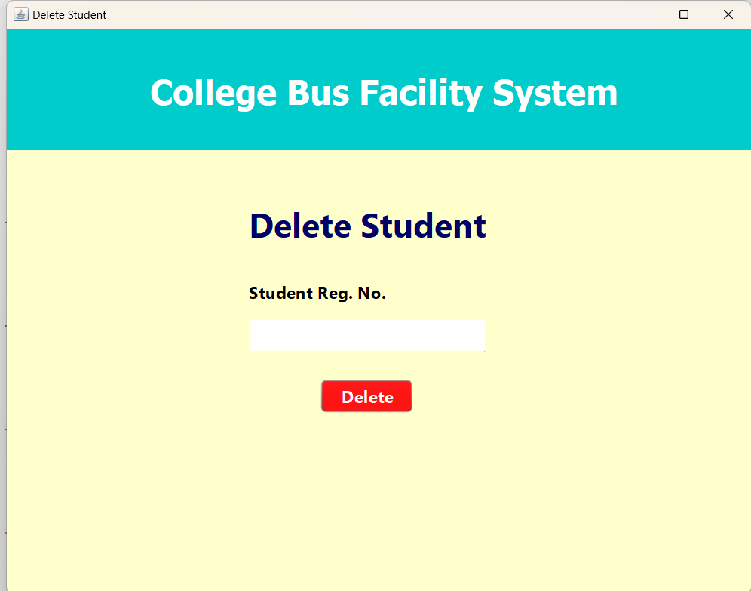
Teacher User

Slide 17
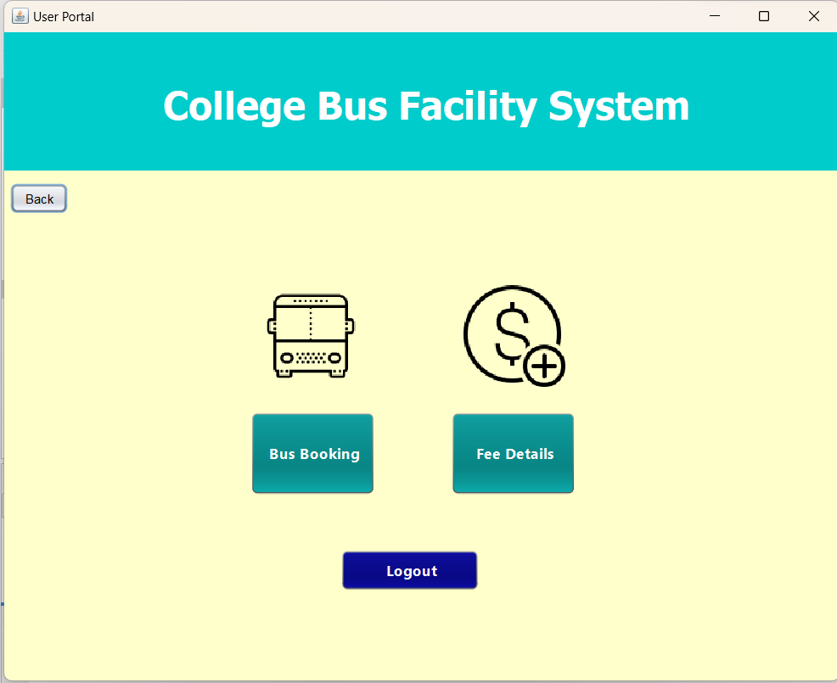
User Portal

Slide 18
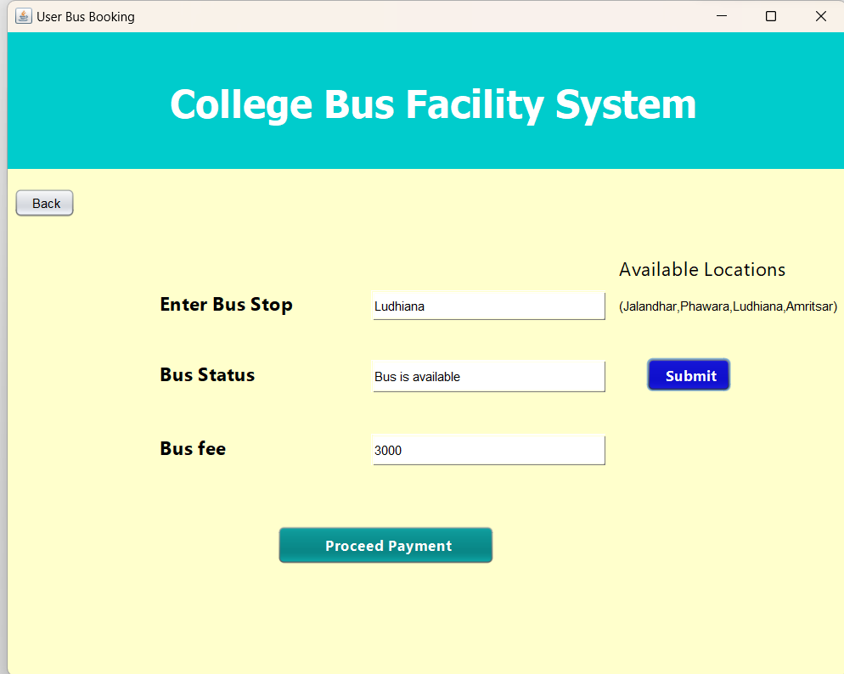
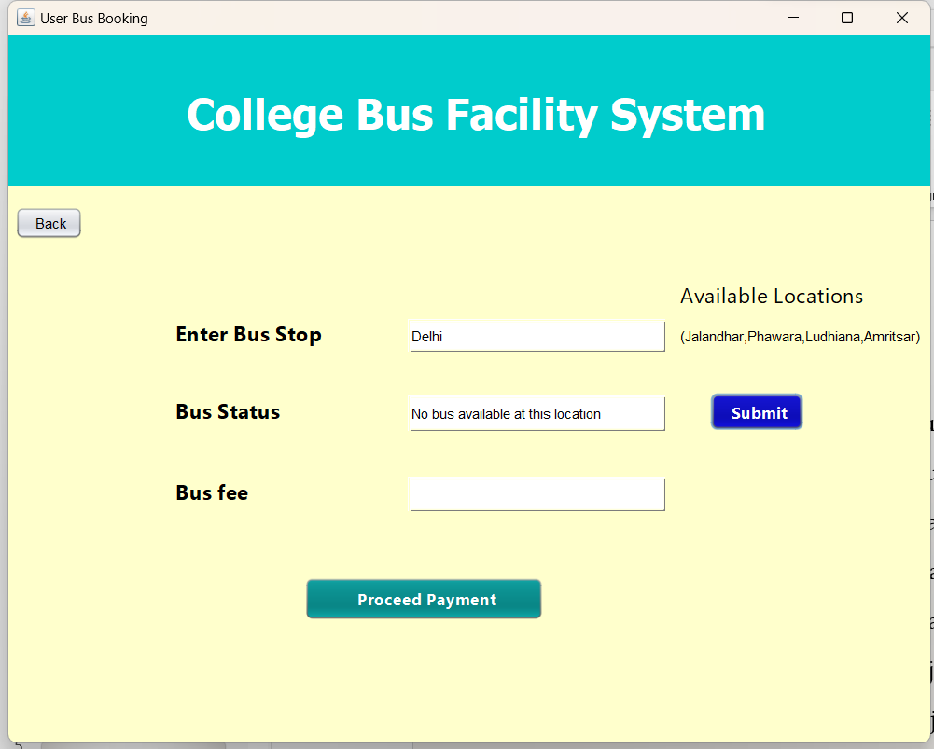
Bus Booking

Slide 19
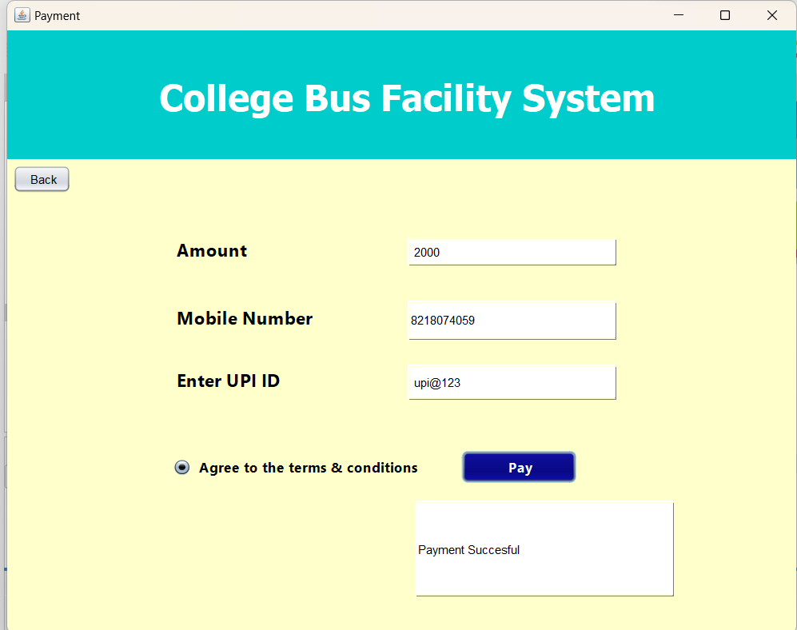
Fee Payment

Slide 20


