Slide 1
Hitlog Processing
-Pulkit Dhingra

Slide 2
Overview
This project analyzes hitlog data (user page views and registration events) to determine which articles are most influential in driving user registrations. The system tracks user journeys through a website and counts how many unique users viewed each article before registering.
Key Features:
Two distinct algorithmic approaches (counter-based and graph-based)
Comprehensive test suite
CLI tool for production use
Jupyter notebooks for exploratory data analysis
Automated code quality checks (ruff linting and formatting)

Slide 3
About the Data
The Hitlog_<date>.csv contains the following columns
Column | Type | Description
Page_name | string | Page-Title
Page_url | string | URL path of page
User_id | string | User Id
Timestamp | datetime | Time user visited the article

Slide 4
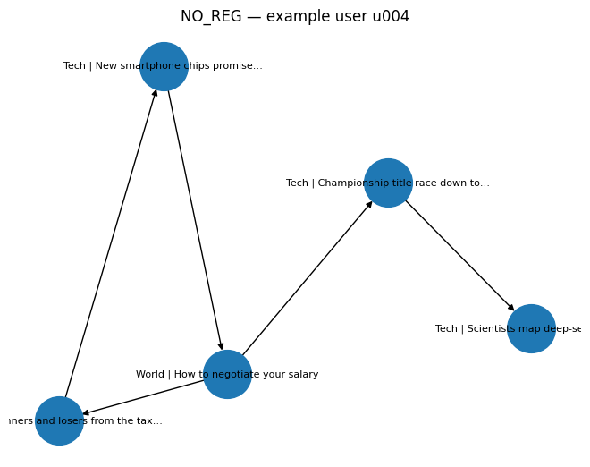
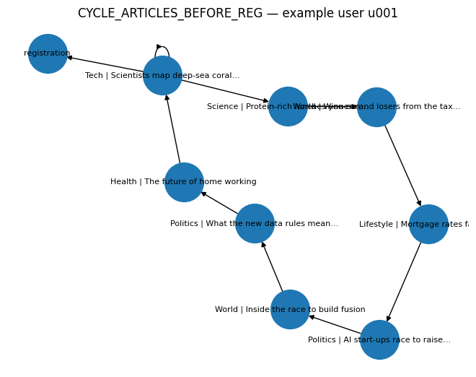
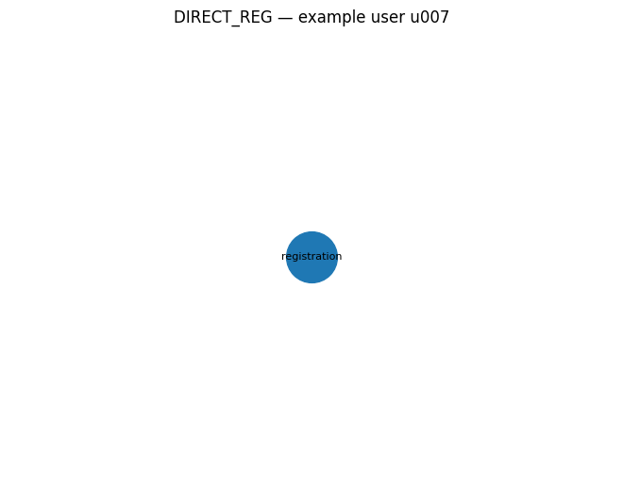
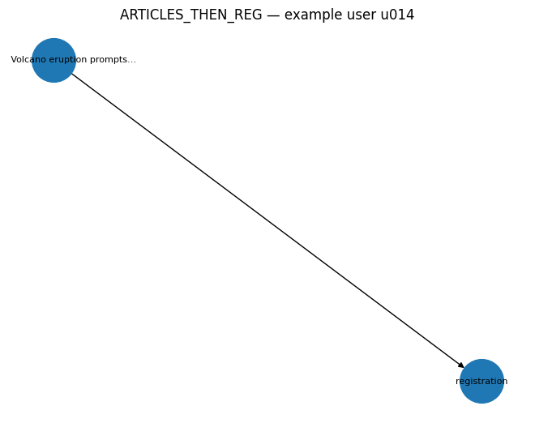
Use case Coverage

Slide 5
Algorithm - URL Counter Based Approach
Process each user's events in chronological order (sorted by timestamp)
Maintain a set of unique articles seen in the current "journey"
When a /register event is encountered:
Increment the count for each article in the journey set by 1
Clear the journey set for the next registration cycle
Articles viewed after registration or without subsequent registration are not counted
Benefits
Easy to understand and implement
Efficient memory usage

Slide 6
Algorithm - Graph-Based Approach
Build a directed graph where:
Nodes represent pages (articles, registration page, etc.)
Edges connect consecutive page views for each user
Traverse through the graph for each user and when a /register event is encountered:
Increment the count for each article in the journey set by 1
Clear the journey set for the next registration cycle
Store metadata (article name, weight) in Node objects
Benefits
Follows conventional data structure approach.
Can be upgraded for weighted page ranking solution.
Drawbacks
High Memory overhead for the current problem
More complex

Slide 7
Algorithms (Add-On)
Building on the Graph based solution, I’ve implemented a Weighed Directed Graph based approach to rank the articles.
Approach
Builds on previous idea of Graph-traversal for each user.
In place of frozen weight (1) the algorithm implements dynamic weights where
Each article gains a higher weight when it directly precedes a registration event.
The influence of earlier articles decays gradually as the traversal moves away from the registration point.
If an article appears multiple times in a user's journey, its cumulative weight increases, reflecting repeated engagement.
The final ranking aggregates these weights across all users to identify the most influential articles.

Slide 8
Results
The output is stored as Comma Separated Value File “.csv” with ranking to all the articles.
Column | Type | Description
Page_name | string | Title
Page_url | string | URL for the article
Total | integer | Number of unique users who registered after viewing

Slide 9
Pipeline
Apart from the conventional notebooks, the code follows a modular structure designed for future enhancements.
The overall pipeline uses the uv package manager for environment management and ruff as the main linting tool.
Several repetitive commands are simplified through the Makefile.
The structure clearly separates the notebook-based solution, which is easy to understand, from the modular codebase that follows industry standards.
The code is covered with test cases for validating the accuracy.

Slide 10
Usage
Code can be executed using CLI python -m telegraph_ranker.cli \ --input <input file directory>\ --output <output file directory>\ --approach <approach – timestamp/graph>
Arguments:
--input: Path to input hitlog CSV file (required)
--output: Path for output CSV file (required)
--approach: Ranking algorithm to use: timestamp (default) or graph

