Slide 1
Identifying Gender from Facial Features
Submitted by Guided by
Divyanshu Gupta - R110218053 Gunjan Chhabra
Pratham Pandey - R134218123
Pulkit Mittal - R134218125
Daksh Kaushik - R142217033
Anurag - R178218006

Slide 2
Introduction
The project aims at exploring various aspects of Gender classification, a binary classification problem that infers whether the person in a given picture is male or female. It uses CNN to achieve its target.
Convolutional neural network (ConvNets or CNNs) is one of the main categories to do images recognition. Image classifications, object detections, recognition faces etc. are some of the areas where CNNs are widely used. CNN image classification takes an input image, process and classifies it under certain categories.

Slide 3
Technologies
The face detection was performed using OpenCV, a library of programming functions mainly aimed at real-time computer vision. Following that processed facial image data was matched with knowledge base containing classified male and female faces. A model was created with the help of tensorflow, an end-to-end open source platform for machine learning, that was later used for real time face detection and gender classification.
A frontend was created using flask, a micro web framework written in Python with support of JavaScript, HTML and CSS.

Slide 4
System Requirements
Hardware: 8GB RAM 8GB Disk Space GPU capabilities for deep learning
Software: Anaconda3
OS: Windows 7/10, MacOS (>10.0), Ubuntu

Slide 5
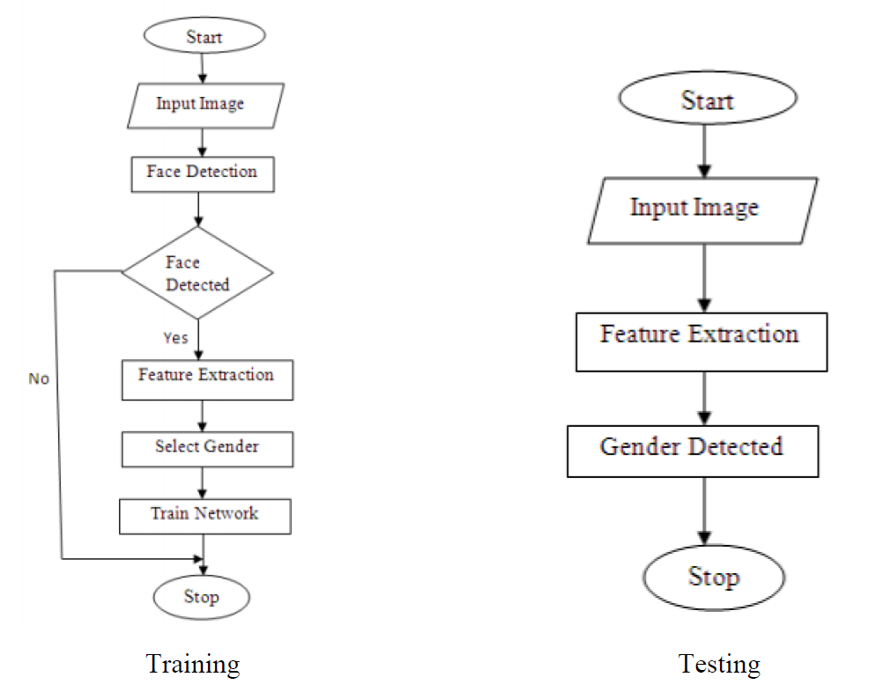
System Design

Slide 6
System Design
The Model is trained on 10,000 images of male and 10,000 images of female. The model is made using multiple number of convolution layers having different filters like 32, 64, 128 using activation function relu. The output is normalized using BatchNormalization and after each convolution layer a maximumpooling layer is applied to extract the best features from it. After each layer 25% of neurons are dropped to avoid overfitting. The layers are then flattened to get the output in 1D which is passed through sigmoid activation function so that we can get the output in the range of 0 and 1.

Slide 7

Usage

Slide 8
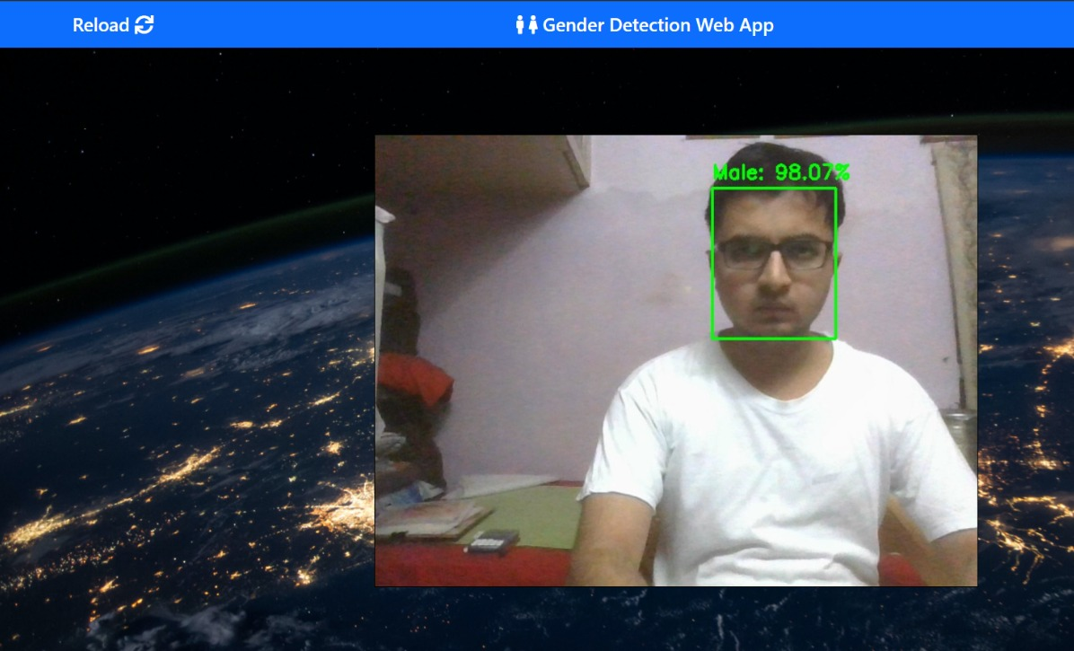
Usage

Slide 9
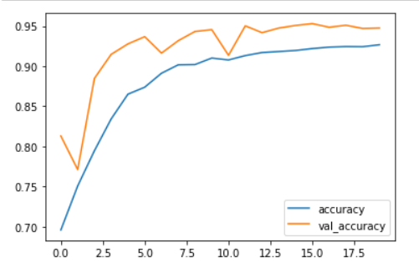
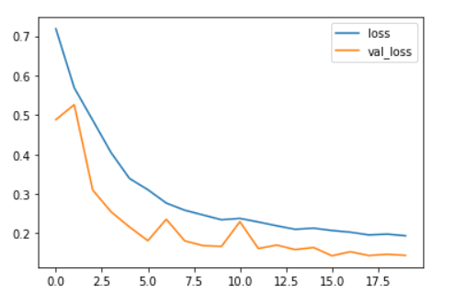
Accuracy
Plot accuracy value through epochs
Plot loss function value through epochs

Slide 10
Conclusion
The built model adds custom layers to successfully recognize the gender giving certain picture with high accuracy over the test data. Nevertheless, there are some limitations detected and opportunities for improvements:
Due computational resource limitation, the model was train with a subset of images. Having an appropriate machine, the model can be trained including all the images. This will make the algorithm to learn from different context of the picture giving it more experience in order to predict better never seen images.
Using different structures for the CNNs. This approach could give better performance to the mode. Although it is an expensive task, as the model can be measured on the test data set after it is trained, and this takes time and computational resources.

Slide 11
References
[1] https://medium.com/@RaghavPrabhu/understanding-of-convolutional-neural-network-cnn-deep-learning-99760835f148
[2] D.Gowtami Annapurna, Dantu Lakshmi Pujita, Dindi Mounika "Gender Identification from Facial Features" (IJIET) http://dx.doi.org/10.21172/ijiet.154.02
[3] https://towardsdatascience.com/building-a-convolutional-neural-network-cnn-in-keras-329fbbadc5f5
[4] Age and gender estimation by using hybrid facial features | IEEE Conference Publication | IEEE Xplore
[5] AFIF4: Deep gender classification based on AdaBoost-based fusion of isolated facial features and foggy faces – ScienceDirect

