Slide 1
AWS CLOUD COMPUTING · PROJECT 26
Cloud-Based Image
Storage and
Gallery System
S3
A stateless web application on Amazon EC2 that keeps every uploaded image as an object in Amazon S3.
Name · Roll number · Class · Date
Notes:
Open with the title. This project takes the simplest idea on the list and uses it to show what cloud computing is actually about: keeping the application separate from the data. Two AWS services, EC2 and S3.

Slide 2
CONTENTS
What this presentation covers
01
01
The problem
02
Objective and scope
Why one server is the wrong place for files
What the system does, and what it does not
03
The AWS services
04
Architecture
EC2, S3 and the role that connects them
How a request travels from browser to bucket
05
Security
06
Demonstration
Keeping the bucket private with signed links
The running application and its test results
Notes:
Give the audience the shape of the talk in one breath, then move on. Do not read all six lines aloud.

Slide 3
THE PROBLEM
Why not just store images on the server?
02
Build this the ordinary way and every photo lands on one machine's disk. Four things then go wrong, and all of them go wrong quietly.
Disk fills up
One copy only
Cannot scale out
Manual backups
Storage is fixed. Photos pile up until uploads start failing.
If the machine dies, every uploaded image dies with it.
A second server holds different files, so users see different galleries.
Someone has to remember to copy the folder somewhere safe.
The cloud answer is a split: the application stays on EC2, the files move to S3.
Notes:
Set up the problem before the solution. Ask where the photos go if you build this on a normal college server. Answer: onto that one machine's disk. Then walk the four blocks.

Slide 4
OBJECTIVE
What the system does
03
Scope
2
AWS services at the core
Upload an image from any browser
Store it as an object in a private S3 bucket
List every stored image, newest first
View the full image through a signed link
Delete an image from the bucket
Reject non-image files and anything over 10 MB
EC2 for compute, S3 for storage
0
files on the instance disk
the server stays disposable
11
nines of durability
S3 is built never to lose an object
Notes:
State the scope plainly so nobody expects features that are not there. Then point at the three numbers: two services, zero files on the instance disk, eleven nines of durability, which means S3 is built never to lose an object.

Slide 5
BUILDING BLOCKS
The AWS services used
04
EC2
S3
IAM
Elastic Compute Cloud
Simple Storage Service
Identity and Access Management
A t3.micro virtual machine running the Flask application on port 8080. Free Tier eligible.
Object storage holding every uploaded image under the uploads prefix of one private bucket.
A role on the instance that hands the application temporary keys, so no password sits in the code.
Deliberately small. No database, no load balancer, no Lambda: two services are enough to show the one idea that matters.
Notes:
EC2 is a rented computer. S3 is not a disk, it is a store of objects addressed by key. IAM is the part most student projects skip: it lets the server use the bucket with no password in the code.

Slide 6
ARCHITECTURE
How the pieces fit together
05
User browser
HTTP
Amazon EC2
boto3
Amazon S3
grants
IAM role
uploads and views
Flask app, port 8080
private bucket
temporary keys
EC2 stays stateless
S3 holds the truth
No keys in the code
Nothing is saved on the instance disk. Terminate it, launch a new one, and the gallery is unchanged.
Objects live under uploads/ with a timestamped unique key, so two users can never overwrite each other.
The role supplies rotating credentials, so nothing secret is ever committed to the repository.
The split between the two middle boxes is the whole project.
Notes:
Spend the most time here. Trace the arrows left to right, then make the three points underneath: the instance holds nothing, S3 holds the truth, no keys live in the code.

Slide 7
REQUEST FLOW
What happens when you press Upload
06
01
Browser posts the file
02
The app validates it
A multipart form sends the image to /upload on the instance.
The extension must be an image type and the body under 10 MB.
03
A unique key is built
04
boto3 streams it to S3
uploads/20261010-141655-5e12be.png, a timestamp plus a random suffix.
upload_fileobj sends the bytes through. Nothing touches the EC2 disk.
05
The gallery re-reads S3
06
Signed links render it
list_objects_v2 returns every object, which the app sorts newest first.
Each thumbnail gets a URL valid for one hour. The bucket stays private.
Notes:
Walk the six steps in order. The point to land on is step four, the file streams straight to S3 and never touches the EC2 disk. Step six explains presigned URLs.

Slide 8
SECURITY
Keeping the bucket private
07
The shortcut, avoided
What this project does
Make the bucket public so image tags work
Paste access keys into the source file
Anyone guessing a URL reads every image
A leaked key becomes a leaked account
Block Public Access stays switched on
An IAM role gives rotating credentials
Presigned URLs expire after one hour
The role may only touch the uploads prefix
Least privilege in one line: the application may read, write and delete under uploads/*, and nothing else in the account.
Notes:
Expect a question about why the bucket is not public, so answer it here. Left column is the shortcut most tutorials take, right column is what this project does.

Slide 9
IMPLEMENTATION
The part that talks to AWS
08
boto3
s3 = boto3.client("s3", region_name=REGION)
# upload: stream the file into the bucket
key = f"uploads/{stamp}-{uuid4().hex[:6]}{ext}"
s3.upload_fileobj(file, BUCKET, key,
ExtraArgs={"ContentType": file.mimetype})
# list: every object, newest first
objects = s3.list_objects_v2(Bucket=BUCKET,
Prefix="uploads/")["Contents"]
# view: a link that works for one hour
url = s3.generate_presigned_url("get_object",
Params={"Bucket": BUCKET, "Key": key},
ExpiresIn=3600)
The AWS SDK for Python. Each call is one HTTPS request to the S3 API.
No credentials
boto3 finds the instance role on its own. No access key in this file.
Unique keys
A timestamp plus six random characters, so uploads cannot collide.
Expiring links
A presigned URL is the bucket signing a time-limited permission.
Notes:
Do not read the code line by line. Four boto3 calls do the whole job: upload, list, sign a link, delete. Point out there is no password anywhere in the file.

Slide 10
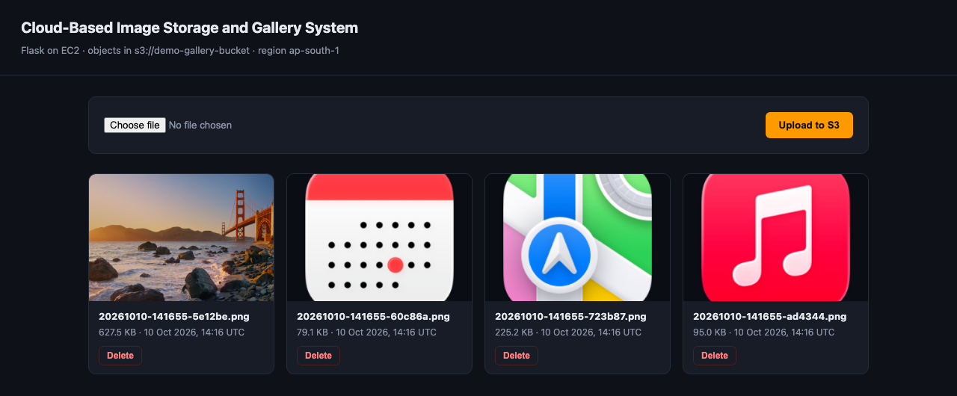
DEMONSTRATION
The running application
09
Upload
The panel posts the file straight to S3.
Cards
Each card is one object in the bucket.
Metadata
Size and time are read from S3 itself.
Thumbnails
Loaded over presigned URLs.
The gallery with four objects in the bucket.
Delete
Removes the object, not a database row.
Notes:
Switch to the live application if you can, otherwise use this screenshot. Upload an image, then open the S3 console and show the same object appearing under the uploads prefix.

Slide 11
DEPLOYMENT
Getting it onto AWS
10
01
02
03
04
05
Create the bucket
Create the IAM role
Launch t3.micro
Install and run
Open the public IP
Block Public Access stays switched on.
Read, write and delete on uploads/* only.
Attach the role, open ports 22 and 8080.
Set the bucket name, start the app with gunicorn.
Upload, then confirm the object in the S3 console.
The whole setup takes about twenty minutes and stays inside the AWS Free Tier. Terminate the instance and empty the bucket afterwards to keep the bill at zero.
Notes:
Deployment is a short repeatable sequence and all five steps are in the report. Mention the Free Tier and that you terminate the instance afterwards.

Slide 12
RESULTS
What was tested
11
TEST CASE
EXPECTED AND OBSERVED RESULT
STATUS
Upload a PNG
Object appears in the bucket, bytes identical to the file sent
Pass
View an image
Presigned URL returns HTTP 200 and the exact uploaded bytes
Pass
List the gallery
Every object listed newest first, with size and timestamp
Pass
Delete an image
Object removed, the gallery falls back to its empty state
Pass
Upload a .txt file
Rejected with a message, nothing written to the bucket
Pass
Upload with no file
Rejected with a message, no request sent to S3
Pass
Delete outside uploads/
Refused as an invalid key, no S3 call made at all
Pass
Every case was run against a live S3 API, including a byte-for-byte comparison of what each presigned URL returned.
Notes:
Say what you tested rather than claiming it works. Four normal cases and three failure cases, including a byte-for-byte check that the image returned is identical to the one uploaded.

Slide 13
SCOPE
Honest limits, and what comes next
12
Current limitations
Where it goes next
No login, so anyone with the address can upload
One bucket holding one shared gallery
Thumbnails are full-size downloads
A single instance, so no failover
Cognito logins
A private prefix per user in the same bucket.
Lambda thumbnails
Resize on upload through an S3 event trigger.
CloudFront
Cache images at the edge instead of signing each view.
DynamoDB metadata
Titles, tags and captions beside the objects.
Every extension plugs into the same two-service core, which is why the simple version was worth building first.
Notes:
Being honest about limits makes the viva easier. No login, so anyone with the address can upload. Then give the four extensions.

Slide 14
CONCLUSION
Separate the compute
from the storage.
The one idea
to remember
EC2 runs the code and can be thrown away at any moment. S3 keeps the images durable and independent of whichever server happens to be running. That single split is what makes the application scalable, and it is the whole lesson of this project.
Thank you. Questions welcome.
Notes:
Close on the single idea: EC2 is disposable, S3 is durable, and separating them is what makes the system scalable. Then invite questions.

