Slide 1
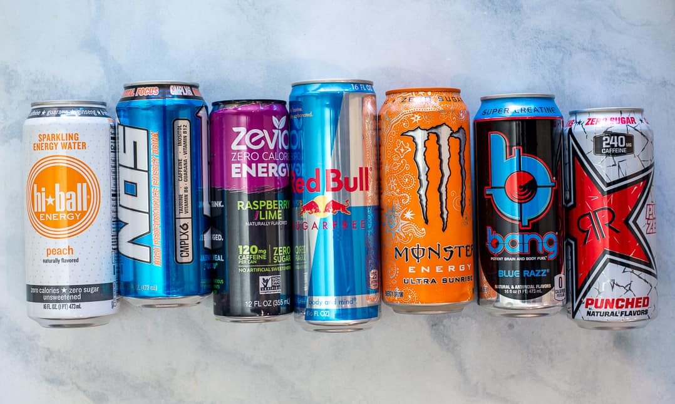
ENERGY DRINKS
Name : Pulkit Agarwal
Roll No :

Slide 2
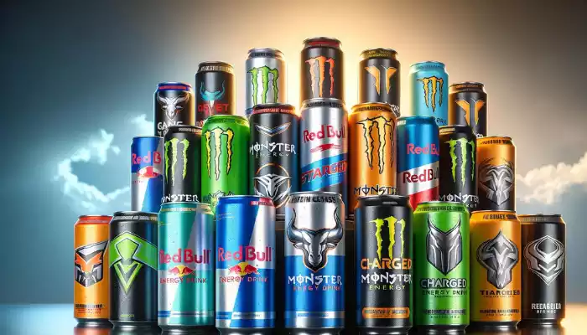
Introduction
Energy drinks are beverages designed to provide a quick boost of energy and mental alertness. Containing high levels of caffeine, sugar, and other stimulants like taurine and guarana, they aim to enhance physical performance and cognitive functions. The market has seen substantial growth due to busy lifestyles and the demand for high-energy activities, with major brands like Red Bull and Monster leading the industry through innovative flavors and marketing strategies .These drinks are particularly popular among young adults and athletes, often associated with extreme sports and high-adrenaline events.

Slide 3
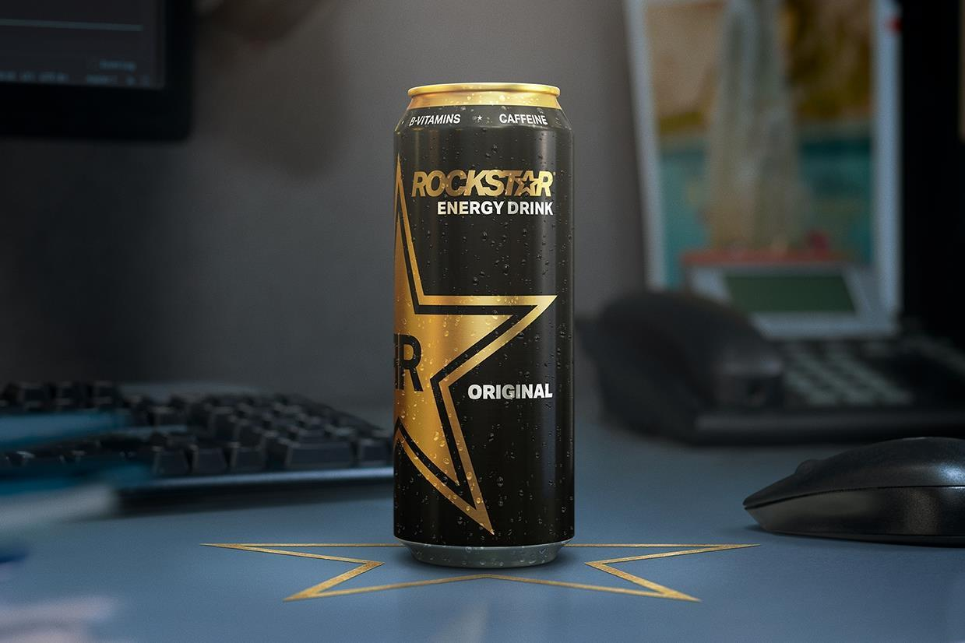
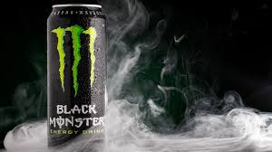
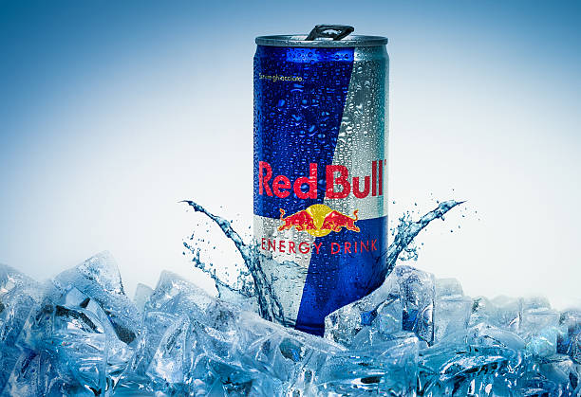
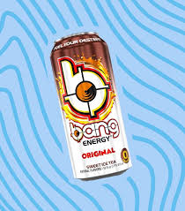
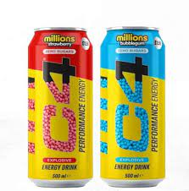
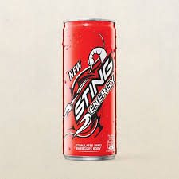
BRAND OFFERING THE PRODUCT
Rockstar
Monster energy
Red bull
Bang
C4
Sting

Slide 4
RAW MATERIALS REQUIRED TO MANUFACTURE
Caffeine
Sugars
Artificial Sweeteners
Taurine
B Vitamins (B2, B3, B6, B12)
Carbonated Water
Flavors
Colors
Preservatives
Acid
Stabilizers and Emulsifiers

Slide 5
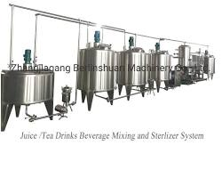
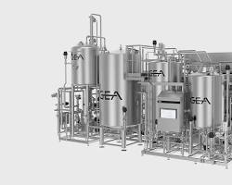
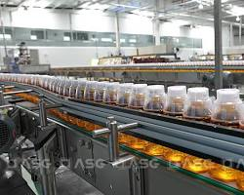
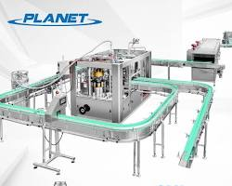
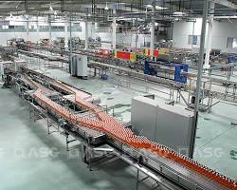
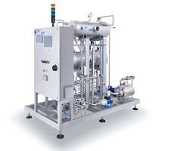
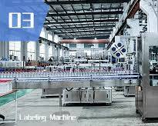
Tools and Equipment for Manufacturing
Mixing tanks
Pasteurizer
Filling machine
Sealing machine
Packaging machine
Carbonation
Labelling machine

Slide 6
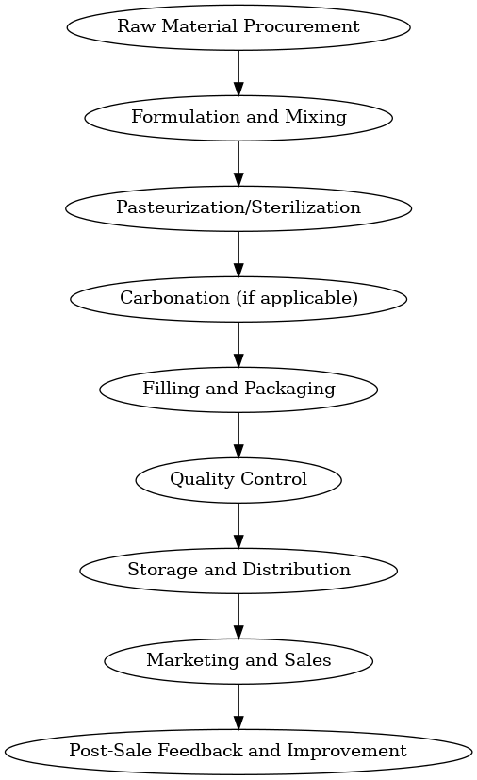
Transformation Process

Slide 7
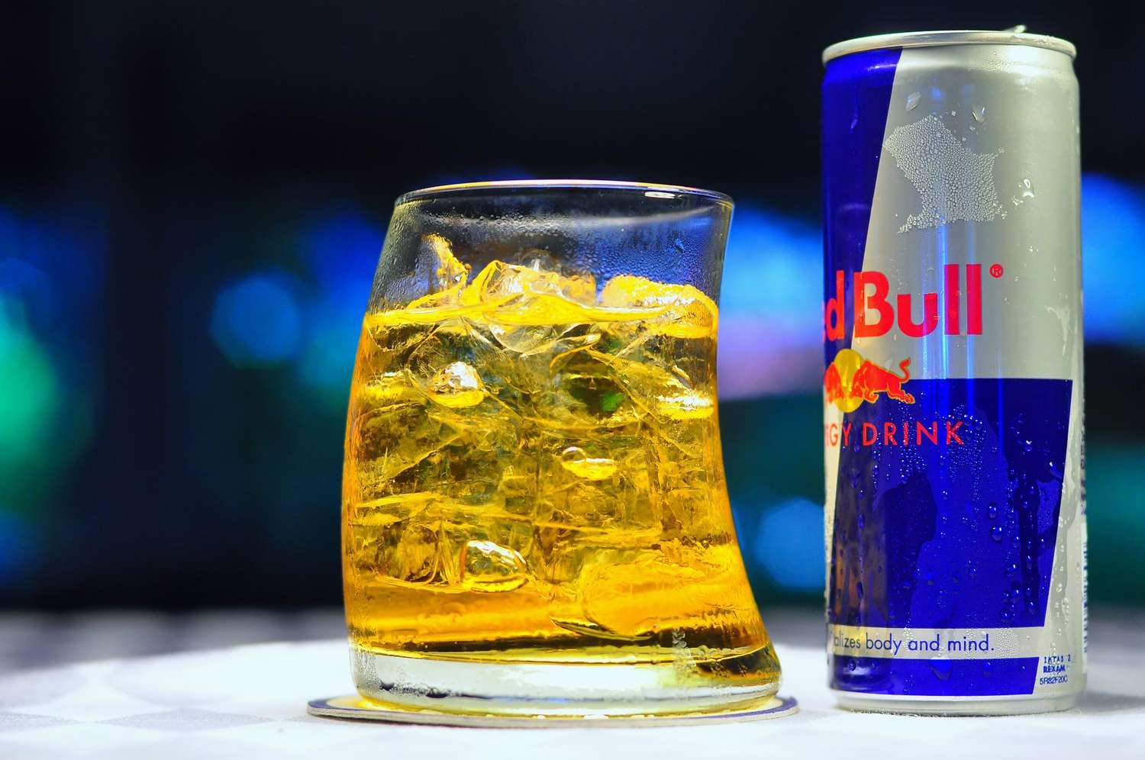
Finished Product
The finished product is a ready-to-drink energy beverage that is packaged in bottles or cans. The product is designed to provide a quick and temporary boost of energy, alertness, and focus.

Slide 8
Packaging Aspect, Material Handling, Transportation, Warehousing and Inventory Management
Packaging: Energy drinks are typically packaged in aluminium cans or plastic bottles to provide a lightweight, durable, and recyclable container.
Material Handling: The energy drink products are handled with care during the manufacturing process, transportation, and warehouse storage to prevent any damage or contamination.
Transportation: Energy drinks are transported by various modes, including trucks, trains, and ships, depending on the distribution network and the target markets.
Warehousing: Energy drinks require temperature-controlled storage facilities to maintain the quality and freshness of the products, especially during prolonged storage.
Inventory Management: Energy drink manufacturers and distributors employ advanced inventory management systems to track the production, distribution, and sales of their products, ensuring efficient supply chain management and timely replenishment.

Slide 9
Conclusion
In conclusion, energy drinks are a popular type of beverage that is designed to provide a quick and temporary boost of energy, alertness, and focus. The manufacturing process for energy drinks involves a combination of ingredients, equipment, and processing steps that result in a finished product that is packaged and distributed to retailers and consumers. The global market for energy drinks is highly competitive, with many brands and products available. As the demand for energy drinks continues to grow, manufacturers and distributors must focus on quality, safety, and sustainability to meet the evolving needs of consumers.

Slide 10
THANK YOU

