Slide 1
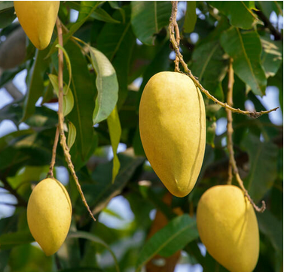
Digital Image Processing Techniques for Object Detection From Complex Background Image

Slide 2
Objection Detection
Object detection is a computer vision technique for locating instances of objects in images or videos.
When humans look at images or video, we can recognize and locate objects of interest within a matter of moments. Object detection replicates this intelligence using a computer.
Different approaches can be used to detect objects, such as Deep Learning, Machine Learning, and Image Segmentation.
Object detection is a powerful tool that can be used in a variety of applications, from facial recognition to autonomous vehicles. It can also be used in applications such as security surveillance, medical imaging, autonomous navigation, and more.

Slide 3
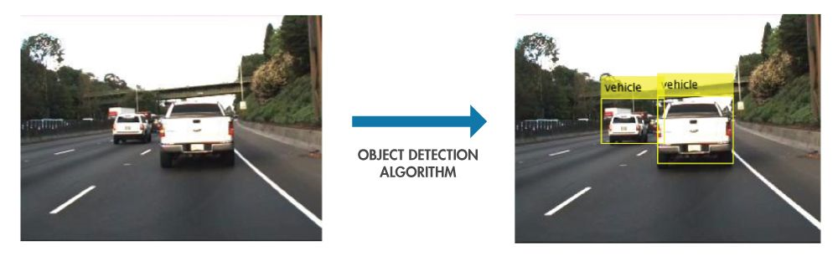
Fig. Example of Object Detection

Slide 4
Objectives
This project aims to detect and allocate the object using a few methods such as Color processing and Blob Analysis.
The Method should be automatically detect and count the total number of object from image of a mango tree.
By using this method, we will be able to efficiently detect the mangos, eliminate the background image and count the total number of object.

Slide 5
Challenges
In the process of object detection, targeted object which is obscured due to presence of other object is one of the main problem faces in image processing field. This is due to the object are not clearly expressing in the image and will assume and eliminated by the program.
Objects which overlapping each other also made the process challenging where hidden object will be detected and counted and the total number will be no accurate.
On color processing, lighting intensity may also affect the original color of object to be not accurate. The light intensity on each object makes the background object have almost the similar color as the target object.
To eliminate all these problem, a proper image segmentation process and technique must taken into account.

Slide 6
Methodology
To achieve the objective, several steps and method had been taken into account in order to get the result.
STEPS
Image Preprocessing
Color Processing
Gray Scaling, Filtering & Enhancing
Blob Analysis & Object Counting

Slide 7
Image Preprocessing
Color Processing
Grayscaling, Filtering & Enhancing
Blob Analysis & Object Counting
Fig. Mango Recognition Block Diagram

Slide 8
STEP 1: Image Preprocessing
First of all, the images are sent into the preprocessing block.
Here a image resize is performed where set to 320x240 pixels.
After that, it will directly go to the RGB adjustment where it will readjust the lighter and darker the object color and background.
% Original Image
Img = imread('Image.png');
% RGB Adjustment
RGBadjust = imadjust(A, [118/255 82/255 0; 254/255 247/255 204/255],[]);

Slide 9
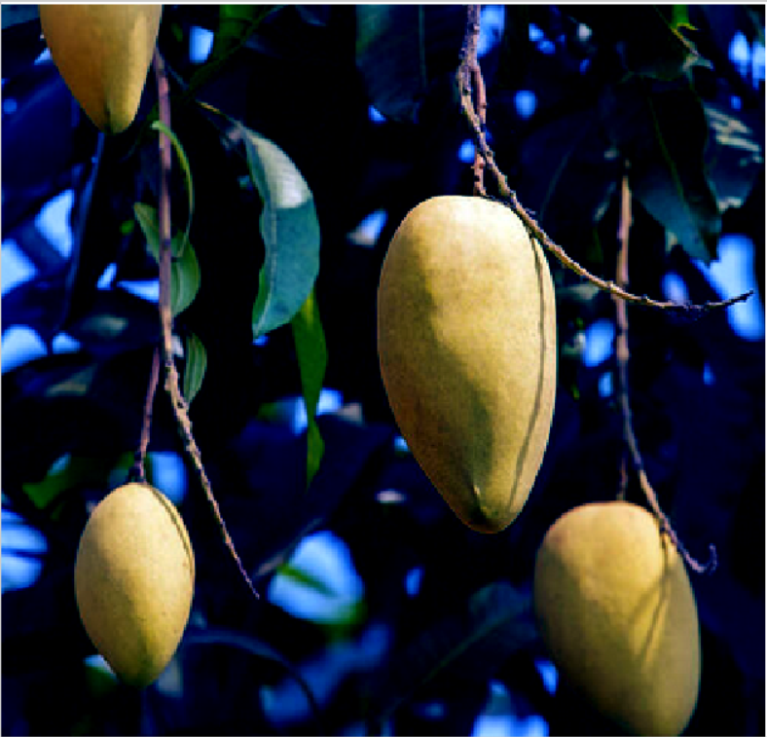
Original Image
After RGB Adjustment

Slide 10
STEP 2: Color Processing
During Color Processing, the elimination of unrelated colors takes place and only yellow color of mango remains.
The elimination of the unrelated object in here are by comparing the current pixel RGB value with the default RGB value of mango.
If detected color is not related then change the current pixel RGB value to 0 which is in black color.
After the color processing, the only left for the image is a clear mango and the leaves which have the same color as mangos.

Slide 11
I = rgb2hsv(RGBadjust);
% Define thresholds for 'Hue'.
channel1Min = 0.965;
channel1Max = 0.188;
% Define thresholds for 'Saturation'
channel2Min = 0.000;
channel2Max = 1.000;
% Define thresholds for 'Value'
channel3Min = 0.000;
channel3Max = 1.000;
% Create mask based on chosen histogram thresholds
BW = ( (I(:,:,1) >= channel1Min) | (I(:,:,1) <= channel1Max) ) & ...
(I(:,:,2) >= channel2Min ) & (I(:,:,2) <= channel2Max) & ...
(I(:,:,3) >= channel3Min ) & (I(:,:,3) <= channel3Max);
% Initialize output masked image based on input image.
maskedRGBImage = RGBadjust;
% Set background pixels where BW is false to zero.
maskedRGBImage(repmat(~BW,[1 1 3])) = 0;

Slide 12
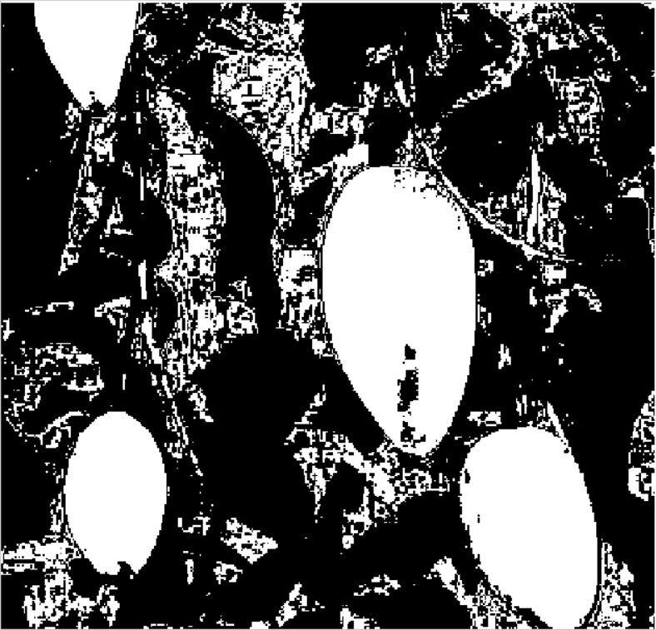
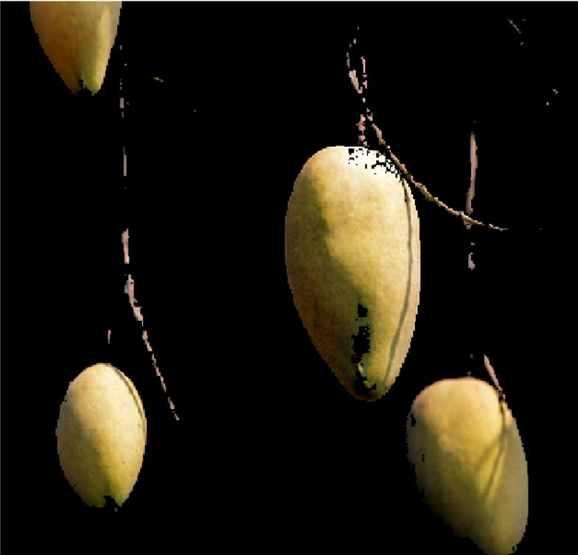
Mask
Masked RGB Image

Slide 13
STEP 3: Gray-Scaling, Filtering & Enhancing
Now the Image must be change to gray scale, perform medium filter to eliminate the small pixel and smoothing the image.
In the medium filter, it will eliminate the pixel which is small and smoothing the images to make the objects edge more clear and clean.
After that, it will be change to binary image and go through another object elimination that eliminate the binary objects which is lesser than 200 pixels in a group of objects.

Slide 14
% Grayscaling the Image
Gray = rgb2gray(maskedRGBImage);
% Medium Filter
filteredImg = medfilt2(Gray);
threshold = graythresh(filteredImg);
binaryImg = im2bw(filteredImg,threshold);
% Eliminating Objects under 200px
binaryImg = bwareaopen(binaryImg, 200);
% Perform morphological operations to enhance the binary image
se = strel('disk', 10);
binaryImg = imclose(binaryImg, se);
binaryImg = imfill(binaryImg, 'holes');
binaryImg = imopen(binaryImg, se);

Slide 15
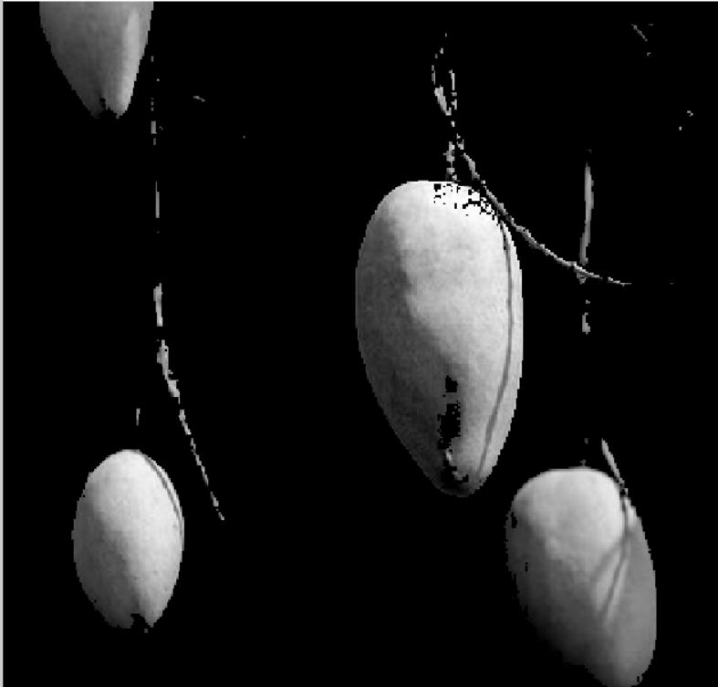
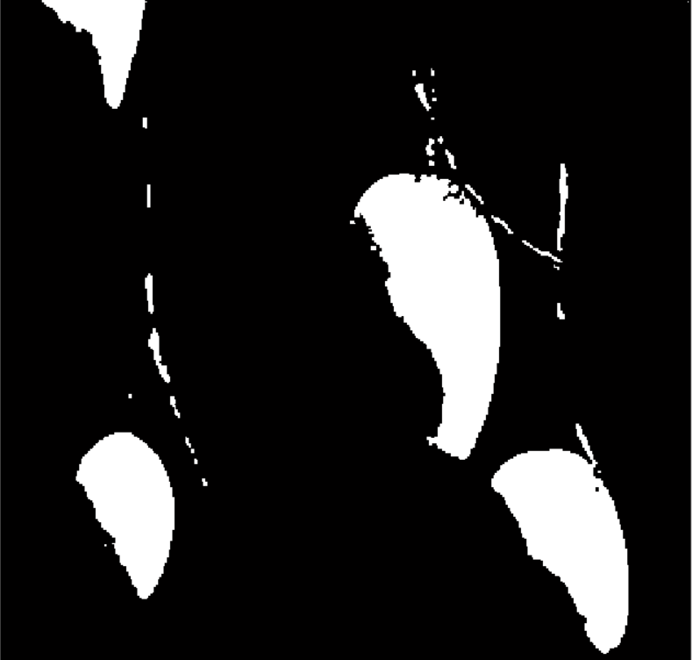
Binary Image
Grayscaled Image

Slide 16


Eliminating Binary Objects under 200px
Enhancing Binary Image

Slide 17
STEP 4: Blob Analysis & Counting Objects
Blob Analysis is a fundamental technique of machine vision based on the analysis of consistent image regions.
As such it is a tool of choice for applications in which the objects being inspected are clearly discernible from the background.
With a diverse set of Blob Analysis methods, we can come up with tailored solutions for a wide range of visual inspection problems.

Slide 18
% Perform blob analysis to get the properties of the mangoes
blobAnalysis = regionprops(binaryImg, 'Area', 'BoundingBox', 'Centroid');
numMangoes = length(blobAnalysis);
% Draw bounding boxes around the mangoes
figure;
imshow(Img);
hold on;
for i = 1:numMangoes
rectangle('Position', blobAnalysis(i).BoundingBox, 'EdgeColor', 'r', 'LineWidth', 2);
end
title(sprintf('%d mango(es) detected',numMangoes));

Slide 19
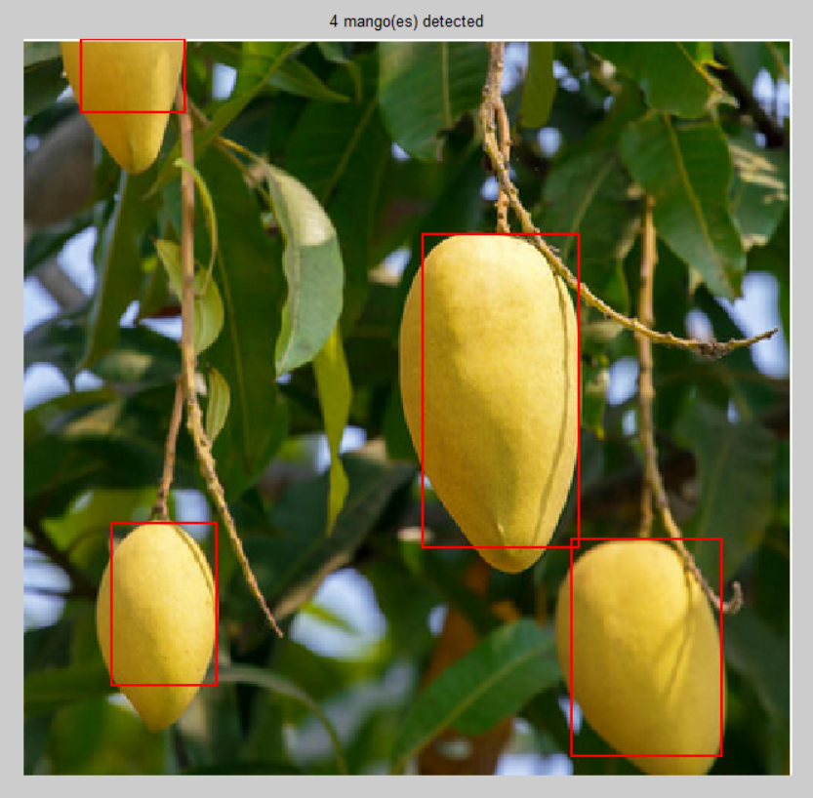

Slide 20

SUBMITTED TO:
DR. BAMBAM KUMAR
ASST. PROFESSOR
NIT PATNA
SUBMITTED BY:
PULKIT GAUTAM 2004006
SHIVANSHU TRIPATHI 2004034
ATUL KUMAR 2004038

