Slide 1
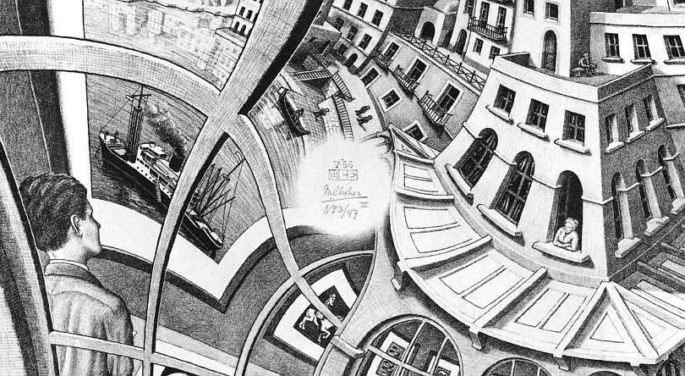
Mathematics and physics

Slide 2
What is mathematics?
“ Somebody once said that philosophy is the misuse of a terminology which was invented just for this purpose.
In the same vein, I would say that mathematics is the science of skilful operations with concepts and rules invented just for this purpose.”
- Wigner

Slide 3
Boundaries
Trying to define mathematics by defining its boundaries with other subjects:
“Mathematics is the part of physics where the experiments are cheap.”
“Mathematics is the part of philosophy where (some) statements are true — without debate or discussion.”
“Mathematics is computer science without electricity.” (So “Computer science is mathematics with electricity.”)

Slide 4
Public perception of mathematics
A 2008 study which was based on an extensive survey among British students, was summarized as follows: Many students and undergraduates seem to think of mathematicians as old, white, middle-class men who are obsessed with their subject, lack social skills and have no personal life outside maths.
The student’s views of maths itself included narrow and inaccurate images that are often limited to numbers and basic arithmetic.

Slide 5
What kind of knowledge do we get from mathematics?
It is “analytic” i.e. one whose truth depends upon the meanings of its constituent terms.
It is concerned with necessary truths in the sense that things could not have been otherwise.
The knowledge is concerned with abstract objects i.e. they are not located in space or time.

Slide 6
What is Physics?
“PHYSICAL SCIENCE is that department of knowledge which relates to the order of nature, or, in other words, to the regular succession of events.
The name of physical science, however, is often applied in a more or less restricted manner to those branches of science in which the phenomena considered are of the simplest kind”
- JC Maxwell

Slide 7
Public perception of physics
In late 2007, People Science and Policy Ltd undertook some research to find out what adults in the UK really think about physics:
“When asked to describe physics, most of them said ‘Something scientific that you do in school.’ ‘The laws and nature of items, energy, power, electricity, gravity.’ “

Slide 8
What kind of knowledge do we get from physics?
It is “synthetic” i.e. truth or falsity depends on experience or intuition or both.
Physics deal with physical objects, which exist in the space and time.

Slide 9
The Unreasonable Effectiveness of Mathematics in the Natural Sciences

Slide 10
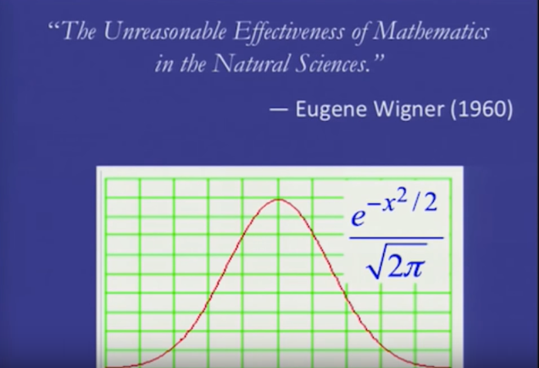
Trans

Slide 11
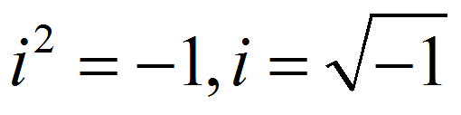
Imaginary numbers

Slide 12
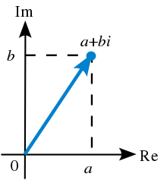

Slide 14
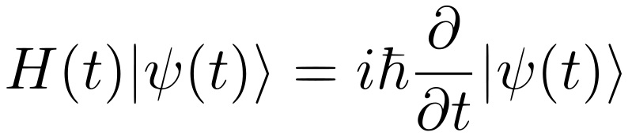

Slide 15
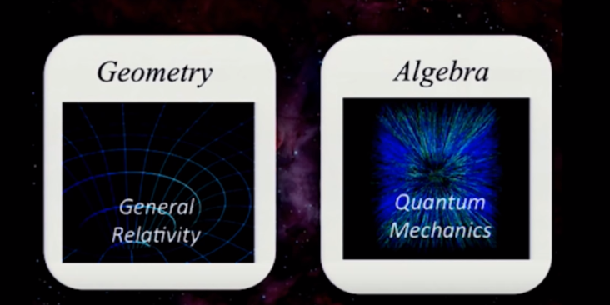

Slide 16
The Unreasonable Effectiveness of Natural Sciences in the Mathematics

Slide 17
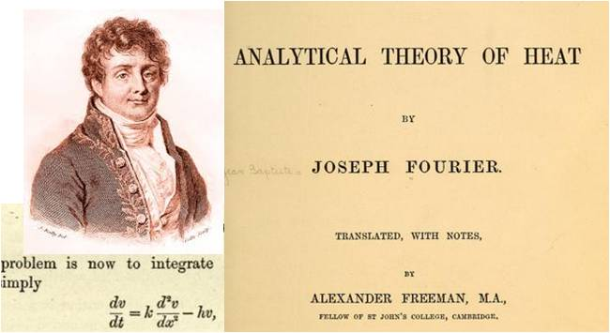
Fourier Analysis

Slide 18
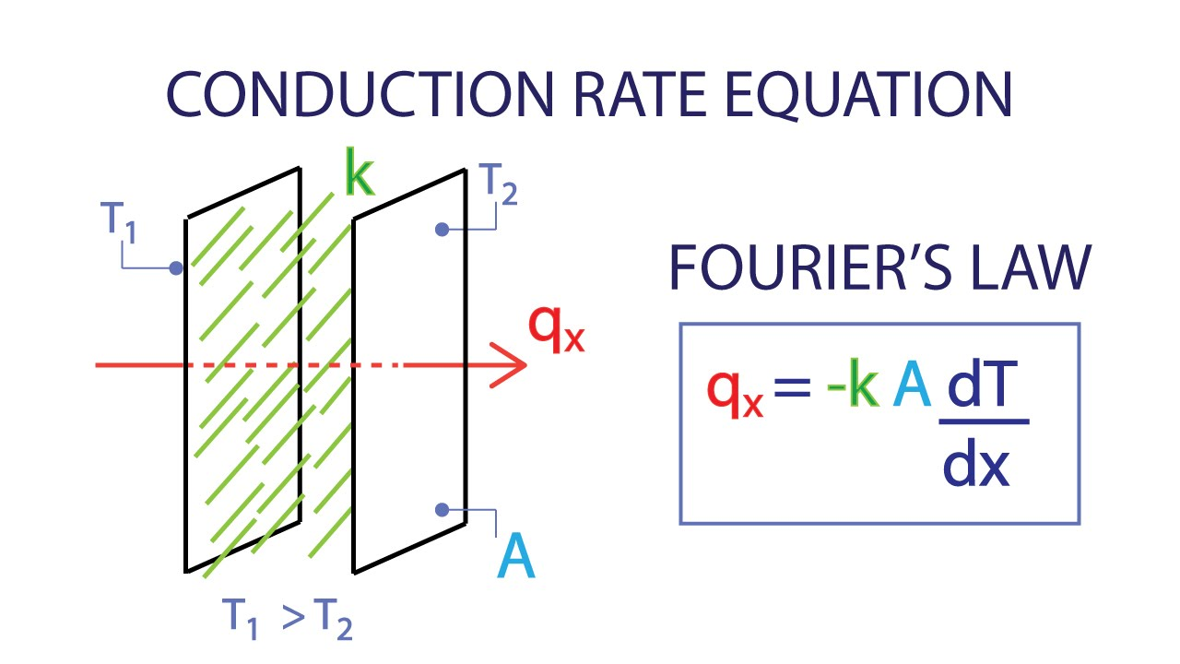
The law of heat conduction, also known as Fourier's law, states that the rate of heat transfer through a material is proportional to the negative gradient in the temperature and to the area, at right angles to that gradient, through which the heat flows

Slide 21
Knot theory and quantum mechanics

Slide 22
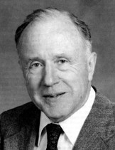
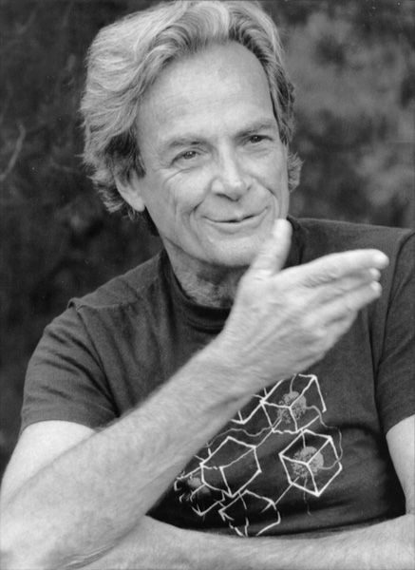
Richard Feynman
John Wheeler

Slide 23
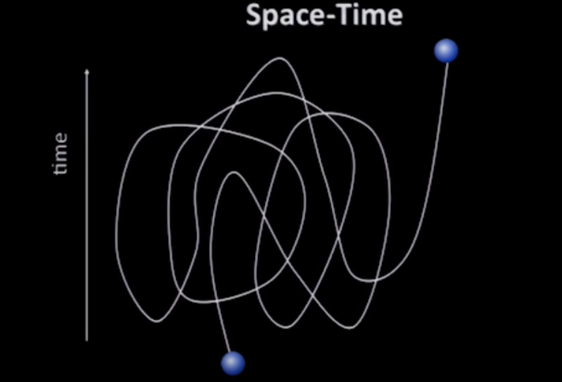

Slide 24
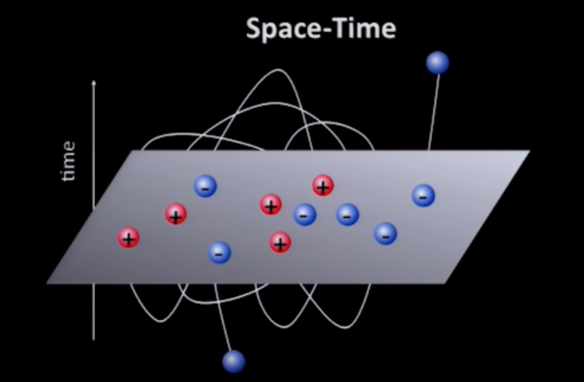

Slide 25
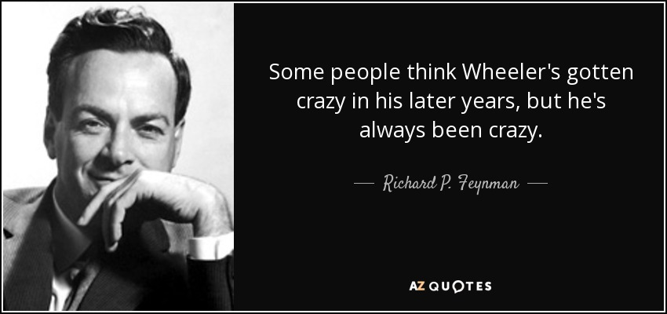

Slide 26
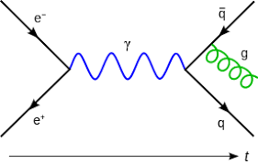

Slide 27
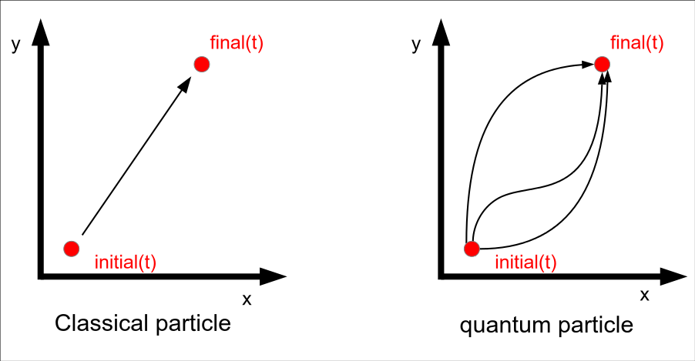

Slide 28
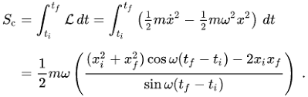
Path Integral

Slide 29
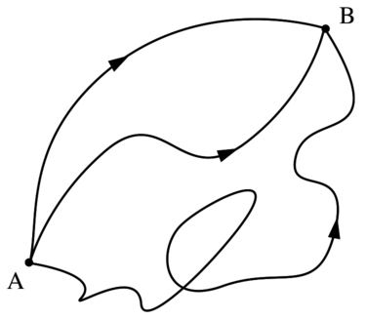

Slide 30
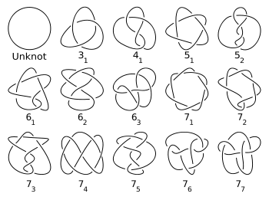

Slide 31
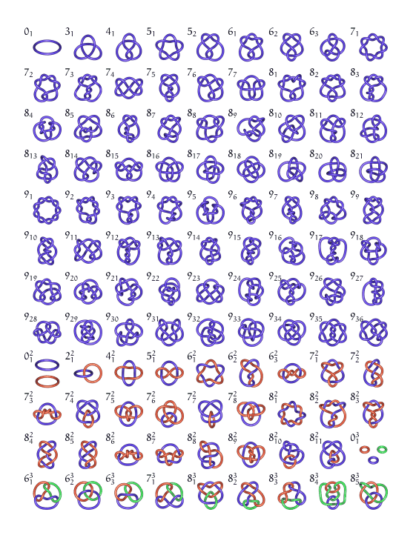

Slide 32
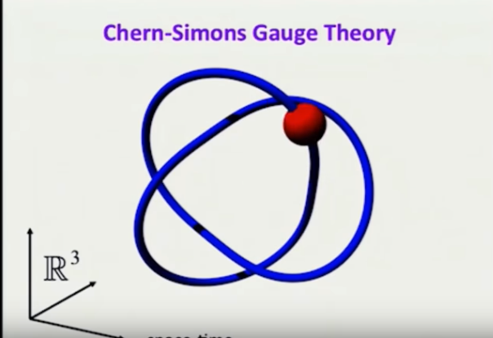

Slide 33
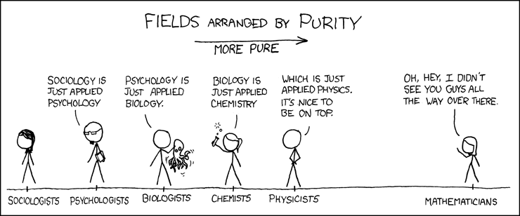

Slide 34
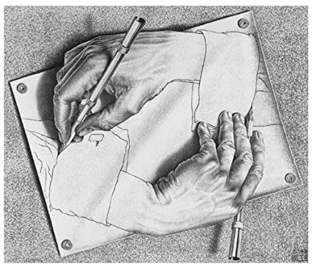

Slide 35
Difference between maths and physics
“The difference between mathematicians and physicists is that after physicists prove a big result they think it is fantastic but after mathematicians prove a big result they think it is trivial.” - Lucien Szpiro

Slide 36
Current relationship
“As a working physicist, I am acutely aware of the fact that the marriage between mathematics and physics, which was so enormously fruitful in past centuries, has recently ended in divorce.”
- Dyson

Slide 37
Effects
“Discussing this divorce, the physicist Res Jost remarked the other day, ‘As usual in such affairs, one of the two parties has clearly got the worst of it.”
- Dyson (contd)

Slide 38
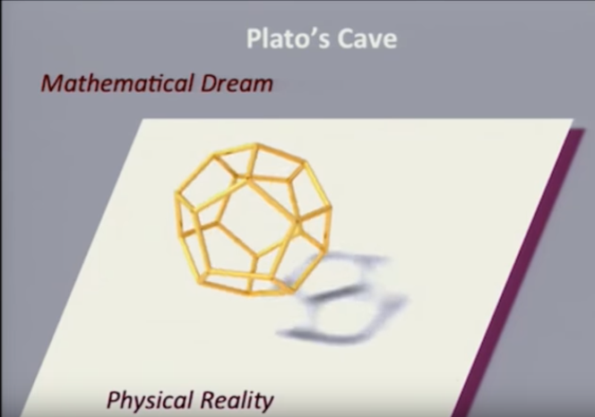

Slide 39
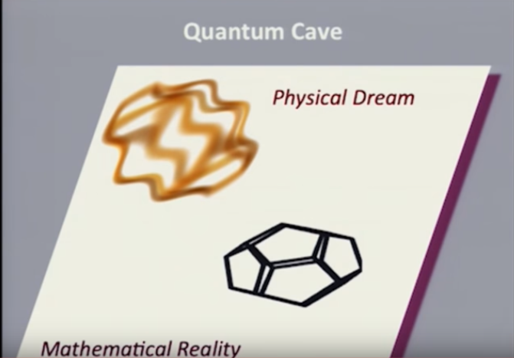

Slide 40
Physics deal with physical objects, which exist in the real world
Mathematics is analytic

Slide 41
Physics deal with physical objects, which exist in the real world
Physics too deals with abstract objects!
Mathematics is analytic
Mathematics is synthetic!

Slide 43
All human beings have within them an intuition of time and an intuition of space.
This makes that statement synthetic and hence informative.
Geometry is based on our intuition of space and it is this intuition which enables the theorems of geometry to be at the same time synthetic and a priori.

Slide 44
“If intuition has to conform to the constitution of the objects, then I do not see how we can know anything of them a priori;
but if the object . . . conforms
constitution of our faculty of intuition, then
can very well represent this possibility to
myself. “
- Kant

Slide 45
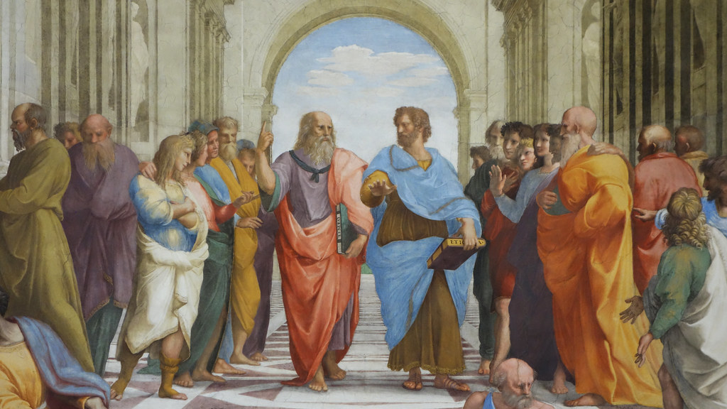
Plato’s Problem
“The problem of explaining how we can know so much" given our limited experience.

Slide 46
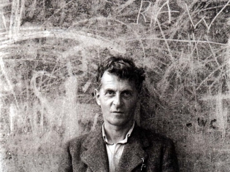
Wittgenstein

Slide 47
Philosophy of Language

Slide 48
Limitations
The scientific method studies and alters the object of investigation.
In reality, the object and method cannot be separated.
For the self, without the universe, is empty!

Slide 49
Solutions to the problem
To find more about our limitations and hence know what we cannot know (Chomsky-Wittgenstein approach)
We can ignore all of what we cannot do and just carry on with what we can do (Pierce-Ramsey approach)

Slide 50
Cognitive limitations
The things that make us do certain things cause us not to do other things
Because we have some abilities, there are certain limitations
To learn about those limitations, we should learn about our abilities!

Slide 51
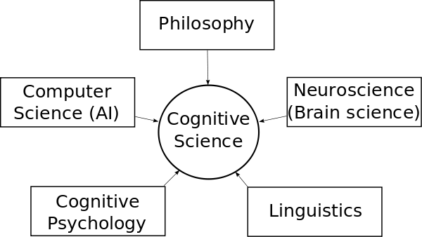
Cognitive Science

Slide 52
Studying the relation between knowledge and science, one may distinguish two different lines of inquiry:
one focusing on science as a body of knowledge
the other on as a vehicle of knowledge.

Slide 53
Body of knowledge
One will ask, then, how science is acquired and to what extent the acquisition of science and the structure of the science are relevant aspects of other neurological capacities.

Slide 54
Vehicle for knowledge
What enables scientific entities to represent facts about the world. Is it possible for science to convey intersubjective knowledge? And what makes this possible?

Slide 55
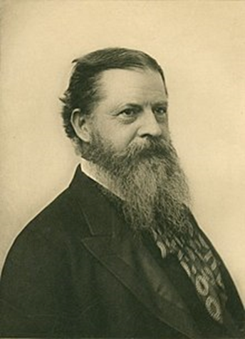
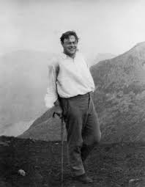
Pragmatism
Frank Ramsey
CS Pierce

Slide 56
Philosophy must be of some use and we must take it seriously;
The chief proposition of philosophy is that philosophy is nonsense.
And again we must then take seriously that it is nonsense, and not pretend that it is important nonsense!

Slide 57
We must avoid the ‘absurd position’ of the child in the following dialogue: ‘Say breakfast.’ ‘Can’t.’ ‘What can’t you say?’ ‘Can’t say breakfast.’ Most famously, Ramsey quipped: ‘But what we can’t say we can’t say, and we can’t whistle it either.’

Slide 58
A science is any discipline in which the fool of this generation can go beyond the point reached by the genius of the last generation. - Max Gluckman

Slide 59
Conclusion
“The most incomprehensible thing about the world is that it is comprehensible.”
- Einstein
“The most comprehensible thing about the world is that it is incomprehensible.”
- Me!

Slide 60
