Slide 1
SQL and NoSQL – Assignment 6
Pulkit Mathur

Slide 2

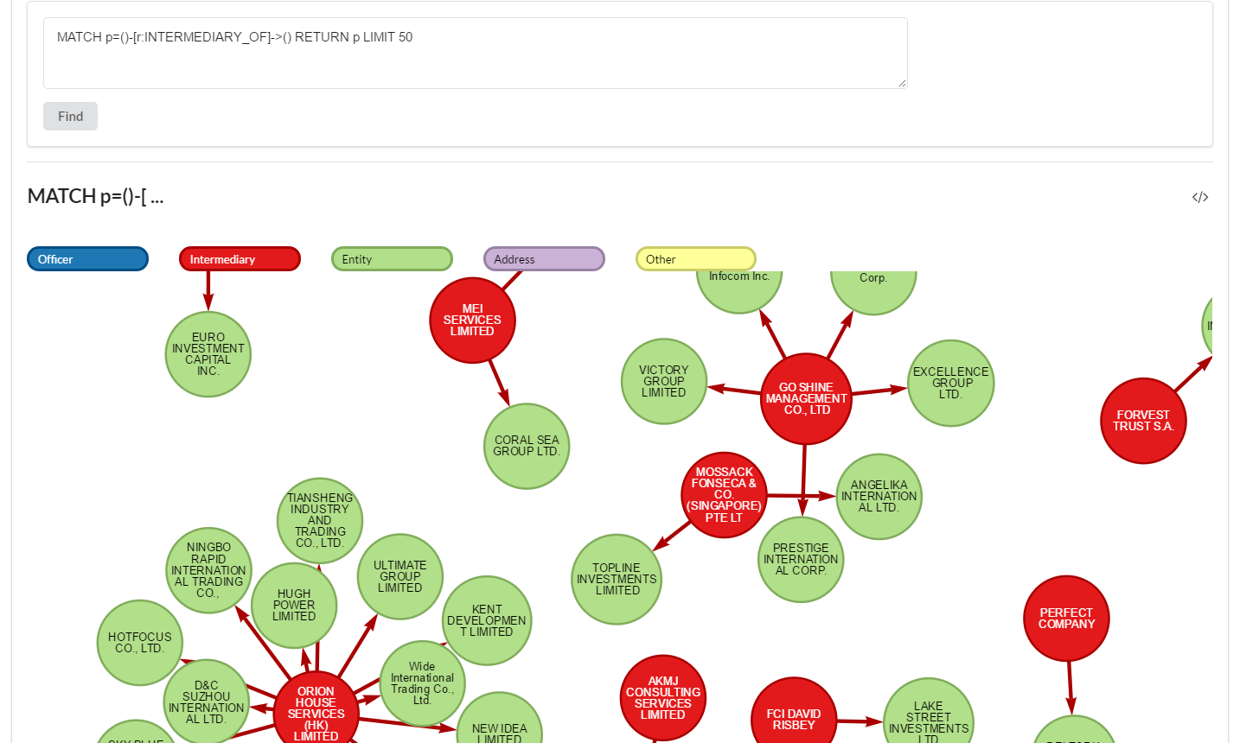

Query 1

Slide 3
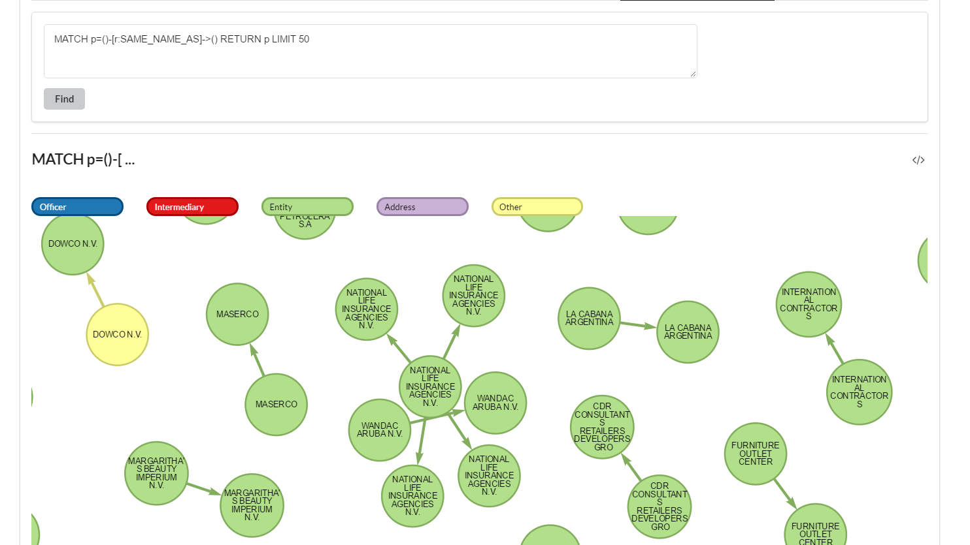
Query 2

Slide 4
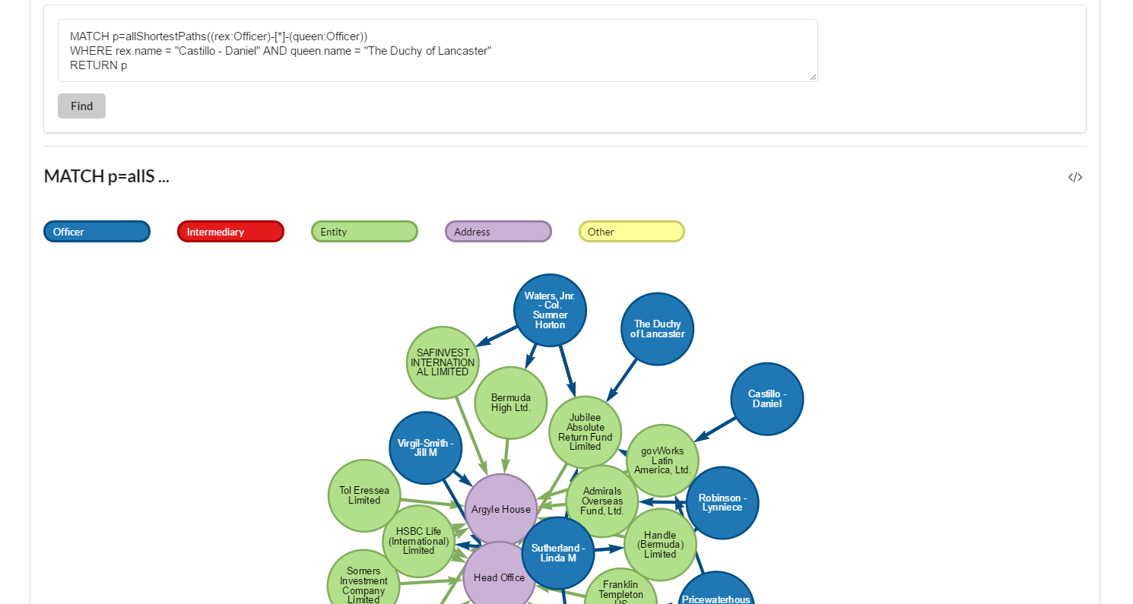
QUERY 3

Slide 5
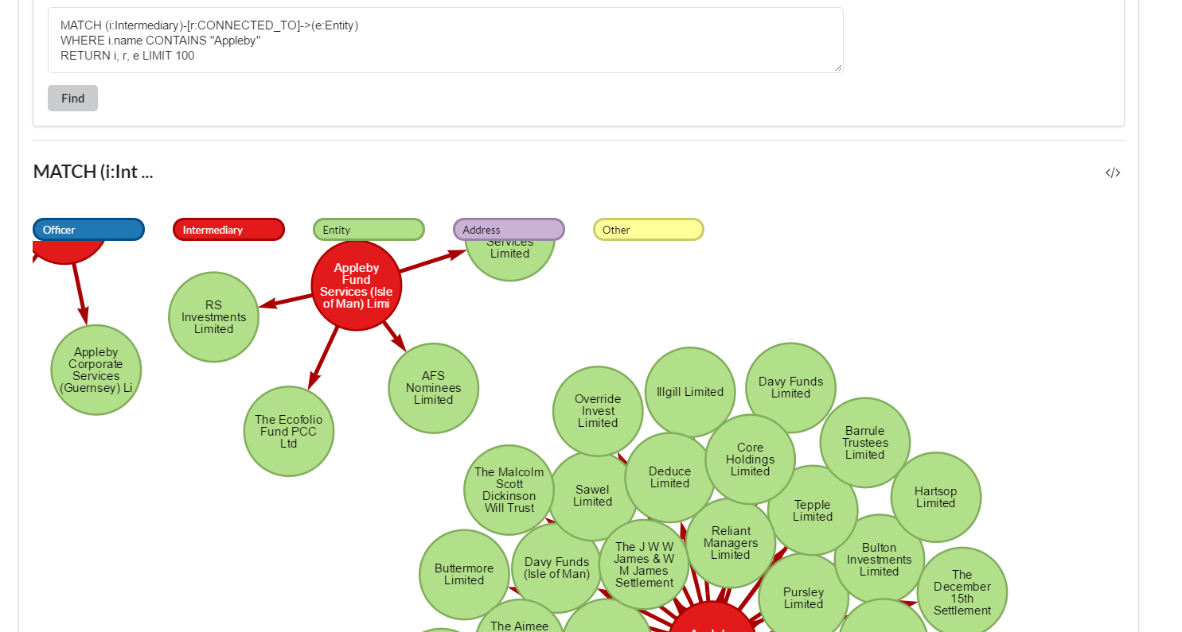
QUERY 4

Slide 6
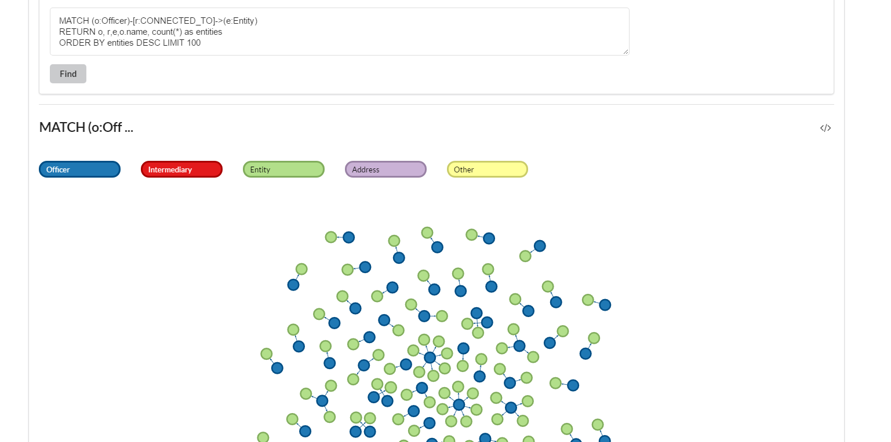
QUERY 5

Slide 7
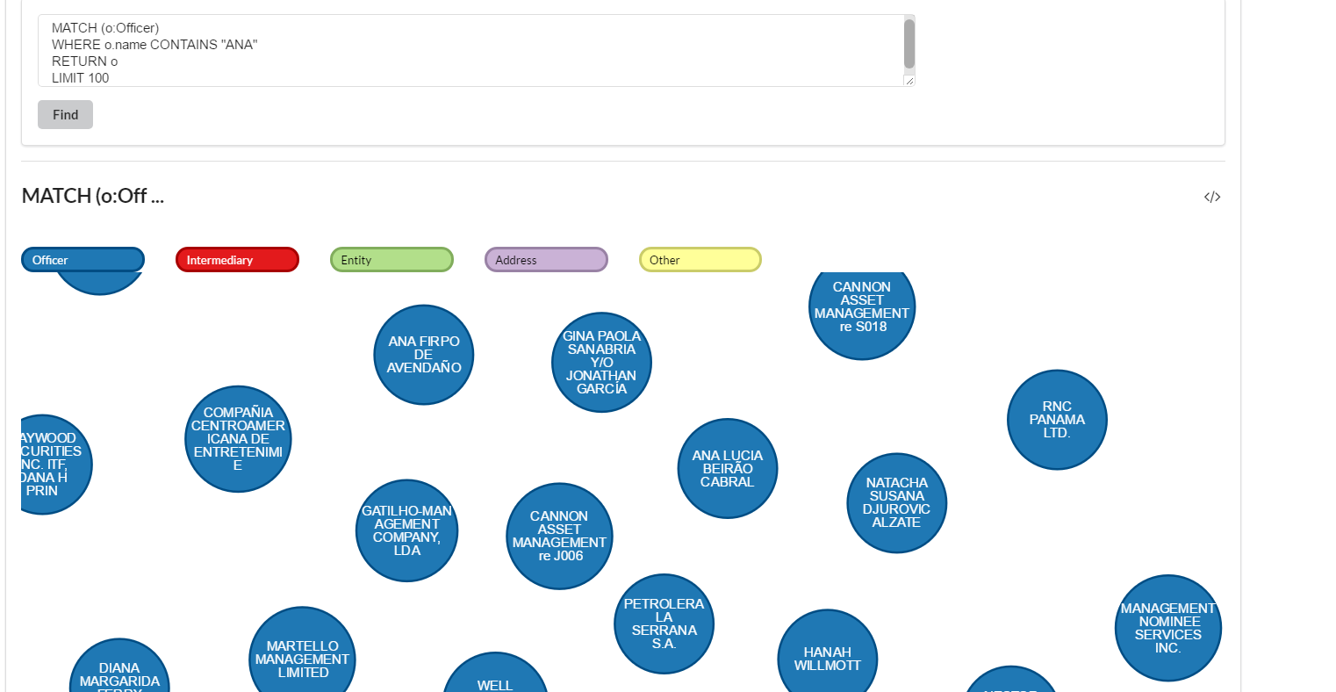
QUERY 6

Slide 8
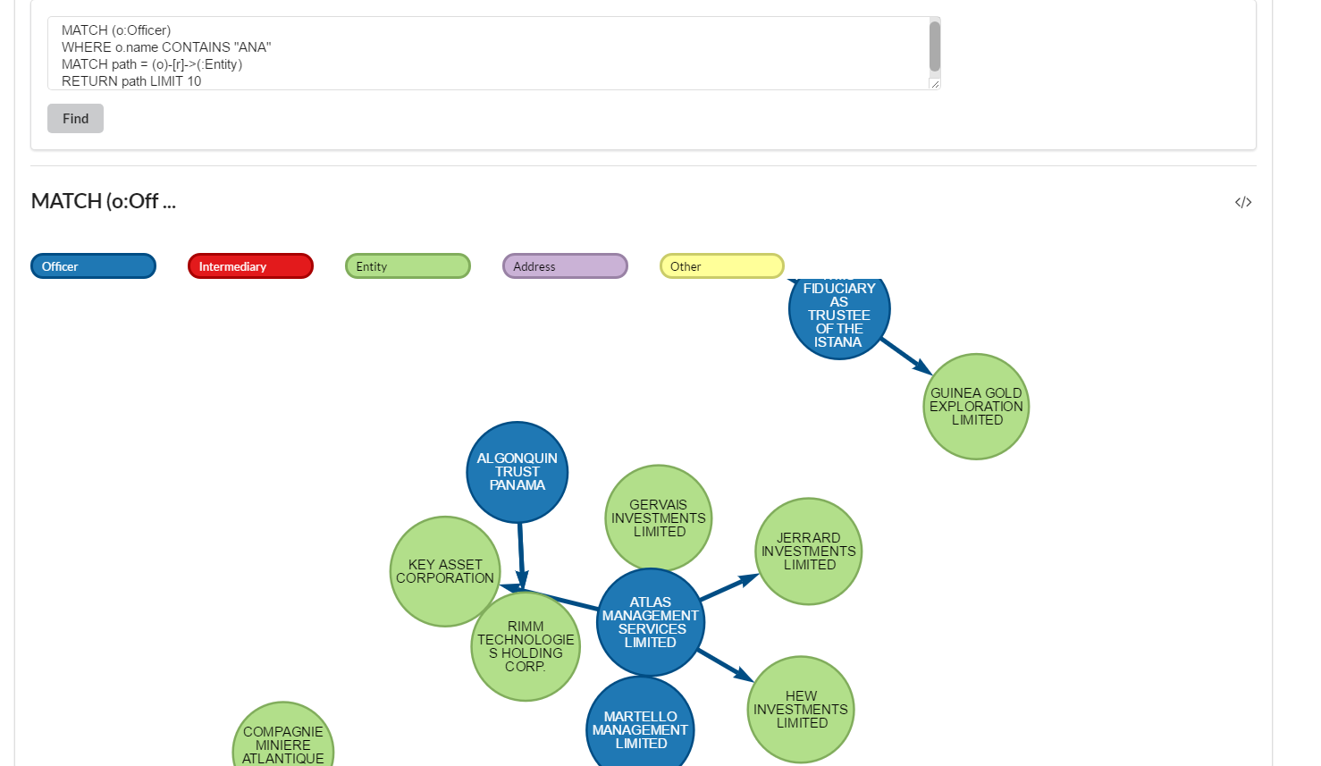
QUERY 7

Slide 9
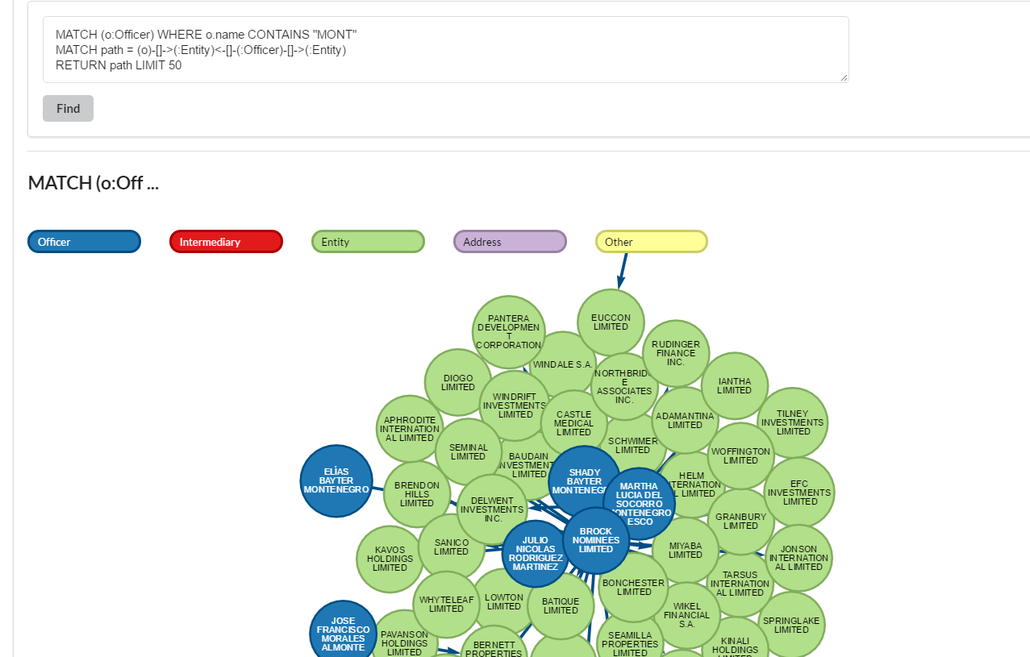
QUERY 8

Slide 10
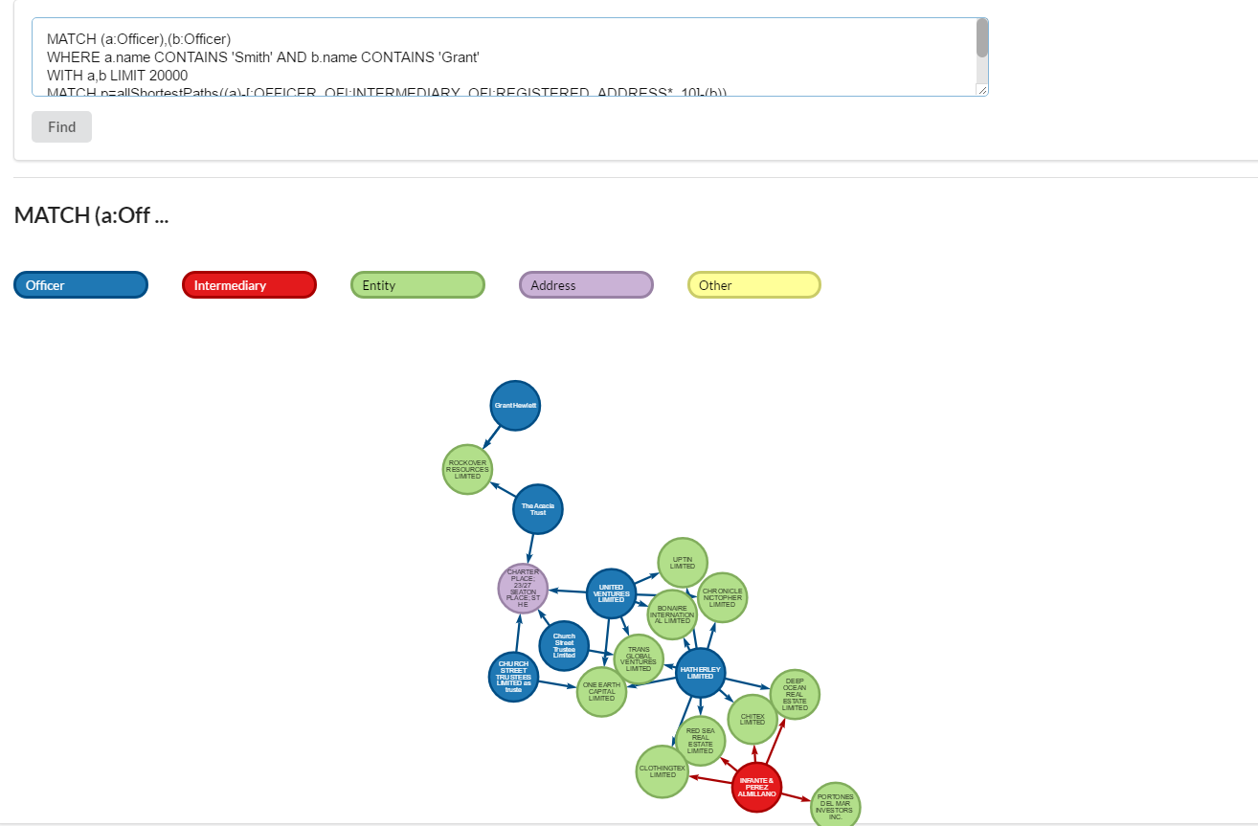
QUERY 9

Slide 11
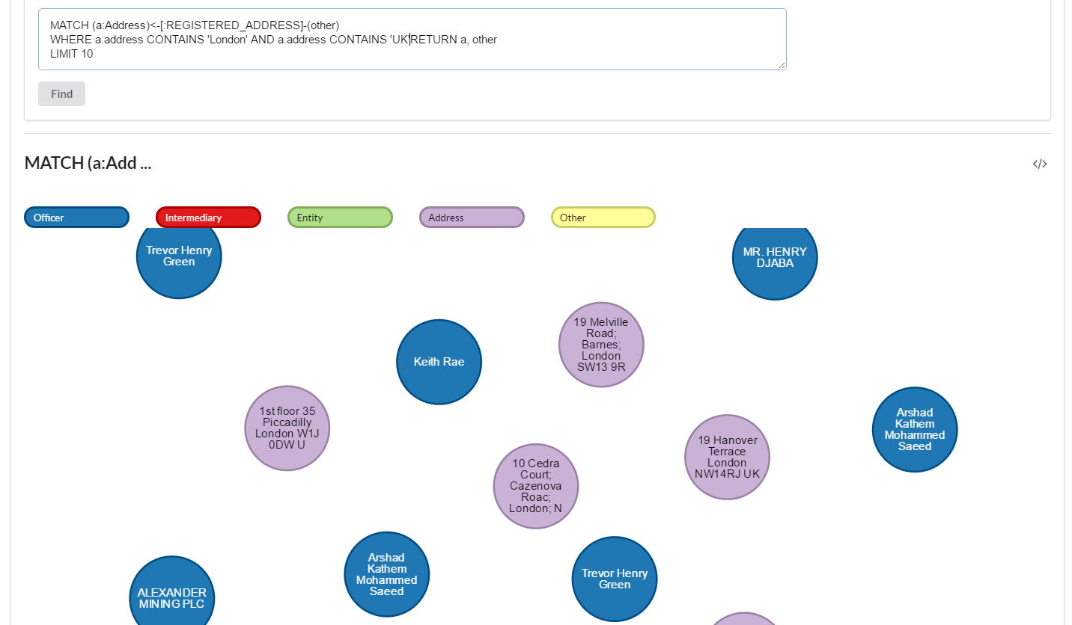
QUERY 10

Slide 12
THANK YOU

