Slide 1
Assignment 4 SQL-NoSQL
Submitted By:
Pulkit Mathur

Slide 2
Database Creation
Created a database named ‘Hospital’
Tables in the database include ‘Heart’, ’Lung’, ‘Patient’, ‘Ratings’
6 queries were developed on all the datasets
6 Map Reduce Queries were also developed
Please find queries and corresponding output from next slide
Data was created using CSV files downloaded from provided sources
Command used to create database: mongoimport -d mydb -c things --type csv --file locations.csv --headerline

Slide 3
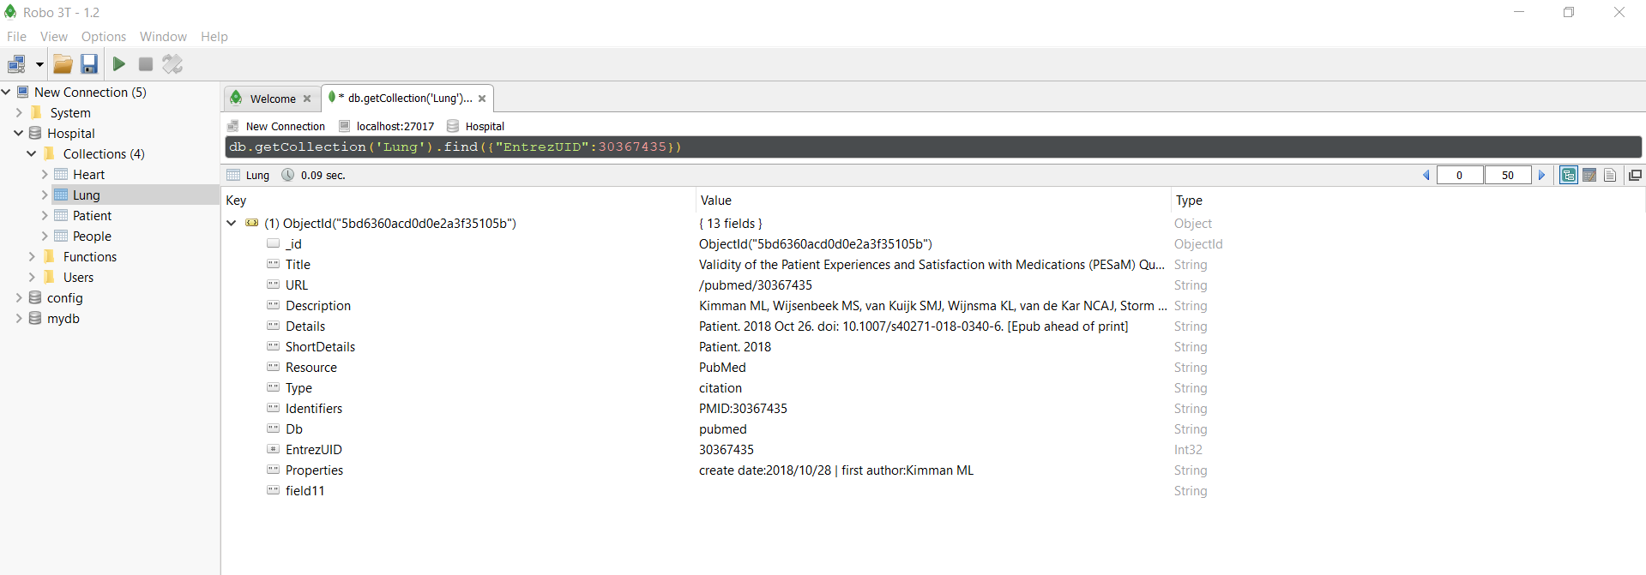
Query 1
Notes:
Query to find a record where EntrezUID is as stated in document Lung.

Slide 4
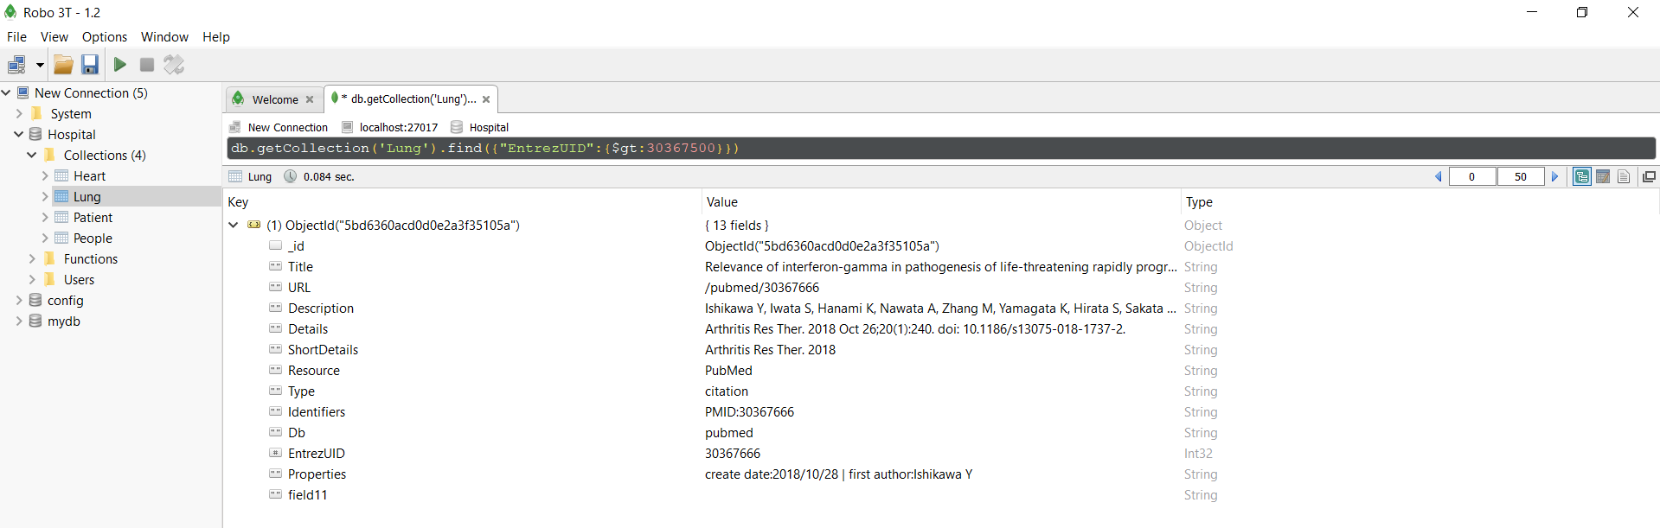
Query 2
Notes:
Query to find all records where ID > that value in the document names Lung.

Slide 5
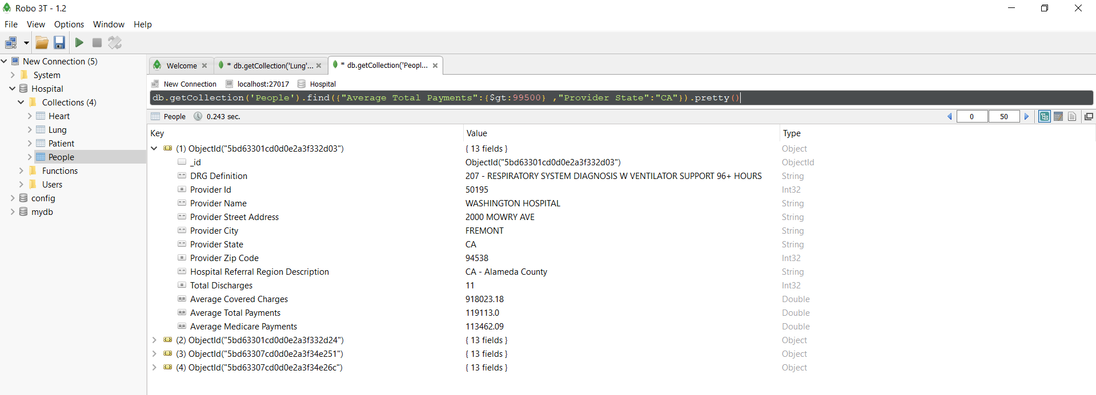
Query 3
Notes:
Query to find records where Average Total Payments is greater than that value and Provider State is CA in document People.

Slide 6
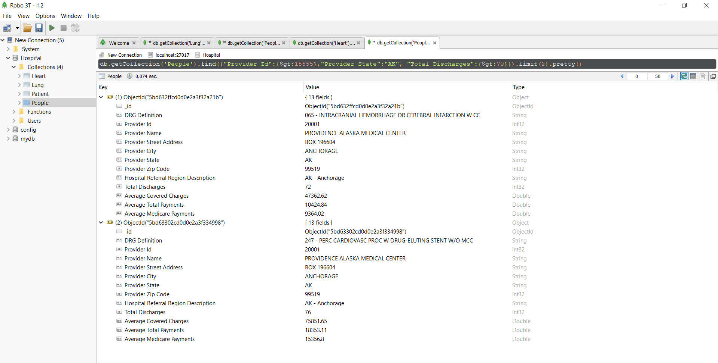
Query 4
Notes:
Query to find records where Provider Id is greater than that value and Provider State is AK and Total discharges are greater than that value in document People.
The results are limited to 2.

Slide 7
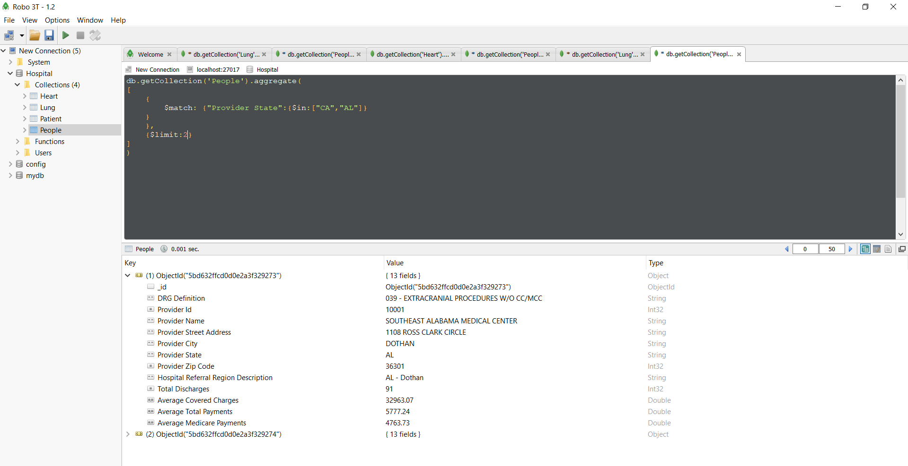
Query 5
Notes:
This is an aggregate query. Here we are limiting our records to two where Provider State is either CA or AL.

Slide 8

Query 6

Slide 9
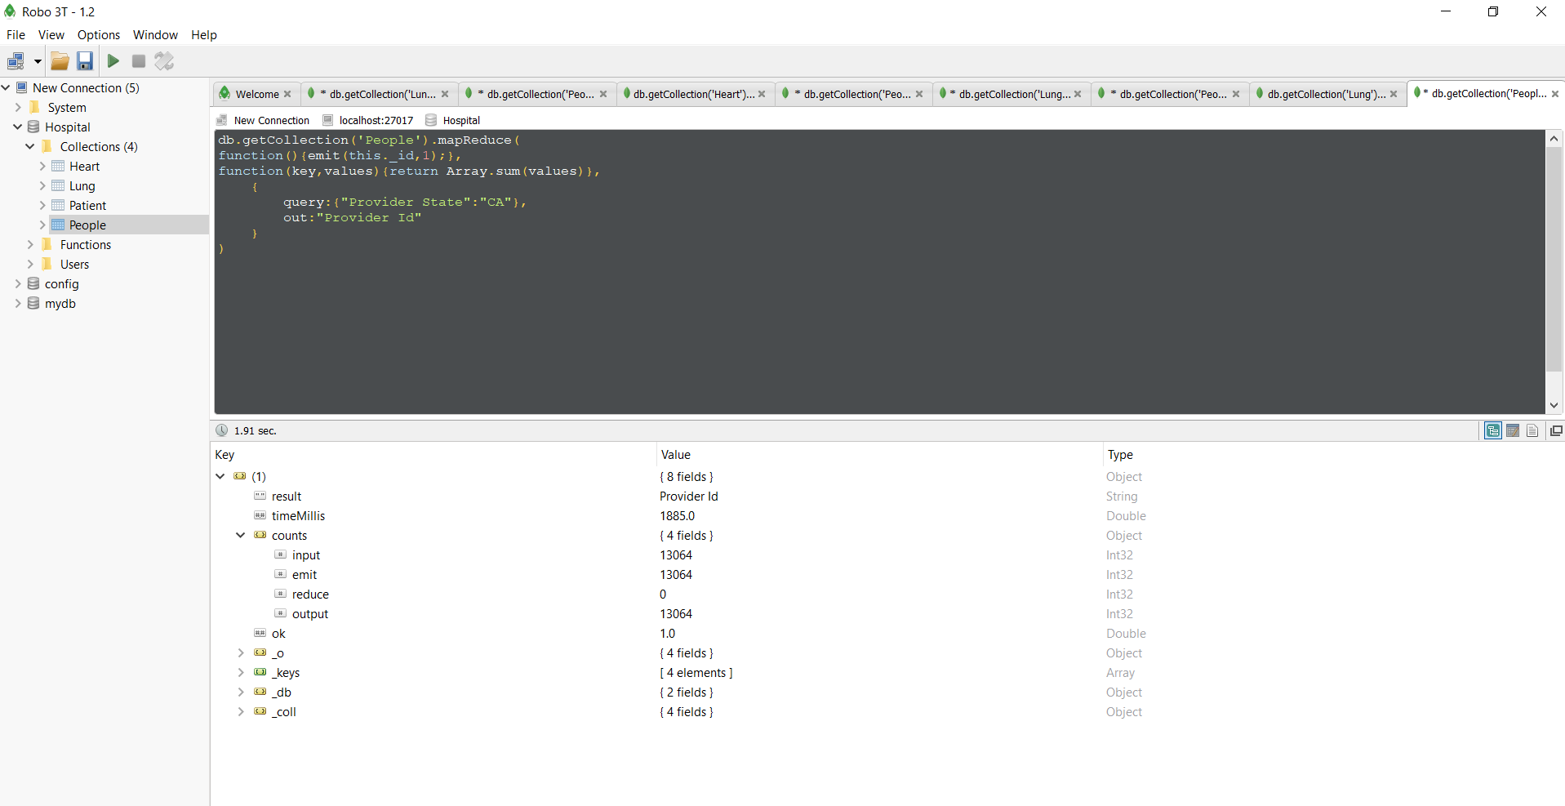
Map Reduce Query 1

Slide 10
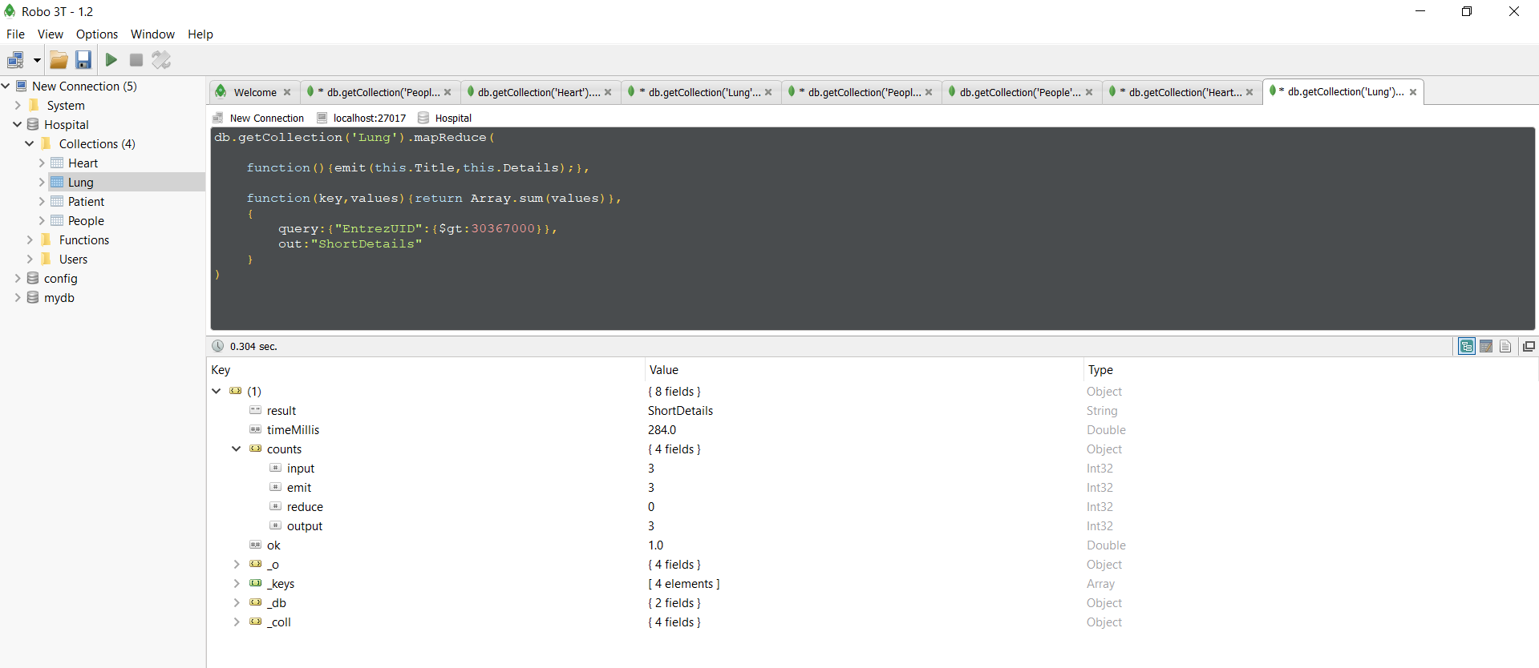
Map Reduce Query 2

Slide 11
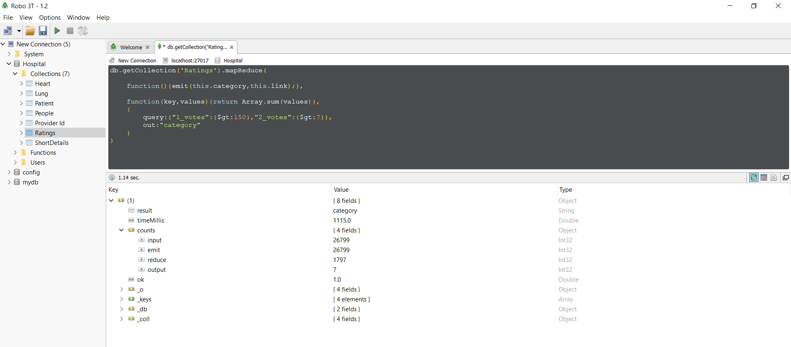
Map Reduce Query 3

Slide 12
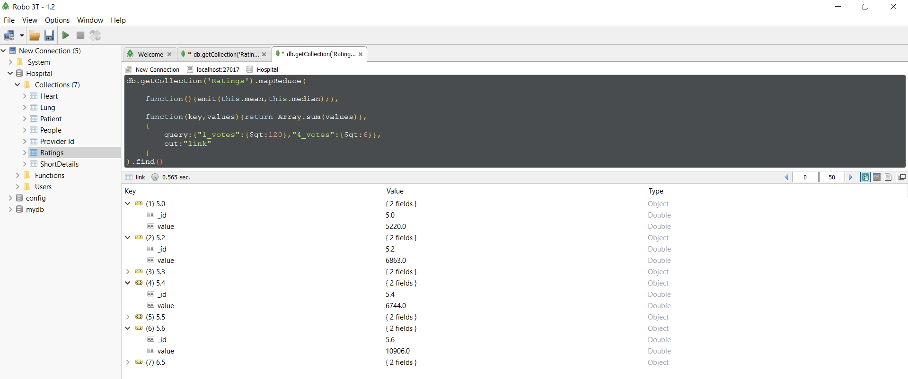
Map Reduce Query 4

Slide 13
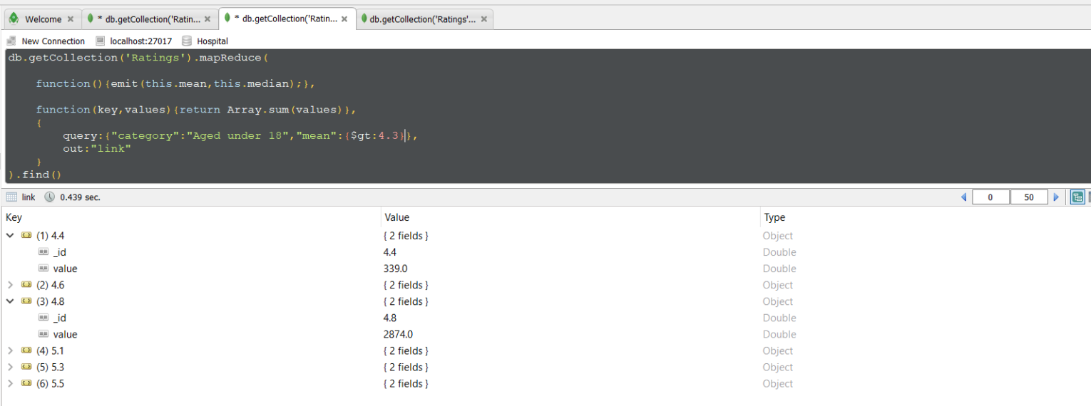
Map Reduce Query 5

Slide 14
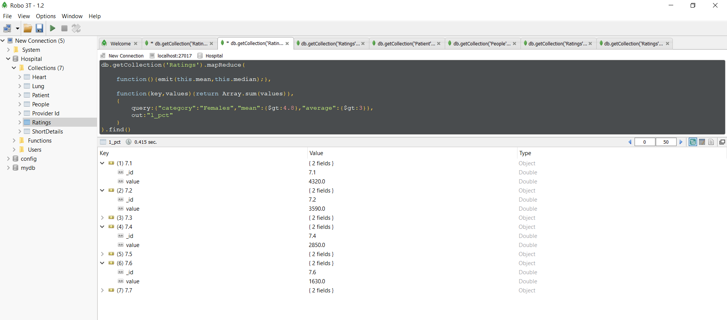
Map Reduce Query 6

Slide 15
Data Visualization
The results obtained after using Tableau for data visualization were as follows:

Slide 16
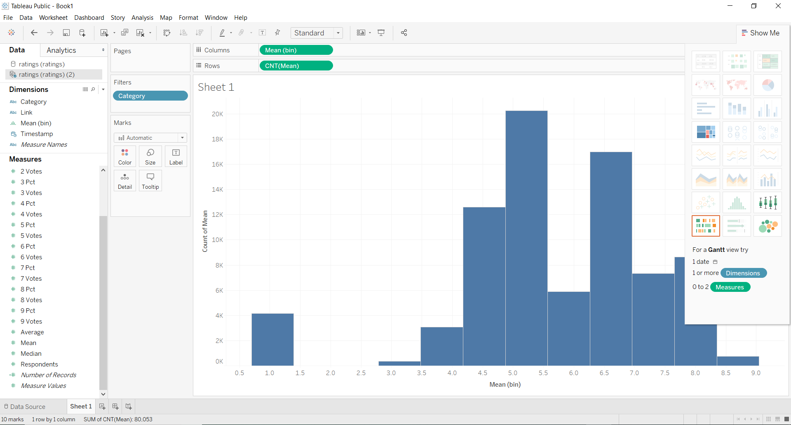
Mean vs Count Distribution

Slide 17
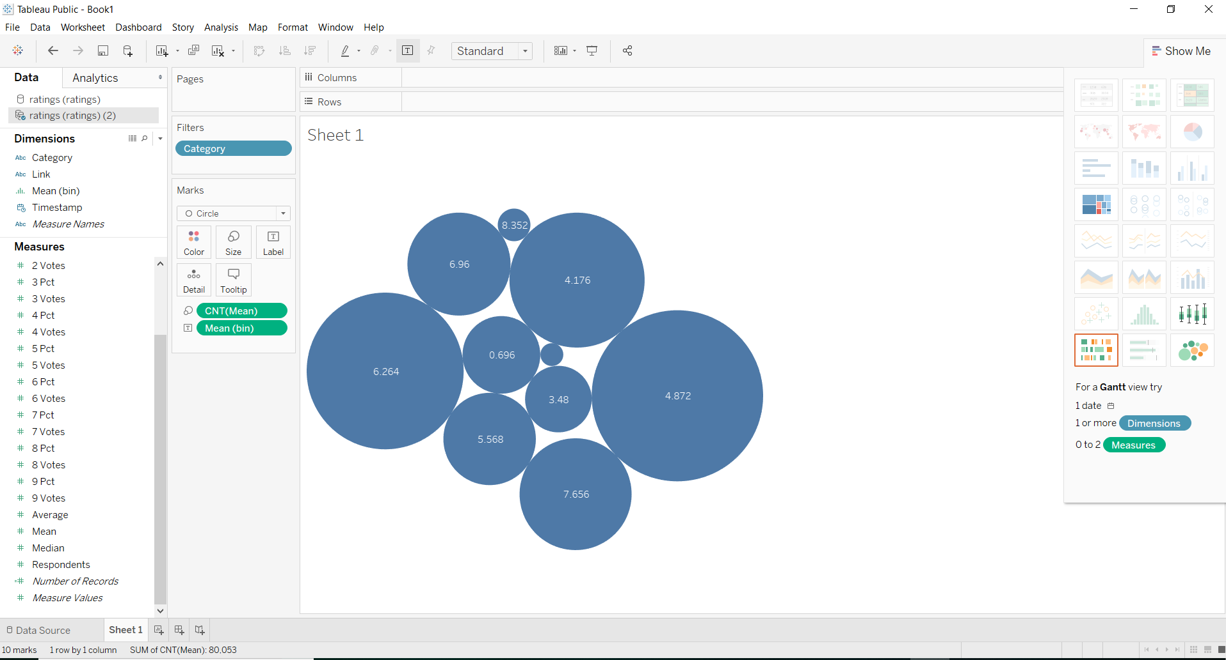
Categorical Distribution of data

Slide 18
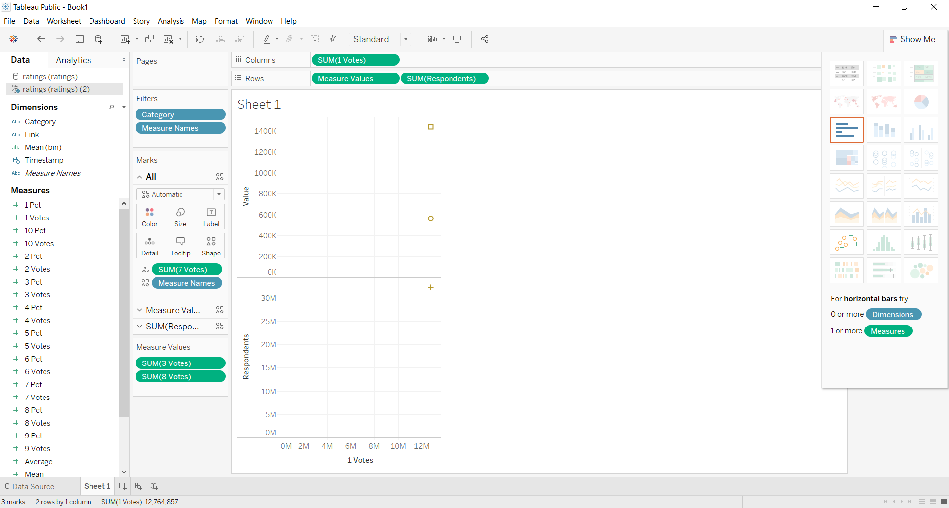
1_votes versus repondents and values plot

Slide 19
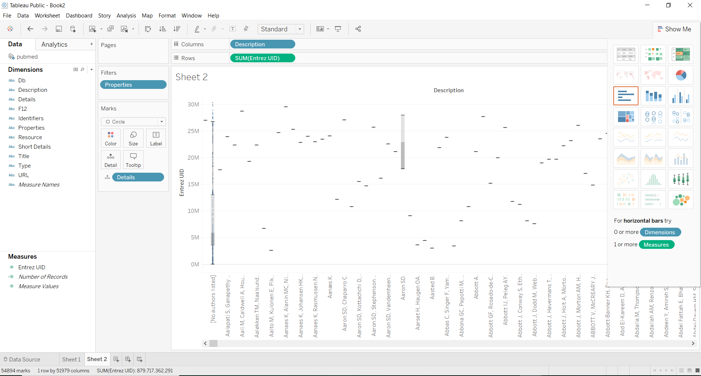
Description versus UIF plot

Slide 20
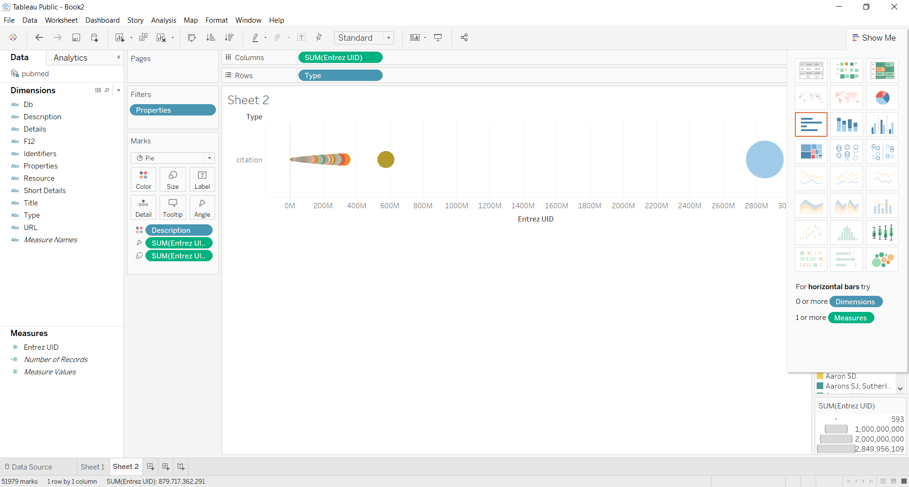

Slide 21
Machine Learning
The rating dataset was imported using the CSV file
Various types of queries like aggregate query and map reduce queries were developed and run on the dataset
After loading the dataset into a pandas dataframe, necessary preprocessing steps were applied like removing unwanted features, finding missing values and replacing them, finding categorical columns and converting categorical data to numeric data using common machine learning pre-processing techniques

Slide 22
Process
Train-test split was made on the data
Various Models were developed and made to fit the data:
Linear Regression
K-Nearest Neighbor
Random Forest
Neural Network
Libraries used: numpy, pandas, pymongo, scikit-learn, seaborn, matplotlib,scipy, pylab

Slide 23
Linear Regression Model Analysis
Mean Squared Error: 0.014931806034791
R2 Score: 0.9946458589337228
Accuracy: 0.9031720796426679

Slide 24
K-Nearest Neighbor Model Analysis
Mean Squared Error: 0.00034437536275771613
R2 Score: 0.9998765163257775
Accuracy: 0.9965932318873495

Slide 25
Random Forest Model Analysis
Mean Squared Error: 0.00012487020540855268
R2 Score: 0.9999552249277031
Accuracy: 0.9982209099856159

Slide 26
Neural Network Model Analysis
Mean Squared Error: 0.00012487020540855268
R2 Score: 0.9999552249277031
Accuracy: 0.9982209099856159

Slide 27
Overall Analysis
Linear regression being the simplest of model, where we try to fit a line to the data gave the least accuracy among all.
K-Nearest Neighbor being a more sophisticated model gave higher accuracy because it considered 12 neighbors and did clustering.
Random Forest uses multiple decision trees to provide a prediction. So being a more complex model, gave higher accuracy than k-nearest neighbor model.
Neural Network is basically a universal function approximator which also helps in injecting non-linearity into the system. Hence due to such complex model being used to fit our data, we got highest accuracy on this.

