Slide 1




PA Decision Risk Prediction
Overview
Sponsor
Presented by
Overview
Proposed Benefit
Business Problem :
It had been observed that the Prior Authorization decisions taken by the RNs were not correct. Incorrect approvals lead to the dollar leakage adding to the medical cost & a false PA denial leads to a preservice appeal & impacts the Provider/Member satisfaction scores.
Objective :
Develop a ML algorithm that will prioritize the inventory for MD review basis the likelihood of its denial. This will ensure the correct decision being taken in the very first time & reduce the number of inappropriate approvals as well as rework (if any) corresponding to those services.
Aggregated MedEx savings ~ $1.01* M for selected use cases (considering 10% incorrect RN approvals)
Procedure Code | Cases touched by RN | Approval % | Average Billed amount | Potential Savings
E0748 | 1391 | 93% | $ 5,936 | $ 693,403
43239 | 925 | 87% | $ 1,755 | $ 126,498
93306 | 694 | 89% | $ 574 | $ 31,965
64493 | 454 | 96% | $ 2,758 | $108,458
58558 | 408 | 85% | $ 4,285 | $133,063
62323 | 367 | 92% | $ 1,724 | $ 52,958
Proposed Process Flow
Decision Risk
Prediction Engine
Can CAC take decision?
Case routed to
Clinical team
Is case High risk?
RN makes notes, provides decision recommendation & route the case to MD
MD takes decision & routes the case back to RN
Service line tagged as high risk or low risk
Yes
No
Incoming PA
Case reaches CAC
No
Yes
No
Can RN take decision?
CAC takes decision & closes the case in ICUE
Case routed to RN
Yes
RN takes decision & closes the case in ICUE
Scores predicted as High Risk & Low Risk based on Denial probability of Prior Auth

Slide 2
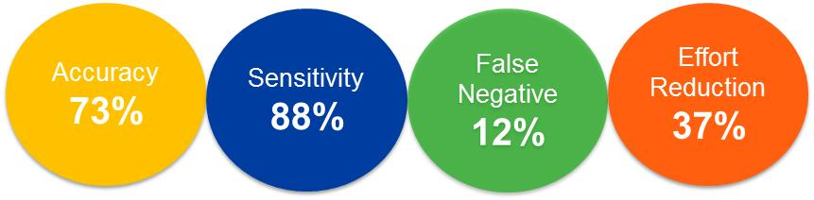
PA Decision Risk Prediction
Contd.
Sponsor
Presented by
First cut model Results
I |  | Line of Business | E&I
II |  | Time Period | Jan’17 – Dec’18
III |  | Solution Type | Predictive
IV |  | Class Definition | Event : MD Denials [36%] Non-Event : MD Approvals, RN Approvals, RN Denials [64%]
Model Diagnosis
I | Algorithm Used |  | Random Forest
II | Model Performance
Model OpportunityQ3’18-Q4’18
Proc Code | Cases Predicted by Model as High Risk but were Approved by RNs
43239 | 183
58558 | 51
62323 | 139
64493 | 240
93306 | 62
E0748 | 106
 | Predicted – 1 | Predicted – 0
Actual – 1 | 2528 | 339
Actual – 0 | 1260* | 1885
*1260 (will be reduced further by model improvisation) will be the additional inventory load for MDs
Next Steps
Model improvisation with additional features into consideration
Expansion of use cases
Need Audit support for sample cases having contradictory decisions by model

Slide 3
Benefit Calculation : PA Decision Risk
Sponsor
Presented by
Total cases touched by RN annually (for all the selected CPTs in 2018) = 4,239
Total cost avoidance by deploying risk scoring engine = ~ $ 1,145,684
Assuming atleast 10% incorrect denials by RN, the additional inventory that will get routed to MD = 424 cases
Additional operational cost for MD review = 424 cases * $ 300 = $ 127,200
Net MedEx Savings = $ 1,145,684 - $ 127,200 = $ 1,018,484

Slide 4
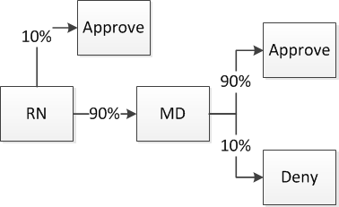
PA Decision Risk Prediction Overview
Develop analytics that will prioritize CCR inventory for MD review basis the likelihood of its denial. This will drive the highest risk cases to the MDs and left-shift lower risk cases to RNs
Overview
MD Audit of High Risk approvals
Use historical MD decision making on PA cases to develop ML model that will score cases as either high or low risk for denial
For low-risk cases, Left shift the decision maker : Identify cases wherein Nurse education or special routing rules can drive down MD case reviews
For high-risk cases, Force case to MD review: route to queue where RN will prep case but will not render decision. This will drive MedEx savings by reducing inappropriate approvals
15 clinical cases that were flagged as high-risk by preliminary model but had been approved by RNs were provided to MDs for retrospective audit. 33% were erroneous approvals
Clinical
15 Cases
Left Shifting Landscaping
Risk Scoring of High-Risk Cases
Low-risk cases
Experienced or specialty RNs approve case if possible
PA Decision Risk
AI Engine
Correctly approved
10 Cases
Erroneously approved
5 Cases
Score case as high or low risk of MD denial based on historical data
RN preps case for MD but can not render an approval
33% error rate on high risk clinical cases
High-risk cases

Slide 5
PA Decision Risk Prediction
Overview
Overview
Business Problem : Prior Authorization cases that were supposed to get denied are getting approved leading to MedEx cost loss
Objective : Develop analytics that will prioritize CCR inventory for MD review basis the likelihood of its denial.
For low-risk cases, Left shift the decision maker : Identify cases wherein Nurse education or special routing rules can drive down MD case reviews
For high-risk cases, Force case to MD review: route to queue where RN will prep case but will not render decision. This will drive MedEx savings by reducing inappropriate approvals (Long term opportunity)
Left Shifting Landscaping
Risk Scoring of High-Risk Cases
Augmented Decisions using clinical profile data
Integrate clinical profile data into decision modeling to provide actionable data to reviewers
Low-risk cases
Experienced or specialty RNs approve case if possible
PA Decision Risk
AI Engine
Clinical Data
Score case as high or low risk of MD denial based on historical data
Combined data view
RN preps case for MD but can not render an approval
Med Policy
High-risk cases
Historical decision making
Preliminary model (5 codes) showed potential $1M affordability opportunity.

