Slide 1

MCR AIM Program
Insights
May 2021 Edition
Analysis Range:

Slide 2

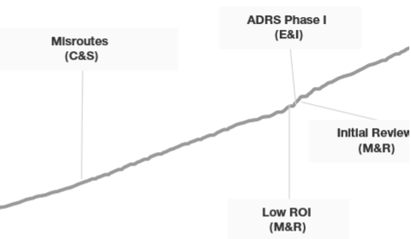

Summary
MCR Inventory Optimization consists of predictive & rule-based analytics solutions to identify by-pass inventory for auto approval driving SG&A savings through efficiency gains
Total Initiatives Implemented
E&I - 11 ; C&S - 4 ; M&R - 3
Implemented – 2021 (YTD)
E&I - ; C&S - ; M&R -
2021 Implementation Timeline
Recalibration : 2021
ADRS Phase 1.2 :
DME Initiative :
Flap and ambulance codes added leading to an annualized release of _________ claims
New Initiatives
E&I ORS
C&S Adjusted Claims
Projected Release and benefits
Key Highlights
ORS One shot initiative is currently on hold
Requirement Gathering
Challenges if any
Enterprise Data & Analytics
2

Slide 3
Inventory and Initiatives Quarterly Performance and Trend
Comparison b/w Q1’20 and Q1’21 MCR inventory to check for rebound
MCR Inventory
E&I
M&R
C&S
Claims Released in Q1’21
In Q1’20 x of inventory in E&I was released by automation in this Q1 y% : On track or any other trend if visible
10K Claims by Predictive
Initiatives
E&I
20K initiative by Optimization
Impact on Work Queues
Nurse Queue -11
Reduction in Q1’21
Projected Reduction in Q1’21
Top Imapacted Queues
Nurse Queue -10
Gatekeeper Non Clinical

Slide 4
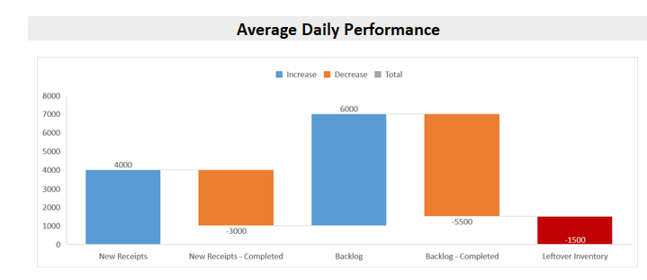
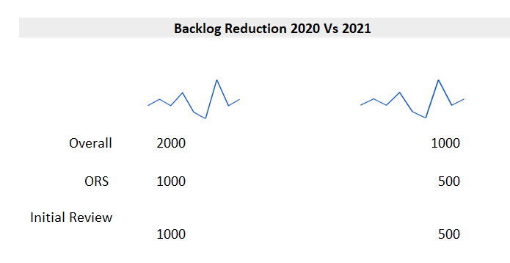
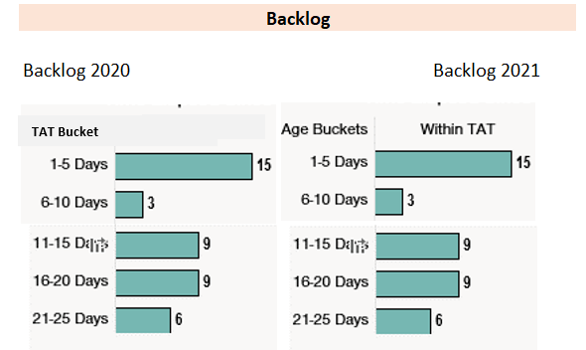
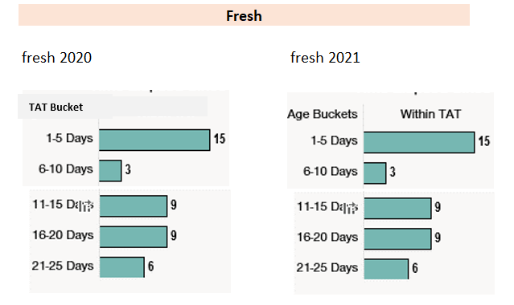
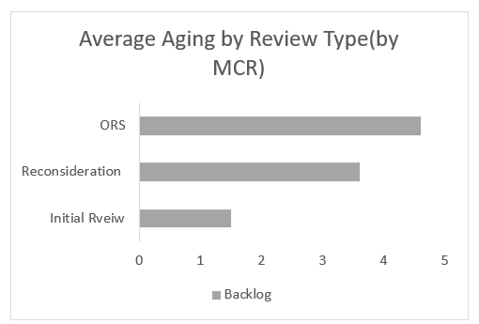
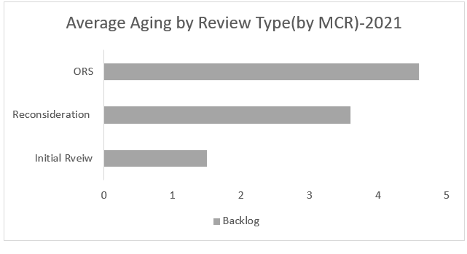
MCR Impact on Inventory Processing E&I
Total Inventory
15k
Processed Cases
10k
Open Cases
10k
Impact on TAT
Review Type comparison

Slide 5
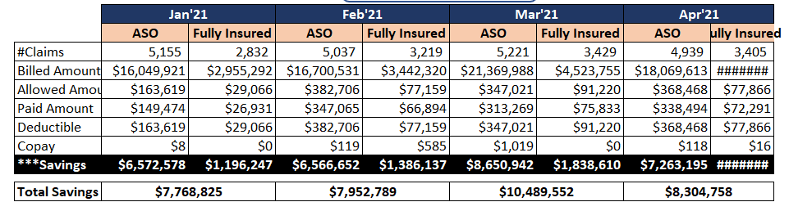
MCR – Dollar Savings
Q1’21 Inventory
Total Inventory Received by MCR
15k
Auto Released
10k
Manual Released
5k
Key Highlighted
*** Savings is calculated as (Allowed amount - Paid Amount - Member Liability), if Allowed Amount is available
(Billed Amount * overall Allowed/ Billed ratio - Paid Amount - Member Liability), if Allowed Amount is not available
where Member Liability = Deductible + Copay
- Coinsurance is not available in TOPS
Overall Allowed Billed Ratio 42%
Inventory Distribution
Fall out First Pass Logic
Remaining Inventory
Denied Inventory

Slide 6
Impact Tracking
Already Released Claims
Ongoing Treatment
Projected Already Claim Release – 2
Check if there any change – In FTE
Leakage Amount
E&I Low ROI – % decrease in Leakage due to threshold ( Leakage amt/ claim )
ADRS Phase 1.1 – From Benefit saving
Time Saved
FTE Saved
Dollar Saved
ADRS Phase 1.2 – From Benefit saving

Slide 7
END of the presentation
Thank you
Enterprise Data & Analytics
7

Slide 10
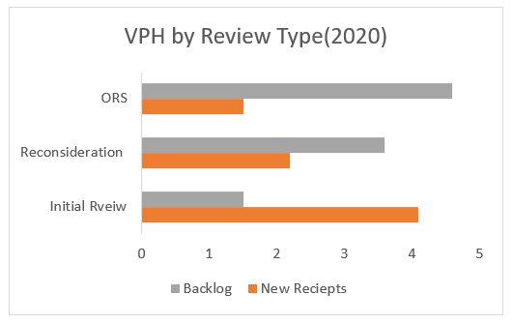
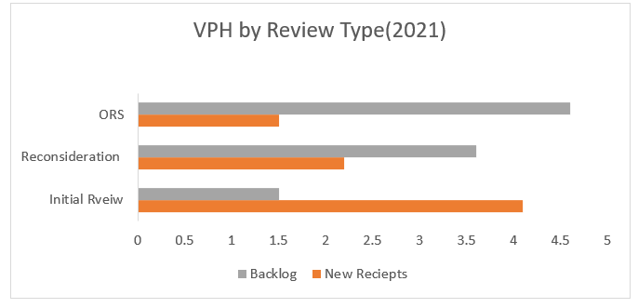
*Continued
Check if there is a difference in the VPH in the work queues of these initiatives

Slide 11
Executive Summary
MCR Inventory Optimization consists of predictive & rule-based analytics solutions to identify by-pass inventory for auto approval driving SG&A savings through efficiency gains
Total Initiatives Implemented
E&I - 11 ; C&S - 4 ; M&R - 3
Implemented – 2021 (YTD)
E&I - ; C&S - ; M&R -
2021 Projected Inventory Reduction
Recalibration : 2021
ADRS Phase 1.2 :
DME Initiative :
Flap and ambulance codes added leading to an annualized release of _________ claims
5 K
2 K
* Run rate calculated basis last 30 days in M&R Readmission will be there as well
169 K
Projected Release -E&I Initiatives
Pipeline 2021
M&R Readmission – Aged claims
E&I ORS
Key Highlights
ORS One shot initiative is currently on hold
New Initiatives : C&S Adjusted Claims, M&R and ADRS Phase 1.2 added in the AIM suite
Enterprise Data & Analytics
11

Slide 12
E&I Initial Review – EDA Solutions
Analyzing the distribution of the E&I Inventory across different categories of CPT codes and solutions deployed with the intent of identifying additional opportunities
Data Source : MCR Inventory Report & TOPS
Time Frame : Jan’20 – Dec’20
LOB : E&I Initial Review
MCR Inventory Claims 641,538
Denial Rate : 18%
In-scope
Claims 312,532 (49%)
Denial Rate : 16%
Ongoing Treatment
Claims 189,535 (30%)
Denial Rate : 10%
Deny Codes
Claims 26,908(4%)
Denial Rate : 80%
Out-scope
Claims 112,563(18%)
Denial Rate : 24%
BOT 1 :
Predictive Model, Low ROI, Trusted Provider
# Claims 89,454
BOT 2 :
MZ Pend BOT
# Claims 40,840
BOT 3 :
Admin Approval
BOT
# Claims 4,030
BOT 4 :
Ongoing Treatment BOT
# Claims 166,909
BOT 5 :
Assisted
Decision Review Suite (ADRS)
# Claims
24,747
24%
Spectracell claims, MAHP claims, Procedure Mod 22 & 63 claims
Air Ambulance claims, Emergency CPT claims, Ground Ambulance claims, Radiology CPT claims
6%
68%
Hepatitis claims, Ground Ambulance claims, Radiology CPT claims
2%
Unlisted Exclusion, Pay code claims
BOT Released Claims
62,512
BOT Released Claims
33,854
BOT Released Claims
1,617
BOT Released Claims
37,170
Deployment in late Dec 2020

Slide 13
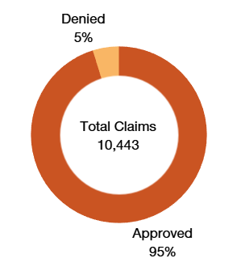
E&I Initial Review Predictive Model Deep Dive
This section provides an overview of the E&I Initial Review Predictive Model solution and illustrates an opportunity for claim release by Bot
156,173 Predictive model in-scope Claims
71,106 Low Risk Claims (Eligible for BOT Release)
85,067 High Risk Claims
9,055 Already Released Claims
Improvement Opportunity
52,572 BOT Released Claims
6,540 additional claims can be sent for BOT release through adequate Model recalibration/ parameters re-tuning
9,479 Issue in Update
Issue in Update - Causes
Audit Process
Hard Edits
Specific guidelines and SOPs need to be followed. Top reasons are-
Other Insurance Lines;
Medicare/ Medicaid ; Zero charge lines
URN Claims
They require special access for release
The Model accuracy stands at 95%
Enterprise Data & Analytics
13

Slide 14
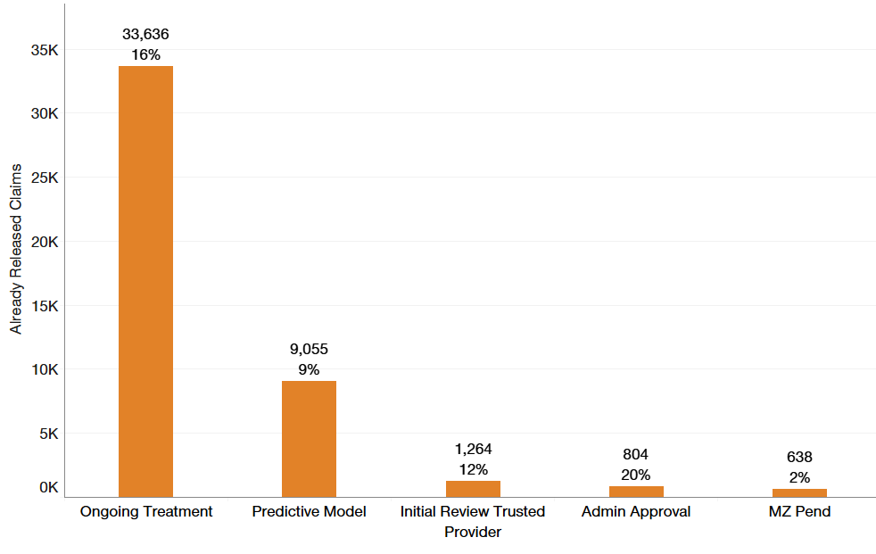
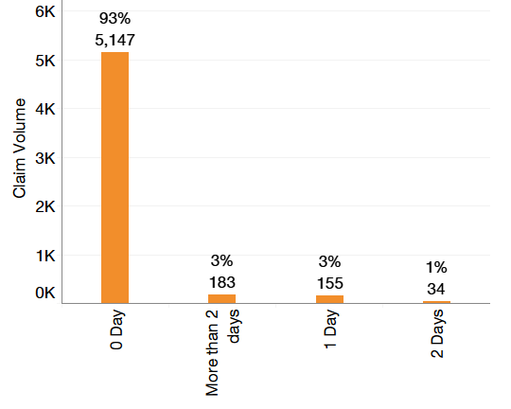
Opportunity : Already Released Claims
This section shows opportunity in reducing the manual effort on claim processing.
Already Released Claims are the claims eligible for release by the BOT. However, the MCR team worked on these claims before they could be released by the BOT.
6 E&I Initiatives with ‘Already Released’ Cases
Initiative Wise Already Released Claim Volume
45,397(12%) Claims ‘Already Released’ by MCR before BOT intervention
Model Name | FTE Utilized
Ongoing Treatment | 3.11
Initial Review | 0.83
Initial Review Trusted Provider | 0.12
Admin Approval | 0.07
MZ Pend | 0.06
4.2 FTE were utilized
across ~ 250 processors
*70% mapping with the Omega data
Predictive Model - Claim Age vs Released by MCR
93 % of the Claims were the same day inventory released by MCR before they could be processed by the bot
Manual review of the aged claims available in the daily inventory report will improve BOT’s throughput
Review of reconciliation inventory by MCR processors before anchor claim led to high volume of already released claims in Ongoing treatment initiatives
FTE = (Volume / (VPH*(1-Shrinkage) * (1-Attrition))) / 2080
VPH : 8.39, Shrinkage : 35.83%, Attrition : 3%
Enterprise Data & Analytics
14

Slide 15
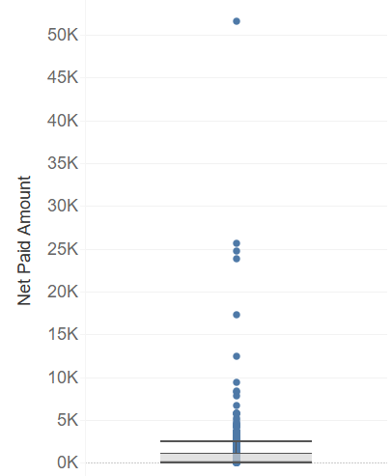
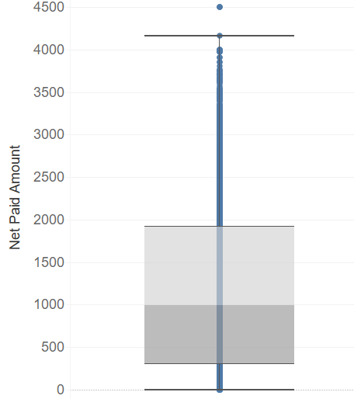
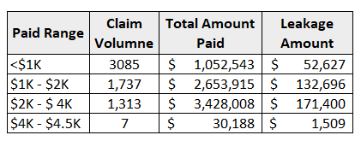
Leakage Analysis
This section provides an overview of the efforts made to minimize the leakage associated with the initiatives
E&I Low ROI
85% Model Accuracy
High Leakage
E&I Initial Review Trusted Provider
95% Model Accuracy
The below charts show the distribution of the net amount paid (and the claim volume) in the initiatives. To minimize the leakage a threshold amount is set on the claims that could be released by the initiative
E&I Low ROI
E&I Initial Review Trusted Provider
7
1,313
1,737
3,085
* An Outlier with net paid amount $200 K has been removed
*Threshold for Claim is currently fixed at $4500
Threshold for Claims fixed at $2500 in Sept’20.
This would lead to a 56% reduction in the leakage with 23% decrease in the inventory released
Enterprise Data & Analytics
15

