Slide 1

SMART INDIA HACKATHON 2026
TITLE PAGE
Problem Statement ID – SIH26263
Problem Statement Title- Development of an APAAR ID-Based Student Data Management and Verification Platform for AICTE-Approved Institutions
Theme- Smart Automation
PS Category- Software
Team ID-
Team Name (Registered on portal) AI Riders

Slide 2











VIDYA PRAMAAN
AI Riders
APAAR-linked student data, validation & verification platform for AICTE
❖ Proposed Solution (Describe your Idea/Solution/Prototype)
❖ Detailed explanation of the proposed solution
Institution upload
APAAR validation
Data verification
Central repository
Analytics & monitoring
Authorised verification
Excel · CSV · API
registry check
25 explained rules
one record per student
live risk map
consent + signed QR
❖ How it addresses the problem
❖ Innovation and uniqueness of the solution
✖ Only totals reported (except PGDM)
✔ Student-level records keyed on APAAR
✖ Excess admissions found late
✔ Seat #61 in a 60-seat course blocked at upload
Explainable flags
Live seat ledger
Fuzzy identity match
rule code + evidence
intake & quota caps
same person, new APAAR
✖ Same student at 2 colleges unnoticed
✔ Cross-college match: exact + fuzzy
✖ Records can't be verified at source
✔ Signed QR + consent-based check
ML risk score
Consent-first sharing
Tamper-evident audit
with plain reasons
student approves by OTP
hash-chained log

Slide 3




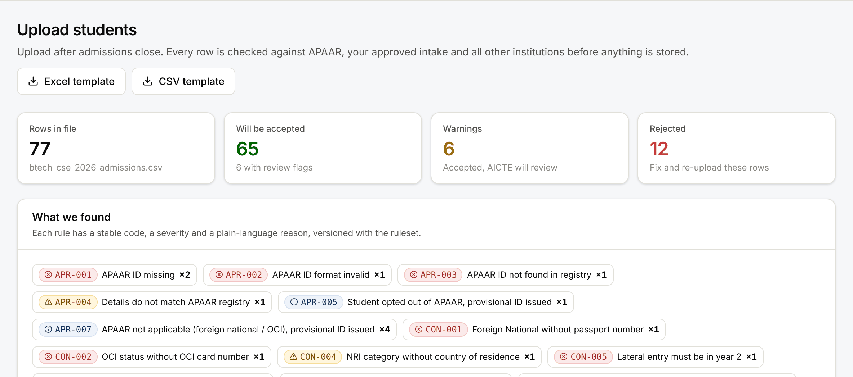
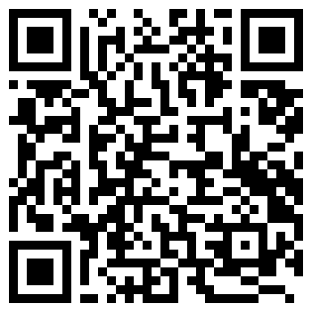
TECHNICAL APPROACH
AI Riders
❖ Technologies to be used (e.g. programming languages, frameworks, hardware)
Python · FastAPI
React · TypeScript
SQLite → Postgres
scikit-learn
RapidFuzz
Ed25519 · W3C VC
REST + OpenAPI
Tailwind · Recharts
demo → production
Isolation Forest
fuzzy matching
signed QR records
❖ Methodology and process for implementation (Flow Charts/Images/ working prototype)
Errors?
1 Upload
Excel / CSV / API
2 Check 25 rules
+ APAAR registry
no
3 Commit
fix & re-upload
yes
Row returned with reason
6 Live dashboard
AICTE review queue
5 ML risk score
with reasons
4 National scan
duplicates · intake
7 Student consent (OTP)
verifier sees only approved fields
8 Signed QR on certificate
anyone verifies; forgery fails
Working prototype: 77-row upload → 65 accepted, 12 returned with rule codes
Try it live: https://vidya-pramaan-sih26263.onrender.com
Demo users for every role · synthetic data

Slide 4








FEASIBILITY AND VIABILITY
AI Riders
❖ Analysis of the feasibility of the idea
16/16
181/181
60/60
41/42
0
~1 s
planted error types
caught at upload
dual enrolments
found across colleges
same person, different
APAAR found
top-ranked colleges
truly anomalous
false flags on
56 clean rows
national scan of
48,053 enrolments
Measured by scripts/benchmark.py on 48,053 synthetic enrolments with planted anomalies · 25 automated API tests (SQLite + PostgreSQL) · browser walkthrough of all 5 roles
❖ Potential challenges and risks
❖ Strategies for overcoming these challenges
No public APAAR API
✔ Registry adapter: mock today → DigiLocker / API Setu after partner onboarding
Students without APAAR (opt-out, FN / OCI)
✔ Provisional ID: noted, never rejected
Student privacy (DPDP Act 2023)
✔ Consent per request, masked IDs, access log for the student
Wrong flags could hurt colleges
✔ Flags are review items; an officer decides; every action audited
Low digital readiness of small colleges
✔ Excel template with drop-downs, plain errors, Hindi toggle, mobile

Slide 5



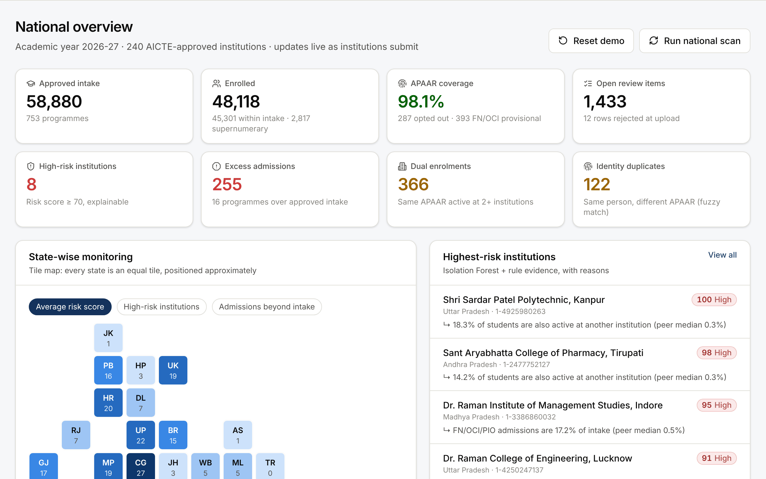



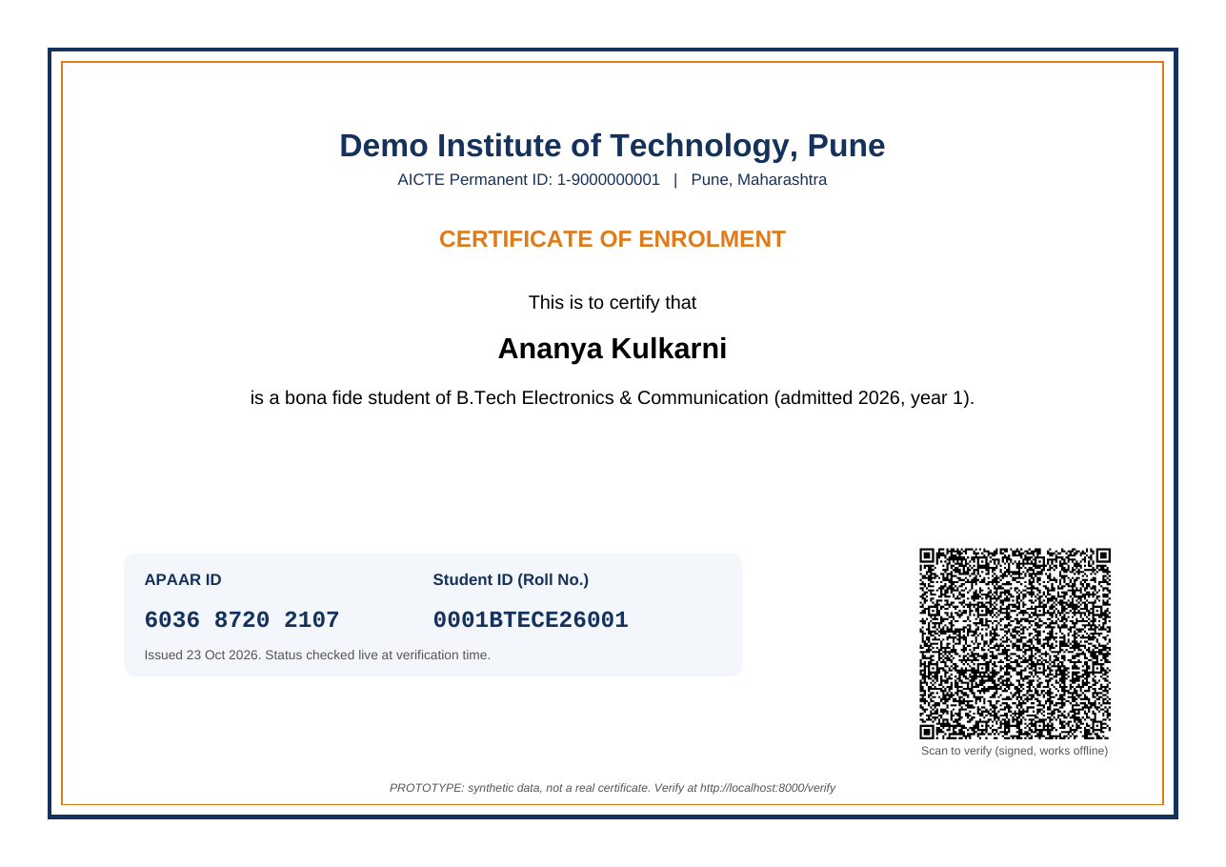
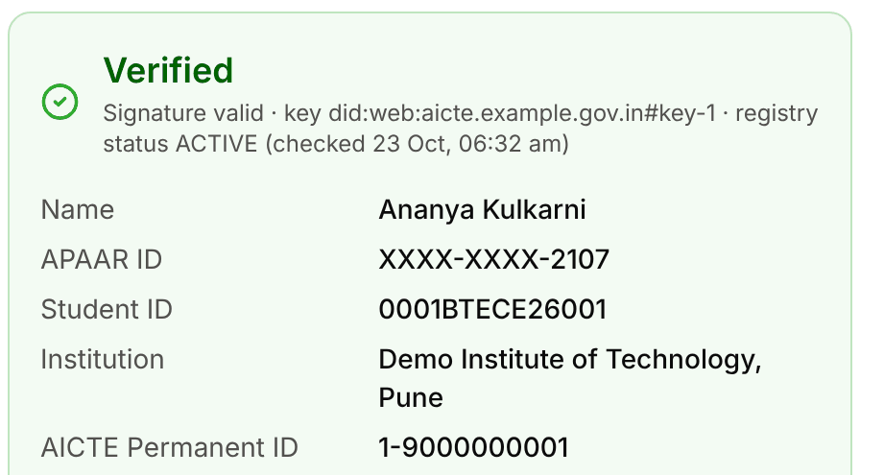

IMPACT AND BENEFITS
AI Riders
❖ Potential impact on the target audience
❖ Benefits of the solution (social, economic, environmental, etc.)
AICTE & regulators
Institutions
Social
Economic
excess & dual enrolment
caught at submission
one upload, errors
explained row by row
fair admissions; students own
and control their record
open-source, no licence cost;
less manual scrutiny & fraud
Environmental
Governance
Policy makers
Employers
paperless returns and
verification; no courier checks
real-time evidence for
approvals & show-cause
state / gender / category
analytics & reports
instant QR check,
consent-based facts
One national view
Students
lifelong record + control
over who sees it
QR scan: signature verified
Certificate: APAAR ID + student ID + QR

Slide 6

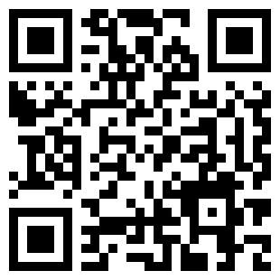
RESEARCH AND REFERENCES
AI Riders
❖ Details / Links of the reference and research work
What our research changed in the design
References
APAAR is created through Aadhaar-based verification
FN / OCI students get a provisional ID (APR-007)
1. AICTE PS SIH26263, SIH 2026 portal sih.gov.in
2. AICTE Approval Process Handbook 2024-27 aicte.gov.in
3. APAAR / Academic Bank of Credits abc.gov.in · digilocker.gov.in
4. DigiLocker Requester & Issuer APIs apisetu.gov.in
5. Digital Personal Data Protection Act 2023; DPDP Rules 2025 meity.gov.in
6. W3C Verifiable Credentials Data Model; RFC 8032 (Ed25519) w3.org/TR/vc-data-model · rfc-editor.org
7. Liu, Ting & Zhou (2008) Isolation Forest, IEEE ICDM doi.org/10.1109/ICDM.2008.17
8. Fellegi & Sunter (1969) A Theory for Record Linkage, JASA doi.org/10.1080/01621459.1969.10501049
APAAR consent is voluntary
Opt-out recorded, never rejected (APR-005)
DPDP Rules 2025 phase in to 2027
Consent, purpose limits, student access log built in
AICTE asks for APAAR-linked records on NAD / ABC
Feed NAD / ABC, not a parallel silo
APH sets supernumerary quotas
Quota caps are configuration, versioned
Live prototype
https://vidya-pramaan-sih26263.onrender.com
Synthetic data only · demo users for every role
Source code & tests
https://github.com/Pulkitkh/VidyaPramaan
25 API tests + browser walkthrough

