Slide 1
THE OPPORTUNITY
From searching for a business
to asking an agent to book it
Personal agents create a new way to buy local services.
“Book me a hotel.” | “Book me a plumber.”
Compare live prices and availability through a booking platform. | Search websites and call businesses for individual quotes and slots.
Book, track and change the reservation. | Fragmented data and booking access.
Agents can scope the job. They need live business data
and booking access to finish it.
GoLocal
1 / 3
Notes:
Speaking pointers, about 40 seconds: Start with the vision that personal agents open a new route to local commerce. Use the hotel example once: an agent should compare available rooms and transact through a platform rather than call hotels individually. Local services remain fragmented across businesses and software. Agents can help scope a request, but dependable live data and authorized booking access are the missing connection GoLocal aims to provide. Transition directly to the product.
The comparison is illustrative: some local businesses already offer online booking and individual APIs. It does not claim that all agents always call providers or that no existing booking technology exists. Personal agents describe a capability and interaction pattern, including agent modes within existing AI products. Source: https://openai.com/index/introducing-chatgpt-agent/ . Hotel analogy and local-services opportunity are founder-supplied pitch framing. No claim about measured mass adoption or guaranteed platform preference.

Slide 2
THE PRODUCT AND FIRST LAUNCH
One booking layer for agents
and local businesses
We connect participating businesses through the software they already use.
Personal agent
GoLocal
Business software
Scopes the job
Gets customer approval
Services, pricing and availability
Compare, book and manage
Schedules and price books
Booking confirmation and updates
3
2–3 weeks
10%
Florida plumbing businesses
onboarded and connected
Target to begin
real bookings
Paid by businesses
on each booking;
shared with partners
GoLocal
2 / 3
Notes:
Speaking pointers, about 45–50 seconds: GoLocal connects participating businesses through their existing software so agents can compare suitable live options, obtain approval, book and manage the booking. Three plumbing businesses are onboarded and connected in Florida. Real bookings are targeted in 2–3 weeks. Planned fee: businesses pay 10% of booking amount, shared between GoLocal and contributing software/channel partners; no allocation specified. Prove a useful local booking network, then expand.
Latest progress and target are founder-reported November 2, 2026. The 2–3-week target is not a completed launch or guarantee. Three connected businesses do not establish fulfilled paid jobs. The diagram describes intended supported operations across authorized connections; it does not claim every price book or scheduling action is available through every vendor. Jobber OAuth scopes: https://developer.getjobber.com/docs/getting_started/ . Complex plumbing scopes can require provider review or a site visit; customer approval is required and payment authorization is not capture. No sub-second booking claim.
Q&A pointer, acquisition: identify explicit local plumbing requests on Nextdoor/Reddit; Google search ads being activated; ChatGPT ads test planned next week. These are experiments, not established acquisition economics or an agent-distribution agreement. Prioritize useful coverage and measure actual bookings, acquisition cost and repeat use. Ads are separate from agent recommendations: https://help.openai.com/en/articles/20001047-ads-in-chatgpt .

Slide 3

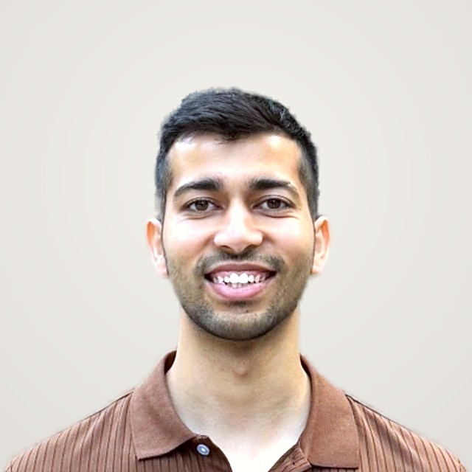
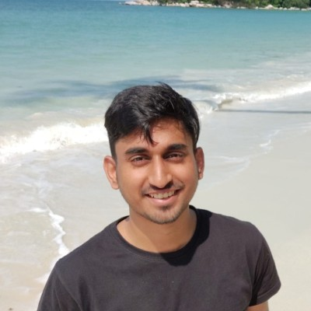
THE FOUNDER AND ENGINEERING TEAM
Built local services for consumers.
Now building for their agents.
Pulkit Walia
ENGINEERING TEAM
Rohit Jain
Founder
Senior Software Developer
at Grab
Harvard Business School MBA
Urban Company founding team
5 years at Amazon, Square and Citrix
Built production MCP integrations
Helped build from launch to a $3B IPO.
Launched a home security brand at 19
Aryan Singh
Grew revenue to $700K.
Building agentic commerce
at Grab
Bessemer Venture Partners investor
Helped build GXS Bank, a digital bank
backed by Grab and Singtel
Deployed $15M in consumer AI startups.
GoLocal
3 / 3
Notes:
Speaking pointers, 30 seconds: Pulkit is the sole founder. Lead with his Urban Company founding-team experience, helping build from launch to a $3B IPO. He also launched a home security brand at 19 and grew revenue to $700K, then deployed $15M in consumer AI startups as a Bessemer Venture Partners investor. Rohit and Aryan are the engineering team. Rohit is a Senior Software Developer at Grab, with prior Amazon, Square and Citrix experience and production MCP integrations. Aryan is building agentic commerce at Grab and helped build GXS Bank. Close on applying this experience to local bookings through personal agents.
Sources: founder-submitted golocal-pitch.pptx for original founder and Rohit credentials. Pulkit corrected Bessemer amount from $50M to $15M and supplied Rohit current Grab title on November 2, 2026. Aryan history and portrait are founder-supplied. LinkedIn reference: https://www.linkedin.com/in/aryan-singh-081851103/ . GXS Bank identity: https://www.gxs.com.sg/about-us . Personal histories have not been independently verified. Rohit and Aryan are not co-founders.
GXS Bank describes itself as a digital bank backed by Grab and Singtel: https://www.gxs.com.sg/about-us (checked November 2, 2026). This source confirms bank identity, not Aryan personal role, which the founder supplied. Pitch timing: slide 1 0:00–0:40; slide 2 0:40–1:30; slide 3 1:30–2:00. Prioritize Urban Company, briefly connect home security and Bessemer experience, then one sentence on the engineers and close with the local-service booking-layer vision.

